Slide 1


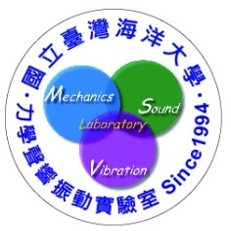
Isogeometric analysis of the dual boundary element method for the Laplace problem with a degenerate boundary
Speakｅｒ：高政宏
Time：13:10~15:00
Ｄａｔｅ：2021/10/6
Place：工203, NIU

Slide 2
Outline
Historical background
Why IGA?
Why DBEM?
B-spline and NURBS
IGA-BEM
Computational results
Conclusion

Slide 3
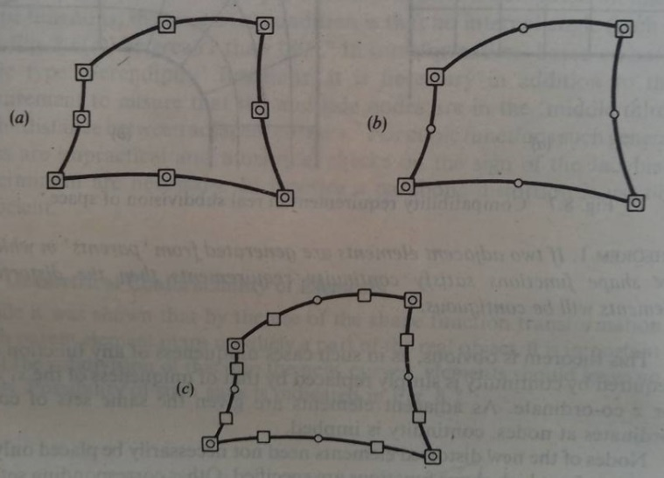

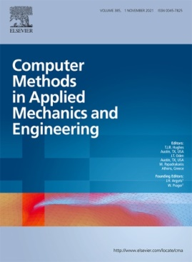
Historical background
CAE
1960
1966
1992
1996
“finite element”
by Clough
Isoparametric
elements
by Irons
Meshless methods
by Nayroles et al.
Hughes et al., 2005
IGA-FEM
(a)Isoparametric
(b)Super-parametric
(c)Sub-parametric
CAD
1966
1972
1975
2003
Bezier curve and surface
NURBS
T-splines
B-splines

Slide 4
Iso?
Isoparametric elements (1966)
Isogeometric analysis (2005)
element's geometry use of the same shape functions

Slide 5

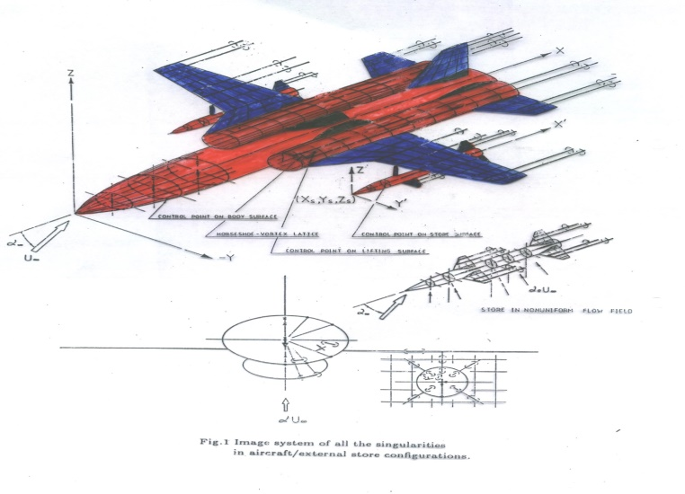
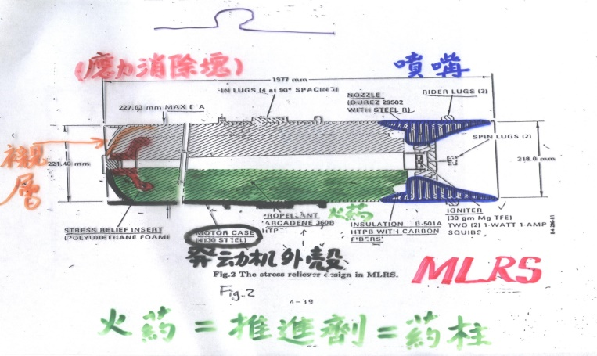


Author’s experiences
(Chen & Kuo)
二所(火箭飛彈研究所)
CSIST
一所(航空研究所)
Design
J.T. Chen, 1980
Analysis
S.R. Kuo, 1980
Meshing
Meshing
Experiment

Slide 6
Why IGA?
Engineering designs are encapsulated in CAD systems.
CAD geometry is exact.
Hundreds of thousands analyses of CAD designs are performed in engineering offices throughout the world every day.
T.J.R.Hughes, J.A.Cottrell, Y.Bazilevs, Isogeometric analysis: CAD, finite elements, NURBS, exact geometry and mesh refinement, Computer Methods in Applied Mechanics and Engineering, Vol.194, pp.4135-4195, 2005. (Google research 5588次)

Slide 7
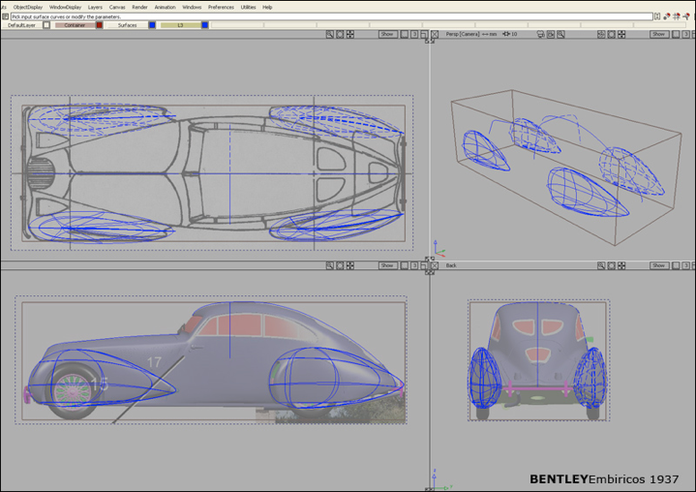
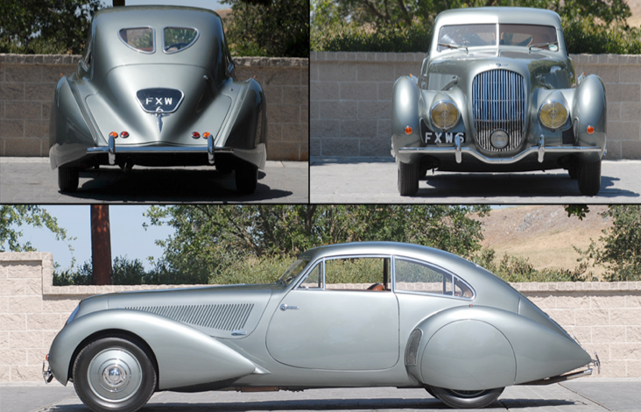
Modeled with NURBS
Alias Studio Tools

Slide 8
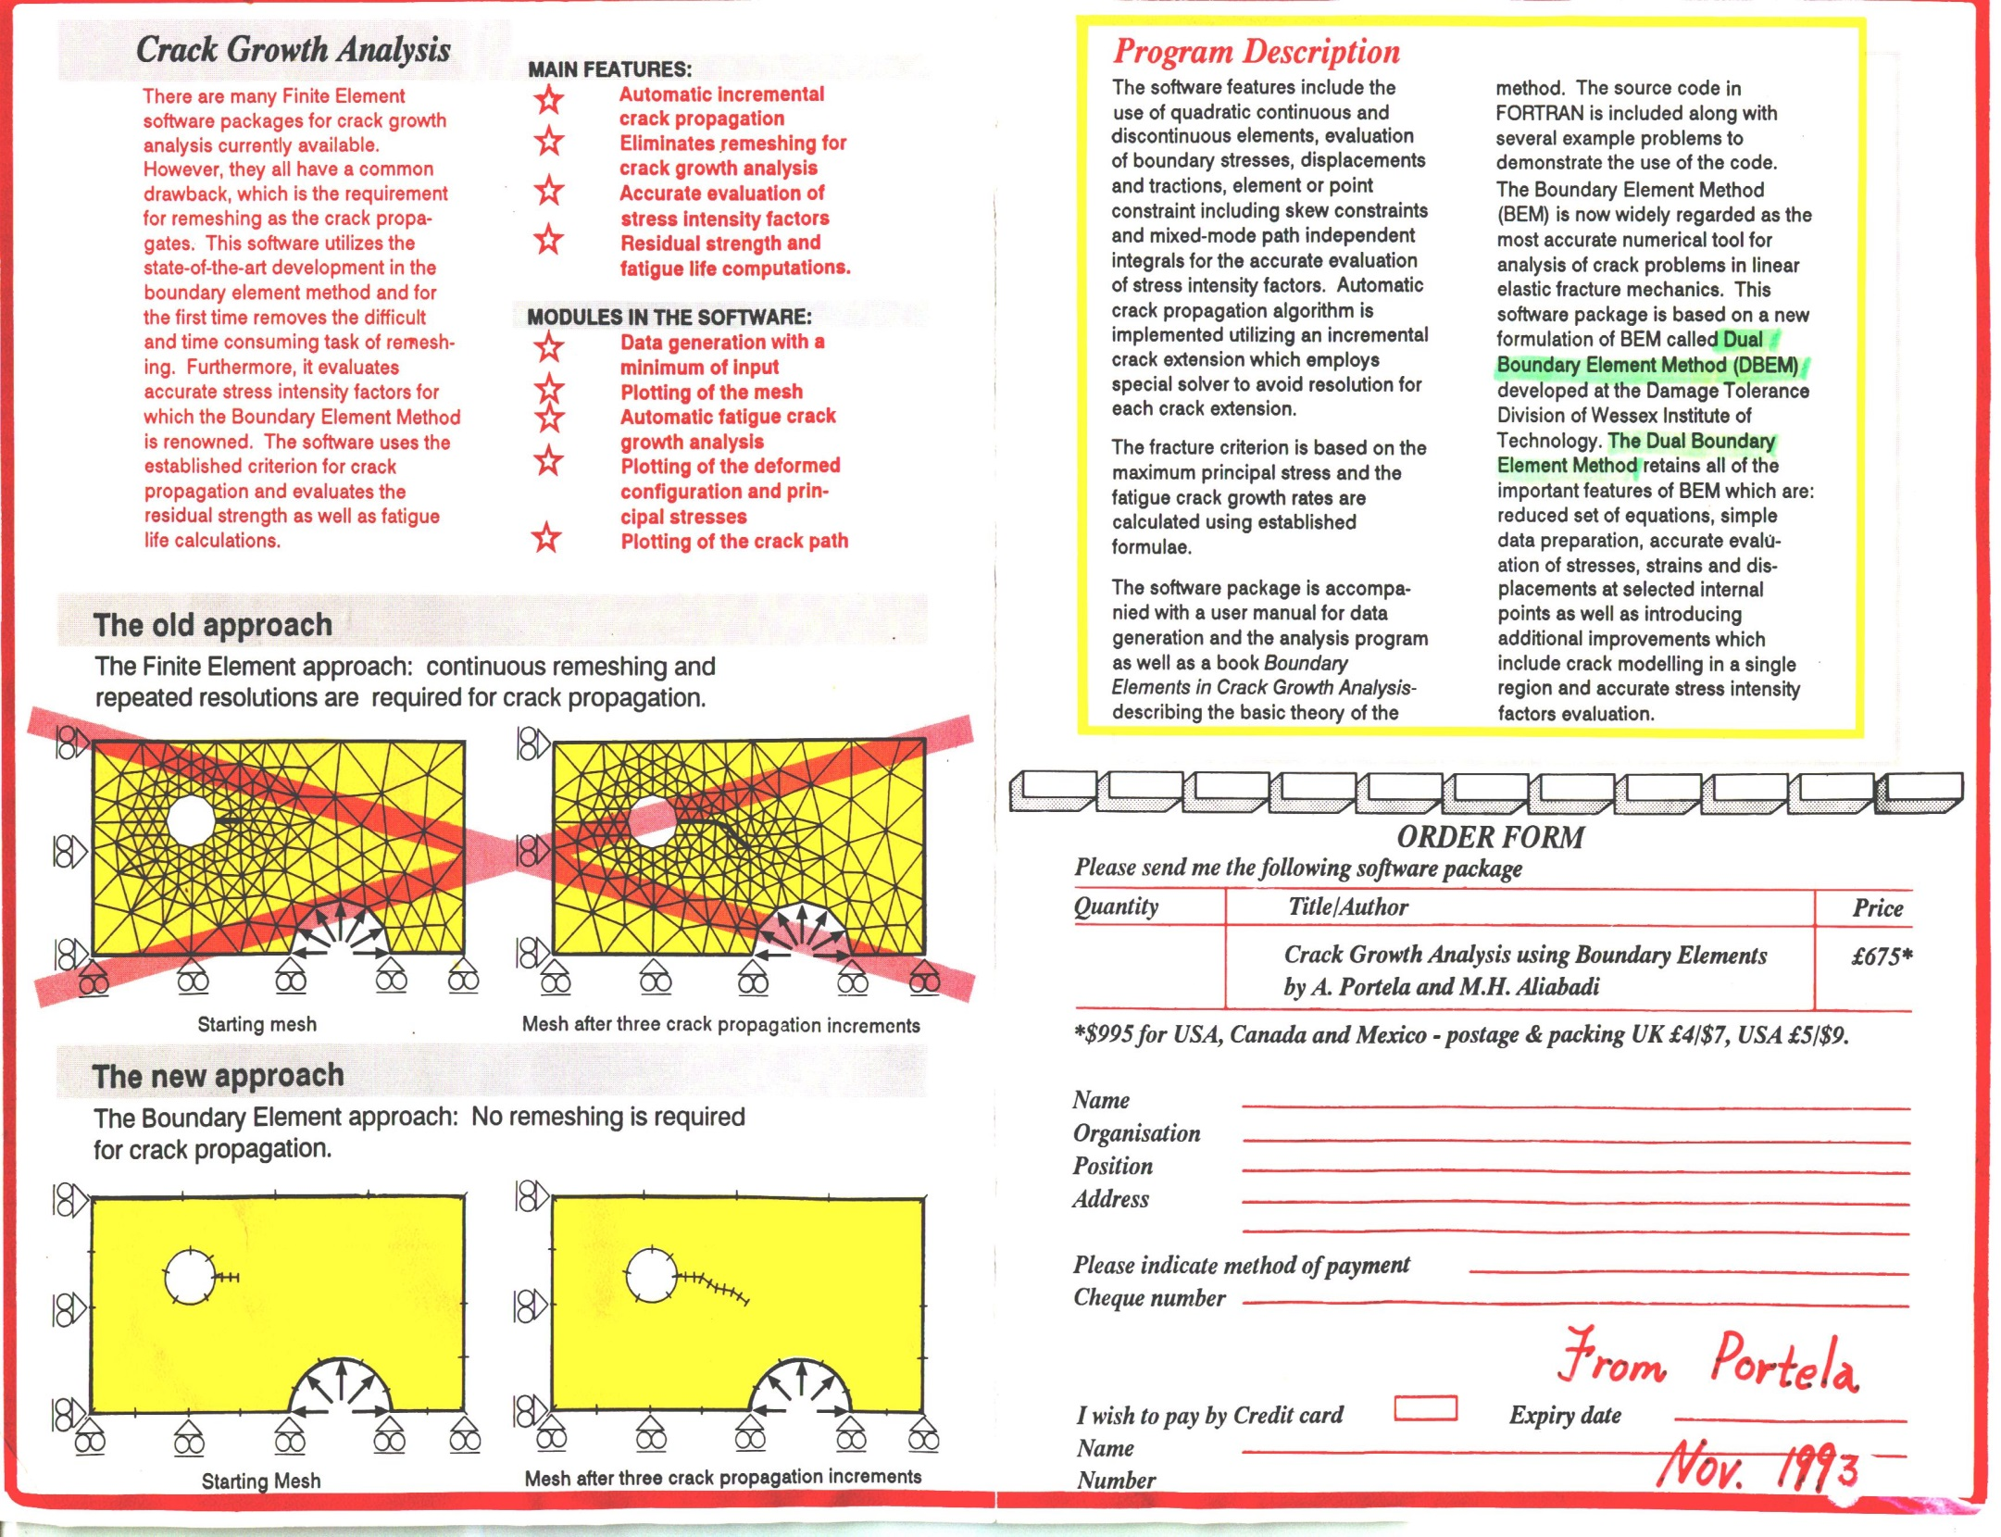
Why Dual BEM?
FEM since 1963
Remesh near tip (局部加密)
BEM since 1969
Subdomain BEM, 1981, Ingraffea
(剪開再裁縫)
Dual BEM (MIT) since 1986
Hong and Chen, 1988
(一次到底不須剪開不須裁縫)
J.T. Chen, H.-K. Hong, Review of dual boundary element methods with emphasis on hypersingular integrals and divergent series, Applied Mechanics Reviews, ASME, Vol.52, No.1, pp.17-33 , 1999. (Google research 447次)

Slide 9
Degeneracy mechanism
(-1,0.5)
(1,0.5)
geometry node
7
4
6
5
N
the Nth constant
or linear element
8
3
(0,0)
Singular (UT)
1
2
Hypersingular (LM)
(-1,-0.5)
(1,-0.5)
5(+) 6(+)
5(+) 6(-)
Conventional BEM Failure
5(+)
6(+)
5(+)
6(+)
Dual BEM not Failure
5(+) 6(+)
5(+) 6(-)
Conventional BEM Failure
5(+)
6(-)
5(+)
6(-)

Slide 10
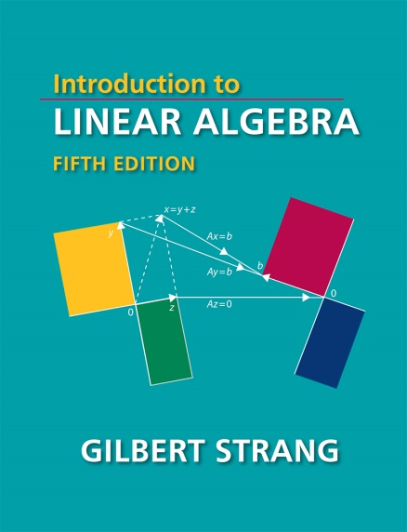
Null space of influence in the BEM
U, T, L, M matrix

Slide 11



Dual BEM & IGA Popular ?
 | Dual BEM | IGA
Journal | ASCE, 1988; ASME, 1999; IEEE, 2003 | CMAME, 2005
Pioneer | Hong & Chen | Hughes
Read | IEEE：3901
Cite | ASCE：381；ASME：446 | CMAME：5588

Slide 12

Our contribution
Highlight
Hong
Hughes
Analysis
(DBEM)
Geometry
(IGA)

Slide 13
B-spline and NURBS
 | B-spline | NURBS
Knot vector
Control points
Basis function
weighting
Curve

Slide 14
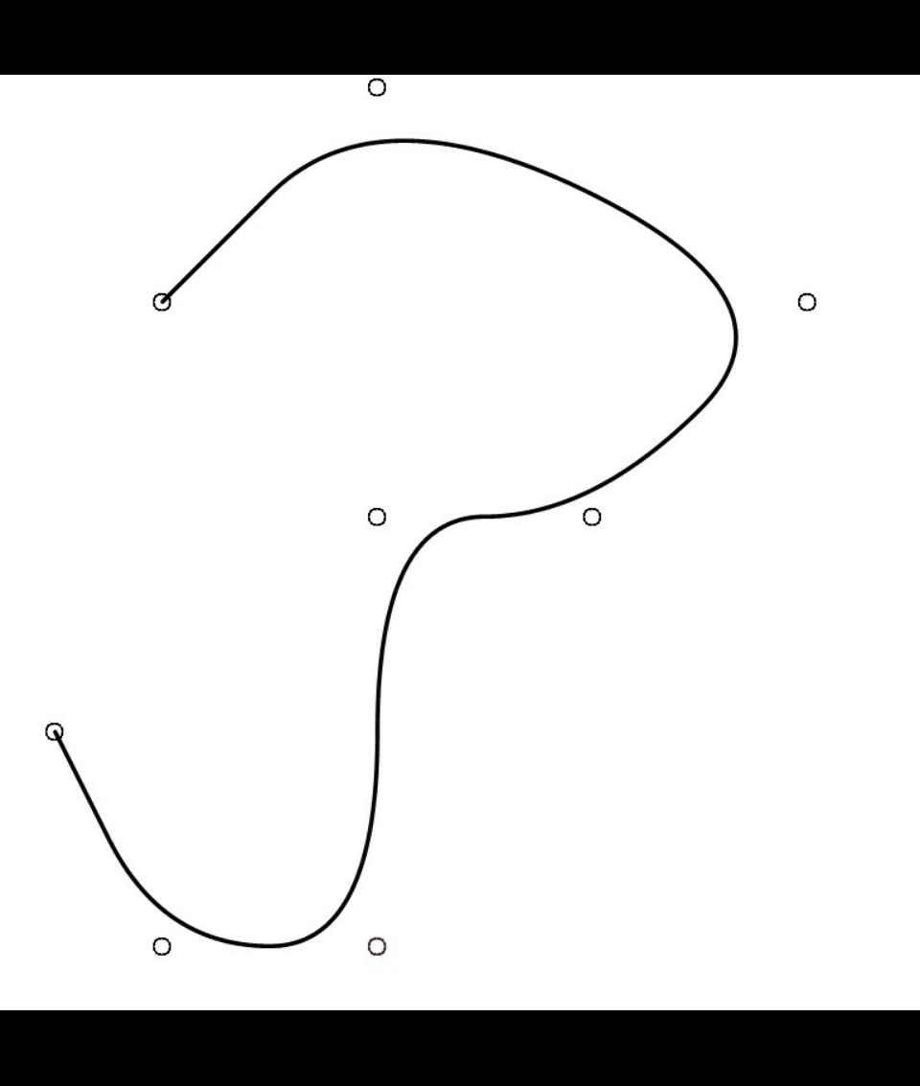


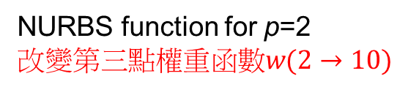

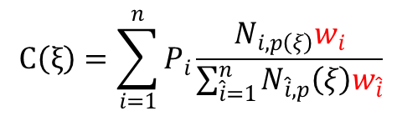
B-spline and NURBS
$Ξ=\left\{0,0,1,2,3,4,5,6,7,8,8\right\}$, 8 control points
B-spline function for p=2
改變第三點控制點位置
NURBS function for p=2
$$改變第三點權重函數w(2→10)$$
$$C\left(ξ\right)=\sum_{i=1}^{n}{P_{i}N_{i,p}(ξ)}$$
$$C\left(ξ\right)=\sum_{i=1}^{n}{P_{i}\frac{N_{i,p\left(ξ\right)}w_{i}}{\sum_{\hat{i}=1}^{n}{N_{\hat{i},p}\left(ξ\right)w_{\hat{i}}}}}$$

Slide 15
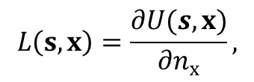

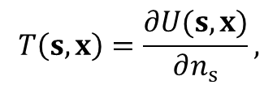


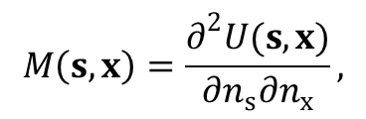

Dual BEM
Singular Formula (UT)
$$s$$
$$x$$
Hypersingular Formula (LM)
$$∇^{2}u\left(x\right)=0$$
$$x$$
$$T\left(s,x\right)=\frac{∂U(s,x)}{∂n_{s}},$$
$$L\left(s,x\right)=\frac{∂U(s,x)}{∂n_{x}},$$
$$M\left(s,x\right)=\frac{∂^{2}U(s,x)}{∂n_{s}∂n_{x}},$$

Slide 16


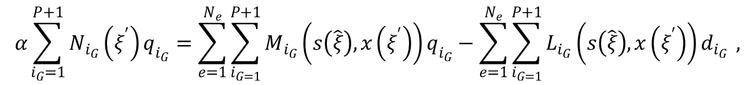
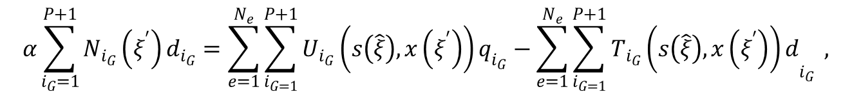
IGA-DBEM
$s,x$, u
$$ξ$$
UT formulation
$$α\sum_{i_{G}=1}^{P+1}{N_{i_{G}}\left(ξ^{′}\right)d_{i_{G}}}=\sum_{e=1}^{N_{e}}{\sum_{i_{G=1}}^{P+1}{U_{i_{G}}\left(s\left(\hat{ξ}\right),x\left(ξ^{′}\right)\right)q_{i_{G}}}}−\sum_{e=1}^{N_{e}}{\sum_{i_{G=1}}^{P+1}{T_{i_{G}}{\left(s\left(\hat{ξ}\right),x\left(ξ^{′}\right)\right)d}_{i_{G}}}} ,$$
LM formulation
$$α\sum_{i_{G}=1}^{P+1}{N_{i_{G}}\left(ξ^{′}\right)q_{i_{G}}}=\sum_{e=1}^{N_{e}}{\sum_{i_{G=1}}^{P+1}{M_{i_{G}}\left(s\left(\hat{ξ}\right),x\left(ξ^{′}\right)\right)q_{i_{G}}}}−\sum_{e=1}^{N_{e}}{\sum_{i_{G=1}}^{P+1}{L_{i_{G}}\left(s\left(\hat{ξ}\right),x\left(ξ^{′}\right)\right)d_{i_{G}}}} ,$$

Slide 17


Test of NURBS (rectangle)
Exact solution
$$u\left(x,y\right)=xy$$
knot vector
$$Ξ=\left\{0,0,2,4,6,8,8\right\}$$
IGA-BEM results
Given Dirichlet B.C.

Slide 18



Test of NURBS (circle)
$$u\left(r,θ\right)=rcosθ$$
$$\frac{1}{\sqrt{2}}$$
Exact solution
weighting
Given Dirichlet B.C.
knot vector
$$Ξ=\left\{0,0,0,1,1,2,2,3,3,4,4,4\right\}$$

Slide 19
Test of NURBS (circle)
IGA-BEM (UT equation)
IGA-BEM (LM equation)

Slide 20









Test of degenerate boundary
$$\frac{∂u}{∂n}=0$$
$$\frac{∂u}{∂n}=0$$
$$\frac{∂u}{∂n}=0$$
$$\frac{∂u}{∂n}=0$$
$$u=−1$$
$$u=1$$
$$∇^{2}u(x,y)=0$$
$$\frac{∂u}{∂n}=0$$
Seepage flow with a sheet pile
under a dam
IGA-BEM (LM equation)

Slide 21

Test of degenerate boundary
UT
UT
LM
UT
UT equation mixed with
the LM equation
UT
UT
UT
LM
LM
UT
LM
LM equation mixed with
the UT equation
LM
LM
LM

Slide 22

Conclusion
IGA
DBEM

Slide 23


The End
  Thanks for your attentions

