Slide 1





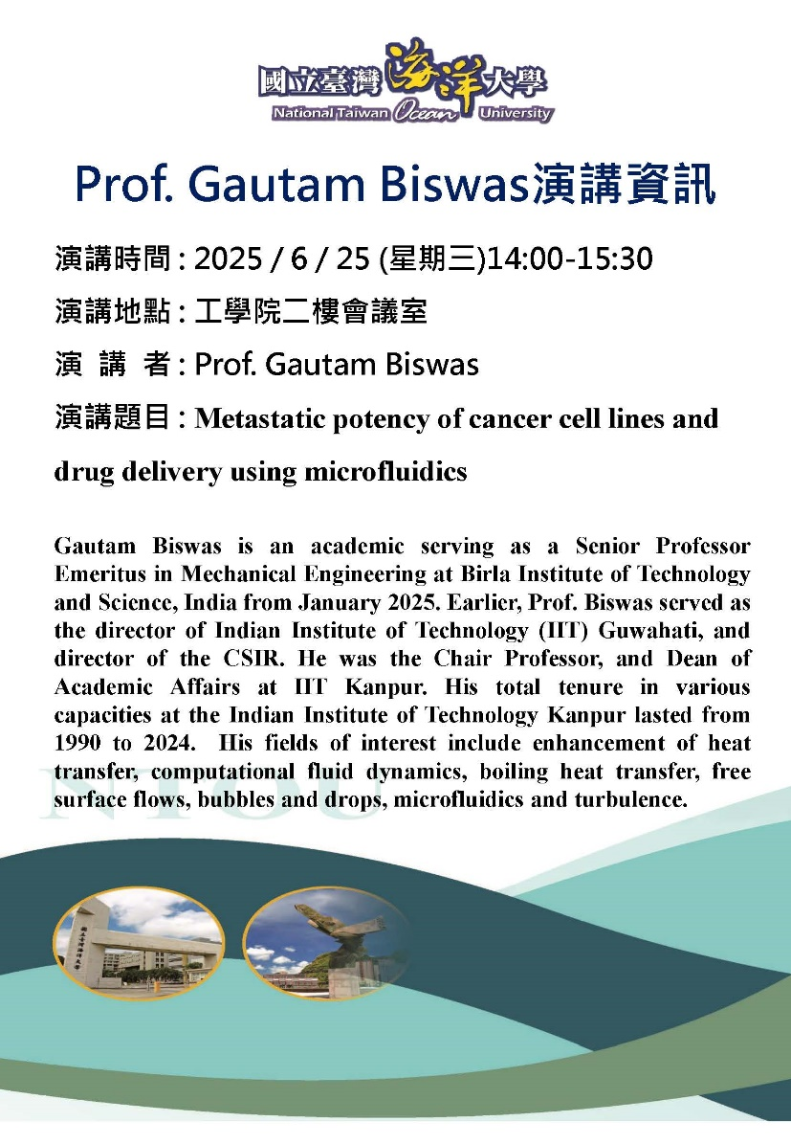
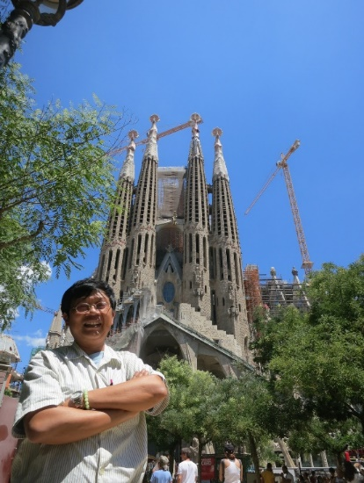

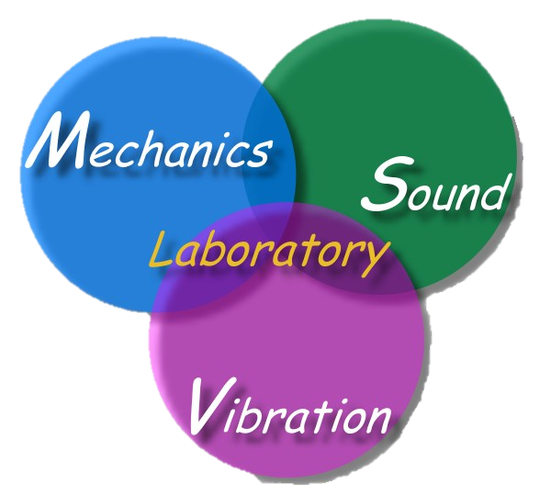
Welcome Prof. Biswas
主講人：陳正宗 特聘講座教授
科技部產學小聯盟 土機海領域召集人
海大河工系 機械系 海工系 台大土木系(客座2023) 成大土木系(合聘)
三校五系教授
STAM & TwSIAM Fellow 數學與力學雙會士
時間：2025 年 06月24 日 15:30-16:40
地點：NTOU HR2 307

Slide 2
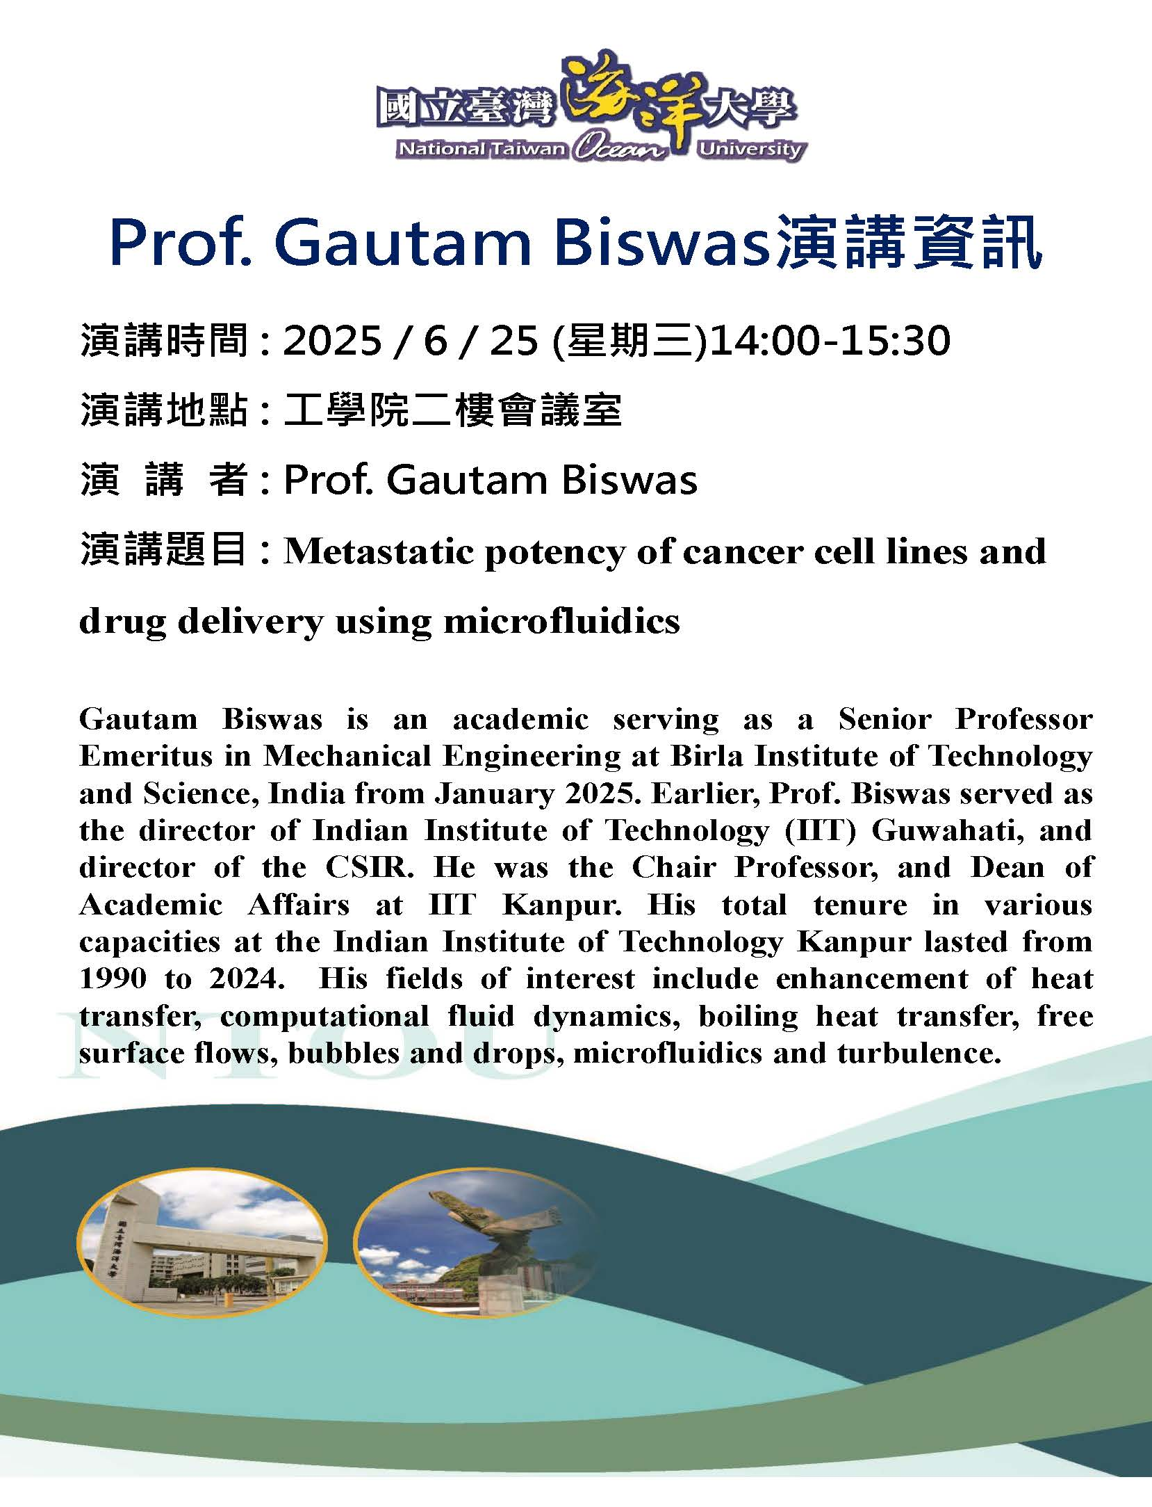
2025.3

Slide 3
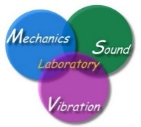

NTOU 讀萬卷書 行萬里路 參百家會 MSV 2025
Time | Conference | Location | Website | 備註
Jan. 7-19 | MMCTSE 9 | Athens, Greece, | https://springer.mmctse.org/index.php#hero | Plenary invited
March 17-20 | CFC 2025 | Santiago de Chile | https://cfc2025.iacm.info/
June 2-6 | ICTS 2025 | Kowloon, Hong Kong | https://www.icts2025.org/#/
July 1-4 | COMPSAFE | Kobe, Japan | https://www.compsafe2025.org/
July 6-11 | ICSV 31 | Incheon | https://www.icsv31.org/
July 17-19 | EMI 2025 | Beijing, China | https://www.emi-conference.org/
July 29-31 | (NME 2025) | Ghent, Belgium | http://www.nmeconf.org/
Aug. 26-28 | EAMC | Stockholm Sweden | https://advancedmater.org/summit/
Sep. 2-5 | 16th ICOVP | Lisbon, Portugal | https://www.icovp-wmvc.com/
Sep. 2-5 | COMPLAS 2025 | Barcelona | https://complas2025.cimne.com/event/area/340d1230-907e-11ef-b344-000c29ddfc0c
Sep. 2-5 | ICNTM25 | Baku, Azerbaijan | https://icntm.tumtmk.org.tr/
Sep. 27-30 | PHENMA 2025 | Kitakyushu, Japan | http://phenma2025.sfedu.ru/
Dec. 7-10 | APCOM | Brisbane | https://www.apcom2025.org/
TBA | JT workshop | Kanazawa
Quitted | BEM/MRM 48

Slide 4
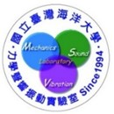



2025 隨心所欲 學術傳承 教學相長 2033
 | 2024 | 2025 | 2026 | 2027 | 2028 | 2029 | 2030 | 2031 | 2032 | 2033
1月 | 核定延長服務 國家講座申請 | 送書 | 可休假(三選一) | 可休假(三選一) | 歡喜教學 甘願研究 | 隨心所欲 游刃有餘 | 自由自在 問心無愧 | 海大點滴 自立自強 | 軟硬皆傳 教學相長 | 榮退
2月
 |  |  |  |  |  |  |  |  |  | 功成身退 後有來者
3月
4月
5月
6月
7月 |  |  | 可休假(三選一) | 65足齡
8月 |  |  |  | 不可休假
9月
10月
11月
12月
檔名:2024-2033 plan 製表:于葶

Slide 5

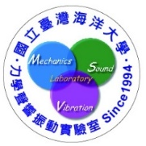
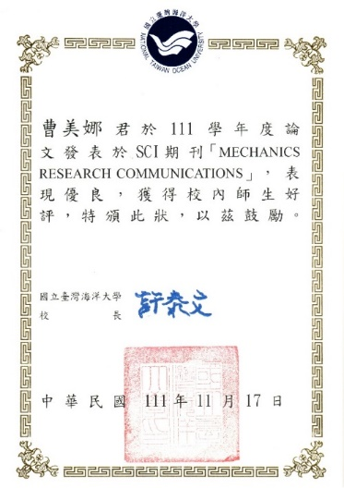


NTOU/MSV 大學生SCI論文成功案例(1994-2025) 小兵立大功
鄭岳世 | Dual series representation and its applications to a string subjected to support motions (1996) | ADV
陳桂鴻* | Analytical study and numerical experiments for Laplace equation with overspecified BCs (1998) | AMM
劉立偉** | On the free terms of the dual BEM for the two and three- dimensional Laplace problems (2000) | JMST
林盛益 | A new point of view for the polar decomposition using singular value decomposition (2002) | IJCN
李應德***、葉雅婷 | A meshless method for free vibration analysis of circular and rectangular clamped plates using radial basis function (2004) | EABE
蔡明宏 | Conformal mapping and bipolar coordinate for eccentric problems (2008) | CAEE
高聖凱 | Waves in string using diamond rule and Mathematica software (2008) | CAEE
謝正昌 | Derivation of stiffness and flexibility for rods and beams by using dual integral equations (2008) | EABE
吳國綸 | Regularized meshless mathod for Cauchy problems (2008) | CM
李家瑋 **** | On the spurious eigensolutions for the real-part boundary element method (2008) | EABE
余尚儒 | Equivalence between Trefftz method and method of fundamental solution for the annular Green’s function (2008) | EABE
蕭宇志 | Analysis of water wave problems containing single and multiple cylinders by using the degenerate kernel method (2010) | ISOPE
高怡絹 | Eigenanalysis for a confocal prolate spheroidal resonator using the null-field BIEM in conjunction with degenerate kernels (2014) | Acta Mechanica
凃雅瀞 | A self-regularized approach for deriving the free-free flexibility and stiffness matrices (2014) | CS
黃乙玲 | Revisit of the degenerate scale for an infinite plane problem containing two circular holes using conformal mapping (2019) | AML
邵程祥、呂政軒 | On the linkage between influence matrices in the BIEM and BEM to explain the mechanism of degenerate scale (2021) | JOM
周彥廷 | On the path independence and invariant of the J-integral for a slant crack and rigid-line inclusion using degenerate kernels and the dual BEM (2021) | EABE
周彥廷 | Construction of a curve by using the state equation of Frenet formula (2021) | JOM
戴暐宸 | An indirect BIE free of degenerate scales (2021) | CPAA
邵程祥、戴暐宸 | On the role of singular and hypersingular BIEs for the BVPs containing a degenerate boundary (2021) | EABE
高浩真 | Support motion of a finite bar with an external spring (2022) | JLFNVAC
曹美娜 | Analytical solutions for the Laplace problem of an eccentric annular domain (2022) | MRC
楊佳穎 臧紀甯 | Animation of cycloid and spiral curves in companion with instantaneous center 2 of rotation and radius of curvature (2023) | JCIE
楊佳穎 | Numerical instability and its treatment for steady state heat conduction problems in exchanger tubes using the dual boundary element method(2023) | NHT
楊佳穎 | Analytical study for numerical instability of steady-state heat conduction problems in exchanger tubes using degenerate kernels in the null-field boundary integral equation method | IJHMT
* : 陳桂鴻現任於國立宜蘭大學土木工程學系副教授
** : 劉立偉現任於國立台灣大學土木系(國立成功大學工程科學系助理教授)
*** : 李應德現任於國立台灣海洋大學河海工程學系助理教授
**** : 李家瑋現任於淡江大學土木工程學系助理教授
一個教授的養成教育都是從大學部就一點一滴的栽培方能奏功

Slide 6
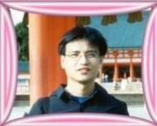
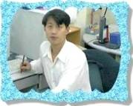
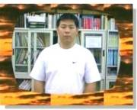
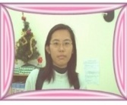
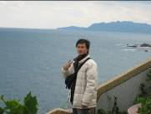

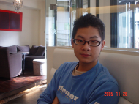
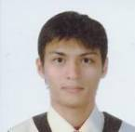

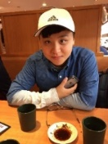
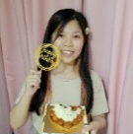
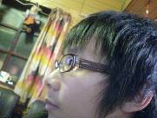
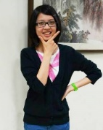
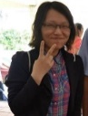


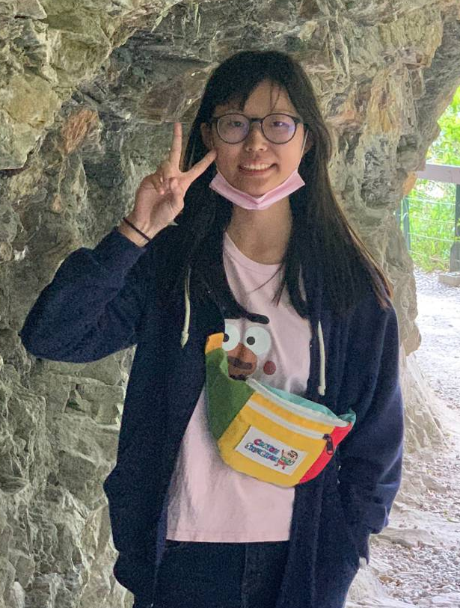




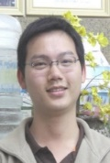

以前海洋大學部河工學長姊(帥哥美女)做的到，學弟妹們一定行
NTOU/MSV 大學部 SCI 論文發表榮譽榜(1994-2025)
鄭岳世
(ADV, 1996)
陳桂鴻
(AMM, 1998)
劉立偉
(JMST, 2000)
葉雅婷
(EABE, 2004)
蔡明宏
(CAEE, 2008)
謝正昌
(EABE, 2008)
林盛益
(IJCN, 2002)
吳國綸
(CM, 2008)
高聖凱
(CAEE, 2008)
楊佳穎 (JCIE®, 2023)
余尚儒
(EABE, 2008)
凃雅瀞
(CS, 2014)
黃乙玲
(AML, 2019)
李家瑋
(EABE, 2008)
高怡絹
(Acta Mechanica, 2014)
邵程祥&呂政軒 戴暐宸 周彥廷
(JOM, 2021) (CPAA, 2021) (EABE2021)
臧紀甯 (JCIE, 2023)
高浩真
(JLFNVAC, 2022)
曹美娜
(MRC, 2022)
蕭宇志
(ISOPE, 2010)
曹美娜 (MRC, 2023)

Slide 7
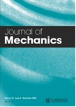
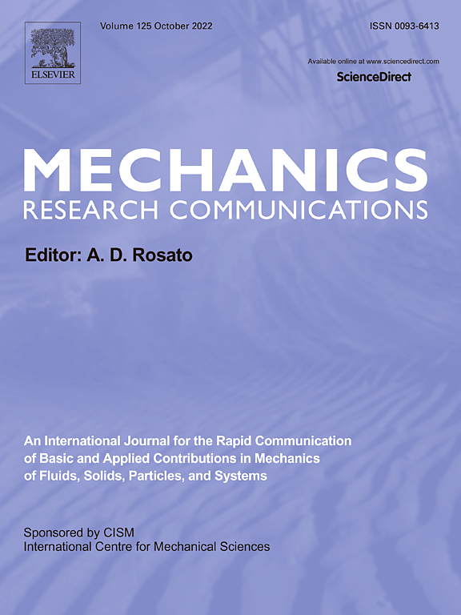
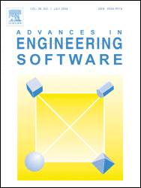
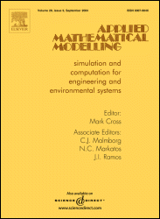
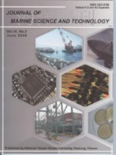
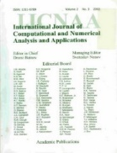
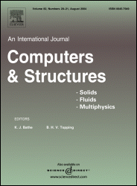
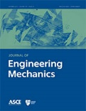
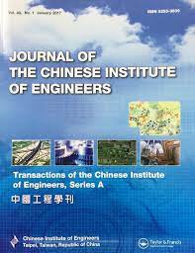
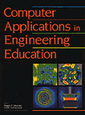

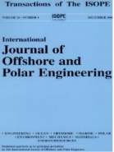

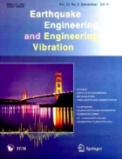
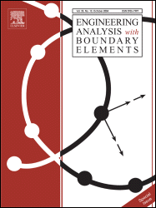
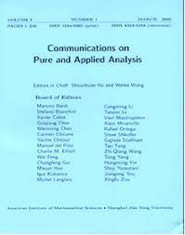
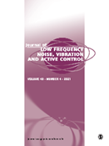
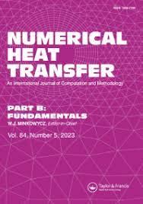
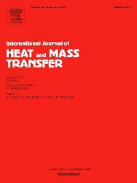
-目前已有24篇文章刊登，遍及19種期刊-
NTOU MSV 大學生SCI論文成功案例(1984-2025) 小兵立大功
SCI
2022 曹美娜
1996 鄭岳世
1998 陳桂鴻
2000 劉立偉
2002 林盛益
2014 凃雅瀞
2018 陳聖劻
2021 周彥廷
2021 邵程祥 呂政軒
2023 楊佳穎 臧紀甯
2010 蕭宇志
2014 高怡絹
2016 凃雅瀞
2004 葉雅婷
2008 謝正昌
2008 李家瑋
2008 余尚儒
2021 周彥廷 2021 邵程祥
2008 蔡明宏
2008 高聖凱
2008 吳國倫
2021 戴暐宸
2022 高浩真
有為者，亦若是
2023 楊佳穎
2023 楊佳穎
2022/01/10

Slide 8
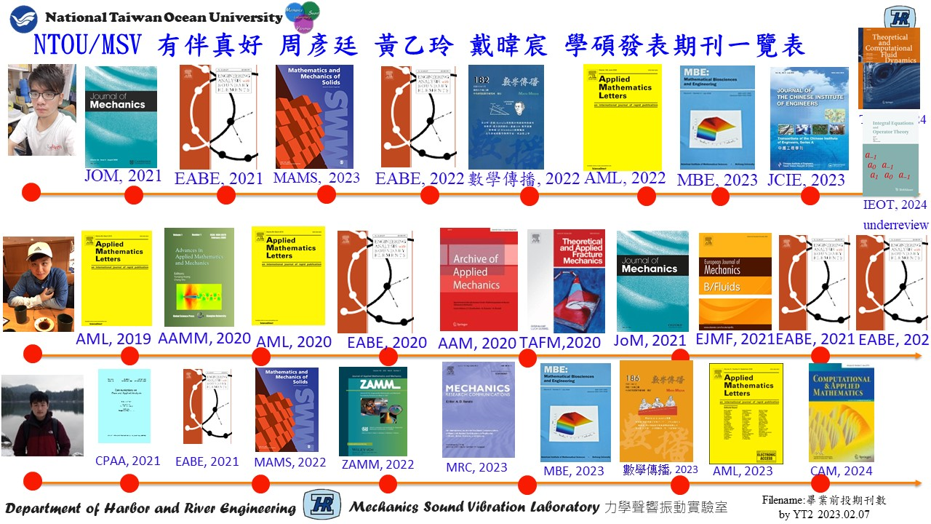

Slide 9




NTOU/MSV Google citing 11篇破百 (March 04, 2025)
Research Gate Scores: 41.16 h index:41 (Scopus)
1999 | J. T. Chen and H.-K. Hong, 1999, Review of dual boundary element methods with emphasis on hypersingular integrals and divergent series, Applied Mechanics Reviews, ASME, Vol.52, No.1, pp.17-33. | 496
1988 | H.-K. Hong and J. T. Chen, 1988, Derivations of Integral Equations of Elasticity, Journal of Engineering Mechanics, ASCE, Vol.114, No.6, pp.1028-1044. | 452
2007 | J. T. Chen, C. S. Wu, Y. T. Lee and K. H. Chen, 2007, On the equivalence of the Trefftz method and method of fundamental solutions for Laplace and biharmonic equations, Computers and Mathematics with Applications, Vol.53, No.6, pp.851-879. | 135
1998 | J. T. Chen and F. C. Wong, 1998, Dual formulation of multiple reciprocity method for the acoustic mode of a cavity with a thin partition, J. of Sound and Vibration, Vol. 217, No.1, pp.75-95. | 131
2002 | J. T. Chen, S. R. Kuo and J. H. Lin, 2002, Analytical study and numerical experiments for degenerate scale problems in the boundary element method for two-dimensional elasticity, Int. J. Numer. Meth. Engng., Vol.54, No.12, pp.1669-1681. | 112
2004 | JT Chen, IL Chen, KH Chen, YT Lee, YT Yeh, 2004, A meshless method for free vibration analysis of circular and rectangular clamped plates using radial basis function, Engineering Analysis with Boundary Elements Vol.28, No.5, 535-545. | 111
2002 | JT Chen, MH Chang, KH Chen, SR Lin, The boundary collocation method with meshless concept for acoustic eigenanalysis of two-dimensional cavities using radial basis function , Journal of Sound and Vibration Vol.257, No.4, 667-711 | 105
2008 | J. T. Chen, P. Y. Chen and C. T. Chen, 2008, Surface motion of multiple alluvial valleys for incident plane SH-waves by using a semi-analytical approach, Soil Dynamics and Earthquake Engineering,, Vol.28, pp.58-72. | 104
2001 | J. T. Chen, J. H. Lin, S. R. Kuo and S. W. Chyuan, 2001, Boundary element analysis for the Helmholtz eigenproblems with a multiply-connected domain, Proc. Royal Society of London Ser. A, Vol.457, No.2014, pp.2521-2546. | 102
2003 | J. T. Chen, L. W. Liu and H.-K. Hong, 2003, Spurious and true eigensolutions of Helmholtz BIEs and BEMs for a multiply-connected problem, Royal Society London Series A, Vol.459, No.2036, pp.1891-1925. | 101
2005 | J. T. Chen, S. R. Lin and K. H. Chen, 2005, Degenerate scale problem when solving Laplace equation by BEM and its treatment, Int. J. Numer. Meth. Engng., Vol.62, No.2, pp.233-261. | 101

Slide 10




NTOU/MSV Highly Read 前十四強(Research Gate 41.16, Jan. 14, 2025)
2003 | S. W. Chyuan, Y. S. Liao and J. T. Chen, An efficient method for solving electrostatic problems, IEEE Computing in Science and Engineering, 5(3):52 – 58. | 4935
2006 | J. T. Chen and C. S. Wu, Alternative derivations for the Poisson integral formula, International Journal of Mathematical Education in Science and Technology, 37(2):165-185. | 4381
2008 | W. M. Lee and J. T. Chen, Null-field integral equation approach for free vibration analysis of circular plates with multiple circular holes, Computational Mechanics, Vol.42, pp.733-747. | 3107
2011 | W. M. Lee and J. T. Chen, Free vibration analysis of a circular plate with multiple circular holes by using addition theorem and indirect BIEM, ASME. Journal of Applied Mechanics, 78:1-10. | 2532
2005 | S. S. Lin, J. C. Liao, J. T. Chen and L. Chen, Lateral performance of piles evaluated via inclinometer data, Computers and Geotechnics, Vol.32, pp.411-421. | 1413
2009 | J. T. Chen, J. N. Ke, H. Z. Liao, Construction of Green‘s function using null field integral approach for Laplace problems with circular boundaries, CMC, 9(2): 93-110. | 1084
2009 | J. T. Chen and Y. T. Lee, Torsional rigidity of a circular bar with multiple circular inclusions using a null field integral equations, Computational Mechanics, Vol.44, No.2, pp.221-232. | 1042
2009 | J. T. Chen, K. H. Chou and S. K. Kao, Derivation of Green’s function using addition theorem, Mechanics Research Communications, Vol.36, No.3, pp.351-363. | 969
1999 | J. T. Chen and H.-K. Hong, Review of dual boundary element methods with emphasis on hypersingular integrals and divergent series, Applied Mechanics Reviews, ASME, Vol.52, No.1, pp.17-33. | 836
2008 | J. T. Chen, K. S. Chou and S. K. Kao, One-dimensional wave animation using Mathematica, Computer Applications in Engineering Education, 17(3):323-339. | 582
2007 | J. T. Chen and A C Wu, 2007, Null-field integral equation approach for multi-inclusion problem under anti-plane shear, ASME, J. Appl. Mech., Vol.74, pp.469-487. | 523
2009 | J. T. Chen, M. H. Tsai and C. S. Liu, Conformal mapping and bipolar coordinate for eccentric Laplace problems, Computer Applications in Engineering Education, Vol.17, No.3, pp.314-322. | 501
2023 | J. T. Chen, C. Y. Yang, Y. T. Chou, C. N. Tsang, Animation of cycloid and spiral curves in companion with instantaneous center of rotation and radius of curvature, Journal of Chinese Institute of Engineers, Vol.46, No.7, pp.693-702. | 509
1988 | H. K. Hong and J. T. Chen, Derivations of Integral Equations of Elasticity, ASCE Journal of Engineering Mechanics, 114(6):1028-1044. | 356

Slide 11
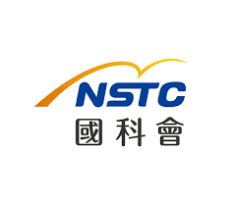



2025 BEM Activities in Taiwan
TwSIAM , June7-8 2025 (清華數學系)
CSSV, June 27 , 2025 (中原電機)
ACMT 3 計算力學會議 Oct.25-26, 2025 (陽交大土木系) 林子剛 教授
TwBEM 16 台灣邊界元會議 Oct.25-26, 2025, (陽交大應數系) 薛名成 與 (海大)陳正宗
CSME 2025 第四十二屆 機械工程學會全國機械研討會()
STAM, 2025 49屆力學會議 (聯合大學機械系)
結構工程研討會 2026
學術交流，以文會友，歡迎參加
國科會
中華民國
力學學會
中華民國
振動噪音工程學會
力學學會計算力學研發小組編輯 海大NTOU/MSV 陳正宗特聘講座教授

Slide 12




NTOU/MSV Grant 2025
NSTC專題(3+1)
雙極座標分離核在邊界積分方程法/邊界元素法之工程應用
自救法於工程秩降問題之應用
提升台灣邊界元素法研究之國際影響力
邊界元中分數正多邊形退化尺度之猜想、解析推導與數值驗證(審查中)
國科會大專生專題(1) TKU
正待有緣人
STAM 計算力學研發小組
高手負責
TwSIAM
彥廷負責 阿德督導
NTOU大暑專題(2)
SVD and polar decomposition (in preparation)
再探莫耳圓 pole method (in preparation, NCTS)
File name: NTOU/MSV Grant by MN

Slide 13


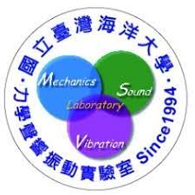
NTOU/MSV Collaborators since1988-2025
PI:陳正宗特聘講座教授
India C.S. Nishad 、 K.G. Vijay
Kuwait S.Neelamani
China 韓厚德、谷岩、傅卓佳、張耀明
Canada 李子才
Taiwan
海大:周宗仁、郭世榮、葉為忠、曹登皓、林三賢、岳景雲、劉德源、
張建仁、劉進賢、李應德
台大:葉超雄、陳正興、洪宏基、楊德良、鍾立來、劉立偉
陳義麟、陳桂鴻、李家瑋、陳立言、李為民、呂學育、徐文信、全湘偉、黃宏財、李明恭、李洋傑、陳誠宗
Filename: NTOU/MSV Cooperators made by品瑄、品臻

Slide 14
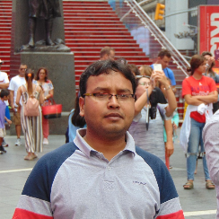
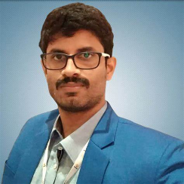
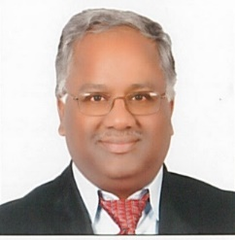
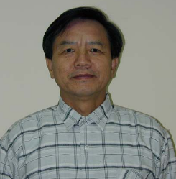
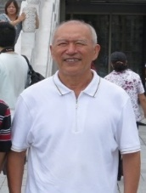
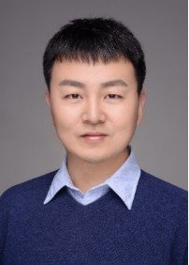
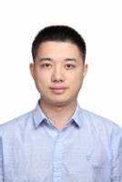
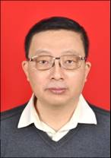
NTOU/MSV Collaborators since1988
India
Canada
Kuwait
S.Neelamani
C.S. Nishad K.G. Vijay
李子才
China
韓厚德 谷岩 傅卓佳 張耀明
Filename: NTOU/MSV Cooperators made by品瑄、品臻

Slide 15











Taiwan-India joint work on breakwater using the dual BEM (2022-2025)
(ZAMM2023)
C.S. Nishad, S. Neelamani, J.T. Chen, and K.G. Vijay, 2023, Gravity Wave Interaction with Cage Enveloped Breakwaters using DBEM, Z Angew Math Mech (ZAMM), e202200064, https://doi.org/10.1002/zamm.202200064
(EABE2023)
K.G. Vijay, C. S. Nishad, S. Neelamani, and J.T. Chen, 2021, Dual BEM for Wave Scattering by a H-Type Porous Barrier with Nonlinear Pressure Drop, Engineering Analysis with Boundary Elements, Vol.131, pp.280-294.
(EABE2024)
R. Appandairaj, K.G.Vijay, K.Murali and J.T.Chen, 2024, Oblique Wave Interaction with Dual Submerged Oscillating Buoy as WEC near a Partially Reflecting Wall, Engineering Analysis with Boundary Elements, Vol.166, 105822.
(EABE, POF and Renewable Energy, 2025, Revision))

Slide 16






Taiwan-India joint work on breakwater using the dual BEM (2025)
(POF 2025)
S. Salman, K. G. Vijay, H. Behera and J. T. Chen, 2025, Gravity wave scattering by barge integrated porous cages: experimental and numerical study, Physics of Fluid, Revised.
(EABE2025)
S. Salmana, K.G.Vijay, C.S. Nishad and J.T.Chen, 2025, Numerical and Experimental Investigation on Compartmentalized Porous Cages, Engineering Analysis with Boundary Elements, Accepted.
R. Appandairaj, K.G. Vijay, C.S. Nishad and J.T. Chen, 2025, Enhanced hydrodynamic performance by a half-aerofoil floating energy converter device in oblique waves, Renewable Energy, Revised.
(Renewable Energy 2025)

Slide 17





























NTOU/MSV Collaborators since1988
陳正宗
Taiwan
周宗仁
郭世榮 葉為忠 曹登皓 林三賢 岳景雲 劉德源 張建仁
劉進賢
李應德 陳立言
陳義麟
陳桂鴻 李家瑋 李為民 呂學育 徐文信
葉超雄 陳正興 洪宏基 楊德良 鍾立來 劉立偉 全湘偉 黃宏財 李明恭
Filename: NTOU/MSV Cooperators made by品瑄、品臻
李洋傑 陳誠宗

Slide 18
NTOU/MSV 30 年成績單 since 1994
陳正宗特聘講座教授自1994年起
建立NTOU/MSV團隊，
4個博士生(PhD)
52位碩士生(Master)
44 位大學生 (under) totally 100 persons
255 SCI papers
87 various sci journals
Failure 3 master students
劉天賜、方銜尉、張嘉焜
Failure of 2 years graduation 江立傑 楊政霖
Success of all graduated master students
At least one sci paper for each one

Slide 19


NTOU MSV
學術三個一百、三個堅持及三難2024
①發表100 篇SCI論文(255)
②審過100 種不同SCI期刊論文(144)
③單篇論文被引用100次 (10 篇)
(446 ASCE, 492 ASME)
發表過 87 種不同SCI期刊論文
I. 大學部也會有 SCI 論文(24)
II.碩士班如期畢業(守了18年)
III.碩博士班學生論文均能在SCI期刊發表
(守了30年)
❶寫論文難
❷寫英文論文更難
❸第一次用英文寫論文是難上加難 陳正宗特聘講座教授

Slide 20



















國立台灣海洋大學力學聲響振動實驗室(NTOU/MSV Lab) 2024
顧問團
陳正宗
陳義麟
陳桂鴻
李家瑋
李應德
徐文信
范佳銘
郭世榮
呂學育
李為民
作
台
游以暄
陳正宗
詹于葶
周彥廷
高聖凱
入口
SERVER
MSVlab2022座位表 浩真製表

Slide 21


邊界元素法 阿基里斯腱
BEM/BIEM achilles tendon
Failure of BIEM/BEM
for the special case

Slide 22
NTOU/MSV 雙陳雙李-一高地虎登百岳一步一腳印 Jan.20, 2025 (undergoing)
 | JOURNAL | TOPIC | DATE | STATUS | REMARK
李家瑋 | JOM (Ma) | Application of boundary integral quadrature method to torsion problems of an isotropic bar containing edge cracks |  | Accepted | Oct.10. 2024
陳桂鴻 | EABE | Application of Defined Auxiliary System in the Method of Layer Potentials for Solving the Stokes Flow Problem |  | Accepted | Dec25, 2024
Vijay | Renew Energy | Enhanced Hydrodynamic Performance by a Half-Aerofoil Floating Wave Energy Converter Device in Oblique Waves |  | Under rev | Aug.01, 2024
陳桂鴻 | NMPDE | Novel Adaptive Mesh Refinement in Boundary Element Method using null-field BIE (NMPDE/IJCM/CMAME) |  | Under rev | Oct10, 2024
李子才 | Numer.Funct.Anal.Optim | Error Analysis of Discrete Null Field Equation Method for Solving Laplace’s Equation; Circular Pseudo-boundaries |  | Under rev | Dec.11, 2024
陳桂鴻 | AMM | Dual boundary element method for solving the Helmholtz equation of complex wave number for the damped wave equation |  | Submitted | Jan.1, 2025
周彥廷 | BIMAS | Null-field boundary integral formulation for boundary value problems using degenerate kernels of curvilinear coordinates |  |  | 準備中
臧紀甯 | AIAA | Thermal stress of a free truss subjected to temperature change |  |  | 準備中
周彥廷 | Physic E | Degenerate scale of 2.5 gon shape: conjecture and numerical demonstration |  |  | 準備中
高浩真 | JVET | Analytical solutions and FEM results for a canti;ever beam with end springs subjected to support motion |  |  | 準備中
周彥廷 | TCFD | Analytical solution for potential flow across two unequal cylinders using the BIE |  | Under rev | Nov.1, 2023
郭世榮 | Proc Math | Analytical study and numerical implementation of n star gon |  |  | 準備中
李子才 |  | Evaluation on Integrals Involving Near Singularity based on Sinh-transformation and Mini-rules |  |  | 準備中
李應德 | IJES | Null-field integral equation approach for piezoelectricity problems with arbitrary elliptical inclusions |  |  | 準備中
李家瑋 | JCP | Dual BEM is necessary – self-regularization technique ? |  |  | 準備中
紀昭銘 | CAEE | Is Mohr Circle a Math or Engineering Problem? A case study on 2004 Taiwan P.E. Exam of Structure Engineering |  |  | 準備中
李家瑋 | EABE | Dual BEM is necessary - CHEEF idea ? |  |  | 準備中
李家瑋 | JLFNV | Is CHIEF necessary |  |  | 準備中
周彥廷 | CAEE | \dot {Q} =WQ |  |  | 準備中
登百岳中2021.ppt j t chen

Slide 23

【海大河工系實驗室介紹】
NTOU MSV研究團隊

Slide 24

【海大河工系教師與研究室介紹】力學聲響振動實驗室 MSVLAB

Slide 25

邊界元 來結緣 Line group 學術俱樂部
(我們不是邊緣人)

Slide 26






















































http://msvlab.hre.ntou.edu.tw/ Since 1999
Welcome to visit the web site of MSVLAB/NTOU
E mail: jtchen@mail.ntou.edu.tw

Slide 27





NTOU/MSV 101 in Taiwan (台灣)
Keelung 101 bus
Keelung 101 Hill
Taipei 101
金瓜石101 Hotel
101 MOST project

Slide 28

Welcome to visit NTOU/MSV
MSV
窗外

Slide 29
邊界元 來結緣
歡迎入群 學術分享
檔名：邊界緣2019.ppt

