Slide 1





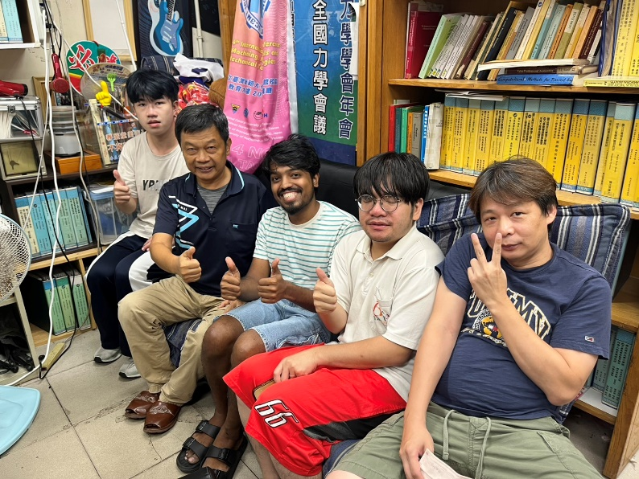
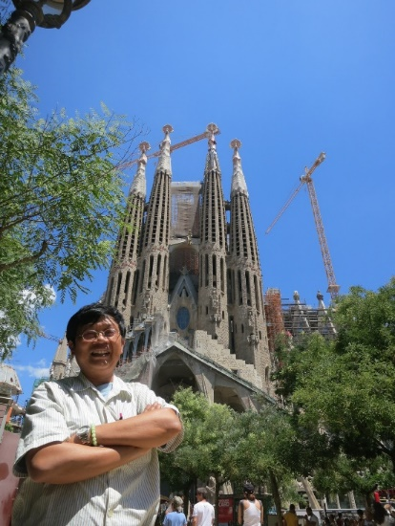

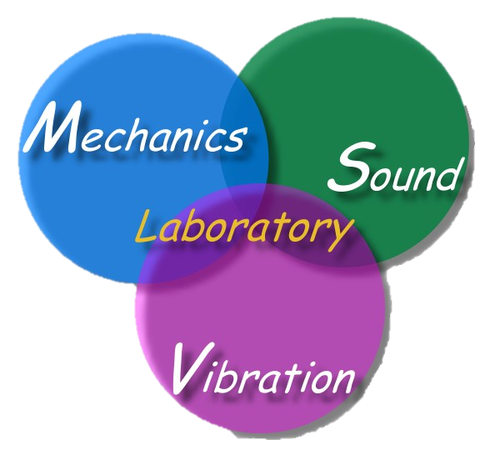
Welcome Indian group
Integrating Technology
India Taiwan
IT cooperation
主講人：陳正宗 特聘講座教授
科技部產學小聯盟 土機海領域召集人
海大河工系 機械系 海工系 台大土木系(客座2023) 成大土木系(合聘)
三校五系教授
STAM & TwSIAM Fellow 數學與力學雙會士
時間：2025 年 09月4 日 13:30-15:00
地點：NTOU HR2 307

Slide 2
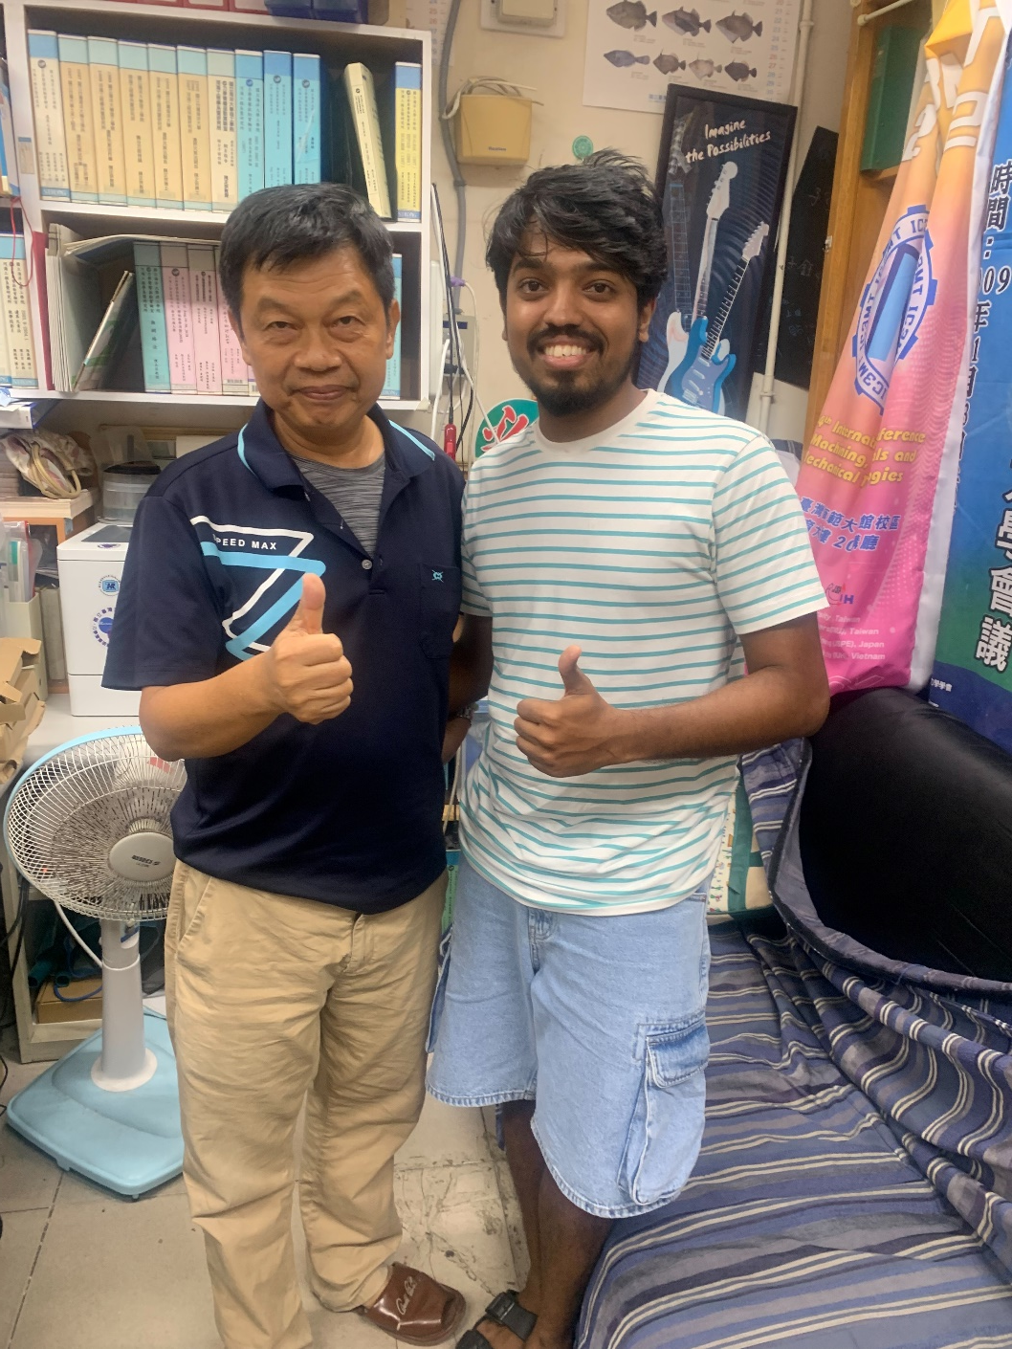
2025.3

Slide 3
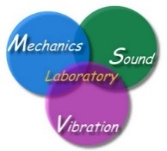

NTOU 讀萬卷書 行萬里路 參百家會 MSV 2025
Time | Conference | Location | Website | 備註
Jan. 7-19 | MMCTSE 9 | Athens, Greece, | https://springer.mmctse.org/index.php#hero | Plenary invited
March 17-20 | CFC 2025 | Santiago de Chile | https://cfc2025.iacm.info/
June 2-6 | ICTS 2025 | Kowloon, Hong Kong | https://www.icts2025.org/#/
July 1-4 | COMPSAFE | Kobe, Japan | https://www.compsafe2025.org/
July 6-11 | ICSV 31 | Incheon | https://www.icsv31.org/
July 17-19 | EMI 2025 | Beijing, China | https://www.emi-conference.org/
July 29-31 | (NME 2025) | Ghent, Belgium | http://www.nmeconf.org/
Aug. 26-28 | EAMC | Stockholm Sweden | https://advancedmater.org/summit/
Sep. 2-5 | 16th ICOVP | Lisbon, Portugal | https://www.icovp-wmvc.com/
Sep. 2-5 | COMPLAS 2025 | Barcelona | https://complas2025.cimne.com/event/area/340d1230-907e-11ef-b344-000c29ddfc0c
Sep. 2-5 | ICNTM25 | Baku, Azerbaijan | https://icntm.tumtmk.org.tr/
Sep. 27-30 | PHENMA 2025 | Kitakyushu, Japan | http://phenma2025.sfedu.ru/
Dec. 7-10 | APCOM | Brisbane | https://www.apcom2025.org/
TBA | JT workshop | Kanazawa
Quitted | BEM/MRM 48

Slide 4
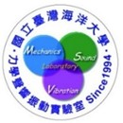



2025 隨心所欲 學術傳承 教學相長 2033
 | 2024 | 2025 | 2026 | 2027 | 2028 | 2029 | 2030 | 2031 | 2032 | 2033
1月 | 核定延長服務 國家講座申請 | 送書 | 休假 |  | 歡喜教學 甘願研究 | 隨心所欲 游刃有餘 | 自由自在 問心無愧 | 海大點滴 自立自強 | 軟硬皆傳 教學相長 | 榮退
2月
 |  |  |  |  |  |  |  |  |  | 功成身退 後有來者
3月
4月
5月
6月
7月 |  |  |  | 65 足齡
8月 |  |  |  | 不可休假
9月
10月
11月
12月
檔名:2024-2033 plan 製表:于葶

Slide 5

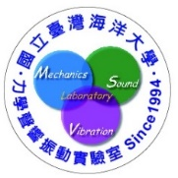
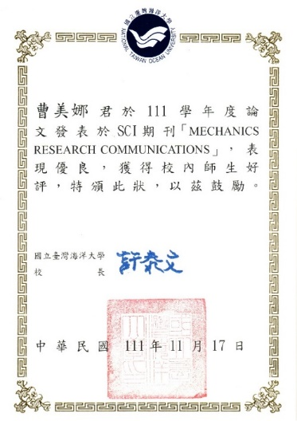


NTOU/MSV 大學生SCI論文成功案例(1994-2025) 小兵立大功
鄭岳世 | Dual series representation and its applications to a string subjected to support motions (1996) | ADV
陳桂鴻* | Analytical study and numerical experiments for Laplace equation with overspecified BCs (1998) | AMM
劉立偉** | On the free terms of the dual BEM for the two and three- dimensional Laplace problems (2000) | JMST
林盛益 | A new point of view for the polar decomposition using singular value decomposition (2002) | IJCN
李應德***、葉雅婷 | A meshless method for free vibration analysis of circular and rectangular clamped plates using radial basis function (2004) | EABE
蔡明宏 | Conformal mapping and bipolar coordinate for eccentric problems (2008) | CAEE
高聖凱 | Waves in string using diamond rule and Mathematica software (2008) | CAEE
謝正昌 | Derivation of stiffness and flexibility for rods and beams by using dual integral equations (2008) | EABE
吳國綸 | Regularized meshless mathod for Cauchy problems (2008) | CM
李家瑋 **** | On the spurious eigensolutions for the real-part boundary element method (2008) | EABE
余尚儒 | Equivalence between Trefftz method and method of fundamental solution for the annular Green’s function (2008) | EABE
蕭宇志 | Analysis of water wave problems containing single and multiple cylinders by using the degenerate kernel method (2010) | ISOPE
高怡絹 | Eigenanalysis for a confocal prolate spheroidal resonator using the null-field BIEM in conjunction with degenerate kernels (2014) | Acta Mechanica
凃雅瀞 | A self-regularized approach for deriving the free-free flexibility and stiffness matrices (2014) | CS
黃乙玲 | Revisit of the degenerate scale for an infinite plane problem containing two circular holes using conformal mapping (2019) | AML
邵程祥、呂政軒 | On the linkage between influence matrices in the BIEM and BEM to explain the mechanism of degenerate scale (2021) | JOM
周彥廷 | On the path independence and invariant of the J-integral for a slant crack and rigid-line inclusion using degenerate kernels and the dual BEM (2021) | EABE
周彥廷 | Construction of a curve by using the state equation of Frenet formula (2021) | JOM
戴暐宸 | An indirect BIE free of degenerate scales (2021) | CPAA
邵程祥、戴暐宸 | On the role of singular and hypersingular BIEs for the BVPs containing a degenerate boundary (2021) | EABE
高浩真 | Support motion of a finite bar with an external spring (2022) | JLFNVAC
曹美娜 | Analytical solutions for the Laplace problem of an eccentric annular domain (2022) | MRC
楊佳穎 臧紀甯 | Animation of cycloid and spiral curves in companion with instantaneous center 2 of rotation and radius of curvature (2023) | JCIE
楊佳穎 | Numerical instability and its treatment for steady state heat conduction problems in exchanger tubes using the dual boundary element method(2023) | NHT
楊佳穎 | Analytical study for numerical instability of steady-state heat conduction problems in exchanger tubes using degenerate kernels in the null-field boundary integral equation method | IJHMT
* : 陳桂鴻現任於國立宜蘭大學土木工程學系副教授
** : 劉立偉現任於國立台灣大學土木系(國立成功大學工程科學系助理教授)
*** : 李應德現任於國立台灣海洋大學河海工程學系助理教授
**** : 李家瑋現任於淡江大學土木工程學系助理教授
一個教授的養成教育都是從大學部就一點一滴的栽培方能奏功

Slide 6
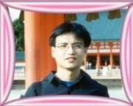
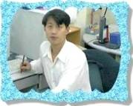
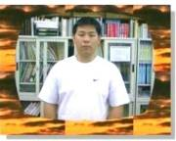
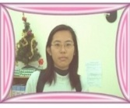
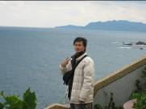

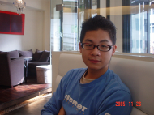
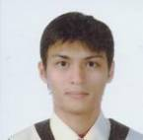

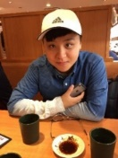
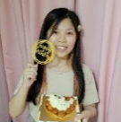
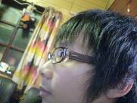
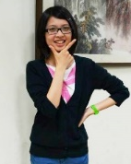
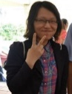


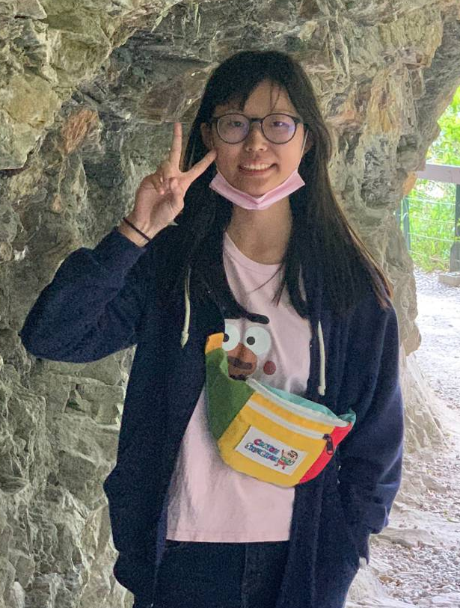






以前海洋大學部河工學長姊(帥哥美女)做的到，學弟妹們一定行
NTOU/MSV 大學部 SCI 論文發表榮譽榜(1994-2025)
鄭岳世
(ADV, 1996)
陳桂鴻
(AMM, 1998)
劉立偉
(JMST, 2000)
葉雅婷
(EABE, 2004)
蔡明宏
(CAEE, 2008)
謝正昌
(EABE, 2008)
林盛益
(IJCN, 2002)
吳國綸
(CM, 2008)
高聖凱
(CAEE, 2008)
楊佳穎 (JCIE®, 2023)
余尚儒
(EABE, 2008)
凃雅瀞
(CS, 2014)
黃乙玲
(AML, 2019)
李家瑋
(EABE, 2008)
高怡絹
(Acta Mechanica, 2014)
邵程祥&呂政軒 戴暐宸 周彥廷
(JOM, 2021) (CPAA, 2021) (EABE2021)
臧紀甯 (JCIE, 2023)
高浩真
(JLFNVAC, 2022)
曹美娜
(MRC, 2022)
蕭宇志
(ISOPE, 2010)
曹美娜 (MRC, 2023)

Slide 7
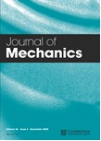
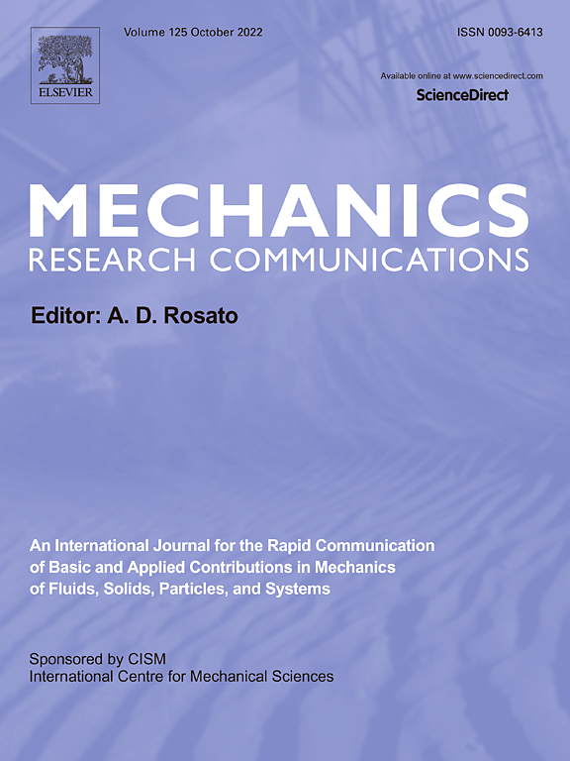
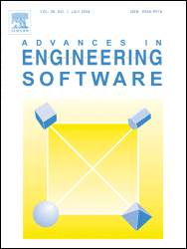
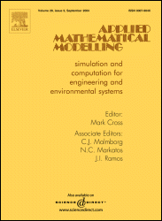
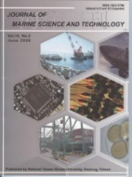
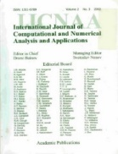
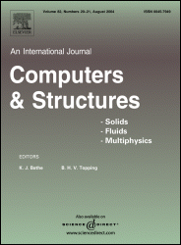
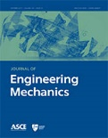
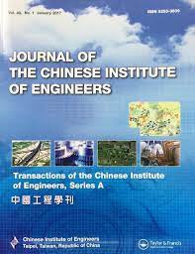


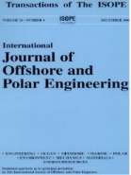

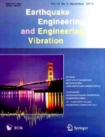
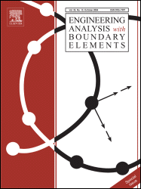
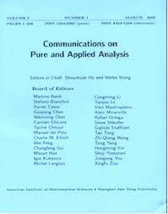
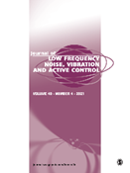
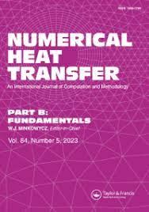
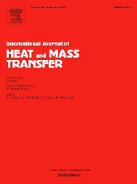
-目前已有24篇文章刊登，遍及19種期刊-
NTOU MSV 大學生SCI論文成功案例(1984-2025) 小兵立大功
SCI
2022 曹美娜
1996 鄭岳世
1998 陳桂鴻
2000 劉立偉
2002 林盛益
2014 凃雅瀞
2018 陳聖劻
2021 周彥廷
2021 邵程祥 呂政軒
2023 楊佳穎 臧紀甯
2010 蕭宇志
2014 高怡絹
2016 凃雅瀞
2004 葉雅婷
2008 謝正昌
2008 李家瑋
2008 余尚儒
2021 周彥廷 2021 邵程祥
2008 蔡明宏
2008 高聖凱
2008 吳國倫
2021 戴暐宸
2022 高浩真
有為者，亦若是
2023 楊佳穎
2023 楊佳穎
2022/01/10

Slide 8
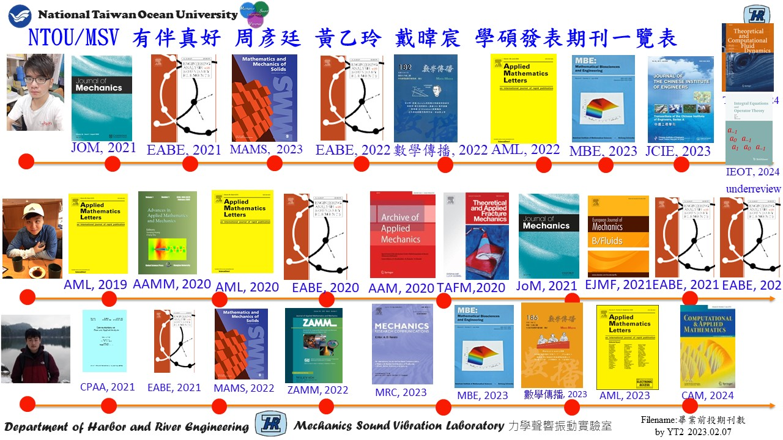

Slide 9




NTOU/MSV Google citing 11篇破百 (July 6, 2025)
Research Gate Scores: 41.16 h index:41 (Scopus)
1999 | J. T. Chen and H.-K. Hong, 1999, Review of dual boundary element methods with emphasis on hypersingular integrals and divergent series, Applied Mechanics Reviews, ASME, Vol.52, No.1, pp.17-33. | 502
1988 | H.-K. Hong and J. T. Chen, 1988, Derivations of Integral Equations of Elasticity, Journal of Engineering Mechanics, ASCE, Vol.114, No.6, pp.1028-1044. | 460
2007 | J. T. Chen, C. S. Wu, Y. T. Lee and K. H. Chen, 2007, On the equivalence of the Trefftz method and method of fundamental solutions for Laplace and biharmonic equations, Computers and Mathematics with Applications, Vol.53, No.6, pp.851-879. | 135
1998 | J. T. Chen and F. C. Wong, 1998, Dual formulation of multiple reciprocity method for the acoustic mode of a cavity with a thin partition, J. of Sound and Vibration, Vol. 217, No.1, pp.75-95. | 131
2002 | J. T. Chen, S. R. Kuo and J. H. Lin, 2002, Analytical study and numerical experiments for degenerate scale problems in the boundary element method for two-dimensional elasticity, Int. J. Numer. Meth. Engng., Vol.54, No.12, pp.1669-1681. | 112
2004 | JT Chen, IL Chen, KH Chen, YT Lee, YT Yeh, 2004, A meshless method for free vibration analysis of circular and rectangular clamped plates using radial basis function, Engineering Analysis with Boundary Elements Vol.28, No.5, 535-545. | 111
2002 | JT Chen, MH Chang, KH Chen, SR Lin, The boundary collocation method with meshless concept for acoustic eigenanalysis of two-dimensional cavities using radial basis function , Journal of Sound and Vibration Vol.257, No.4, 667-711 | 105
2008 | J. T. Chen, P. Y. Chen and C. T. Chen, 2008, Surface motion of multiple alluvial valleys for incident plane SH-waves by using a semi-analytical approach, Soil Dynamics and Earthquake Engineering,, Vol.28, pp.58-72. | 104
2001 | J. T. Chen, J. H. Lin, S. R. Kuo and S. W. Chyuan, 2001, Boundary element analysis for the Helmholtz eigenproblems with a multiply-connected domain, Proc. Royal Society of London Ser. A, Vol.457, No.2014, pp.2521-2546. | 102
2003 | J. T. Chen, L. W. Liu and H.-K. Hong, 2003, Spurious and true eigensolutions of Helmholtz BIEs and BEMs for a multiply-connected problem, Royal Society London Series A, Vol.459, No.2036, pp.1891-1925. | 102
2005 | J. T. Chen, S. R. Lin and K. H. Chen, 2005, Degenerate scale problem when solving Laplace equation by BEM and its treatment, Int. J. Numer. Meth. Engng., Vol.62, No.2, pp.233-261. | 101

Slide 10




NTOU/MSV Highly Read 前十四強(Research Gate 41.16, June 13, 2025)
2003 | S. W. Chyuan, Y. S. Liao and J. T. Chen, An efficient method for solving electrostatic problems, IEEE Computing in Science and Engineering, 5(3):52 – 58. | 5004
2006 | J. T. Chen and C. S. Wu, Alternative derivations for the Poisson integral formula, International Journal of Mathematical Education in Science and Technology, 37(2):165-185. | 4458
2008 | W. M. Lee and J. T. Chen, Null-field integral equation approach for free vibration analysis of circular plates with multiple circular holes, Computational Mechanics, Vol.42, pp.733-747. | 3255
2011 | W. M. Lee and J. T. Chen, Free vibration analysis of a circular plate with multiple circular holes by using addition theorem and indirect BIEM, ASME. Journal of Applied Mechanics, 78:1-10. | 2669
2005 | S. S. Lin, J. C. Liao, J. T. Chen and L. Chen, Lateral performance of piles evaluated via inclinometer data, Computers and Geotechnics, Vol.32, pp.411-421. | 1413
2009 | J. T. Chen, J. N. Ke, H. Z. Liao, Construction of Green‘s function using null field integral approach for Laplace problems with circular boundaries, CMC, 9(2): 93-110. | 1121
2009 | J. T. Chen and Y. T. Lee, Torsional rigidity of a circular bar with multiple circular inclusions using a null field integral equations, Computational Mechanics, Vol.44, No.2, pp.221-232. | 1068
2009 | J. T. Chen, K. H. Chou and S. K. Kao, Derivation of Green’s function using addition theorem, Mechanics Research Communications, Vol.36, No.3, pp.351-363. | 1078
1999 | J. T. Chen and H.-K. Hong, Review of dual boundary element methods with emphasis on hypersingular integrals and divergent series, Applied Mechanics Reviews, ASME, Vol.52, No.1, pp.17-33. | 876
2009 | J. T. Chen, K. S. Chou and S. K. Kao, One-dimensional wave animation using Mathematica, Computer Applications in Engineering Education, 17(3):323-339. | 661
2021 | J. T. Chen, J.W. Lee, S. K. Kao, Y. T. Chou, Construction of a curve by using the state equation of Frenet formula, Journal of Mechanics, Vol.37, No.454-465. | 601
2007 | J. T. Chen and A C Wu, 2007, Null-field integral equation approach for multi-inclusion problem under anti-plane shear, ASME, J. Appl. Mech., Vol.74, pp.469-487. | 523
2009 | J. T. Chen, M. H. Tsai and C. S. Liu, Conformal mapping and bipolar coordinate for eccentric Laplace problems, Computer Applications in Engineering Education, Vol.17, No.3, pp.314-322. | 501
1988 | H. K. Hong and J. T. Chen, Derivations of Integral Equations of Elasticity, ASCE Journal of Engineering Mechanics, 114(6):1028-1044. | 521

Slide 11
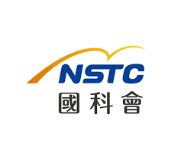



2025 BEM Activities in Taiwan
TwSIAM , June7-8 2025 (清華數學系)
CSSV, June 27 , 2025 (中原電機)
ACMT 3 計算力學會議 Sep.26-27, 2025 (陽交大土木系) 林子剛 教授
TwBEM 16 台灣邊界元會議 Sep.26-27, 2025, (陽交大應數系) 薛名成 與 (海大)陳正宗
STAM, Nov.21-22, 2025 49屆力學會議 (聯合大學機械系)
CSME 2025 Dec 5-6, 第四十二屆 機械工程學會全國機械研討會, (陽交大機械系)
結構工程研討會 2026
學術交流，以文會友，歡迎參加
國科會
中華民國
力學學會
中華民國
振動噪音工程學會
力學學會計算力學研發小組編輯 海大NTOU/MSV 陳正宗特聘講座教授

Slide 12




NTOU/MSV Grant 2025
NSTC Grant (3)
Self-regularization approach for rank-deficient system
Degenerate scale of fractional gon – conjecture, analytical derivation and numerical implementation
Promoting the influence of Taiwan power on BEM
Undergraduate program
Mohr circle and pole method
SVD and polar decomposition
Frenet formula
TwSIAM student chapter (YT Chou)
STAM Comp Mech. group (SK)
`
File name: NTOU/MSV Grant by MN

Slide 13
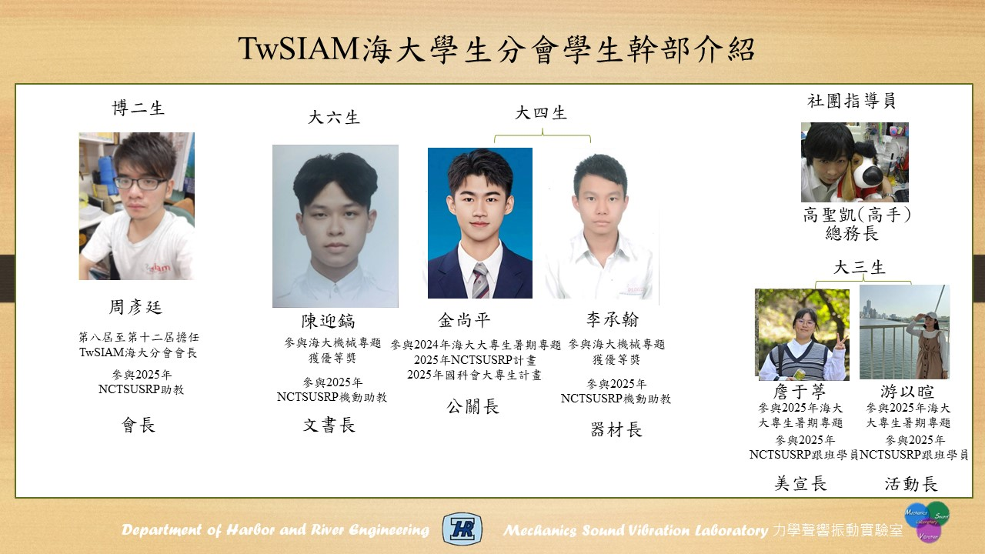
Taiwan SIAM NTOU chapter 2025
File name: NTOU/MSV Grant by MN

Slide 14


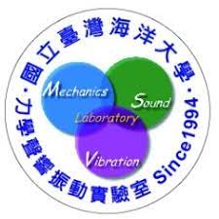
NTOU/MSV Collaborators since1988-2025
PI:陳正宗特聘講座教授
India C.S. Nishad 、 K.G. Vijay
Kuwait S.Neelamani
China 韓厚德、谷岩、傅卓佳、張耀明
Canada 李子才
Taiwan
海大:周宗仁、郭世榮、葉為忠、曹登皓、林三賢、岳景雲、劉德源、
張建仁、劉進賢、李應德
台大:葉超雄、陳正興、洪宏基、楊德良、鍾立來、劉立偉
陳義麟、陳桂鴻、李家瑋、陳立言、李為民、呂學育、徐文信、全湘偉、黃宏財、李明恭、李洋傑、陳誠宗
Filename: NTOU/MSV Cooperators made by品瑄、品臻

Slide 15
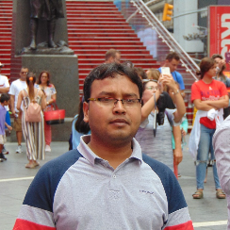
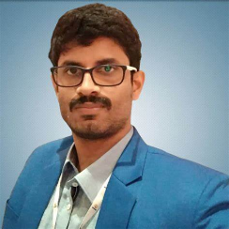
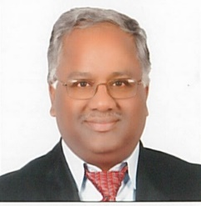
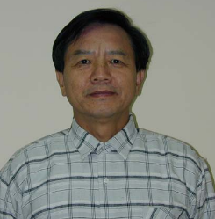
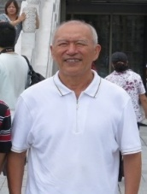
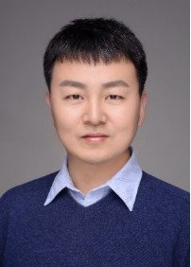
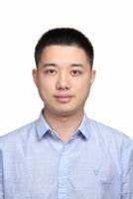
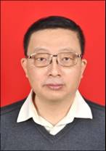
NTOU/MSV Collaborators since1988
India
Canada
Kuwait
S.Neelamani
C.S. Nishad K.G. Vijay
李子才
China
韓厚德 谷岩 傅卓佳 張耀明
Filename: NTOU/MSV Cooperators made by品瑄、品臻

Slide 16
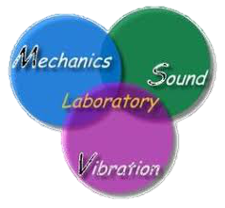










Taiwan-India joint work on breakwater using the dual BEM (2022-2025)
(ZAMM2023)
C.S. Nishad, S. Neelamani, J.T. Chen, and K.G. Vijay, 2023, Gravity Wave Interaction with Cage Enveloped Breakwaters using DBEM, Z Angew Math Mech (ZAMM), e202200064, https://doi.org/10.1002/zamm.202200064
(EABE2023)
K.G. Vijay, C. S. Nishad, S. Neelamani, and J.T. Chen, 2021, Dual BEM for Wave Scattering by a H-Type Porous Barrier with Nonlinear Pressure Drop, Engineering Analysis with Boundary Elements, Vol.131, pp.280-294.
(EABE2024)
R. Appandairaj, K.G.Vijay, K.Murali and J.T.Chen, 2024, Oblique Wave Interaction with Dual Submerged Oscillating Buoy as WEC near a Partially Reflecting Wall, Engineering Analysis with Boundary Elements, Vol.166, 105822.
(Renewable Energy, 2025, Revision))

Slide 17






Taiwan-India joint work on breakwater using the dual BEM (2025)
(POF 2025)
S. Salman, K. G. Vijay, H. Behera and J. T. Chen, 2025, Gravity wave scattering by barge integrated porous cages: experimental and numerical study, Physics of Fluid, Vol.37, 087149.
(EABE2025)
S. Salmana, K.G.Vijay, C.S. Nishad and J.T.Chen, 2025, Numerical and Experimental Investigation on Compartmentalized Porous Cages, Engineering Analysis with Boundary Elements, 179 106353.
R. Appandairaj, K.G. Vijay, C.S. Nishad and J.T. Chen, 2025, Enhanced hydrodynamic performance by a half-aerofoil floating energy converter device in oblique waves, Renewable Energy, Revised.
(Renewable Energy 2025)

Slide 18




















Dual BEM
(made in Taiwan)
B. Amadei
E. N. Pan, C. S. Chen, 1997
(U. Akron , USA)
(Rock fracture)
Portela and Aliabadi
(Portugal and UK, 1992)
(Fracture and Fatigue)
Liu Y J
(U. Cincinnati, USA.2006)
(Acoustics-thin barrier)
Leonel E D
(Brazil)
2011
(Cohesion crack)
Han and Cho
(South Korea, 2023)
曹登皓 岳景雲
(NTOU, Taiwan, 1992)
(Thin breakwater)
德不孤
H.P. Nguyen
(Viet Nam, 2023)
Dual BEM
Hong and Chen
1984-1986
NTU, Taiwan
必有鄰
張見明 (SIF)
(Hunan, China, 2015)
高效偉 (SIF)
(Dalian, China, 2015)
Chern S and Wu B 2023
(Hydraulic fracture)
Vijay and Nishad
(India, 2020)
(Water wave)
Zozulya
(Mexico, 2000)
(Hypersingular BIE)
Linkov
(Russia, 1999)
(Hypersingular BIE)
DBEM-followers.ppt by Chen J T

Slide 19





























NTOU/MSV Collaborators since1988
陳正宗
Taiwan
周宗仁
郭世榮 葉為忠 曹登皓 林三賢 岳景雲 劉德源 張建仁
劉進賢
李應德 陳立言
陳義麟
陳桂鴻 李家瑋 李為民 呂學育 徐文信
葉超雄 陳正興 洪宏基 楊德良 鍾立來 劉立偉 全湘偉 黃宏財 李明恭
Filename: NTOU/MSV Cooperators made by品瑄、品臻
李洋傑 陳誠宗

Slide 20
NTOU/MSV since 1994
NTOU/MSV group
4 PhD
53 Master
44 undergraduate
261 SCI papers
87 various sci journals
Failure 3 master students
(劉天賜、方銜尉、張嘉焜)
Failure of 2 years graduation (江立傑 楊政霖)
Success of all graduated master students
At least one sci paper for each one

Slide 21


NTOU MSV
① Publish 261 SCI papers
② Review 144 SCI journals
Paper citing (460 ASCE, 502 ASME)
Publish papers on 87 SCI journals
I. Undergrafuate publish SCI papers (24)
II.Master graduation during 2 years (18 years)
III.Master and PhD all have sci papers
❶ writing paper is difficult
❷ writing English paper is more difficult
❸ first time writing English paper is even more
difficult座教授

Slide 22



















國立台灣海洋大學力學聲響振動實驗室(NTOU/MSV Lab) 2024
顧問團
陳正宗
陳義麟
陳桂鴻
李家瑋
李應德
徐文信
范佳銘
郭世榮
呂學育
李為民
作
台
游以暄
金尚平
詹于葶
周彥廷
高聖凱
入口
SERVER
MSVlab2022座位表 浩真製表

Slide 23


邊界元素法 阿基里斯腱
BEM/BIEM achilles tendon
Failure of BIEM/BEM
for the special case

Slide 24











會員編號:
P1266
會員編號:
16924
會員編號:
F00002
中華民國力學學會
中國機械工程學會
理事
正會員
監事
TwSIAM
台灣計算力學學會
監事
永久會員
榮譽會員
中華民國數學會
永久會員
斐陶斐榮譽學會
永久會員
理事
會員編號:
33193
地震工程學會
中國工程師學會
振動與噪音工程學會
NTOU/MSV 學會群 製表by Mei-Na

Slide 25

【海大河工系實驗室介紹】
NTOU MSV研究團隊

Slide 26

【海大河工系教師與研究室介紹】力學聲響振動實驗室 MSVLAB

Slide 27

邊界元 來結緣 Line group 學術俱樂部
(我們不是邊緣人)

Slide 28






















































http://msvlab.hre.ntou.edu.tw/ Since 1999
Welcome to visit the web site of MSVLAB/NTOU
E mail: jtchen@mail.ntou.edu.tw

Slide 29





NTOU/MSV 101 in Taiwan (台灣)
Keelung 101 bus
Keelung 101 Hill
Taipei 101
金瓜石101 Hotel
101 MOST project

Slide 30

Welcome to visit NTOU/MSV
MSV
窗外

Slide 31
邊界元 來結緣
歡迎入群 學術分享
檔名：邊界緣2019.ppt

