Slide 1





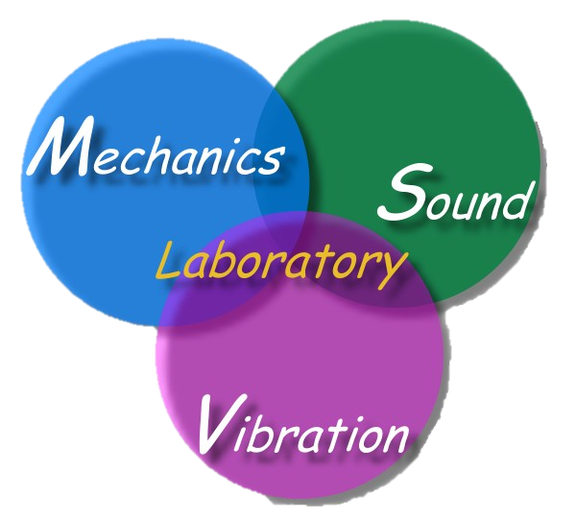
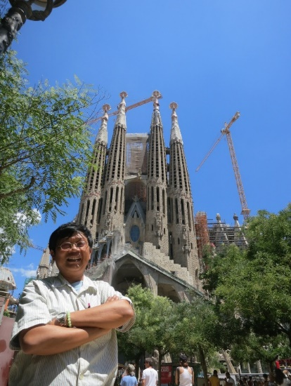

台灣海大力學聲響振動(NTOU-msv) 研究近況分享
主講人：陳正宗 特聘講座教授
科技部產學小聯盟 土機海領域召集人
海大河工系 機械系 海工系 台大土木系(客座2023) 成大土木系(合聘)
三校五系教授
STAM & TwSIAM Fellow 數學與力學雙會士
時間：2024 年 8月16 日 14:10-15:25
地點：台大土木新館 CERB 402 and 405
台淡宜海MSV 01-2024 交流會

Slide 2
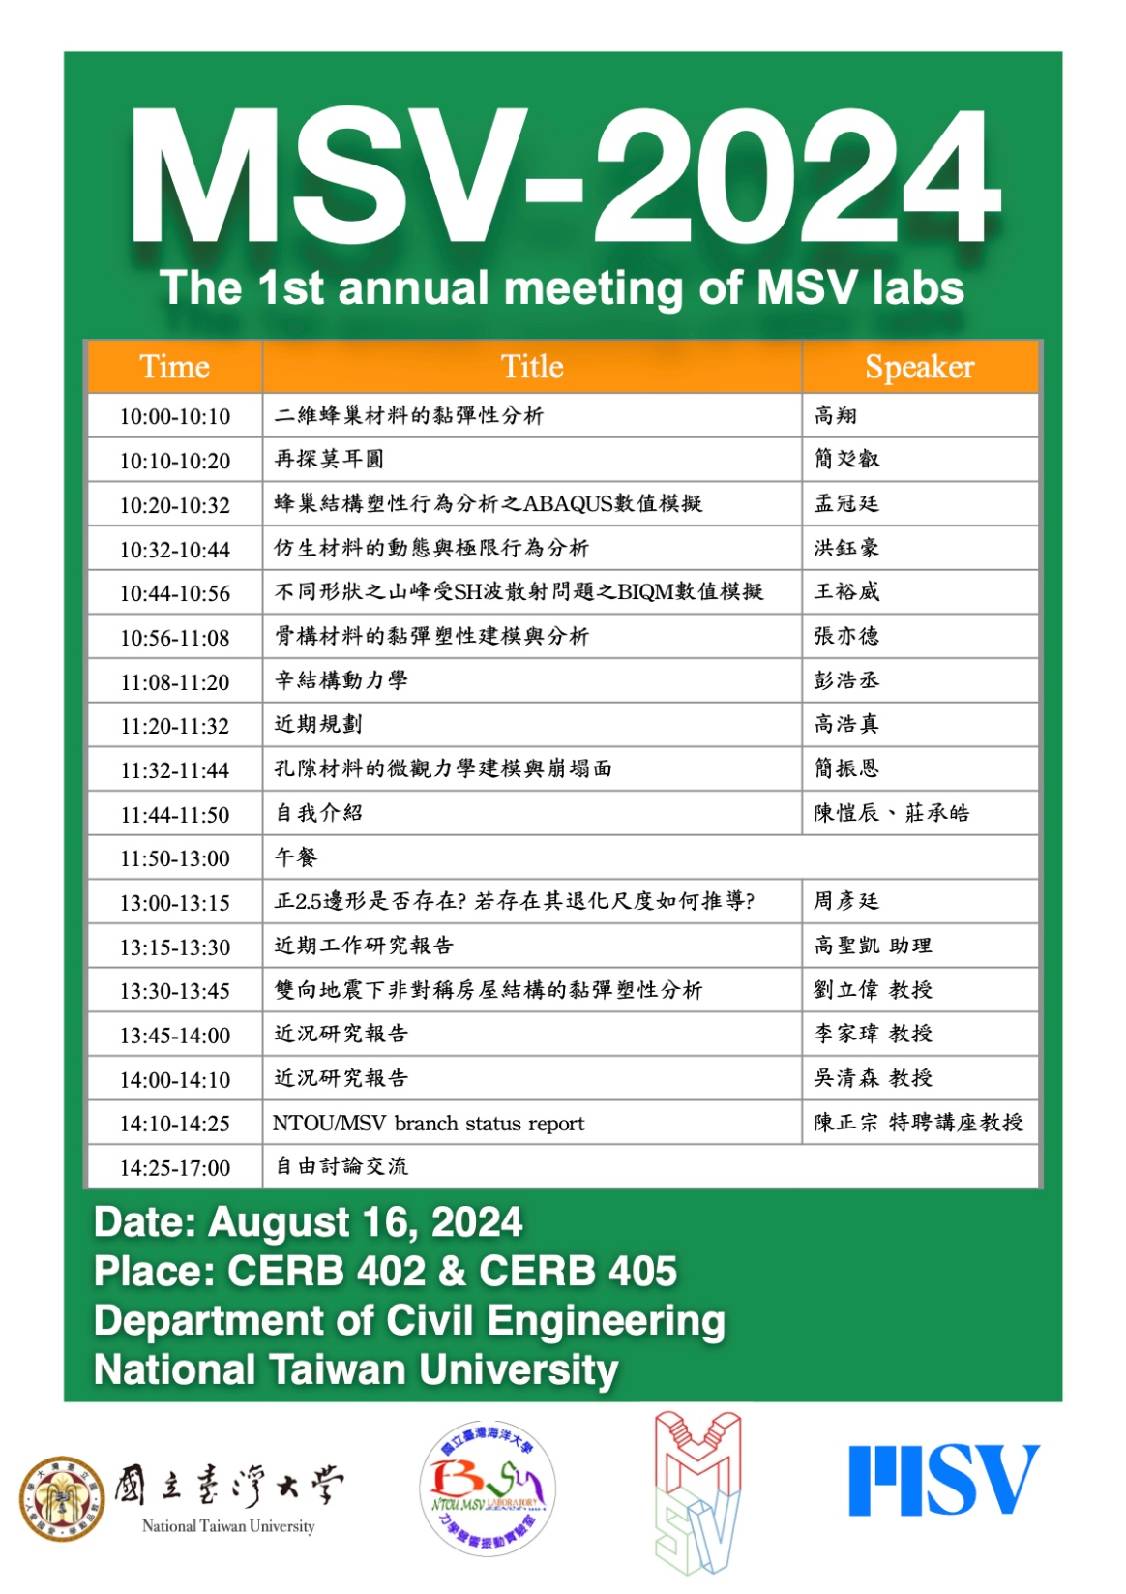

Slide 3


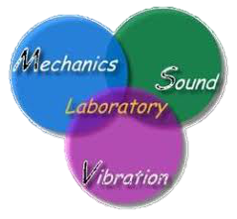

ACMT 2 & TWBEM 15 Speakers
地點：國立成功大學光復校區 國際會議廳
日期：2024-10-05(六)~10-06(日)
主持人：舒宇宸 副教授 陳正宗 特聘講座教授
時間 | 講者 | 題目
10/05 14:50 | 陳正宗 | 2.5邊形有退化尺度嗎?
10/05 15:20 | 李雪甄 | Numerical simulation of basal crevasses of the tidewater glacier using GLS method
10/05 15:50 | 陳桂鴻 | The applications of null-field technique in computational mechanics
10/05 16:40 | 薛名成 | On unconditional long-time stability of BDF type timestepping schemes for the Navier-Stokes equations
10/05 17:10 | 李應德 | Semi-analytical approach for piezoelectric materials with multiple cracks
10/05 17:40 | 胡偉帆 | Learning to solve partial differential equations
10/06 11:00 | 高政宏 | Analysis of degenerate scale for heat exchange tubes by using the BIEM/BEM
10/06 11:30 | 陳孟豁 | Parallel calculation on Mandel's problem
10/06 12:00 | 李家瑋 | Development of the boundary integral quadrature method and some engineering applications
Organizer： Associate Prof. YC Shu E-mail：ycshu@mail.ncku.edu.tw
Distinguished Chair Prof. JT Chen E-mail：jtchen@mail.ntou.edu.tw
Associate Prof. KH Chen E-mail：khc6177@mail.niu.edu.tw
Associate Prof. YT Lee E-mail：ytlee@mail.ntou.edu.tw
Assistant Prof. JH Kao E-mail：m93520009@mail.ntou.edu.tw
聯絡人：高政宏 博士 E-mail：m93520009@mail.ntou.edu.tw
服務團隊：NTOU/MSV http://msvlab.hre.ntou.edu.tw/index1.htm
TWBEM15.ppt JH製表

Slide 4
小丑歌詞改編
掌聲在歡呼之中響起
眼淚已湧在笑容裡
啟幕時歡樂送到你眼前
落幕時孤獨留給自己
是多少磨鍊 和多少眼淚
才能夠站在這裡
失敗的痛苦 成功的鼓勵
有誰知道 這是多少歲月的累積
小丑 小丑
是他的辛酸 化作喜悅 呈獻給你
掌聲在歡呼之中響起
眼淚已湧在笑容裡
接受時歡樂送到你眼前
寫作時孤獨留給自己
是多少磨鍊 和多少眼淚
才能夠站在這裡
reject的痛苦 accept的鼓勵
有誰知道 這是多少歲月的累積
paper paper
是他的辛酸 化作喜悅 呈獻給你

Slide 5
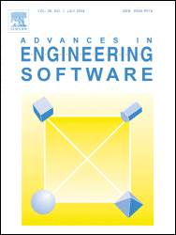
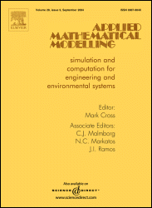
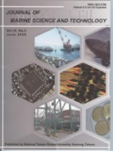
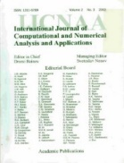
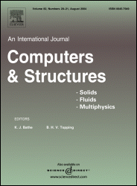
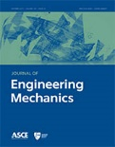
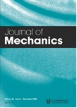
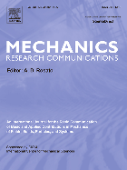
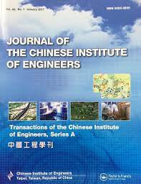
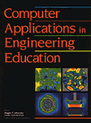

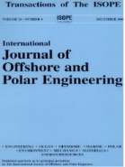

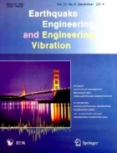
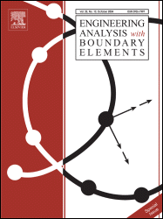
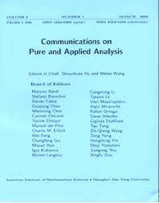
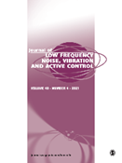
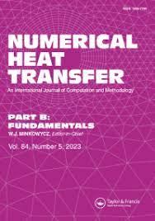
NTOU MSV 大學生SCI論文成功案例(1994-2024) 小兵立大功
SCI
2021 周彥廷
2021 邵程祥 呂政軒
1996 鄭岳世
1998 陳桂鴻
2000 劉立偉
2002 林盛益
2014 凃雅瀞
2018 陳聖劻
2022 曹美娜
2023 楊佳穎 臧紀甯
2010 蕭宇志
2014 高怡絹
2016 凃雅瀞
2021 戴暐宸
2022 高浩真
2008 蔡明宏
2008 高聖凱
2008 吳國倫
2004 葉雅婷
2008 謝正昌
2008 李家瑋
2008 余尚儒
2021 周彥廷 2021 邵程祥
有為者，亦若是
-目前已有21篇文章刊登，遍及16種期刊-
2023 楊佳穎
2022/01/10

Slide 6
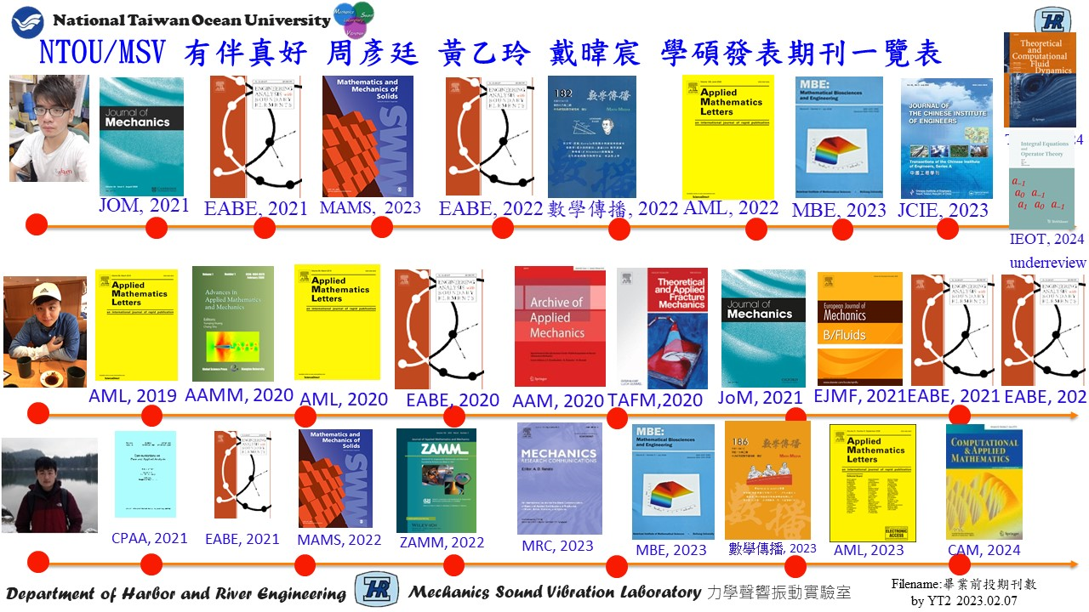

Slide 7


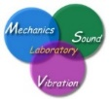
NTOU/MSV Google citing 10篇破百 (Aug. 09, 2024)
Research Gate Scores: 41.16 h index:41 (Scopus)
1999 | J. T. Chen and H.-K. Hong, 1999, Review of dual boundary element methods with emphasis on hypersingular integrals and divergent series, Applied Mechanics Reviews, ASME, Vol.52, No.1, pp.17-33. | 491
1988 | H.-K. Hong and J. T. Chen, 1988, Derivations of Integral Equations of Elasticity, Journal of Engineering Mechanics, ASCE, Vol.114, No.6, pp.1028-1044. | 442
2007 | J. T. Chen, C. S. Wu, Y. T. Lee and K. H. Chen, 2007, On the equivalence of the Trefftz method and method of fundamental solutions for Laplace and biharmonic equations, Computers and Mathematics with Applications, Vol.53, No.6, pp.851-879. | 134
1998 | J. T. Chen and F. C. Wong, 1998, Dual formulation of multiple reciprocity method for the acoustic mode of a cavity with a thin partition, J. of Sound and Vibration, Vol. 217, No.1, pp.75-95. | 129
2002 | J. T. Chen, S. R. Kuo and J. H. Lin, 2002, Analytical study and numerical experiments for degenerate scale problems in the boundary element method for two-dimensional elasticity, Int. J. Numer. Meth. Engng., Vol.54, No.12, pp.1669-1681. | 110
2004 | JT Chen, IL Chen, KH Chen, YT Lee, YT Yeh, 2004, A meshless method for free vibration analysis of circular and rectangular clamped plates using radial basis function, Engineering Analysis with Boundary Elements Vol.28, No.5, 535-545. | 108
2008 | J. T. Chen, P. Y. Chen and C. T. Chen, 2008, Surface motion of multiple alluvial valleys for incident plane SH-waves by using a semi-analytical approach, Soil Dynamics and Earthquake Engineering,, Vol.28, pp.58-72. | 103
2002 | JT Chen, MH Chang, KH Chen, SR Lin, The boundary collocation method with meshless concept for acoustic eigenanalysis of two-dimensional cavities using radial basis function , Journal of Sound and Vibration Vol.257, No.4, 667-711 | 101
2001 | J. T. Chen, J. H. Lin, S. R. Kuo and S. W. Chyuan, 2001, Boundary element analysis for the Helmholtz eigenproblems with a multiply-connected domain, Proc. Royal Society of London Ser. A, Vol.457, No.2014, pp.2521-2546. | 100
2003 | J. T. Chen, L. W. Liu and H.-K. Hong, 2003, Spurious and true eigensolutions of Helmholtz BIEs and BEMs for a multiply-connected problem, Royal Society London Series A, Vol.459, No.2036, pp.1891-1925. | 100

Slide 8




NTOU/MSV Highly Read 前十四強(Research Gate 41.16, Aug. 06, 2024)
2003 | S. W. Chyuan, Y. S. Liao and J. T. Chen, An efficient method for solving electrostatic problems, IEEE Computing in Science and Engineering, 5(3):52 – 58. | 4923
2006 | J. T. Chen and C. S. Wu, Alternative derivations for the Poisson integral formula, International Journal of Mathematical Education in Science and Technology, 37(2):165-185. | 4157
2008 | W. M. Lee and J. T. Chen, Null-field integral equation approach for free vibration analysis of circular plates with multiple circular holes, Computational Mechanics, Vol.42, pp.733-747. | 3031
2011 | W. M. Lee and J. T. Chen, Free vibration analysis of a circular plate with multiple circular holes by using addition theorem and indirect BIEM, ASME. Journal of Applied Mechanics, 78:1-10. | 2381
2005 | S. S. Lin, J. C. Liao, J. T. Chen and L. Chen, Lateral performance of piles evaluated via inclinometer data, Computers and Geotechnics, Vol.32, pp.411-421. | 1371
2009 | J. T. Chen, J. N. Ke, H. Z. Liao, Construction of Green‘s function using null field integral approach for Laplace problems with circular boundaries, CMC, 9(2): 93-110. | 1036
2009 | J. T. Chen and Y. T. Lee, Torsional rigidity of a circular bar with multiple circular inclusions using a null field integral equations, Computational Mechanics, Vol.44, No.2, pp.221-232. | 939
1999 | J. T. Chen and H.-K. Hong, Review of dual boundary element methods with emphasis on hypersingular integrals and divergent series, Applied Mechanics Reviews, ASME, Vol.52, No.1, pp.17-33. | 805
2009 | J. T. Chen, K. H. Chou and S. K. Kao, Derivation of Green’s function using addition theorem, Mechanics Research Communications, Vol.36, No.3, pp.351-363. | 767
2008 | J. T. Chen, K. S. Chou and S. K. Kao, One-dimensional wave animation using Mathematica, Computer Applications in Engineering Education, 17(3):323-339. | 582
2007 | J. T. Chen and A C Wu, 2007, Null-field integral equation approach for multi-inclusion problem under anti-plane shear, ASME, J. Appl. Mech., Vol.74, pp.469-487. | 523
2009 | J. T. Chen, M. H. Tsai and C. S. Liu, Conformal mapping and bipolar coordinate for eccentric Laplace problems, Computer Applications in Engineering Education, Vol.17, No.3, pp.314-322. | 501
2023 | J. T. Chen, C. Y. Yang, Y. T. Chou, C. N. Tsang, Animation of cycloid and spiral curves in companion with instantaneous center of rotation and radius of curvature, Journal of Chinese Institute of Engineers, Vol.46, No.7, pp.693-702. | 509
1988 | H. K. Hong and J. T. Chen, Derivations of Integral Equations of Elasticity, ASCE Journal of Engineering Mechanics, 114(6):1028-1044. | 356

Slide 9




NTOU/MSV Grant 2024
NSTC專題(4+1)
直接與間接邊界元素法等價嗎? (待結案)
受外部彈簧和阻尼邊界影響下桿或梁的支承運動問題研究 (待結案)
雙極座標分離核在邊界積分方程法/邊界元素法之工程應用
自救法於工程秩降問題之應用
提升台灣邊界元素法研究之國際影響力 (審查中)
國科會大專生專題(1) TKU
邊界積分求積法於滲流問題中的自由液面模擬與板樁設計 鄭景云
NTOU大暑專題(2)
變分法在工程上之應用—最速陡降曲線熱交換管形狀因子
再探莫耳圓
傅昱嘉
簡彣叡
File name: NTOU/MSV Grant by MN

Slide 10


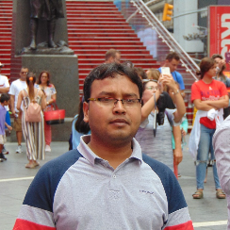
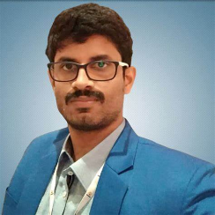
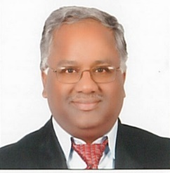
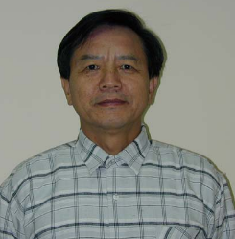
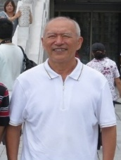
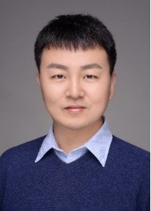
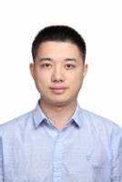
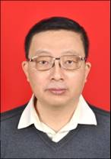
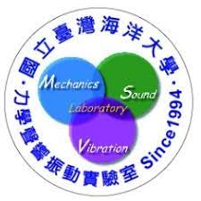

NTOU/MSV Collaborators since1988
India
Canada
Kuwait
S.Neelamani
C.S. Nishad K.G. Vijay
李子才
China
韓厚德 谷岩 傅卓佳 張耀明
Filename: NTOU/MSV Cooperators made by品瑄、品臻

Slide 11
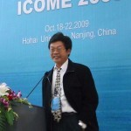
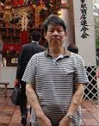
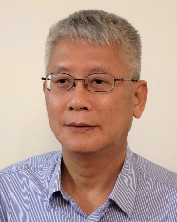
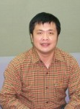
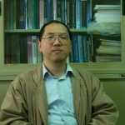
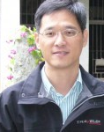
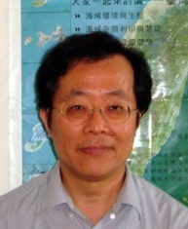
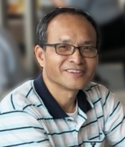
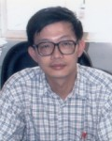
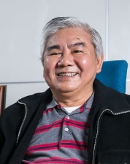
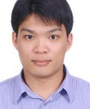
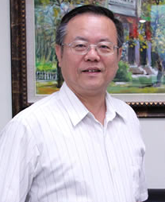
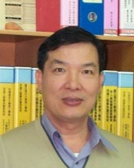
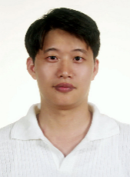
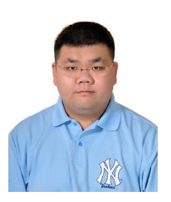
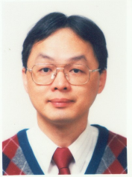

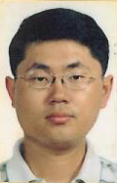
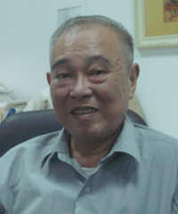
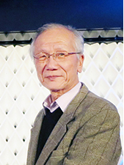







NTOU/MSV Collaborators since1988
陳正宗
Taiwan
周宗仁
郭世榮 葉為忠 曹登皓 林三賢 岳景雲 劉德源 張建仁
劉進賢
李應德 陳立言
陳義麟
陳桂鴻 李家瑋 李為民 呂學育 徐文信
葉超雄 陳正興 洪宏基 楊德良 鍾立來 劉立偉 全湘偉 黃宏財 李明恭
Filename: NTOU/MSV Cooperators made by品瑄、品臻

Slide 12
NTOU/MSV 30 年成績單 since 1994
陳正宗特聘講座教授自1994年起
建立NTOU/MSV團隊，
4個博士生
52位碩士生
44 位大學生 totally 100 persons
SCI papers
87 various sci journals
Failure 3 master students
劉天賜、方銜尉、張嘉焜
Failure of 2 years graduation 江立傑 楊政霖
Success of all graduated master students
At least one sci paper for each one

Slide 13


NTOU MSV 學術三個一百、三個堅持及三難2024
①發表100 篇SCI論文(251)
②審過100 種不同SCI期刊論文(144)
③單篇論文被引用100次 (10 篇)
(442 ASCE, 491 ASME)
發表過 87 種不同SCI期刊論文
I. 大學部也會有 SCI 論文(23)
II.碩士班如期畢業(守了18年)
III.碩博士班學生論文均能在SCI期刊發表
(守了30年)
❶寫論文難
❷寫英文論文更難
❸第一次用英文寫論文是難上加難 陳正宗特聘講座教授

Slide 14


邊界元素法 阿基里斯腱
BEM/BIEM achilles tendon
Failure of BIEM/BEM
for the special case

Slide 15
NTOU/MSV 一陳雙李-二高地虎登百岳一步一腳印 A, 2024 (completed)
 | JOURNAL | TOPIC | DATE | STATUS | REMARK
戴暐宸 | MRC | Green’s function of an eccentric domain | Appear |  | Oct.12, 2022
陳正宗 | MBE | On the solution arising in two-cylinder electrostatics | Appear |  | Feb.14, 2023
楊洪聞 | ASME-JHMT | Steady state heat conduction in exchanger tubes by using the meshfree boundary integral equation method: conduction shape factor and degenerate scale | Appear |  | May 07,2023
李為民 | ActaMech | Construction of dynamic Green‘s function for an infinite acoustic field with multiple spheroids | Appear
李為民 | JTCA | Dynamic Green’s functions for an infinite acoustic field with multiple spheres subjected to the Robin BC | Appear |  | April 9, 2022
K.G. Vijay | ZAMM | Gravity Wave Interaction with Cage Enveloped Breakwaters using DBEM | Appear |  | May 31, 2023
楊佳穎 | JCIE | Animation of cycloid and spiral curves in companion with instantaneous center of rotation and radius of curvature | Appear |  | Dec.27, 2022
戴暐宸 | AML | An analytical Green’s function for an infinite plane with two circular holes using degenerate kernels | Appear |  | July, 2023
高政宏 | EABE-SP | Are the direct and indirect BEM equivalent | Appear | Aug.20 | Feb.06, 2023
戴暐宸 | 數學傳播 | Stokes’轉換與 Cesaro um 在 Fourier series 逐項微分不合法時的應用 | Appear |  | Mar 28,2023
楊佳穎 | NHT | Numerical instability and its treatment for steady state heat conduction problems in exchanger tubes using the dual BEM | In Press |  | Aug. 13,2023
高浩真 | IJSSD | Analytical solutions and FEM results for the support motion of a finite bar with an external viscously damped and spring boundary | In Press | Feb. 2024 | Dec.19, 2023
戴暐宸 | CAM | On two holes in harmonic problems | In Press | Feb. 2024 | June 06, 2022
K.G.Vijay | EABE | Oblique Wave Interaction with Dual Submerged Oscillating Buoy as WEC near a Partially Reflecting Wall | Appear | Re-review | Jan.18, 2024
楊佳穎 | IJHMT | Analytical study for numerical instability of steady state heat conduction problems in exchanger tubes using degenerate kernel in the null-filed BIE | in Press | Re-review | Mar.26, 2024
楊洪聞 | EABE | Meshfree boundary integral equation method for solving the steady state heat conduction in exchanger tubes containing slits | Appear | Re-review | Dec.28, 2023
卿建業 | 中國土木水利 | 綜合聲譽與JCR指標的土木水利工程國際期刊列表建議 | Appear |  | Jan, 12, 2024
登百岳中2021.ppt j t chen

Slide 16
NTOU/MSV 一陳雙李-二高地虎登百岳一步一腳印 A, 2024 (undergoing)
 | JOURNAL | TOPIC | DATE | STATUS | REMARK
周彥廷 | TCFD | Analytical solution for potential flow across two unequal cylinders using the BIE |  | Under rev | Nov.1, 2023
高浩真 | JVET | Aanalytical solutions and FEM results for a canti;ever beam with end springs subjected to support motion |  | Submitted | Aug.6, 2024
Vijay | RenewEnergy | Enhanced Hydrodynamic Performance by a Half-Aerofoil Floating Wave Energy Converter Device in Oblique Waves |  | Submitted | Aug.01, 2024
李家瑋 | JOM (Ma) | BIQM for torsional problem of an orthotropic bar |  |  | 準備中
臧紀甯 | JTS | Thermal stress of a free truss subjected to temperature change |  |  | 準備中
周彥廷 |  | Null-field boundary integral formulation for boundary value problems using degenerate kernels of curvilinear coordinates |  |  | 準備中
周彥廷 | Physic E | Degenerate scale of 2.5 gon shape: conjecture and numerical demonstration |  |  | 準備中
郭世榮 |  | Analytical study and numerical implemetation of n star gon |  |  | 準備中
李子才 |  | Error Analysis of Discrete Null Field Equation Method for Solving Laplace’s Equation; Circular Pseudo-boundaries |  |  | 準備中
李子才 |  | Evaluation on Integrals Involving Near Singularity based on Sinh-transformation and Mini-rules |  |  | 準備中
李應德 | IJES | Null-field integral equation approach for piezoelectricity problems with arbitrary elliptical inclusions |  |  | 準備中
李家瑋 | JCP | Dual BEM is necessary – self-regularization technique ? |  |  | 準備中
紀昭銘 | CAEE | Is Mohr Circle a Math or Engineering Problem? A case study on 2004 Taiwan P.E. Exam of Structure Engineering |  |  | 準備中
李家瑋 | EABE | Dual BEM is necessary - CHEEF idea ? |  |  | 準備中
李家瑋 | JLFNV | Is CHIEF necessary |  |  | 準備中
周彥廷 | CAEE | \dot {Q} =WQ |  |  | 準備中
登百岳中2021.ppt j t chen

Slide 17

【海大河工系實驗室介紹】 NTOU MSV研究團隊

Slide 18

【海大河工系教師與研究室介紹】力學聲響振動實驗室 MSVLAB

Slide 19

邊界元 來結緣 Line group 學術俱樂部
(我們不是邊緣人)

Slide 20






















































http://msvlab.hre.ntou.edu.tw/ Since 1999
Welcome to visit the web site of MSVLAB/NTOU
E mail: jtchen@mail.ntou.edu.tw

Slide 21
邊界元 來結緣
歡迎入群 學術分享
檔名：邊界緣2019.ppt

Slide 22





NTOU/MSV 101 in Taiwan (台灣)
Keelung 101 bus
Keelung 101 Hill
Taipei 101
金瓜石101 Hotel
101 MOST project

Slide 23

Welcome to visit NTOU/MSV
MSV
窗外

Slide 24





















學問一點一滴，一路走來(2018-2023)-周彥廷
海洋大學大學生暑期計畫
工學院第三名(2019)
NCTS大學部學生
暑期研究計畫(2020)
Bipolar ABF
科技部
大專生計畫(2020)
2018.10月加入MSV團隊學習
TwSIAM大學生組
優良海報論文獎(2020)
JOM, 2021
EABE, 2021
MAMS, 2023
EABE, 2022
數學傳播, 2022
J.T. Chen,
J.W. Lee,
S.K. Kao,
Y.T. Chou
J.T. Chen,
J.H. Kao,
S.K. Kao,
Y.L. Huang,
Y.T. Chou
J.T. Chen,
S.K. Kao,
W.C. Tai,
Y.T. Lee,
J.W. Lee,
Y.T. Chou
Y.T. Lee,
J.H. Kao,
Y.T. Chou,
J.T. Chen
陳正宗
吳庭安
周彥廷
陳彥亨
AML, 2022
MBE, 2023
JCIE, 2023
JMAA, 2023
CF, 2023
J.T. Chen
Y.T. Chou,
J.H. Kao,
J.W. Lee
J.T. Chen,
S.K. Kao,
Y.T. Chou,
W.C. Tai
J.T. Chen,
C.Y. Yang,
Y.T. Chou,
C.N. Tsang
SIF & Double degeneracy
Revision
Revision
(in Preparation)
Filename:YT2一路走來 by YT2 2023.02.07

Slide 25


















戴暐宸(天龍) 學問一點一滴，一路走來(2019-2023)
Unequal holes bipolar
Elliptical ABF
Eccentric Green’s function
Infinite plane two holes Green’s function
Bipolar ABF
Degenerate scale
Degenerate boundary
MRC, 2023
數學傳播, 2023
AML, 2023
CAM, 2023
W.C. Tai
Y.T. Lee
J.T. Chen
J.T. Chen
Y.T. Lee
W.C. Tai
M.N. Tsao
MBE, 2023
J.T. Chen
W.C. Tai
Y.T. Lee
J.T. Chen
Y.T. Lee
S.K. Kao
W.C. Tai
Revised
J.T. Chen
S.K. Kao
Y.T. Chou
W.C. Tai
J.T. Chen
S.K. Kao
W.C. Tai
H.C. Kao
ZAMM, 2022
EABE, 2021
MAMS, 2022
J.T. Chen
J.W. Lee
S.K. Kao
W.C. Tai
CPAA, 2021
J.T. Chen,
J.H. Kao,
S.K. Kao,
C.H. Shao,
W.C. Tai
J.T. Chen,
S.K. Kao,
W.C. Tai,
Y.T. Lee,
J.W. Lee,
Y.T. Chou
J.T. Chen,
J.H. Kao,
S.K. Kao,
W.C. Tai

Slide 26



西安交流會 2024 Chen J T Distinguished Chair Prof. Taiwan Ocean University Guest Prof. , Taiwan University (2023) Adj. Prof., Cheng-Kung University NME 2024 Aug.01, 2024
西安理工2024.ppt

Slide 27


























國立台灣海洋大學力學聲響振動實驗室(NTOU/MSV Lab) 2024
顧問團
陳正宗
陳義麟
陳桂鴻
李家瑋
李應德
徐文信
范佳銘
郭世榮
呂學育
李為民
作
台
工讀生
工讀生
周彥廷
高浩真
簡彣叡
高政宏
傅昱嘉
高聖凱
唐奕翔
入口
SERVER
MSVlab2022座位表 浩真製表

Slide 28



MSV到外校拿博士者
台大
成大
交大
鄭岳世
劉立偉
吳清森
高政宏
陳誠宗
鍾瑜隆

Slide 29

NTOU/MSV 大學生SCI論文成功案例(1994-2024) 小兵立大功
鄭岳世 | Dual series representation and its applications to a string subjected to support motions (1996) | ADV
陳桂鴻* | Analytical study and numerical experiments for Laplace equation with overspecified BCs (1998) | AMM
劉立偉** | On the free terms of the dual BEM for the two and three- dimensional Laplace problems (2000) | JMST
林盛益 | A new point of view for the polar decomposition using singular value decomposition (2002) | IJCN
李應德***、葉雅婷 | A meshless method for free vibration analysis of circular and rectangular clamped plates using radial basis function (2004) | EABE
蔡明宏 | Conformal mapping and bipolar coordinate for eccentric problems (2008) | CAEE
高聖凱 | Waves in string using diamond rule and Mathematica software (2008) | CAEE
謝正昌 | Derivation of stiffness and flexibility for rods and beams by using dual integral equations (2008) | EABE
吳國綸 | Regularized meshless mathod for Cauchy problems (2008) | CM
李家瑋 **** | On the spurious eigensolutions for the real-part boundary element method (2008) | EABE
余尚儒 | Equivalence between Trefftz method and method of fundamental solution for the annular Green’s function (2008) | EABE
蕭宇志 | Analysis of water wave problems containing single and multiple cylinders by using the degenerate kernel method (2010) | ISOPE
高怡絹 | Eigenanalysis for a confocal prolate spheroidal resonator using the null-field BIEM in conjunction with degenerate kernels (2014) | Acta Mechanica
凃雅瀞 | A self-regularized approach for deriving the free-free flexibility and stiffness matrices (2014) | CS
黃乙玲 | Revisit of the degenerate scale for an infinite plane problem containing two circular holes using conformal mapping (2019) | AML
邵程祥、呂政軒 | On the linkage between influence matrices in the BIEM and BEM to explain the mechanism of degenerate scale (2021) | JOM
周彥廷 | On the path independence and invariant of the J-integral for a slant crack and rigid-line inclusion using degenerate kernels and the dual BEM (2021) | EABE
戴暐宸 | An indirect BIE free of degenerate scales (2021) | CPAA
邵程祥、戴暐宸 | On the role of singular and hypersingular BIEs for the BVPs containing a degenerate boundary (2021) | EABE
高浩真 | Support motion of a finite bar with an external spring (2022) | JLFNVAC
曹美娜 | Analytical solutions for the Laplace problem of an eccentric annular domain (2022) | MRC
楊佳穎 臧紀甯 | Animation of cycloid and spiral curves in companion with instantaneous center 2 of rotation and radius of curvature (2023) | JCIE
楊佳穎 | Numerical instability and its treatment for steady state heat conduction problems in exchanger tubes using the dual boundary element method(2023) | NHT
* : 陳桂鴻現任於國立宜蘭大學土木工程學系副教授
** : 劉立偉現任於國立台灣大學土木系助理教授(國立成功大學工程科學系助理教授)
*** : 李應德現任於國立台灣海洋大學河海工程學系副教授
**** : 李家瑋現任於淡江大學土木工程學系副教授
一個教授的養成教育都是從大學部就一點一滴的栽培方能奏功

Slide 30
NTOU/MSV Collaborators since 1988 (德不孤 必有鄰)
PI:陳正宗特聘講座教授
India C.S. Nishad 、 K.G. Vijay
Kuwait S.Neelamani
China 韓厚德、谷岩、傅卓佳、張耀明
Canada 李子才
Taiwan
海大:周宗仁、郭世榮、葉為忠、曹登皓、林三賢、岳景雲、劉德源、
張建仁、劉進賢、李應德
台大:葉超雄、陳正興、洪宏基、楊德良、鍾立來、劉立偉
陳義麟、陳桂鴻、李家瑋、陳立言、李為民、呂學育、徐文信、全湘偉、黃宏財、李明恭
Filename: NTOU/MSV Cooperators made by品瑄、品臻

Slide 31
































History & Background Taiwan BEM workshop (1986-2021) (TwBEM 12-2021 on line meeting)
Year | The host unit | The organizer | Ceremony | (BEM 11)
1986 | NTU IAM | Prof. Y H Pao | Establishment of NTU IAM | Prof. F J Rizzo
1989 | NTU | Prof. D L Young | NSC | Prof. J A Liggett
1998 | NSC | Prof. J T Chen | NCHC | Prof. A H D Cheng
2010 | NTOU-HRE-MSV | Prof. J T Chen | NTOU-HRE 50th anniversary | Prof. Z C Li
2011 | NCTS(South) | Prof. K M Lee | NCKU 80th anniversary | NCKU
2012 | Feng Chia University | Prof. Y C Shiah | Prof. Hong’s 60th birthday | Prof. H-K Hong
2013 | National Chung Hsing University | Prof. K J Shou | Congratulations for Academicain | Dean S L Crouch Academician,NAE
2014 | National SYS University | Prof. T T Lu | Prof. Young’s 70th birthday | Prof. D L Young
2015 | NCREE (cross strait) | Dr. R Z Wang | NCREE | Cross strait ceremony
2016 | NCTS (Japan-Taiwan) | Prof. J H Lee | NCTS | Prof. H-K Hong Prof. W-W Lin
2017 | NIU | Prof. I L Chern Prof. K H Chen | Ilan Univ | Prof. H-K Hong Prof. W-C Wang
2018 | ISU | Prof. H T Huang Prof. I L Chen | Iso univ. | Prof. D L Young
2019 | NCKU | Prof. L W Liu | Cheng Kung Univ | Prof. J T Chen
2020 | NTOU | Prof. Y T Lee Prof. C M Fan | NTOU-HRE 60th anniversary | Prof. C B Hwu

Slide 32


第一屆計算力學學會年會暨第十四屆台灣邊界元會議
(Oct. 28-29, 2023)
第二屆計算力學學會年暨第十五屆台灣邊界元會議
(Oct. 5-6, 2024) 成大工科與數學系

