Slide 1



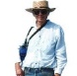
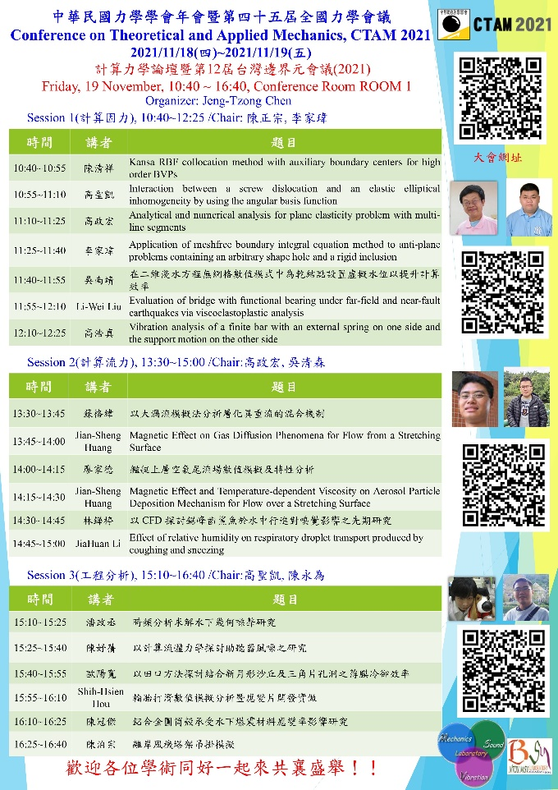




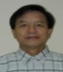









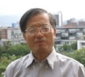










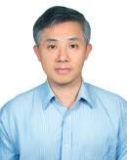
History & Background Taiwan BEM workshop (1986-2020) see you in TKU (BEM 12-2021)
Year | The host unit | The organizer | Ceremony | (BEM 11)
1986 | NTU IAM | Prof. Y H Pao | Establishment of NTU IAM | Prof. F J Rizzo
1989 | NTU | Prof. D L Young | NSC | Prof. J A Liggett
1998 | NSC | Prof. J T Chen | NCHC | Prof. A H D Cheng
2010 | NTOU-HRE-MSV | Prof. J T Chen | NTOU-HRE 50th anniversary | Prof. Z C Li
2011 | NCTS(South) | Prof. K M Lee | NCKU 80th anniversary | NCKU
2012 | Feng Chia University | Prof. Y C Shiah | Prof. Hong’s 60th birthday | Prof. H-K Hong
2013 | National Chung Hsing University | Prof. K J Shou | Congratulations for Academicain | Dean S L Crouch Academician,NAE
2014 | National SYS University | Prof. T T Lu | Prof. Young’s 70th birthday | Prof. D L Young
2015 | NCREE (cross strait) | Dr. R Z Wang | NCREE | Cross strait ceremony
2016 | NCTS (Japan-Taiwan) | Prof. J H Lee | NCTS | Prof. H-K Hong Prof. W-W Lin
2017 | NIU | Prof. I L Chern Prof. K H Chen | Ilan Univ | Prof. H-K Hong Prof. W-C Wang
2018 | ISU | Prof. H T Huang Prof. I L Chen | Iso univ. | Prof. D L Young
2019 | NCKU | Prof. L W Liu | Cheng Kung Univ | Prof. J T Chen
2020 | NTOU | Prof. Y T Lee Prof. C M Fan | NTOU-HRE 60th anniversary | Prof. C B Hwu

Slide 2
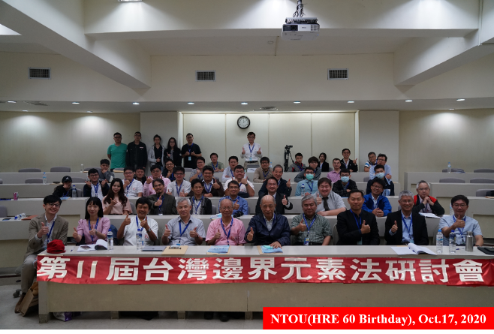
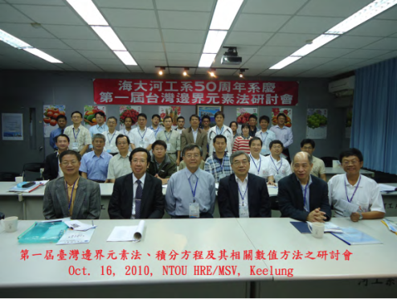
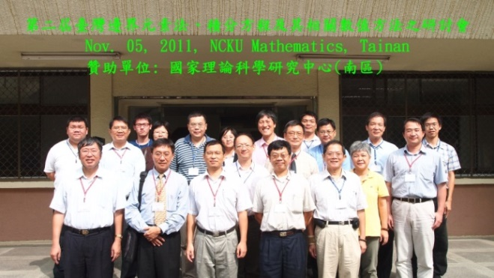
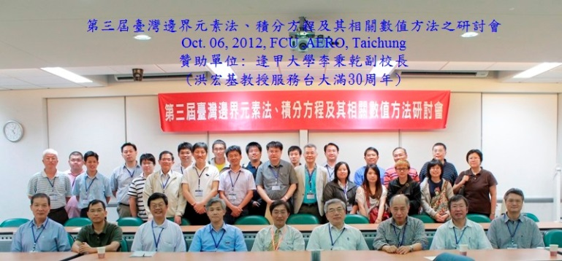
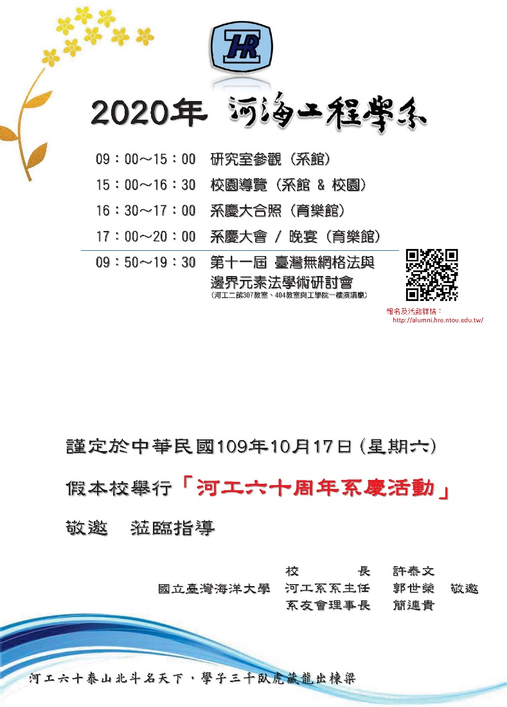
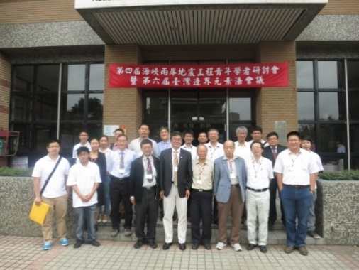
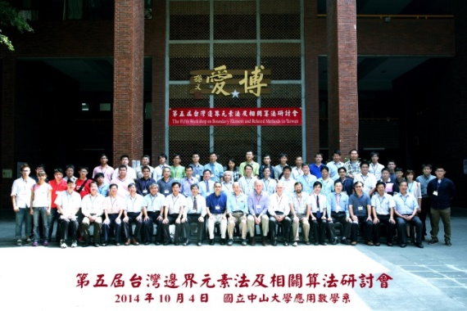
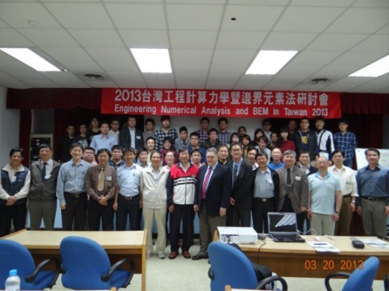
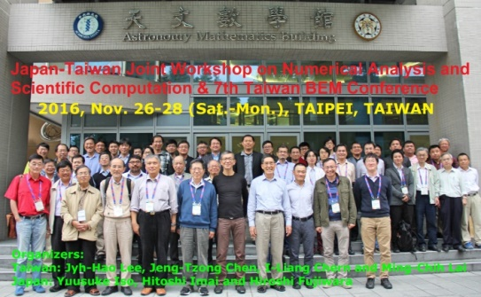
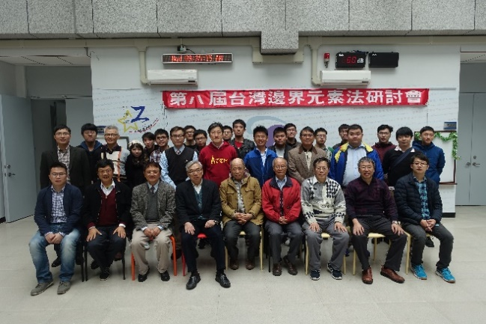
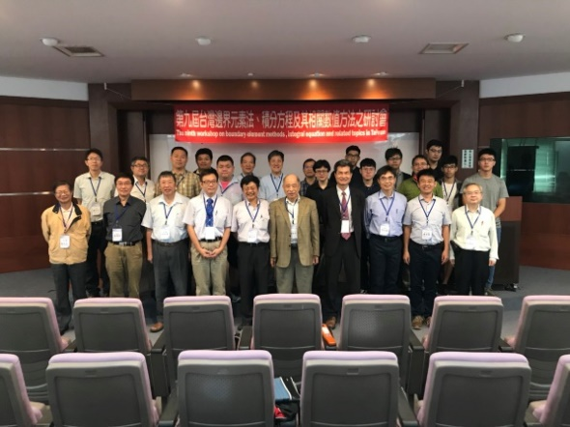
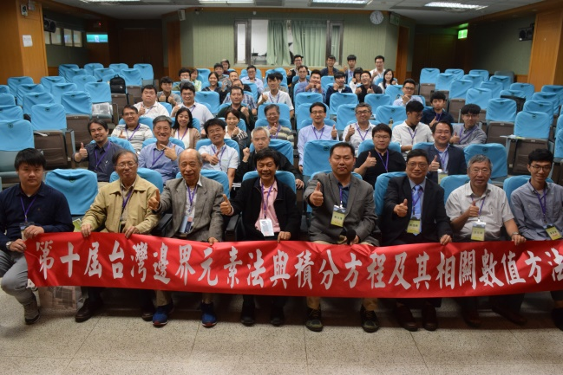
Taiwan BEM/Meshless Meeting (2010-2020)

Slide 3
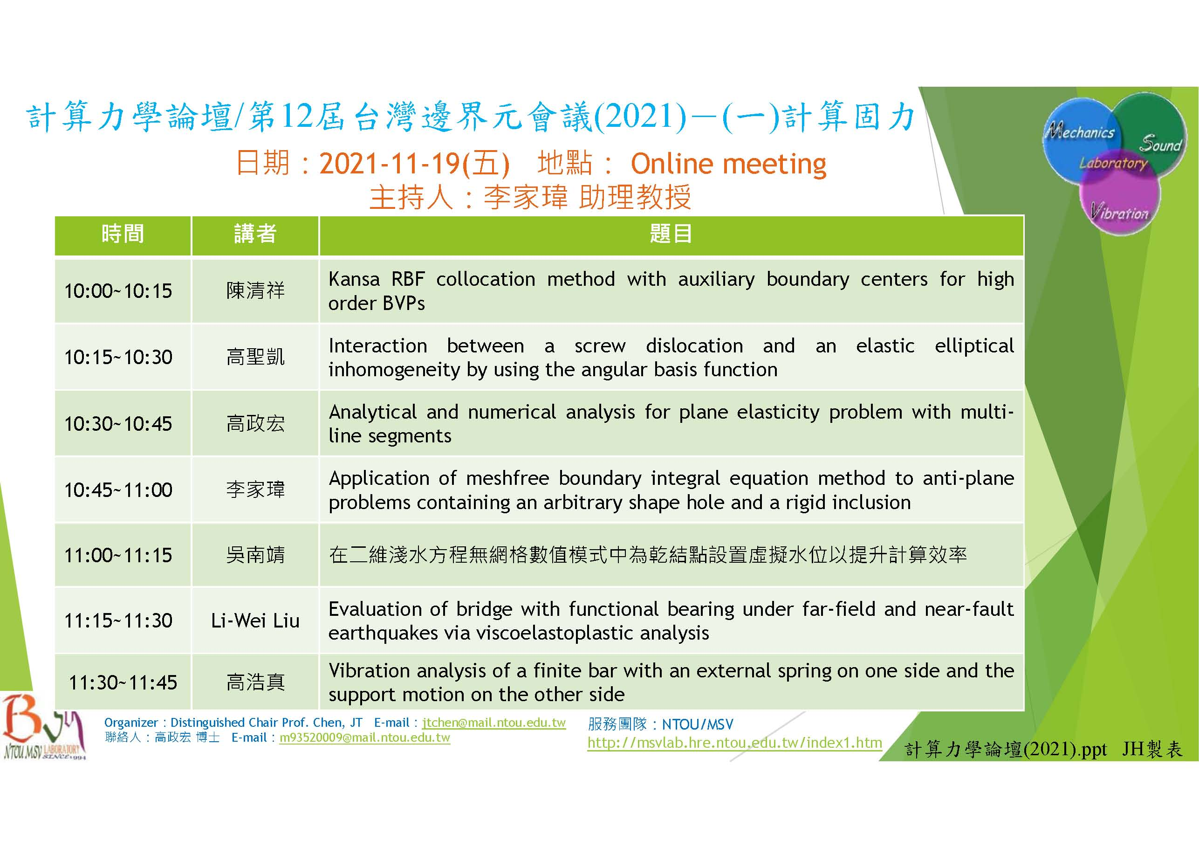
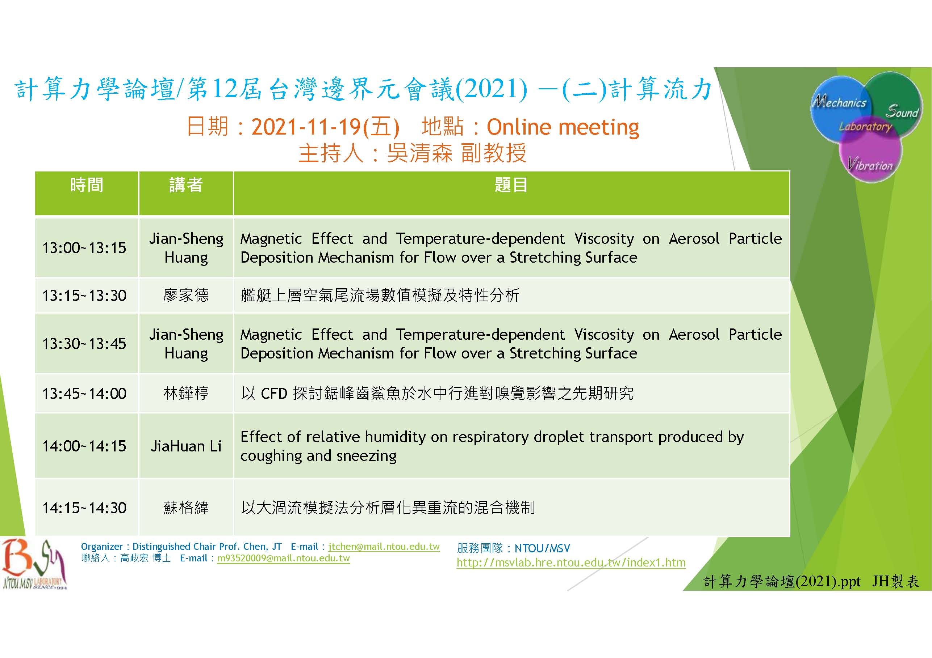
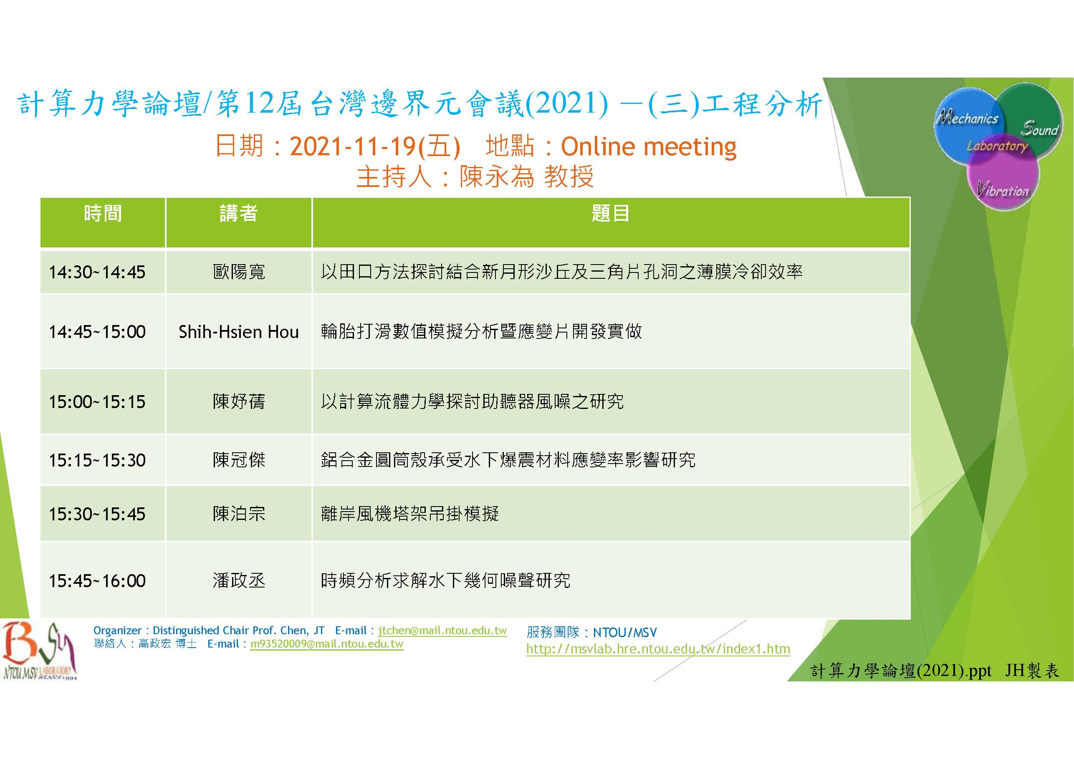
Taiwan BEM/Meshless Meeting (2021)

