Slide 1



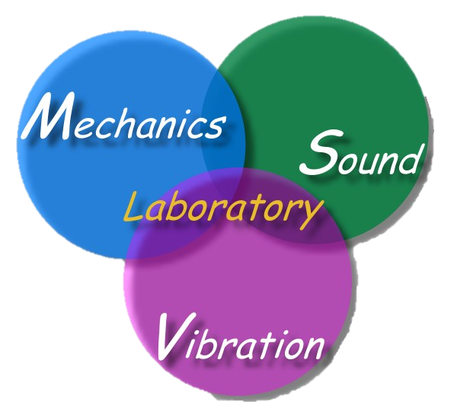
數學力學與計算-邊界元走過四十年 Math., Mech. and Computation (BEM 40 years) (1983-2023)
主講人：陳正宗 特聘講座教授
科技部產學小聯盟 土機海領域召集人
海大河工系 機械系 海工系 台大土木系(客座) 成大土木系(合聘)三校五系教授
STAM & TwSIAM Fellow 數學與力學雙會士
報告時間：112年09月13日（星期三）14:00 – 16:00
報告地點：師範大學 M212
NTNu-math2023.ppt

Slide 2
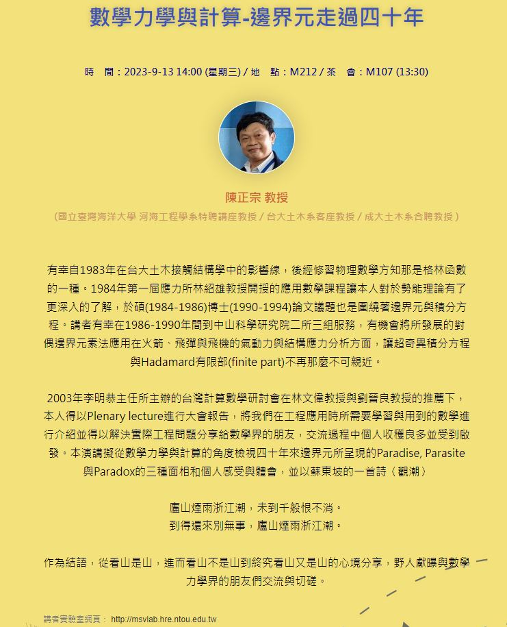


Slide 3
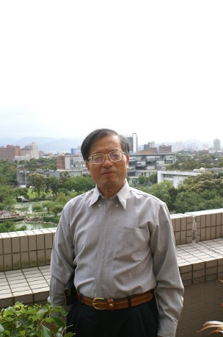
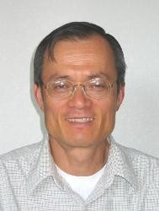
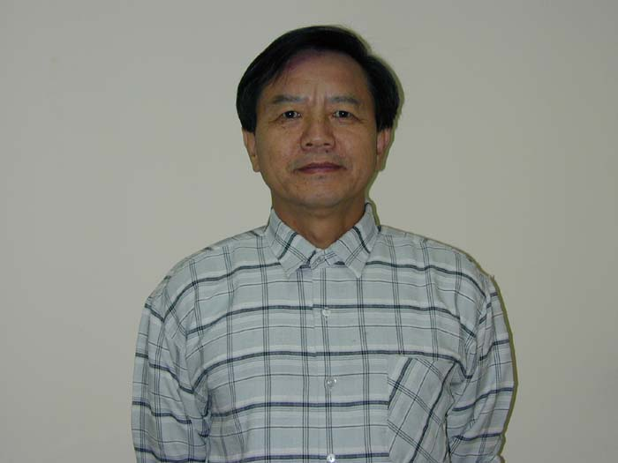

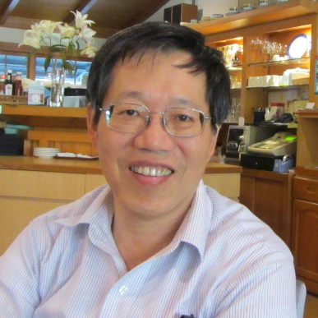
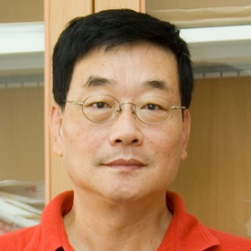
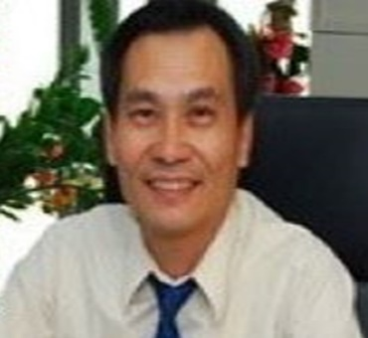
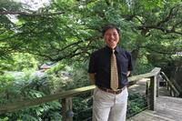
NTOUMSV數學貴人
台大 | 中研院 | 德州農工 | 中山
張國男 | 李志豪 | 陳鞏 | 李子才
交大 | 清華 | 中華 | 台大
林文偉 | 劉晉良 | 李明恭 | 陳宜良

Slide 4
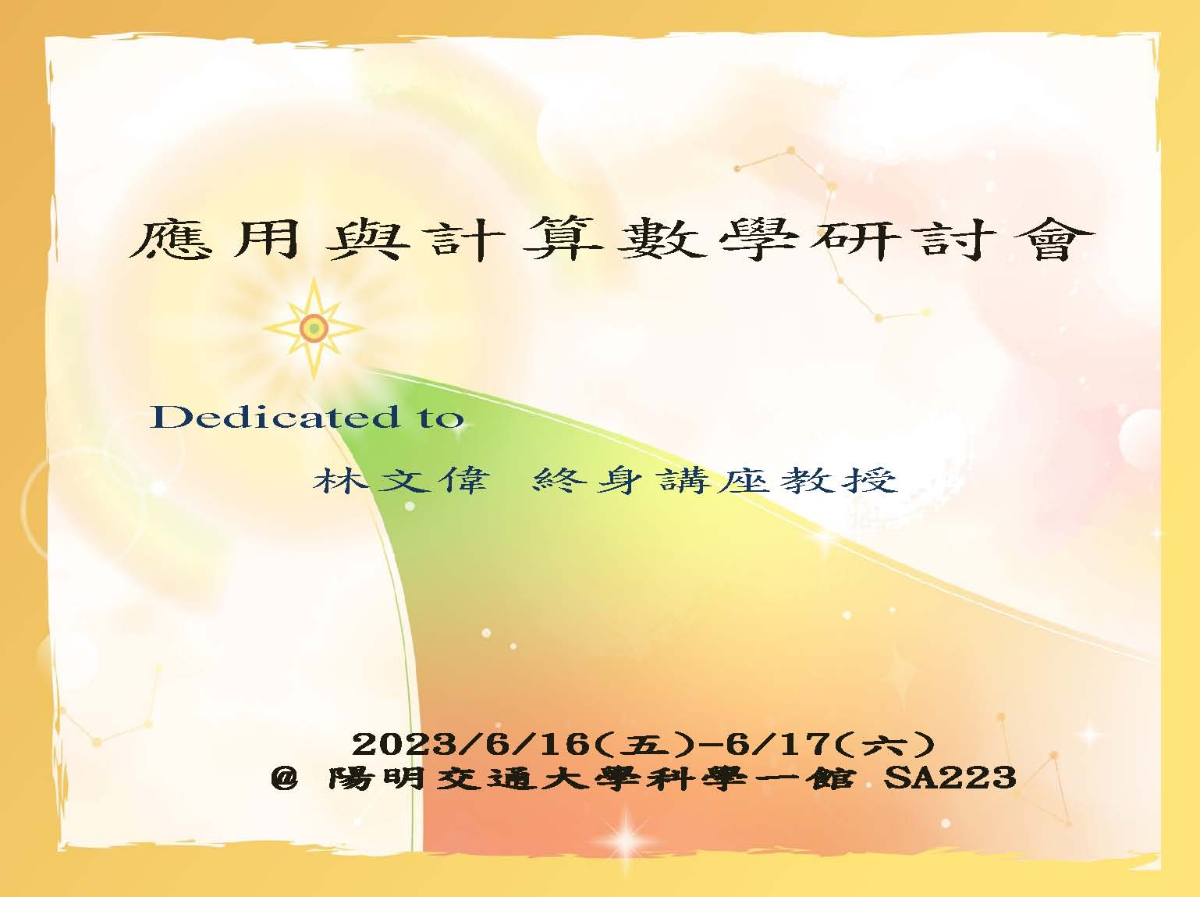
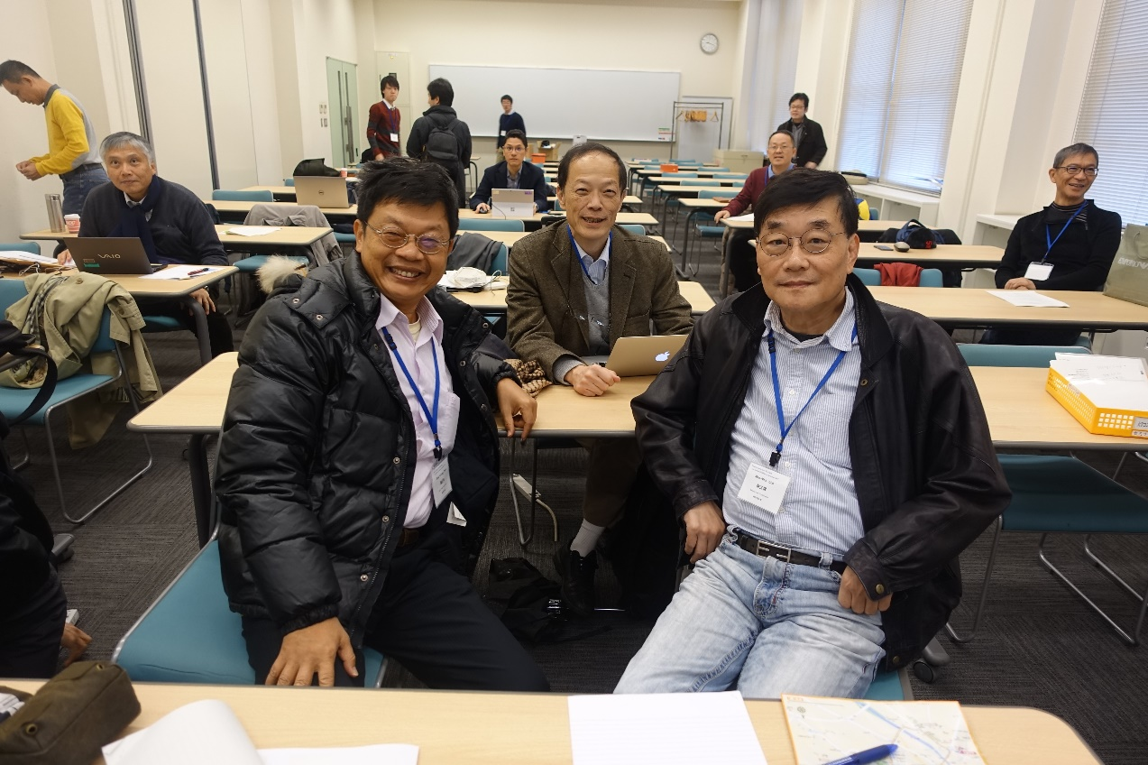
數學貴人: 張國男 李志豪 陳鞏 陳宜良 李子才 林文偉 劉晉良 李明恭 …
(2017)

Slide 5
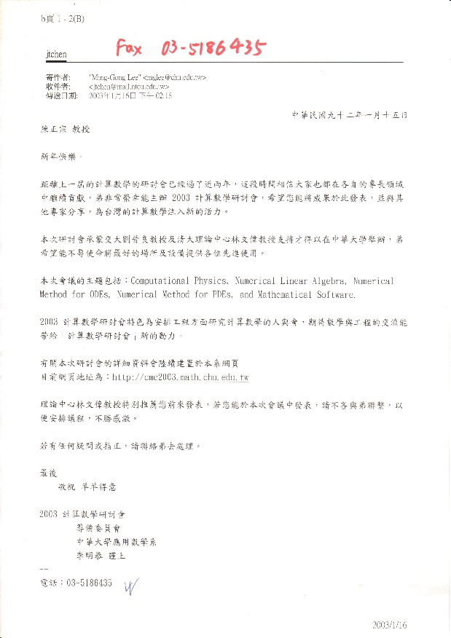
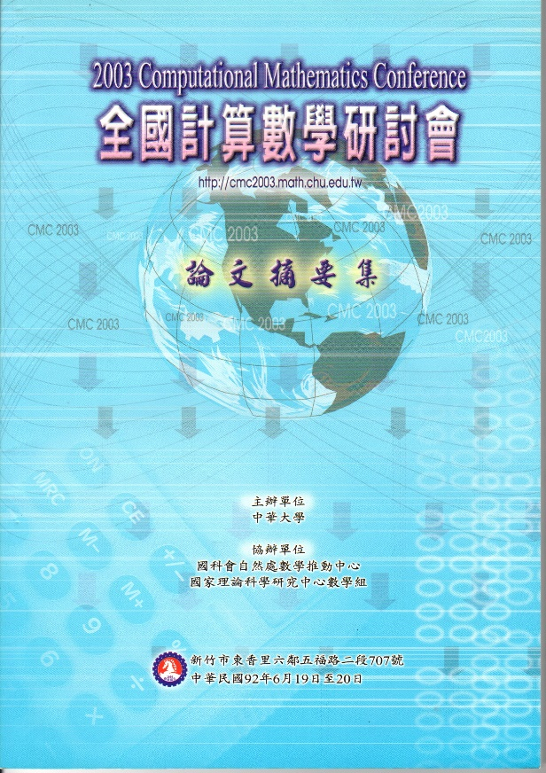
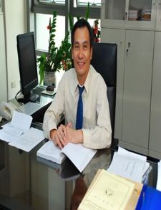
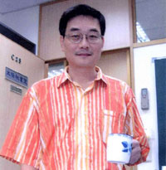
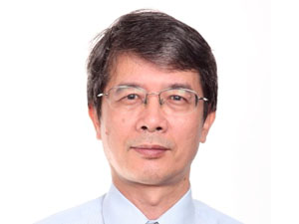
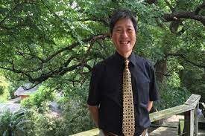


與林文偉老師結緣
(2003)
(1985)
(2003)
File name:一人當選三人服務 (2022) Made by:劉冠辰 Date:111/10/31

Slide 6
注入數學活水 研究多采多姿
Before 與林文偉老師結緣 After
 | Before 2003 | After 2003
SCI papers | 83 | 246
SCI journals | 36 | 83
NSTC Math Grants | 0 | 2
Math friends | Only a few | A lot
Society | 7 | 9
Top 2 % scholar | No | Yes (App. Math.)
Math lectures | No | 台成清交中...
年度 | 計畫題目 | 計畫編號
94 | 多體輻射與散射 | 94-2115-M-019-003
95 | 以退化核求解含夾雜拉普拉斯與赫姆茲方程之系統性解法(兩年案) | NSC 95-2115-M-019 -003 -MY2

Slide 7
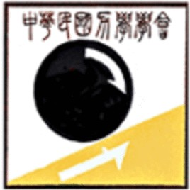




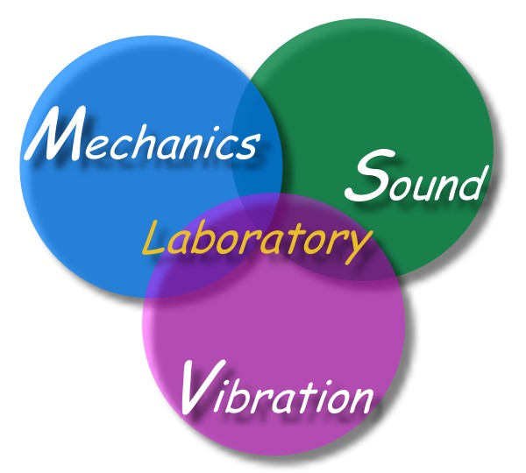







會員編號:
P1266
會員編號:
16924
會員編號:
F00002
中華民國力學學會
中國機械工程學會
理事
正會員
監事
TwSIAM
台灣計算力學學會
監事
永久會員
榮譽會員
中華民國數學會
永久會員
斐陶斐榮譽學會
永久會員
理事
會員編號:
33193
中國工程師學會
振動與噪音工程學會
地震工程學會
NTOU/MSV 學會群 製表by Mei-Na

Slide 8

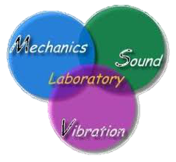




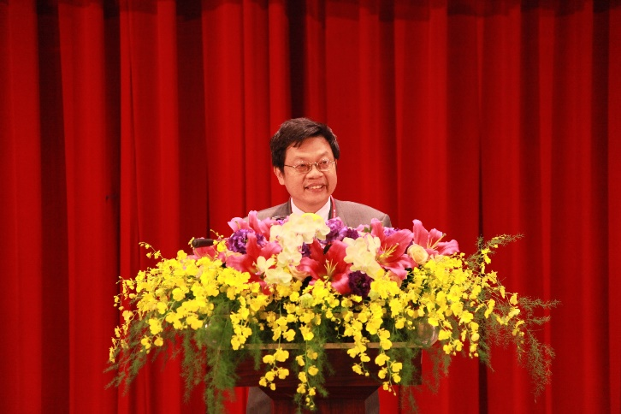




海洋大學
陳正宗
特聘講座教授
台灣大學
陳正宗
客座教授
陳正宗
合聘教授
成功大學
File name:三校五系合聘教授 by Mei-Na

Slide 9
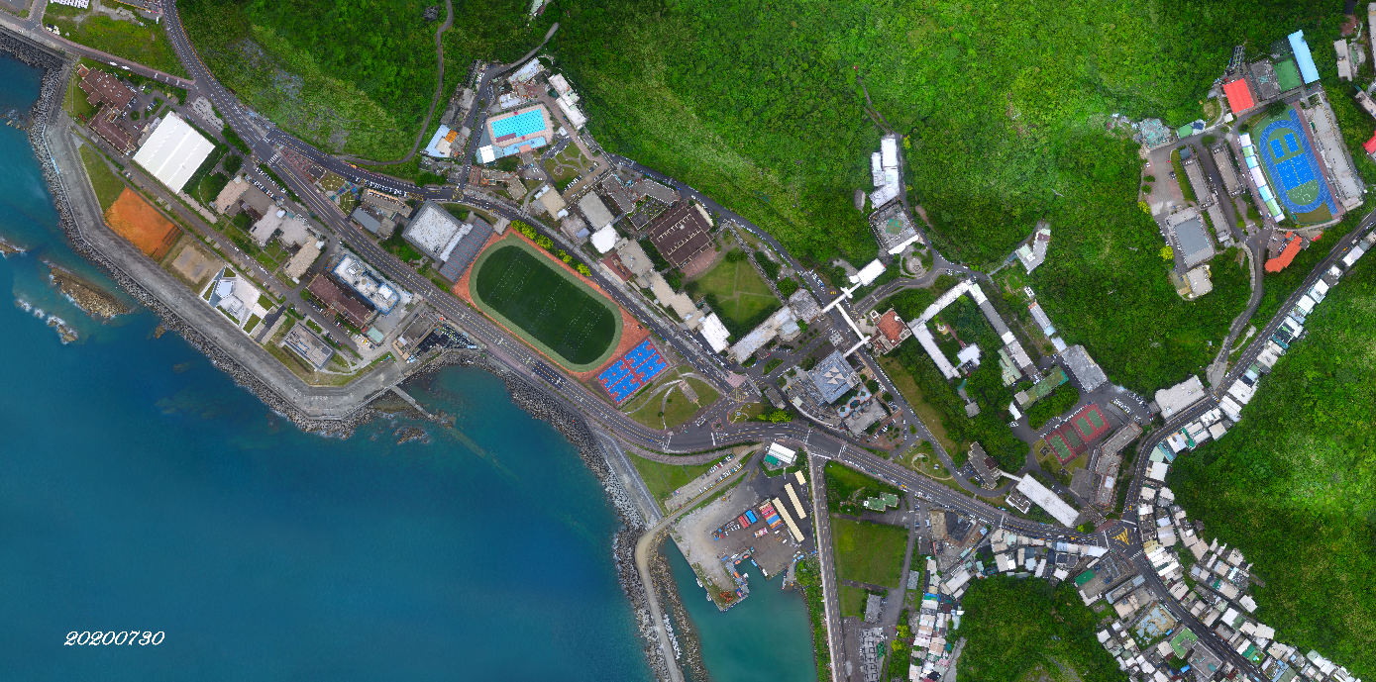
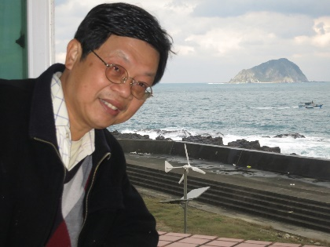



國立臺灣海洋大學河工系 (1994-2023)
第一屆計算力學學會年會
暨第十四屆台灣邊界元會議
洪老師七十大壽慶祝論壇 (Oct. 28-29, 2023)
National Taiwan Ocean University
Harbor & River Engineering

Slide 10

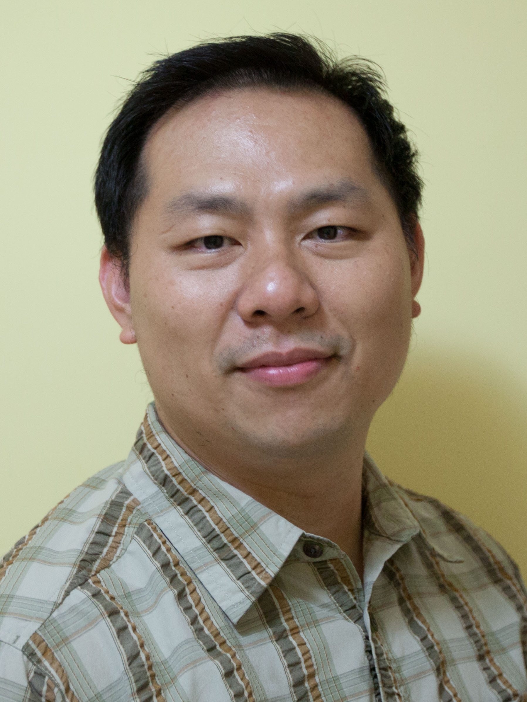
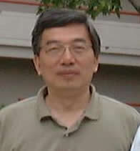
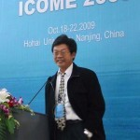
一人聘任 三人服務 學術三代傳承 (2023)
劉立偉助理教授 洪宏基終身特聘教授 海大陳正宗特聘講座教授
(2022 聘任) (2023 退休) (2022-2023 客座一年)
File name:一人當選三人服務 (2022) Made by:劉冠辰 Date:111/10/31

Slide 11









Global MSV Family
NKUST
Chen, I-Lin
NTOU
Chen, Jeng-Tzong
Lee, Ying-Te
NIU
Chen, Kue-Hong
Kao, Jeng-Hong
Wu, Ching-Sen
TKU
Lee, Jia-Wei
NTU
Hong, Hong-Ki
Liu, Li-Wei
NCKU
Liu, Li-Wei
三明學院
Chen, Cheng-Tzong
WUYI
Chung, Yu-Long
LHSTU
Lin, Sue-Ray

Slide 12

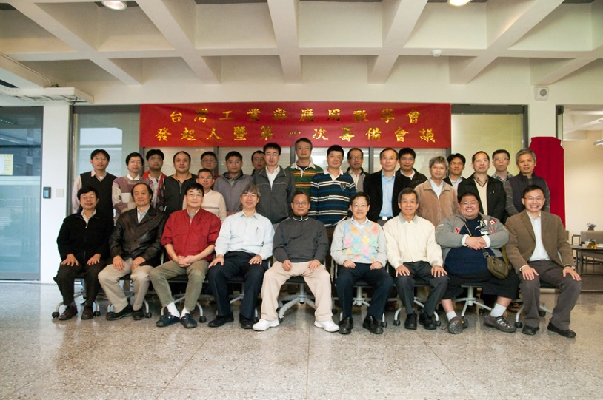
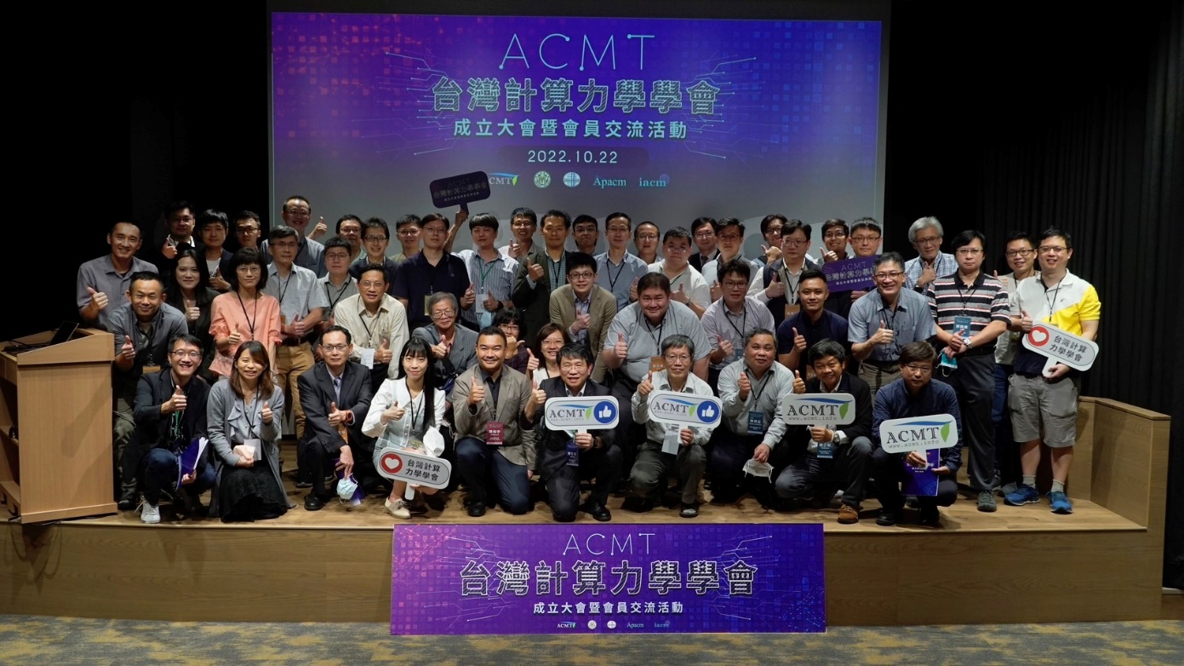

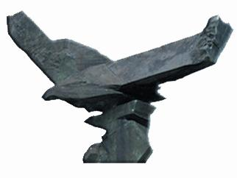

TwSIAM (11 YEARS)
ACMT(1 YEAR)

Slide 13
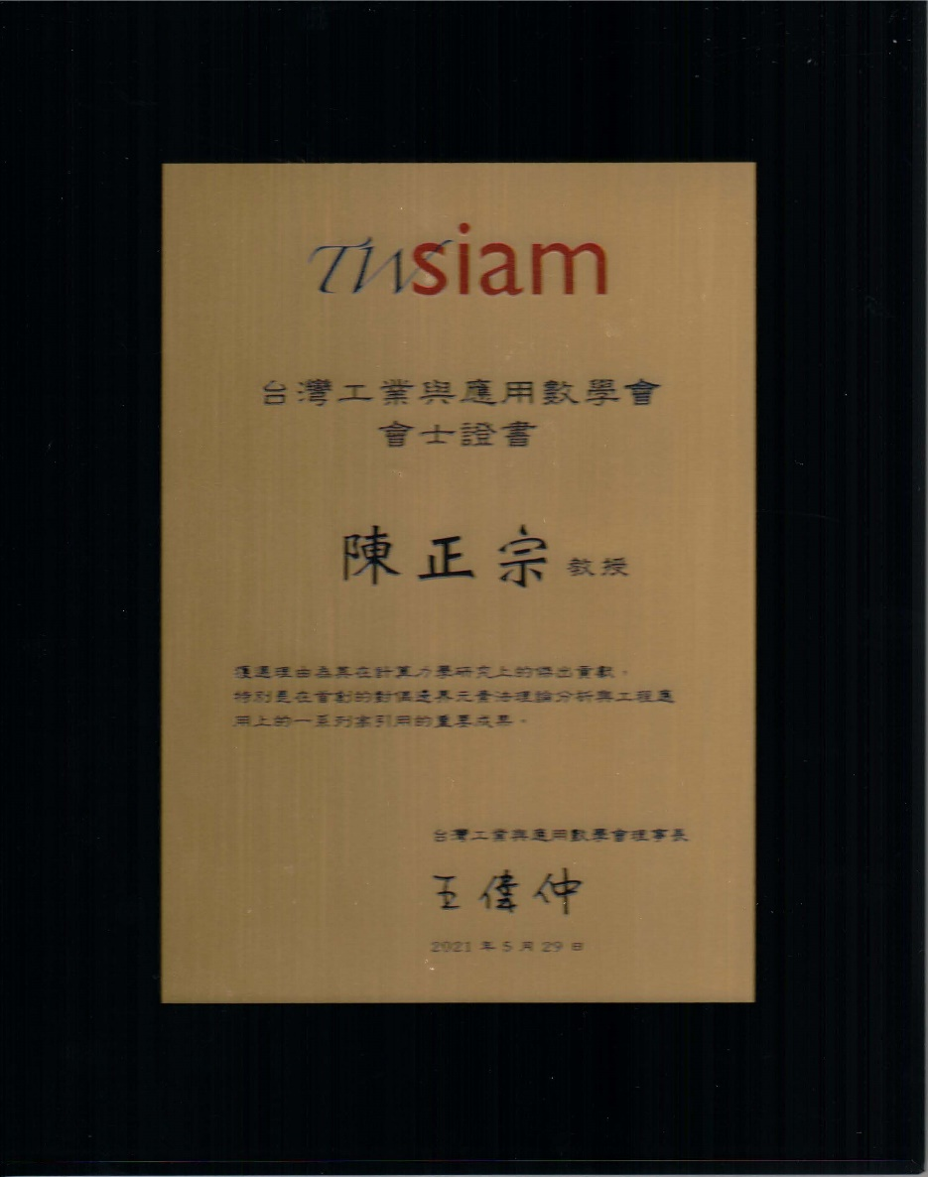
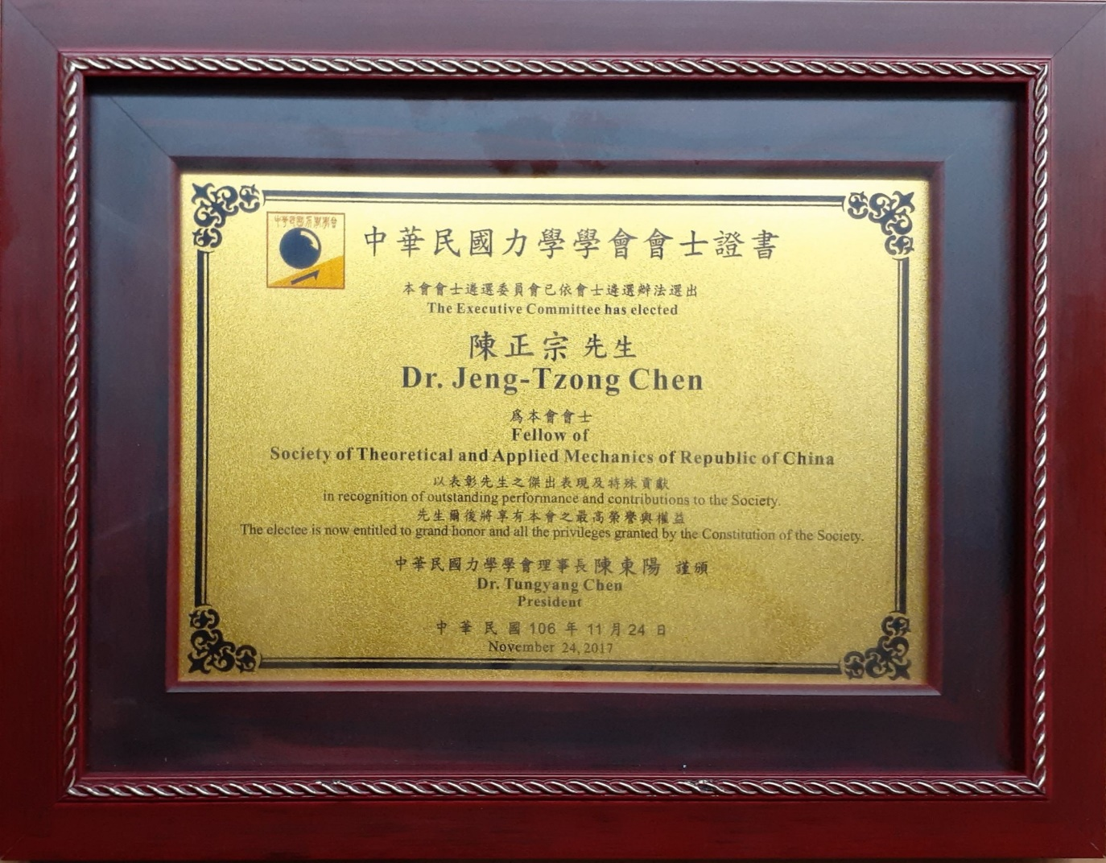
安打定理(數學與力學)
Fellows on Math. (TwSIAM) and Mech.(STAM)

Slide 14



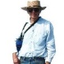
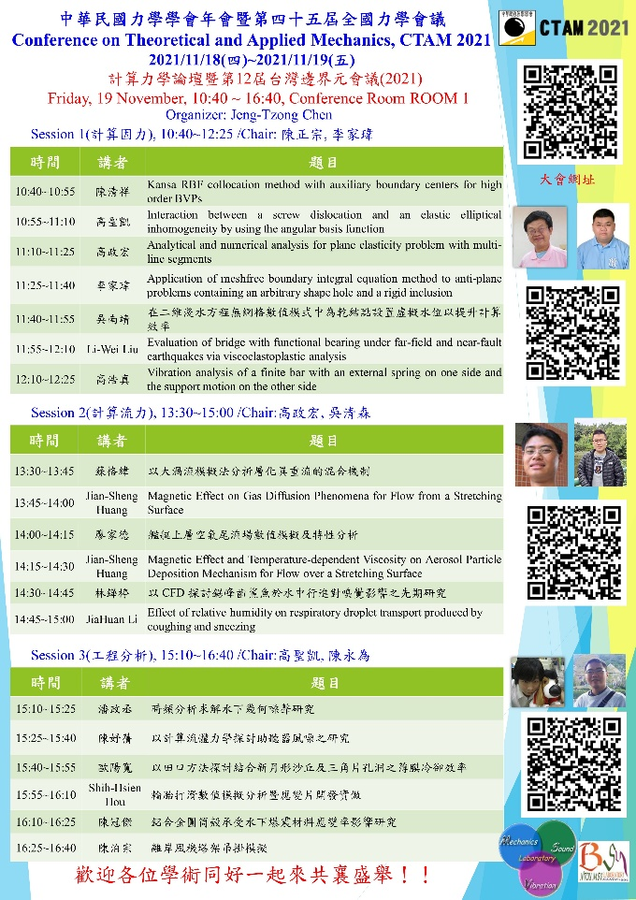













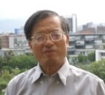










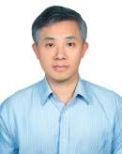
History & Background Taiwan BEM workshop (1986-2021) (TwBEM 12-2021 on line meeting)
Year | The host unit | The organizer | Ceremony | (BEM 11)
1986 | NTU IAM | Prof. Y H Pao | Establishment of NTU IAM | Prof. F J Rizzo
1989 | NTU | Prof. D L Young | NSC | Prof. J A Liggett
1998 | NSC | Prof. J T Chen | NCHC | Prof. A H D Cheng
2010 | NTOU-HRE-MSV | Prof. J T Chen | NTOU-HRE 50th anniversary | Prof. Z C Li
2011 | NCTS(South) | Prof. K M Lee | NCKU 80th anniversary | NCKU
2012 | Feng Chia University | Prof. Y C Shiah | Prof. Hong’s 60th birthday | Prof. H-K Hong
2013 | National Chung Hsing University | Prof. K J Shou | Congratulations for Academicain | Dean S L Crouch Academician,NAE
2014 | National SYS University | Prof. T T Lu | Prof. Young’s 70th birthday | Prof. D L Young
2015 | NCREE (cross strait) | Dr. R Z Wang | NCREE | Cross strait ceremony
2016 | NCTS (Japan-Taiwan) | Prof. J H Lee | NCTS | Prof. H-K Hong Prof. W-W Lin
2017 | NIU | Prof. I L Chern Prof. K H Chen | Ilan Univ | Prof. H-K Hong Prof. W-C Wang
2018 | ISU | Prof. H T Huang Prof. I L Chen | Iso univ. | Prof. D L Young
2019 | NCKU | Prof. L W Liu | Cheng Kung Univ | Prof. J T Chen
2020 | NTOU | Prof. Y T Lee Prof. C M Fan | NTOU-HRE 60th anniversary | Prof. C B Hwu

Slide 15
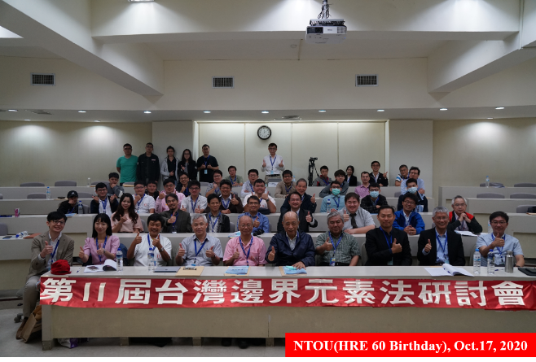
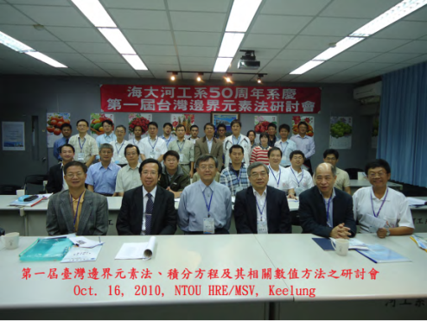
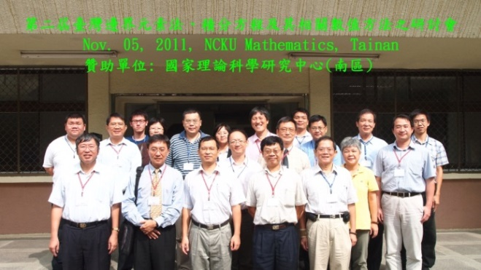
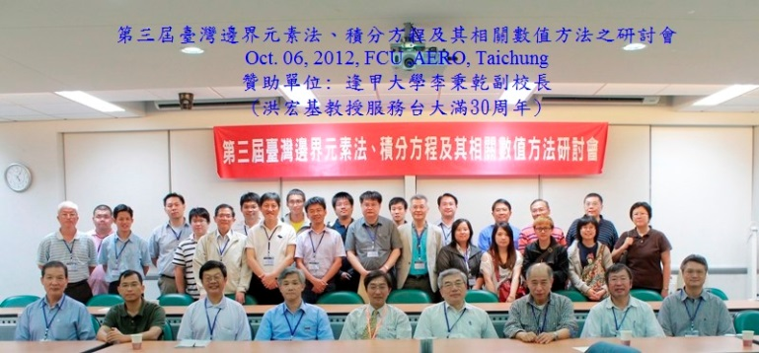
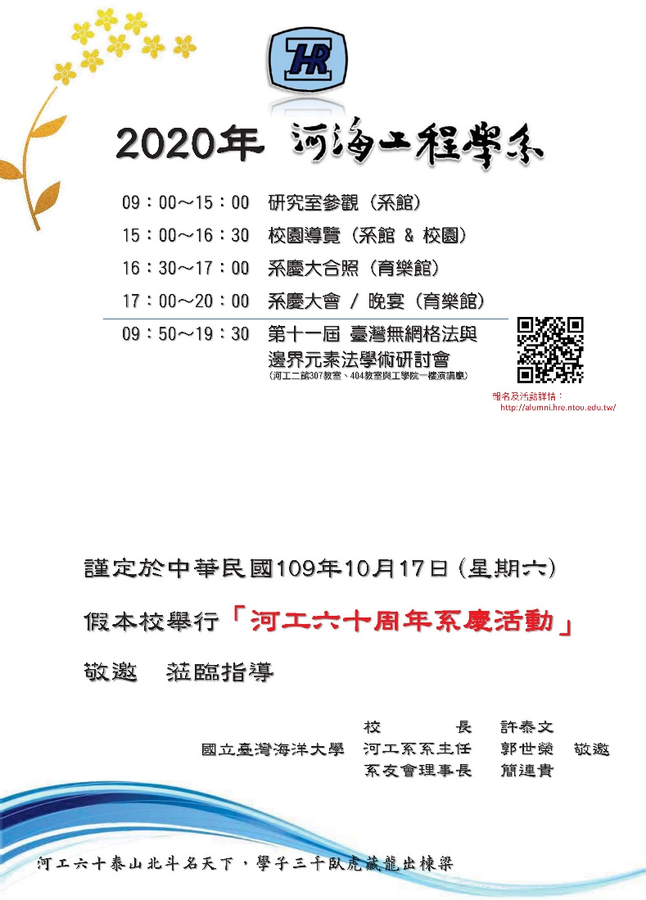
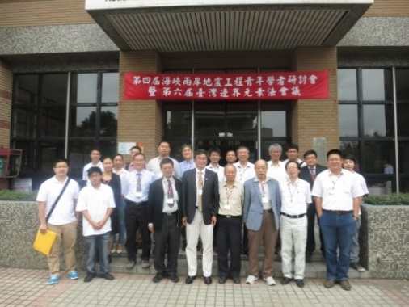
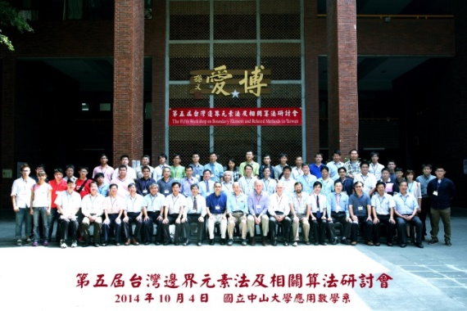
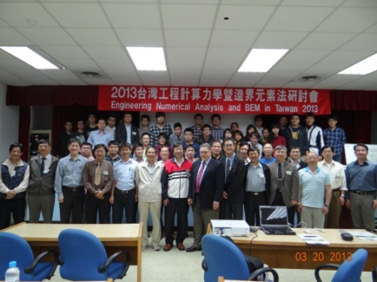
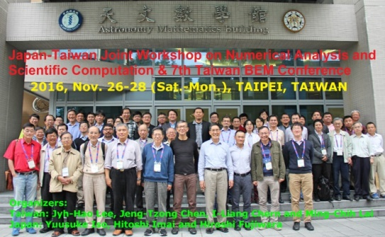
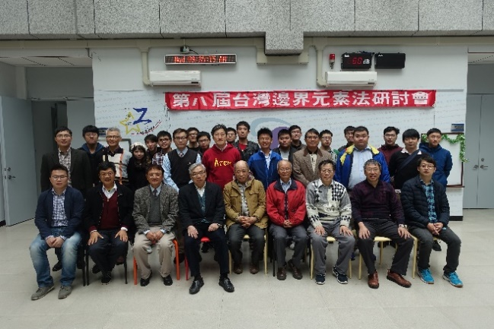
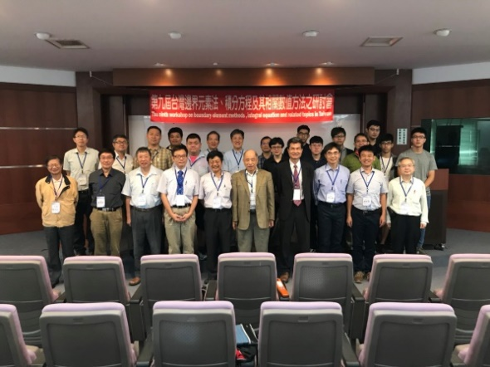
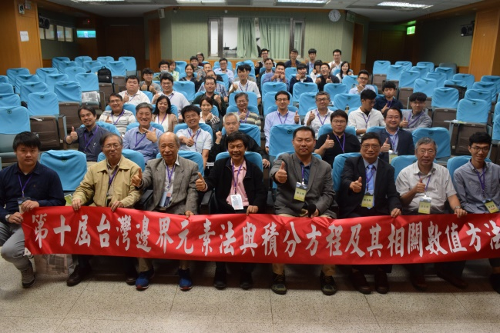
Taiwan BEM/Meshless Meeting (2010-2020)

Slide 16
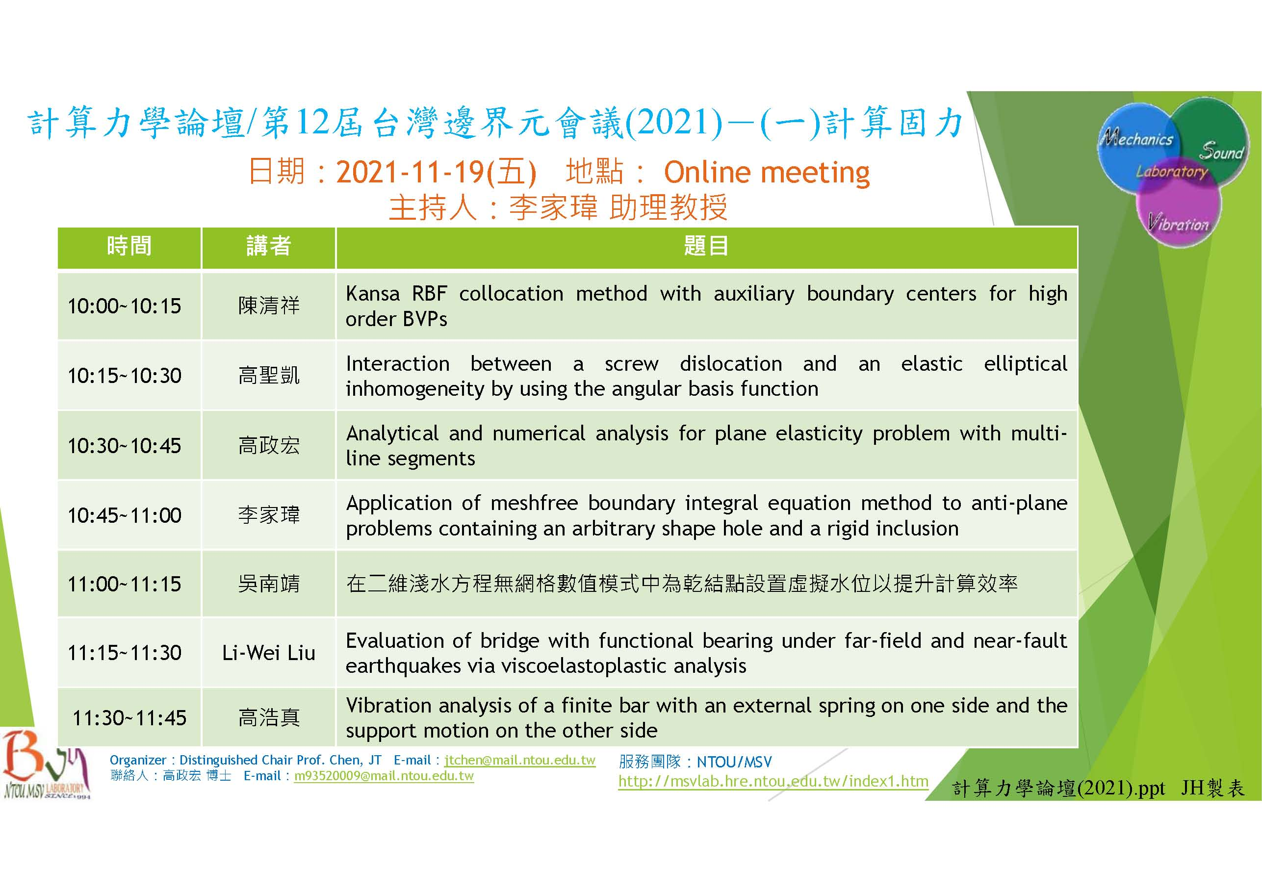
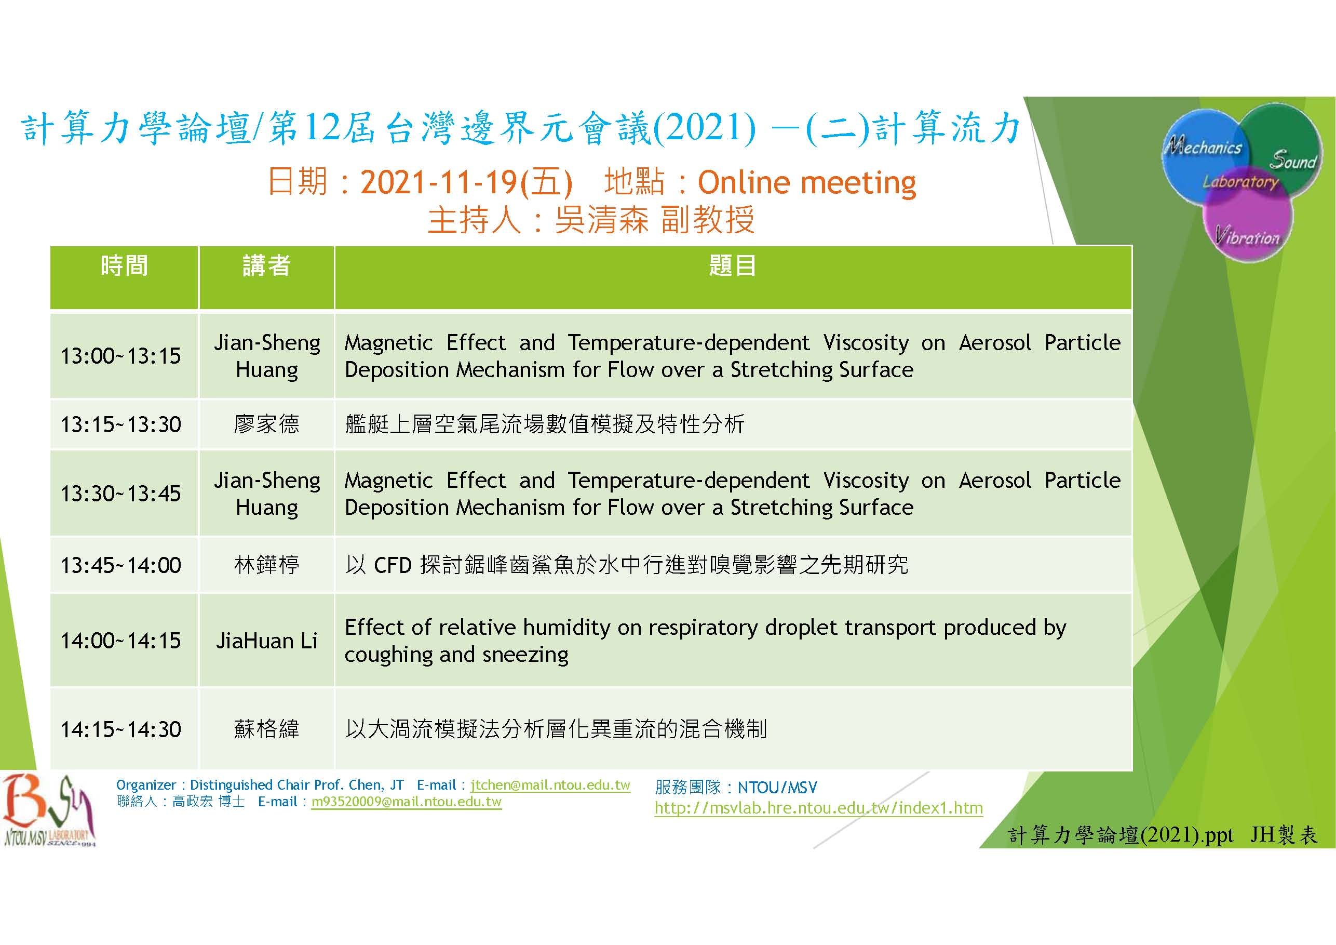
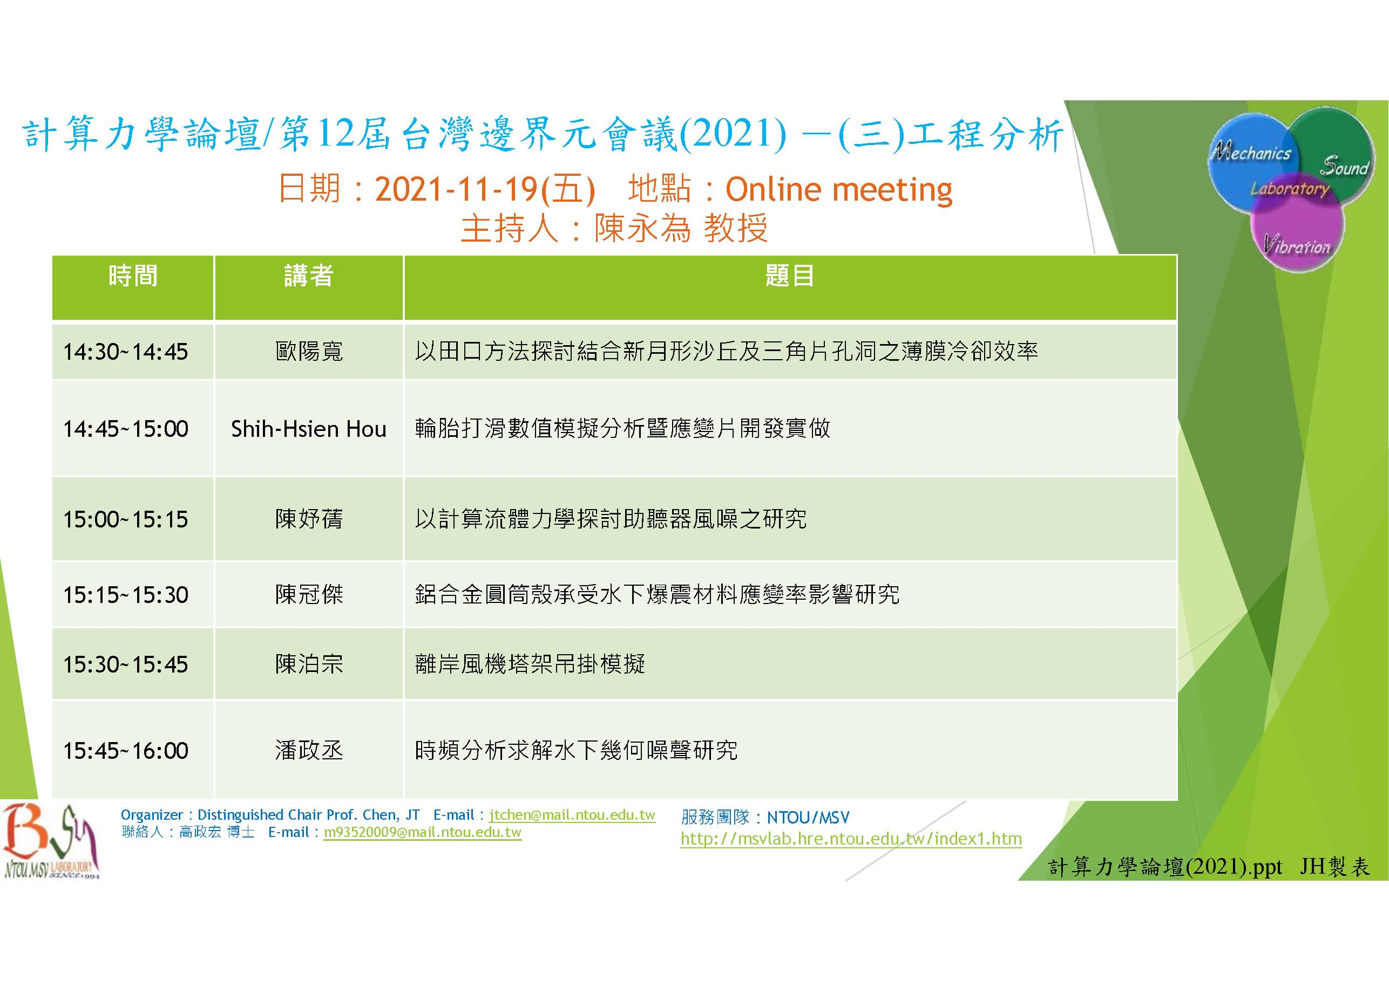
Taiwan BEM 12/Meshless Meeting (2021) on-line

Slide 17
Taiwan BEM 13, 2022 (Since 2010)
國際 IC3MT (Nov. 11-14, 2022) National Taiwan Normal University
Session II Room A (Nov.12, 2022, 14:00-15:30)
國內 CTAM (Nov. 18-19, 2022) 高雄科技大學建功校區
計算力學論壇(Nov.18, 2022, 13:20-14:50)行政大樓行504教室 葉超雄老師紀念演講(曉東講堂)
Authors | Paper Title
Jia-Wei Lee, Yu-An Chuang | Application of meshfree boundary integral equation method to SH-wave scattering problems containing a cylindrical canyon of arbitrary shape
Jeng-Hong Kao, Ting-An Wu, Wen-Chen Tai, Yen-Ting Chou, Jeng-Tzong Chen | Solutions of antiplane shear problems with a crack or a rigid line inclusion by using the indirect BIE
Der Liang Young, Amir Noorizadegan | Study of 3D transient heat conduction in functionally graded materials using a local space-time collocation method
Sonal Nirwal, Chih-Ping Lin, Ernian Pan | Surface waves in piezoelectric-flexoelectric composite plates
Li-Wei Liu, Zih-Ce Ciou | Applications of return-free integration to study on contraction ratios of stainless steel
Speaker | Paper Title
李耘昊 | 泰奧揚森八連桿步行機構之運動與運動靜力分析
謝侑昇 | 無網格邊界積分方程法求解彈性桿的扭轉問題
Chih-Ping Lin | An efficient computation model for layered elastic VTI half-space and its applications in surface wave testing
呂佳鴻 | 外曲式肘節射出機之機構動力特性與強度分析
楊洪聞 | 無網格邊界積分方程法分析熱交換管中的穩態熱傳問題與其退化尺度的探討
戴暐宸 | Analytical study on the Laplace problem of an eccentric domain
吳南靖 | 嵌入質量守恆於流速配點計算之無網格數值模式
Speaker | Paper Title
陳正宗/李家瑋 李應德/高浩真 | Support motion of a finite bar with a viscously damped boundary
海報論文競賽
高政宏 | On the double-degeneracy problem in the indirect BEM
Taiwan BEM 自2010年已邁入第十三屆，今年分國內與國際會議二場舉行，歡迎參加
Filename: Taiwan BEM 13 (Since 2010).ppt Made by HJ

Slide 18
第一屆計算力學學會年會
暨第十四屆台灣邊界元會議 (Oct. 28-29, 2023)
洪老師七十大壽慶祝論壇
邀洪老師師生故舊演講 20~30分鐘
NTOU/MSV 資助演講費 (invited speaker)
洪老師七十大壽慶生
陳正宗、陳桂鴻、劉立偉、李應德、吳清森、李家瑋 協辦
Invited speakers:
洪宏基 潘爾年 楊德良 林聰悟 壽克堅 呂宗澤
夏育群 李明恭 黃宏財 李國明 陳桂鴻 李洋傑
File name: 第一屆計算力學學會年會研討會規劃 by MN

Slide 19


第一屆計算力學學會年會
暨第十四屆台灣邊界元會議
(Oct. 28-29, 2023)
洪老師七十大壽慶祝論壇
File name: 第一屆計算力學學會年會研討會規劃 by MN

Slide 20
邊界元的前生今世
(BEFORE 1969)
大二材料力學 moment diagram(左天雄)
1982 大三結構學 influence line (陳永祥)
Summer : Greenberg
1985 研一 物理數學 Green function (陳俊雄
江衍偉)

Slide 21

V- & M-diagrams & Influence Lines Green`s Functions (Pan 2022 NTOU MSV seminar)
Two-point Green’s function G(x_{f};x_{s}) with fixed source point x_{s} at a and varying field point x_{f} (=x).
Two-point Green’s function G(x_{f};x_{s}) with fixed field point x_{f} at B (x_{f} =a) and varying source point x_{s}.
<x-a>^{n}
x_{s}
P=1 kN
B
•
x_{f}=a
Singularity functions in Mechanics of Materials
Influence lines in Structural Analysis
L
1-a/L
Pb/L
-a/L
V-diagram
Influence line for V_{B}
-Pa/L
Pab/L
a(1-a/L)
M-diagram
Influence line for M_{B}
Notes:
The great Green’s function concept that I learned from my Theory of Structure Course. The Green’s function G(x_{f};x_{s}) is a two-point function with the source point at x_{s} and field point at x_{f}. The following figures explain the difference between Green’s function and the influence line. The major difference between shear and moment diagrams as compared to influence lines is that shear and bending moment diagrams show the variation of the shear and the moment over the entire structure (varying field point x_{f}) for loads at a fixed position (fixed source point x_{s}). An influence line for shear or moment shows the variation of the function at one section (fixed field point x_{f}) cause by a moving load (varying source point x_{s}).

Slide 22

Concentrated Force Solution ≡ Green’s Function
P
x
a
b
Two-point Green’s function of deflection G(x;x₀)
P=1
x₀
x

Slide 23


An Example of Direct Application of The Green’s Function
x₀
dx₀
Notes:
Checked and the result is correct

Slide 24




計算硬體capability與計算軟體efficiency (硬體軟體本一家 分不開)
鮑亦興院士(1930-2013)
How old are you ? 計算尺 >70
求積儀 >60
`
計算硬體
算盤 求積儀 計算尺
計算機VAX8600 電腦
求積儀 (Gauss 定理 從邊繞來算 面積分>>>線積分)
珠算口訣 +1 – 5 (-4)
1930年1月－2013年6月18日
(上海交通大學 台灣大學)

Slide 25

計算硬体capability與計算軟體efficiency
算則的重要(Numerical algorithm)
1+2+ … + 100 (土法煉鋼 >>>Gauss 從頭尾和算)
求積儀 (Gauss 定理 從邊繞來算 面積分>>>線積分)
有限元素法(FEM >>> BEM)邊界元素法
邊界的觀念
處處是高斯 ?
算面積
>>>

Slide 26

求積儀 VCR
>>>
求積儀 (Gauss 定理 從邊繞來算 面積分>>>線積分)
有限元素法(FEM >>> BEM)邊界元素法
算面積

Slide 27


求積儀(3.14159) 台北科教館 March 14, 2021
>>>
https://sites.google.com/g2.nctu.edu.tw/taiwan314/?fbclid=IwAR0z0N1K3zFDsFmBbhbCnm2GQAB_v1HB4SoI7vTGM2N3-exs6SBYWqX3NOk
林俊吉教授
中華民國數學會副理事長

Slide 28



求積儀(3.14159) 台北科教館 March 14, 2021
>>>

Slide 29

求積儀客觀性(求積儀隨便擺)
(Frame indifference and objectivity)

Slide 30






求積儀繞一圈計算面積-(2013力學營學員分享)
圖形 | 面積 (用計算機計算) | 求積儀繞一圈
橢圓
 |  | 面積誤差
長方形
 |  | 面積誤差
 |  | 面積誤差
圓形
 |  | 面積誤差
橢圓
感謝中華顧問
每年贊助150 萬
舉辦力學營
(2010-2016)
長方形
正三角形
圓形

Slide 31

輪機在船上:早期在計算指示馬力
(海大輪機系友 NTOU/MSV 陳義麟博士 提供)
(台大造船辛敬業繪製船圖 計算船體幾何特性)

Slide 32



求積儀的故事(士農工商) NTOU/MSV edited
1. 台大土木系 (陳正宗 1984畢)
大二測量實習算醉月湖面積
2. 台大造船系 (辛敬業 1982畢)
大四繪製船圖時，進行各種幾何特性計算
3. 海大輪機系(陳義麟 1977畢)
輪機課時計算船體指示馬力
4. 台大數學系 (陳宜良 1975畢)
Mechanical calculation
5. 台大農藝系 (磯永吉教授 Iso 先生 1886-1972)
感謝Phi Tau Phi 學會贊助演講，獲得以上交流成果
File name: 求積儀的故事 by Mei-Na

Slide 33
邊界元走過四十年
(1983-2023)

Slide 34




搞計算教工數 一輩子 逃不了 高斯的手掌心
刪繁就簡三秋樹
領異標新二月花
Why BEM (Advantage)
~鄭板橋
B
Gauss
1+2+3+...+100=?
$$\frac{(1+100)×100}{2}$$
Area = ?
Area
B
Planimeter
3D
BEM
2D
B
Gauss' theorem
Green's identities
Somigliana identity

Slide 35



Overview of numerical methods
Numerical Methods
Mesh Methods
Meshless Methods
Null-field BIEM
Finite Difference Method
Finite Element Method
Boundary Element Method
Degenerate kernels
Difference Equation
PDE- variational
Integral Equation
把
脈
針
灸
開刀
Page 35

Slide 36





BEM/BIEM與``辟(B)``法 邊界元素法 境界要素法
避
僻
壁
璧
臂
辟法
B法

Slide 37


邊界元素法精神
.
.
.
觸類旁通
(boundary to boundary)
旁觀者清(Boundary)
當局者迷(Domain)
.
.
旁敲側擊(Trace)
鞭辟入裡
(Boundary to domain)
Filename: 邊界元素法精神.ppt 浩真製表

Slide 38









Paradise 三軍五行
V-band
金
水
木
火
土
breakwater
Army
Navy
Air Force
Seepage
Rocket
Noise wall

Slide 39

裂縫成長 Crack growth
FEM since 1963
Remesh near tip
BEM since 1969
Subdomain BEM, 1981, Ingraffea
Dual BEM (MIT) since 1986
Hong and Chen, 1988
Chen and Hong, 1999

Slide 40


Seepage (sheet pile)
A K Chugh, US Bureau of Reclamation (USBR), USA

Slide 41
Degenerate boundary
geometry node
(-1,0.5)
(1,0.5)
7
4
the Nth constant
or linear element
N
6
5
8
3
(0,0)
1
2
(-1,-0.5)
(1,-0.5)
5(+) 6(+)
5(+) 6(-)
5(+)
6(+)
dependency
5(+)
6(+)
5(+) 6(+)
5(+) 6(-)
5(+)
6(-)
5(+)
6(-)
Nonuniqueness

Slide 42
How to get an additional constraint
The number of constraint equation is not enough to
determine coefficients of p and q.
Another constraint equation is obtained by differential operator
42

Slide 43


Dual BEM results and experiment data by NTOU
Thin breakwater
(degenerate
boundary)
W K Weng and C Y Yueh
(1.7-mm thick)
d/h = 0.2
BEM
Dual BEM

Slide 44

OCEAN Lab at HRE, NTOU (Weng W K)

Slide 45




Taiwan-India joint work on breakwater using the dual BEM (2022-2023)
C.S. Nishad, S. Neelamani, J.T. Chen, and K.G. Vijay, 2023, Gravity Wave Interaction with Cage Enveloped Breakwaters using DBEM, Z Angew Math Mech (ZAMM), Revised.
K.G. Vijay, C. S. Nishad, S. Neelamani, and J.T. Chen, 2021, Dual BEM for Wave Scattering by a H-Type Porous Barrier with Nonlinear Pressure Drop, Engineering Analysis with Boundary Elements, Vol.131, pp.280-294.

Slide 46
Dual Integral Equations by Hong and Chen(1984-1986)
Singular integral equation
Hypersingular integral equation
Cauchy principal value
Hadamard principal value
(Mangler principal value)
Boundary element method
Dual boundary element method
1969
1986
normal
boundary
degenerate
boundary
NTUCE
Ó

Slide 47


Liggett and Liu (1983)
The singularities that occur when the base point and field point coincide are not integrable ???
Multi-domain BEM, Ingraffea 1981
(before 1983)
J C Nedelec 1982
Google citing
1728
Google citing
574

Slide 48







Degenerate Terminology 退化?
Degenerate eigenvalue | Degenerate scale | Degenerate boundary | Degenerate kernel
a<1
$${Γ }^{−}$$
$${Γ }^{+}$$
a=1
$$U\left(x,x\right)=\left\{\begin{aligned}P\left(x\right)Q\left(s\right), \left|x\right|>\left|s\right| \\ P\left(s\right)Q\left(x\right), \left|x\right|<\left|s\right|\end{aligned}\right.$$
$${Γ }^{+}$$
a>1
$$\iint{U\left(x,s\right)}db(x)db\left(s\right)=\int{P\left(x\right)}db(x)\int{Q\left(s\right)}db(s)$$
$${Γ }^{−}$$
(2.1) (1.2) modes eigenvalues 相同
eigen mode 不同

Slide 49



Solid rocket motor (Army工蜂火箭)

Slide 50


Shong-Fon II missile (Navy)
Thin airfoil
(degenerate boundary)

Slide 51



IDF (Air Force)
Thin airfoil
(degenerate boundary)

Slide 52



V-band structure (Tien-Gen missile)

Slide 53


Citing records of dual BEM
(updated Sep. 09, 2023)
Chen and Hong, 1999
ASME-AMR
Hong and Chen, 1988
ASCE-EM
Google: 423
Google: 479

Slide 54










3 Para~ over 30 years
Fictitious frequency
Spurious eigenvalue
3D→2D
Infinite domain
Stress concentration
Fracture and fatigue
Paradise
(1988-1998)
Parasite
(1998-2008)
Dependency
Degenerate scale
Degenerate boundary
Resonance
Levy’s problem
( From T.C.T. Ting )
Paradox
(2008-2018)
Degenerate scale

Slide 55





Paradise of BEM (1984-2000)
3D→2D
Infinite domain
Paradise
刪繁就簡三秋樹
鄭板橋
領異標新二月花
Stress concentration
Fracture and fatigue

Slide 56
Parasite of BEM (2000-2022)
Minimum singular value
t(a,0)
Rank-deficient systems
0/0
Radius
Mechanics Research Communications
Fictitious frequency
Pitfall
Parasite
Degenerate scale
Engineering Analysis with Boundary Elements
Dependency
Spurious eigenvalue
Degenerate boundary
International Journal for Numerical Methods in Engineering
Thermochimita Acta
Parasite of BEM.pptx made by York

Slide 57

Some Paradox (NTOU/MSV)
Scale degeneracy (BIEM)
Frequency degeneracy (Resonance)
Angle degeneracy
質點位移 隨時無窮大
Degenerate scale
Levy’s problem
Degenerate scale
( T.C.T. Ting 丁啟財)
時，解為無限大.
0.78760
0.93040
此時可加一補解，使得
wedge內應力處處無窮大
補 reasonable eigensolution
Unique solution
Nonunique solution

Slide 58



(Hangzhou: paradise in the world) (U(x,s):parasite in the BEM)
BEM/BIEM (Disadvantage: Failure)
Match maker (ask for help)
Engineering
problems
Test function
Fundamental sol.
Green function
PDE and IE are
not equivalent
PDE model
IE model(BEM)
Existence
unique solution
Degenerate scale
Degenerate boundary
Spurious eigenvalues
Fictitious frequency
Nonunique solution
Fredholm alternative theorem
Range deficiency
Rank deficiency
Singular matrix
Infinite solution (Not sufficient)
引狼入室
(set a fox to keep geese)
No solution (Not necessary)

Slide 59
邊界元素法
阿基里斯腱
BEM/BIEM
achilles
tendon

Slide 60


邊界元素法 阿基里斯腱
BEM/BIEM achilles tendon
Failure of BIEM/BEM
for the special case

Slide 61

Analytical derivation (Objectivity)
dimensionless argument
Degrees
Laplace equation
Rad
Lin and Wu (2007), Journal of the Mathematical Society of the Philippines
林琦焜 吳恭儉
radius
arc

Slide 62




Null space of influence matrices in the BEM Stupid Chen paid more than 40 years (from 1981 to 2023) to understand one book cover of Master Strang book May 15, 2023
Paradise, parasite and paradox in the dual BEM (U, T , L and M matrices)

Slide 63
Message from Gilbert Strang May 15, 2023 last lecture
Dear NTOU/MSV people,
Thank you for such a generous message ! I am very happy
that you approve of the final lecture -- I wasn't sure what to say . I am so fortunate to have the chance to teach at MIT and also to have the lectures for Math 18.06 and 18.065 on Opencourseware ocw.mit.edu . It is neat that you found applications for the 4 subspaces figure.
Linear algebra is a beautiful subject --- and teaching is a beautiful life.
I hope all your work and your life goes well !
Very best wishes
Gilbert Strang May 17, 2023

Slide 64






NTOU/MSV 與 MIT 大師 結緣 1989 BEM 11 J J Connor 1995 S H Crandall Gilbert Strang May 15, 202`3 last lecture

Slide 65





Mapping diagram of Strang
No. | Year | Author | Book or paper | Title | Status
1 | 2016 | Gilbert Strang | Book | Introduction to Linear Algebra (5th edition) | Appear
2 | 2021 | YL Huang | TAFM | Study on the stress intensity factor and the double-degeneracy mechanism in the BEM/BIEM for anti-plane shear problems (double degeneracy) | Appear
3 | 2021 | WC Tai | CPAA | An indirect BIE free of degenerate scales (degenerate scale) | Appear
4 | 2021 | CH Shao | EABE | On the role of singular and hypersingular BIEs for the BVPs containing a degenerate boundary (degenerate boundary) | Appear
5 | 2022 | JH Kao | JE | Study on the double-degeneracy mechanism of BEM/BIEM for a plane elasticity problem with the line segments (double degeneracy) | Appear
6 | 2023 | JH Kao | EABE | Are the direct and indirect BEM/BIEMs equivalent ? | Under review
1
2
3
4
5
6
File name: Mapping diagram of Strang Made by T.L.

Slide 66











太極
Real variable
兩儀
Complex variable
四相Quaternion
八卦Clifford
ASCE, 1988
(324 citings)
2018
2016
2000
2013
NTOU/MSV
J. T. Chen
NCKU/MSV
L.W. Liu
ASME, 1999
(398 citings)
NTU/MSV
H.-K.Hong
TKU/MSV
J.W. Lee
2015

Slide 67


八卦邊界元
Bagua boundary element method
Real variable BEM
Complex variable BEM
八卦
BEM
Clifford algebra valued BEM
Quaternion valued BEM

Slide 68










Numerical instability of BEM/BIEM
Statics (rigid line inclusion) 2D Laplace equation | Dynamics (time-harmonic) Helmholtz equation | Statics (heat conduction) 2D Laplace equation
Degenerate scale | Fictitious frequency | Degenerate scale
($l=2.37291$)
[$l=2.37105$]
Exchanger tube conduction shape factor
radiation and scattering
Stress intensity factor
File name:Numerical instability of BEMBIEM by PH

Slide 69


心得分享(黃文生)
本無菩提樹
明鏡亦非台
本來無一物
何處惹塵埃
時時勤拂拭
勿使惹塵埃

Slide 70

1984-2023 研究近四十年
分享蘇東坡心境
廬山煙雨浙江潮
未到千般恨不消
到得還來別無事
廬山煙雨浙江潮

Slide 71
Take home parameters
Paradise parasite PARADOX
Take home poems
蘇軾觀潮 惠能悟禪
File name:一人當選三人服務 (2022) Made by:劉冠辰 Date:111/10/31

Slide 72

邊界元 來結緣 Line group 學術俱樂部
(我們不是邊緣人)

Slide 73



Thanks for your kind attention
感謝 陳建隆 講座教授與陳界山院長 邀請
URL:http://msvlab.hre.ntou.edu.tw/ Since 1999
U tube: https://www.youtube.com/watch?v=1d3xr9zdFGg Since 2015
E mail: jtchen@mail.ntou.edu.tw
Google citing: http://scholar.google.com/citations?user=CcL1xQoAAAAJ&hl=en

Slide 77





Dual BEM, DDM and Dislocation theory
Dual BEM
Hong and Chen (ASCE, 1988)
-a
a
0
∞
DDM
Crouch S.L. (1983)
Dislocation theory
Neuber-Papkovitch function
Higher order element
by Shou K.J.

Slide 78





Paradox in mathematics and mechanics (1986-2019)
Elasticity
BIEM
Harbor
Levy’s problem
Harbor resonance
Degenerate scale
( From T.C.T. Ting )
莊子 日取一半尺
Zeno 人賽不過龜
有限體積無限表面積

Slide 79
Some Paradox (NTOU/MSV)
Angle degeneracy
Scale degeneracy (BIEM)
Frequency degeneracy (Resonance)
質點位移 隨時無窮大
Degenerate scale
Degenerate scale
0.78760
0.93040
時，解為無限大.
wedge內應力處處無窮大
此時可加一補解，使得
補reasonable eigensolution
Unique solution
Nonunique solution

Slide 80
Taiwan role on BEM
Project | Roles
EABE IF=2.138 Best Paper Award since 2018 | Editor-in-Chief: Alexander H. D. Cheng Associate Editors: J. T. Chen (2008~2016, 2020~) Editorial Board: D.L. Young & C M Fan
Rizzo Award | Committee: J. T. Chen (only five in the world)
BEM/MRM | Committee: Alexander H. D. Cheng & J. T. Chen
Beteq | Y.C. Shiah
ICOME | J. T. Chen
Taiwan role on BEM.ppt by KT

Slide 81








NTOU/MSV Editorial Staff 2021 (Associate Editor: Chen J T)
Taylor & Francis
I.F. 0.667/Q4
Elsevier
I.F. 2.884/Q1
Oxford Univ. Press
I.F. 1.293/Q4
Elsevier, 2021
I.F. 1.293/Q4
Exective Editor
(1999-2001)
Secretary
Secretary
Secretary
Jeng-Hong Kao
高政宏
Yi-Ling Huang
黃乙玲
Shing-Kai Kao
高聖凱
Filename:Associate Editor-2020 by 蘇祉瑜 2020.10.13

Slide 82






BEM Power in the world (NTOU/MSV)
5
1
3
2
4
Top five
China | Iran | United States | Taiwan | United kingdom

Slide 83

History & Background Taiwan BEM workshop (1986-2020) see you in TKU (BEM 12-2021)
Year | The host unit | The organizer | Ceremony | (BEM 11)
1986 | NTU IAM | Prof. Y H Pao | Establishment of NTU IAM | Prof. F J Rizzo
1989 | NTU | Prof. D L Young | NSC | Prof. J A Liggett
1998 | NSC | Prof. J T Chen | NCHC | Prof. A H D Cheng
2010 | NTOU-HRE-MSV | Prof. J T Chen | NTOU-HRE 50th anniversary | Prof. Z C Li
2011 | NCTS(South) | Prof. K M Lee | NCKU 80th anniversary | NCKU
2012 | Feng Chia University | Prof. Y C Shiah | Prof. Hong’s 60th birthday | Prof. H-K Hong
2013 | National Chung Hsing University | Prof. K J Shou | Congratulations for Academicain | Dean S L Crouch Academician,NAE
2014 | National SYS University | Prof. T T Lu | Prof. Young’s 70th birthday | Prof. D L Young
2015 | NCREE (cross strait) | Dr. R Z Wang | NCREE | Cross strait ceremony
2016 | NCTS (Japan-Taiwan) | Prof. J H Lee | NCTS | Prof. H-K Hong Prof. W-W Lin
2017 | NIU | Prof. I L Chern Prof. K H Chen | Ilan Univ | Prof. H-K Hong Prof. W-C Wang
2018 | ISU | Prof. H T Huang Prof. I L Chen | Iso univ. | Prof. D L Young
2019 | NCKU | Prof. L W Liu | Cheng Kung Univ | Prof. J T Chen
2020 | NTOU | Prof. Y T Lee Prof. C M Fan | NTOU-HRE 60th anniversary | Prof. C B Hwu

Slide 84
Taiwan BEM/Meshless Meeting (2010-2020)

Slide 85
Taiwan BEM/Meshless Meeting (2021)

Slide 86


Citing:
Chen J T On Hadamard principal value
and boundary integral equation of fracture mechanics
M. Sc. Thesis (應力所碩士論文)
Institute of Applied Mechanics,
National Taiwan University, 1986. (洪宏基教授指導)
論文有機會
用英文寫
1986 NTU IAM 種的因
2003 St Petersburg 得善果
St. Petersburg 2003 (列寧格勒)

Slide 87
Dual BEM 走過三十年(1984-2022)
Yu D. H. (余德浩) | (1983) | 中國科學院博士論文(Chinese)
Takakuda K.(高久田) | (1985) | JSME
Chen J. T. (陳正宗) | (1986) | 台灣大學應力所碩士論文supervised by Prof. H. –K. Hong
Ugodchicoff and Khutoryanskiy | (1986) | Kazan Univ. Press (Russian)
Hu H. C.(胡海昌) | (1986) | 中國科學中文版(Chinese)
 | (1987) | 中國科學英文版(English)
Hong H. -K. and Chen J. T. (洪宏基與陳正宗) | (1988) | ASCE,EM
Portela and Aliabadi M. H. | (1992) | IJNME
Chen J T and H K Hong | (1999) | ASME-AMR

Slide 88
邊界元 來結緣 Line group 學術俱樂部
(我們不是邊緣人)

Slide 89
Thanks for your kind attention
感謝 方志中主任 邀請
URL:http://msvlab.hre.ntou.edu.tw/ Since 1999
U tube: https://www.youtube.com/watch?v=1d3xr9zdFGg Since 2015
E mail: jtchen@mail.ntou.edu.tw
Google citing: http://scholar.google.com/citations?user=CcL1xQoAAAAJ&hl=en

Slide 90























































http://msvlab.hre.ntou.edu.tw/ Since 1999
台灣製造 輸出中國
NTOU/MSV 有您真好
Welcome to visit the web site of MSVLAB/NTOU
台灣天下
捨我其誰
E mail: jtchen@mail.ntou.edu.tw

Slide 91

Welcome to visit NTOU/MSV
MSV
窗外

Slide 92
Taiwan BEM series (2017-2021)
屆數 | 年代 | 主持人 | 主辦地點
8 | 2017 | 陳桂鴻 吳清森 李洋傑 | 宜蘭大學(宜蘭)
9 | 2018 | 黃宏財 陳義麟 吳土城 | 義守大學(高雄)
10 | 2019 | 李國明 劉立偉 夏育群 胡潛濱 | 成功大學(台南)
11 | 2020 | 李應德 范佳銘 陳正宗 郭世榮 | 海洋大學(基隆) 河工系60周年慶
12 | 2021 | 李家瑋 李明恭 | 淡江大學(淡水)
Taiwan BEM series.ppt by KT
ICOME 2023 在台灣

Slide 93
Welcome to visit NTOU/MSV
MSV
窗外

Slide 94



21類學術領域中
工程類
全球 266人
台灣 5人
河海工程學系
Department of Harbor and River Engineering
海洋大學 工學院
陳正宗 特聘講座教授
Thomson Reuters
Highly Cited Researchers (Jan 2013)
2013.05.27 Norman製表

Slide 95



NTOU/MSV Web
Our publications
Conferences Information
NTOUMSV
News
27

Slide 96

NTOU/MSV 團隊(課題組) 歡迎您

Slide 97

NTOU/MSV 2020團隊(課題組) 歡迎您

Slide 98

NTOU/MSV 2020團隊(課題組) 歡迎您

Slide 99

NTOU/MSV 1994-2020

Slide 100


邊界元源於有限元的離散思路
諸元一統
為學最樂
特別解基本解徑向解由奇至簡千般好
有限元邊界元無單元從有到無萬事通
有限元邊界元無單元朝陽結缘
特別解基本解徑向解藍綠合解

Slide 101


一般邊界 (ordinary boundary)
選西瓜&煮貢丸都需邊界元
退化邊界 (degenerate boundary)

Slide 102
Citing:
Chen J T On Hadamard principal value
and boundary integral equation of fracture mechanics
M. Sc. Thesis (應力所碩士論文)
Institute of Applied Mechanics,
National Taiwan University, 1986. (洪宏基教授指導)
論文要用英文寫
St. Petersburg 2003 (列寧格勒)

Slide 103














History (BEM Workshop in 1986)
I was a TA at that time (1986).
MOE
Academic
Award
F. J. Rizzo
D. J. Shippy
S. Mukherjee
62
44
54
Albert Einstein
1922 lecture in Japan
55
63
58
湯川 秀樹1949 Nobel
ゆかわひでき

Slide 104





















Generation of BEM/BIE(E & M)
M
J.-C. Nédélec
祝家麟
袁政強
徐立偉
李小林
李茂軍
Students
李金
Students
Students
M
Iso
Students
Onishi
Kimura
Shoichi Kobayashi
Kazuki NiiNo
E
Yoshiji Niwa
Naoshi Nishimura
Hitoshi Yoshikawa
Ryota Misawa
E
沈士育
No.
M
李國明

Slide 105









































陳文, China
中國科學院
劉清泉
陳清祥
(C. S. Chen, USA)
程宏達
(Alex H.-D. Cheng, USA)
陳政清院士
Crouch院士
石钟慈院士
杜慶華院士
NTOU/MSV visitors
J Bona
A Borthwick院士
J Sladek院士
V Sladek院士
吳漢津
(H C Wu, Iowa, USA)
陳 鞏(Texas A M, USA)
祝家麟
(J. L. Zhu, China)
姚振漢
(Yao Z H, China)
余德浩
中國科學院
韓厚德
(Han, HD, China)
吳鼎文
(T. W. Wu, USA)
Arnost Marks
陳俊賢
(J S Chen, UCLA)
Jeong-Guon Ih (KAIST, Korea)
香港城大
韓耀宗
湖南大學
張見明
黃忠億
應文俊
劉東杰, China
(黃晉, China)
S Urushadze
Zozulya
S Pospíšil`
Jiří Plešek
Ivo Štěpánek
中村玄
(G Nakamura,
Japan)
105
田中正隆
(M.Tanaka, Japan)
蔦原道久
(M. Tsutahara)
木須博行
(H Kisu)
René Marek
Slavomír Parma
磯祐介(Y. Iso)

Slide 106
My Beginning Since 1994
教學 | 研究 | 服務
僅兩位同學來上課 ，且其中一個是陪另一位來的。 | 國科會計劃經費 NT$132,000元起。 研究室空間 3.5 坪 | (1)土木水利期刊助手 (洪宏基 教授) (2)中國水利學刊助手 (楊德良 教授) (3)海洋學刊執行編輯 (張順雄 教授) 目前 2 SCI 期刊副主編 5 SCI 期刊編委
無助理教授
6 學分 無6年條款 學生吃苦耐勞
得天下英才
教之

Slide 107


My Engng. Math (III),HRE, NTOU 1994
(Aug., 23, Chen, J T, 1962~)
(Jan 23, 1862-1943 複變一人)
(1994, 工數三)
(David Hilbert, 1862-1943)

Slide 108


工數一定要好好教(老師)
認真學(學生)
台灣製造 輸出中國
碩博指導成功案例(SCI)
學生念不下去了
工數選修 ?
人數不足 (開不成)
雞同鴨講
雞也難過 鴨也難受
微積分也
要變選修?
力學怎麼辦
台灣天下
捨我其誰

Slide 109


可以算的儘量算
不能算的也要想辦法算
Write what is writable, and make writable what is not so (科技論文寫作)
Measure what is measurable, and make measurable what is not so (SCI Impact factor)
Compute what is computable, and make computable what is not so (工數)
算出來的與量出來的僅供參考
什麼都會算 但不知算什麼 (對或錯?)

Slide 110
工數一定要好好教(老師)
認真學(學生)
台灣製造 輸出中國
碩博指導成功案例(SCI)
學生念不下去了
工數選修 ?
人數不足 (開不成)
雞同鴨講
雞也難過 鴨也難受
微積分也
要變選修?
力學怎麼辦
台灣天下
捨我其誰

Slide 111

Academica
Sinica
人才學術階梯
MOE
awards
President
award
Life-time
Disting
NSC awards
中央研究院院士
總統科學獎
教育部國家產學大師
(特聘)講座教授
教育部國家講座
終身國家講座
Full Prof.
Assoc.
教育部學術獎
Assi.
(終身)特聘教授
Ph.D
Master
科技部傑出獎二次
科技部傑出獎一次
Bachelor
科技部吳大猷獎
助理教授
教授
副教授
碩士
博士
學士

Slide 112

說好話
種善因
得良果
送花朵
留手香
出惡言
難兩全

Slide 113




Seepage with free surface
FEM (iteration No.49)
BEM(iteration No.13)
Initial guess
Initial guess
After iteration
After iteration
Remesh area
Remesh line

Slide 114




Paradise parasite
In the sky, there is a paradise
In the earth, there is Suchou and Hangzhou
上有天堂 下有蘇杭
BEM always needs fundamental solution or Green function
邊界元素法有格林函數與基本解
天堂(paradise)?? 寄生蟲(parasite)??
Fundamental solution
BEM
Suzhou
2008
Hangzhou
2015
Green function
Paradise in the Earth
Parasite in the BEM

