Slide 1
Review:
The solution of linear equation using
the decomposition matrices of K matrix

Slide 2
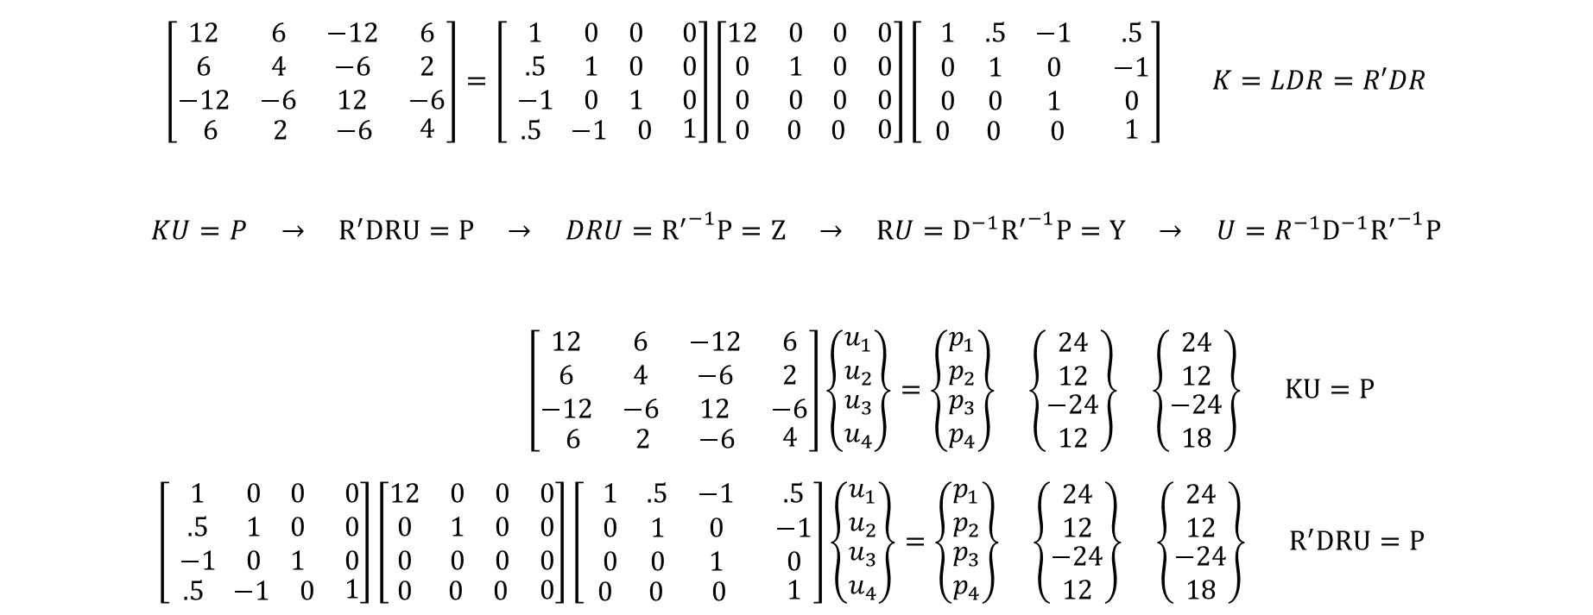
$$\left[\begin{matrix}\begin{matrix}12 & 6 & −12 \\ 6 & 4 & −6 \\ −12 & −6 & 12\end{matrix} & \begin{matrix}6 \\ 2 \\ −6\end{matrix} \\ \begin{matrix} 6 & 2 & −6\end{matrix} & 4\end{matrix}\right]=\left[\begin{matrix}\begin{matrix}1 & 0 & 0 \\ .5 & 1 & 0 \\ −1 & 0 & 1\end{matrix} & \begin{matrix}0 \\ 0 \\ 0\end{matrix} \\ \begin{matrix} .5 & −1 & 0\end{matrix} & 1\end{matrix}\right]\left[\begin{matrix}\begin{matrix}12 & 0 & 0 \\ 0 & 1 & 0 \\ 0 & 0 & 0\end{matrix} & \begin{matrix}0 \\ 0 \\ 0\end{matrix} \\ \begin{matrix} 0 & 0 & 0\end{matrix} & 0\end{matrix}\right]\left[ \begin{matrix}\begin{matrix}1 & .5 & −1 \\ 0 & 1 & 0 \\ 0 & 0 & 1\end{matrix} & \begin{matrix}.5 \\ −1 \\ 0\end{matrix} \\ \begin{matrix} 0 & 0 & 0 \end{matrix} & 1\end{matrix}\right] K=LDR=R′DR$$
$$KU=P → R^{′}DRU=P → DRU={R^{′}}^{−1}P=Z → RU=D^{−1}{R^{′}}^{−1}P=Y → U=R^{−1}D^{−1}{R^{′}}^{−1}P$$
$\left[\begin{matrix}\begin{matrix}12 & 6 & −12 \\ 6 & 4 & −6 \\ −12 & −6 & 12\end{matrix} & \begin{matrix}6 \\ 2 \\ −6\end{matrix} \\ \begin{matrix} 6 & 2 & −6\end{matrix} & 4\end{matrix}\right]\left\{\begin{matrix}\begin{matrix}u_{1} \\ u_{2}\end{matrix} \\ \begin{matrix}u_{3} \\ u_{4}\end{matrix}\end{matrix}\right\}=\left\{\begin{matrix}\begin{matrix}p_{1} \\ p_{2}\end{matrix} \\ \begin{matrix}p_{3} \\ p_{4}\end{matrix}\end{matrix}\right\}$ $\left\{\begin{matrix}\begin{matrix}24 \\ 12\end{matrix} \\ \begin{matrix}−24 \\ 12\end{matrix}\end{matrix}\right\}$ $\left\{\begin{matrix}\begin{matrix}24 \\ 12\end{matrix} \\ \begin{matrix}−24 \\ 18\end{matrix}\end{matrix}\right\} KU=P$
$\left[\begin{matrix}\begin{matrix}1 & 0 & 0 \\ .5 & 1 & 0 \\ −1 & 0 & 1\end{matrix} & \begin{matrix}0 \\ 0 \\ 0\end{matrix} \\ \begin{matrix} .5 & −1 & 0\end{matrix} & 1\end{matrix}\right]\left[\begin{matrix}\begin{matrix}12 & 0 & 0 \\ 0 & 1 & 0 \\ 0 & 0 & 0\end{matrix} & \begin{matrix}0 \\ 0 \\ 0\end{matrix} \\ \begin{matrix} 0 & 0 & 0\end{matrix} & 0\end{matrix}\right]\left[ \begin{matrix}\begin{matrix}1 & .5 & −1 \\ 0 & 1 & 0 \\ 0 & 0 & 1\end{matrix} & \begin{matrix}.5 \\ −1 \\ 0\end{matrix} \\ \begin{matrix} 0 & 0 & 0 \end{matrix} & 1\end{matrix}\right]\left\{\begin{matrix}\begin{matrix}u_{1} \\ u_{2}\end{matrix} \\ \begin{matrix}u_{3} \\ u_{4}\end{matrix}\end{matrix}\right\}=\left\{\begin{matrix}\begin{matrix}p_{1} \\ p_{2}\end{matrix} \\ \begin{matrix}p_{3} \\ p_{4}\end{matrix}\end{matrix}\right\}$ $\left\{\begin{matrix}\begin{matrix}24 \\ 12\end{matrix} \\ \begin{matrix}−24 \\ 12\end{matrix}\end{matrix}\right\}$ $\left\{\begin{matrix}\begin{matrix}24 \\ 12\end{matrix} \\ \begin{matrix}−24 \\ 18\end{matrix}\end{matrix}\right\} R^{′}DRU=P$

Slide 3
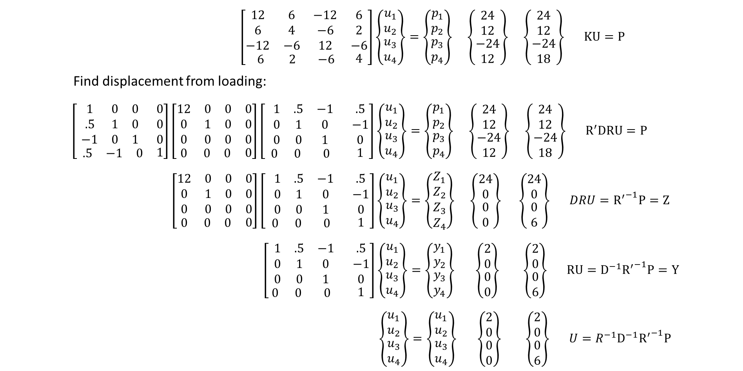
$\left[\begin{matrix}\begin{matrix}12 & 6 & −12 \\ 6 & 4 & −6 \\ −12 & −6 & 12\end{matrix} & \begin{matrix}6 \\ 2 \\ −6\end{matrix} \\ \begin{matrix} 6 & 2 & −6\end{matrix} & 4\end{matrix}\right]\left\{\begin{matrix}\begin{matrix}u_{1} \\ u_{2}\end{matrix} \\ \begin{matrix}u_{3} \\ u_{4}\end{matrix}\end{matrix}\right\}=\left\{\begin{matrix}\begin{matrix}p_{1} \\ p_{2}\end{matrix} \\ \begin{matrix}p_{3} \\ p_{4}\end{matrix}\end{matrix}\right\}$ $\left\{\begin{matrix}\begin{matrix}24 \\ 12\end{matrix} \\ \begin{matrix}−24 \\ 12\end{matrix}\end{matrix}\right\}$ $\left\{\begin{matrix}\begin{matrix}24 \\ 12\end{matrix} \\ \begin{matrix}−24 \\ 18\end{matrix}\end{matrix}\right\} KU=P$
Find displacement from loading:
$\left[\begin{matrix}\begin{matrix}1 & 0 & 0 \\ .5 & 1 & 0 \\ −1 & 0 & 1\end{matrix} & \begin{matrix}0 \\ 0 \\ 0\end{matrix} \\ \begin{matrix} .5 & −1 & 0\end{matrix} & 1\end{matrix}\right]\left[\begin{matrix}\begin{matrix}12 & 0 & 0 \\ 0 & 1 & 0 \\ 0 & 0 & 0\end{matrix} & \begin{matrix}0 \\ 0 \\ 0\end{matrix} \\ \begin{matrix} 0 & 0 & 0\end{matrix} & 0\end{matrix}\right]\left[ \begin{matrix}\begin{matrix}1 & .5 & −1 \\ 0 & 1 & 0 \\ 0 & 0 & 1\end{matrix} & \begin{matrix}.5 \\ −1 \\ 0\end{matrix} \\ \begin{matrix} 0 & 0 & 0 \end{matrix} & 1\end{matrix}\right]\left\{\begin{matrix}\begin{matrix}u_{1} \\ u_{2}\end{matrix} \\ \begin{matrix}u_{3} \\ u_{4}\end{matrix}\end{matrix}\right\}=\left\{\begin{matrix}\begin{matrix}p_{1} \\ p_{2}\end{matrix} \\ \begin{matrix}p_{3} \\ p_{4}\end{matrix}\end{matrix}\right\}$ $\left\{\begin{matrix}\begin{matrix}24 \\ 12\end{matrix} \\ \begin{matrix}−24 \\ 12\end{matrix}\end{matrix}\right\}$ $\left\{\begin{matrix}\begin{matrix}24 \\ 12\end{matrix} \\ \begin{matrix}−24 \\ 18\end{matrix}\end{matrix}\right\} R^{′}DRU=P$
$\left[\begin{matrix}\begin{matrix}12 & 0 & 0 \\ 0 & 1 & 0 \\ 0 & 0 & 0\end{matrix} & \begin{matrix}0 \\ 0 \\ 0\end{matrix} \\ \begin{matrix} 0 & 0 & 0\end{matrix} & 0\end{matrix}\right]\left[ \begin{matrix}\begin{matrix}1 & .5 & −1 \\ 0 & 1 & 0 \\ 0 & 0 & 1\end{matrix} & \begin{matrix}.5 \\ −1 \\ 0\end{matrix} \\ \begin{matrix} 0 & 0 & 0 \end{matrix} & 1\end{matrix}\right]\left\{\begin{matrix}\begin{matrix}u_{1} \\ u_{2}\end{matrix} \\ \begin{matrix}u_{3} \\ u_{4}\end{matrix}\end{matrix}\right\}=\left\{\begin{matrix}\begin{matrix}Z_{1} \\ Z_{2}\end{matrix} \\ \begin{matrix}Z_{3} \\ Z_{4}\end{matrix}\end{matrix}\right\}$ $\left\{\begin{matrix}\begin{matrix}24 \\ 0\end{matrix} \\ \begin{matrix}0 \\ 0\end{matrix}\end{matrix}\right\}$ $\left\{\begin{matrix}\begin{matrix}24 \\ 0\end{matrix} \\ \begin{matrix}0 \\ 6\end{matrix}\end{matrix}\right\} DRU={R^{′}}^{−1}P=Z$
$\left[\begin{matrix}\begin{matrix}1 & .5 & −1 \\ 0 & 1 & 0 \\ 0 & 0 & 1\end{matrix} & \begin{matrix}.5 \\ −1 \\ 0\end{matrix} \\ \begin{matrix} 0 & 0 & 0 \end{matrix} & 1\end{matrix}\right]\left\{\begin{matrix}\begin{matrix}u_{1} \\ u_{2}\end{matrix} \\ \begin{matrix}u_{3} \\ u_{4}\end{matrix}\end{matrix}\right\}=\left\{\begin{matrix}\begin{matrix}y_{1} \\ y_{2}\end{matrix} \\ \begin{matrix}y_{3} \\ y_{4}\end{matrix}\end{matrix}\right\}$ $\left\{\begin{matrix}\begin{matrix}2 \\ 0\end{matrix} \\ \begin{matrix}0 \\ 0\end{matrix}\end{matrix}\right\}$ $\left\{\begin{matrix}\begin{matrix}2 \\ 0\end{matrix} \\ \begin{matrix}0 \\ 6\end{matrix}\end{matrix}\right\} RU=D^{−1}{R^{′}}^{−1}P=Y$
$\left\{\begin{matrix}\begin{matrix}u_{1} \\ u_{2}\end{matrix} \\ \begin{matrix}u_{3} \\ u_{4}\end{matrix}\end{matrix}\right\}=\left\{\begin{matrix}\begin{matrix}u_{1} \\ u_{2}\end{matrix} \\ \begin{matrix}u_{3} \\ u_{4}\end{matrix}\end{matrix}\right\}$ $\left\{\begin{matrix}\begin{matrix}2 \\ 0\end{matrix} \\ \begin{matrix}0 \\ 0\end{matrix}\end{matrix}\right\}$ $\left\{\begin{matrix}\begin{matrix}2 \\ 0\end{matrix} \\ \begin{matrix}0 \\ 6\end{matrix}\end{matrix}\right\} U=R^{−1}D^{−1}{R^{′}}^{−1}P$

Slide 4
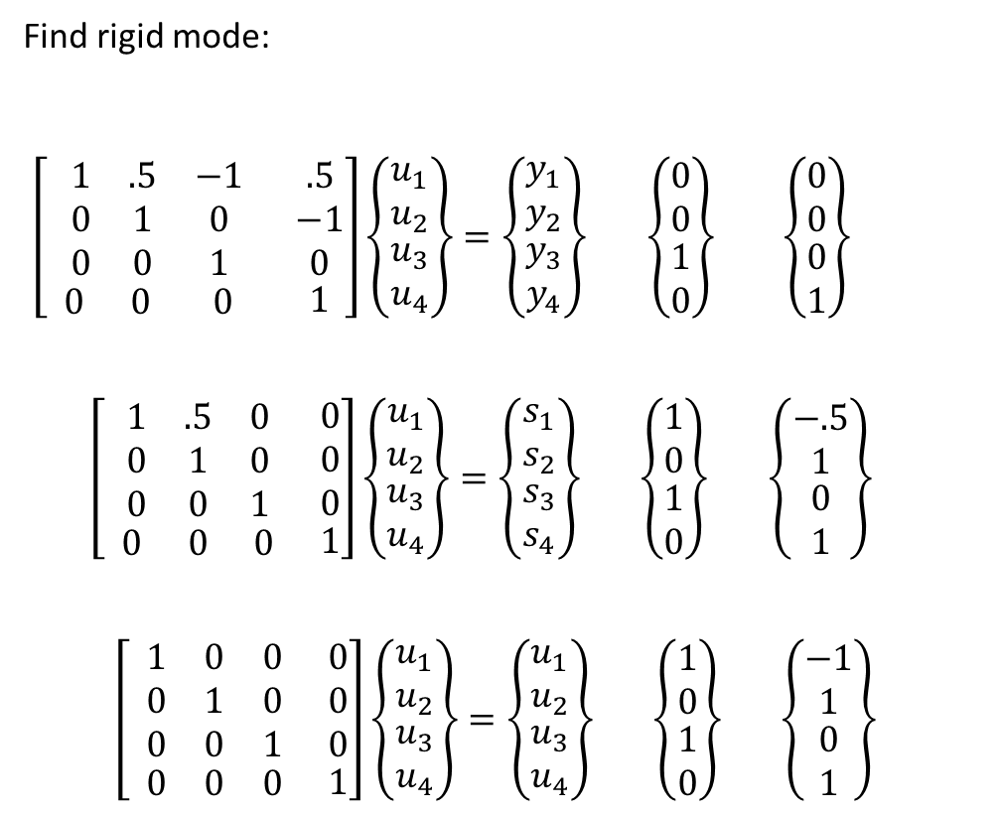
Find rigid mode:
$\left[ \begin{matrix}\begin{matrix}1 & .5 & −1 \\ 0 & 1 & 0 \\ 0 & 0 & 1\end{matrix} & \begin{matrix}.5 \\ −1 \\ 0\end{matrix} \\ \begin{matrix} 0 & 0 & 0 \end{matrix} & 1\end{matrix}\right]\left\{\begin{matrix}\begin{matrix}u_{1} \\ u_{2}\end{matrix} \\ \begin{matrix}u_{3} \\ u_{4}\end{matrix}\end{matrix}\right\}=\left\{\begin{matrix}\begin{matrix}y_{1} \\ y_{2}\end{matrix} \\ \begin{matrix}y_{3} \\ y_{4}\end{matrix}\end{matrix}\right\}$ $\left\{\begin{matrix}\begin{matrix}0 \\ 0\end{matrix} \\ \begin{matrix}1 \\ 0\end{matrix}\end{matrix}\right\}$ $\left\{\begin{matrix}\begin{matrix}0 \\ 0\end{matrix} \\ \begin{matrix}0 \\ 1\end{matrix}\end{matrix}\right\}$
$\left[ \begin{matrix}\begin{matrix}1 & .5 & 0 \\ 0 & 1 & 0 \\ 0 & 0 & 1\end{matrix} & \begin{matrix}0 \\ 0 \\ 0\end{matrix} \\ \begin{matrix} 0 & 0 & 0 \end{matrix} & 1\end{matrix}\right]\left\{\begin{matrix}\begin{matrix}u_{1} \\ u_{2}\end{matrix} \\ \begin{matrix}u_{3} \\ u_{4}\end{matrix}\end{matrix}\right\}=\left\{\begin{matrix}\begin{matrix}s_{1} \\ s_{2}\end{matrix} \\ \begin{matrix}s_{3} \\ s_{4}\end{matrix}\end{matrix}\right\}$ $\left\{\begin{matrix}\begin{matrix}1 \\ 0\end{matrix} \\ \begin{matrix}1 \\ 0\end{matrix}\end{matrix}\right\}$ $\left\{\begin{matrix}\begin{matrix}−.5 \\ 1\end{matrix} \\ \begin{matrix}0 \\ 1\end{matrix}\end{matrix}\right\}$
$\left[ \begin{matrix}\begin{matrix}1 & 0 & 0 \\ 0 & 1 & 0 \\ 0 & 0 & 1\end{matrix} & \begin{matrix}0 \\ 0 \\ 0\end{matrix} \\ \begin{matrix} 0 & 0 & 0 \end{matrix} & 1\end{matrix}\right]\left\{\begin{matrix}\begin{matrix}u_{1} \\ u_{2}\end{matrix} \\ \begin{matrix}u_{3} \\ u_{4}\end{matrix}\end{matrix}\right\}=\left\{\begin{matrix}\begin{matrix}u_{1} \\ u_{2}\end{matrix} \\ \begin{matrix}u_{3} \\ u_{4}\end{matrix}\end{matrix}\right\}$ $\left\{\begin{matrix}\begin{matrix}1 \\ 0\end{matrix} \\ \begin{matrix}1 \\ 0\end{matrix}\end{matrix}\right\}$ $\left\{\begin{matrix}\begin{matrix}−1 \\ 1\end{matrix} \\ \begin{matrix}0 \\ 1\end{matrix}\end{matrix}\right\}$

Slide 5





Numerical example : A beam element
$$u_{1}$$
$$u_{3}$$
$$u_{2}$$
$$u_{4}$$
$$K=\frac{EI}{L^{3}}\left[\begin{matrix}\begin{matrix}12 & 6L & −12 \\ 6L & 4L^{2} & −6L \\ −12 & −6L & 12\end{matrix} & \begin{matrix}6L \\ {2L}^{2} \\ −6L\end{matrix} \\ \begin{matrix}6L & 2L^{2} & −6L\end{matrix} & 4L^{2}\end{matrix}\right]$$
Let $EI=1$ and $L=1$
$K=\left[\begin{matrix}\begin{matrix}12 & 6 & −12 \\ 6 & 4 & −6 \\ −12 & −6 & 12\end{matrix} & \begin{matrix}6 \\ 2 \\ −6\end{matrix} \\ \begin{matrix} 6 & 2 & −6\end{matrix} & 4\end{matrix}\right]$

Slide 6
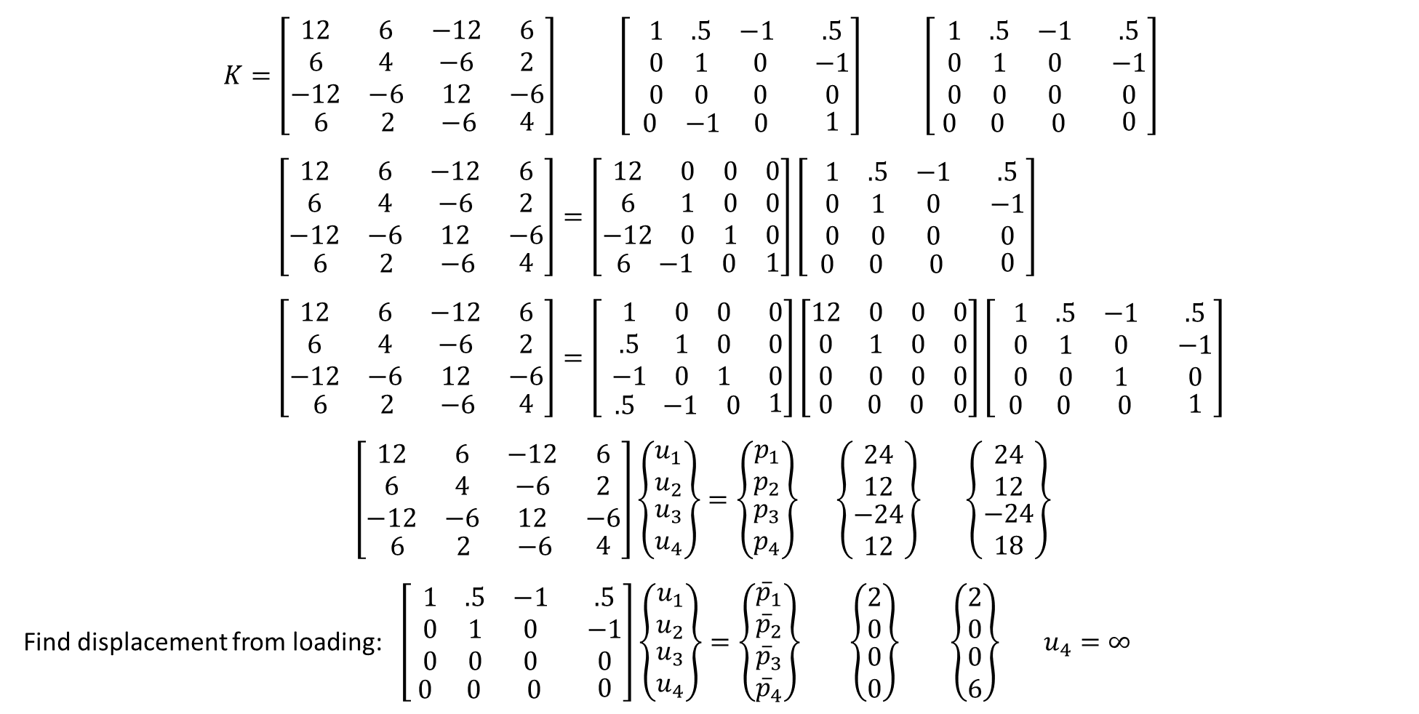
$K=\left[\begin{matrix}\begin{matrix}12 & 6 & −12 \\ 6 & 4 & −6 \\ −12 & −6 & 12\end{matrix} & \begin{matrix}6 \\ 2 \\ −6\end{matrix} \\ \begin{matrix} 6 & 2 & −6\end{matrix} & 4\end{matrix}\right]$ $\left[ \begin{matrix}\begin{matrix}1 & .5 & −1 \\ 0 & 1 & 0 \\ 0 & 0 & 0\end{matrix} & \begin{matrix}.5 \\ −1 \\ 0\end{matrix} \\ \begin{matrix}0 & −1 & 0 \end{matrix} & 1\end{matrix}\right]$ $\left[\begin{matrix}\begin{matrix}1 & .5 & −1 \\ 0 & 1 & 0 \\ 0 & 0 & 0\end{matrix} & \begin{matrix}.5 \\ −1 \\ 0\end{matrix} \\ \begin{matrix} 0 & 0 & 0 \end{matrix} & 0\end{matrix}\right]$
$\left[\begin{matrix}\begin{matrix}12 & 6 & −12 \\ 6 & 4 & −6 \\ −12 & −6 & 12\end{matrix} & \begin{matrix}6 \\ 2 \\ −6\end{matrix} \\ \begin{matrix} 6 & 2 & −6\end{matrix} & 4\end{matrix}\right]=\left[\begin{matrix}\begin{matrix}12 & 0 & 0 \\ 6 & 1 & 0 \\ −12 & 0 & 1\end{matrix} & \begin{matrix}0 \\ 0 \\ 0\end{matrix} \\ \begin{matrix} 6 & −1 & 0\end{matrix} & 1\end{matrix}\right]\left[ \begin{matrix}\begin{matrix}1 & .5 & −1 \\ 0 & 1 & 0 \\ 0 & 0 & 0\end{matrix} & \begin{matrix}.5 \\ −1 \\ 0\end{matrix} \\ \begin{matrix} 0 & 0 & 0 \end{matrix} & 0\end{matrix}\right]$
$\left[\begin{matrix}\begin{matrix}12 & 6 & −12 \\ 6 & 4 & −6 \\ −12 & −6 & 12\end{matrix} & \begin{matrix}6 \\ 2 \\ −6\end{matrix} \\ \begin{matrix} 6 & 2 & −6\end{matrix} & 4\end{matrix}\right]=\left[\begin{matrix}\begin{matrix}1 & 0 & 0 \\ .5 & 1 & 0 \\ −1 & 0 & 1\end{matrix} & \begin{matrix}0 \\ 0 \\ 0\end{matrix} \\ \begin{matrix} .5 & −1 & 0\end{matrix} & 1\end{matrix}\right]\left[\begin{matrix}\begin{matrix}12 & 0 & 0 \\ 0 & 1 & 0 \\ 0 & 0 & 0\end{matrix} & \begin{matrix}0 \\ 0 \\ 0\end{matrix} \\ \begin{matrix} 0 & 0 & 0\end{matrix} & 0\end{matrix}\right]\left[ \begin{matrix}\begin{matrix}1 & .5 & −1 \\ 0 & 1 & 0 \\ 0 & 0 & 1\end{matrix} & \begin{matrix}.5 \\ −1 \\ 0\end{matrix} \\ \begin{matrix} 0 & 0 & 0 \end{matrix} & 1\end{matrix}\right]$
$\left[\begin{matrix}\begin{matrix}12 & 6 & −12 \\ 6 & 4 & −6 \\ −12 & −6 & 12\end{matrix} & \begin{matrix}6 \\ 2 \\ −6\end{matrix} \\ \begin{matrix} 6 & 2 & −6\end{matrix} & 4\end{matrix}\right]\left\{\begin{matrix}\begin{matrix}u_{1} \\ u_{2}\end{matrix} \\ \begin{matrix}u_{3} \\ u_{4}\end{matrix}\end{matrix}\right\}=\left\{\begin{matrix}\begin{matrix}p_{1} \\ p_{2}\end{matrix} \\ \begin{matrix}p_{3} \\ p_{4}\end{matrix}\end{matrix}\right\}$ $\left\{\begin{matrix}\begin{matrix}24 \\ 12\end{matrix} \\ \begin{matrix}−24 \\ 12\end{matrix}\end{matrix}\right\}$ $\left\{\begin{matrix}\begin{matrix}24 \\ 12\end{matrix} \\ \begin{matrix}−24 \\ 18\end{matrix}\end{matrix}\right\}$
Find displacement from loading: $\left[\begin{matrix}\begin{matrix}1 & .5 & −1 \\ 0 & 1 & 0 \\ 0 & 0 & 0\end{matrix} & \begin{matrix}.5 \\ −1 \\ 0\end{matrix} \\ \begin{matrix} 0 & 0 & 0 \end{matrix} & 0\end{matrix}\right]\left\{\begin{matrix}\begin{matrix}u_{1} \\ u_{2}\end{matrix} \\ \begin{matrix}u_{3} \\ u_{4}\end{matrix}\end{matrix}\right\}=\left\{\begin{matrix}\begin{matrix}{\overline{p}}_{1} \\ {\overline{p}}_{2}\end{matrix} \\ \begin{matrix}{\overline{p}}_{3} \\ {\overline{p}}_{4}\end{matrix}\end{matrix}\right\}$ $\left\{\begin{matrix}\begin{matrix}2 \\ 0\end{matrix} \\ \begin{matrix}0 \\ 0\end{matrix}\end{matrix}\right\}$ $\left\{\begin{matrix}\begin{matrix}2 \\ 0\end{matrix} \\ \begin{matrix}0 \\ 6\end{matrix}\end{matrix}\right\}$ $u_{4}=∞$

Slide 7

Find rigid mode:
$\left[\begin{matrix}\begin{matrix}1 & .5 \\ 0 & 1\end{matrix} & \begin{matrix}−1 & .5 \\ 0 & −1\end{matrix}\end{matrix}\right]\left\{\begin{matrix}\begin{matrix}u_{1} \\ u_{2}\end{matrix} \\ \begin{matrix}u_{3} \\ u_{4}\end{matrix}\end{matrix}\right\}=\left\{\begin{matrix}0 \\ 0\end{matrix}\right\}$ $\left[\begin{matrix}1 & .5 \\ 0 & 1\end{matrix}\right]\left\{\begin{matrix}u_{1} \\ u_{2}\end{matrix}\right\}=−\left[\begin{matrix}−1 & .5 \\ 0 & −1\end{matrix}\right]\left\{\begin{matrix}u_{3} \\ u_{4}\end{matrix}\right\}$
$\left[\begin{matrix}\begin{matrix}1 & 0 \\ 0 & 1\end{matrix} & \begin{matrix}−1 & 1 \\ 0 & −1\end{matrix}\end{matrix}\right]\left\{\begin{matrix}\begin{matrix}u_{1} \\ u_{2}\end{matrix} \\ \begin{matrix}u_{3} \\ u_{4}\end{matrix}\end{matrix}\right\}=\left\{\begin{matrix}0 \\ 0\end{matrix}\right\}$ $\left\{\begin{matrix}u_{1} \\ u_{2}\end{matrix}\right\}=−\left[\begin{matrix}−1 & 1 \\ 0 & −1\end{matrix}\right]\left\{\begin{matrix}u_{3} \\ u_{4}\end{matrix}\right\}$ $\left\{\begin{matrix}\begin{matrix}u_{1} \\ u_{2}\end{matrix} \\ \begin{matrix}u_{3} \\ u_{4}\end{matrix}\end{matrix}\right\}=−\left[\begin{matrix}\begin{matrix}−1 & 1 \\ 0 & −1\end{matrix} \\ \begin{matrix}−1 & 0 \\ 0 & −1\end{matrix}\end{matrix}\right]\left\{\begin{matrix}u_{3} \\ u_{4}\end{matrix}\right\}$

Slide 8

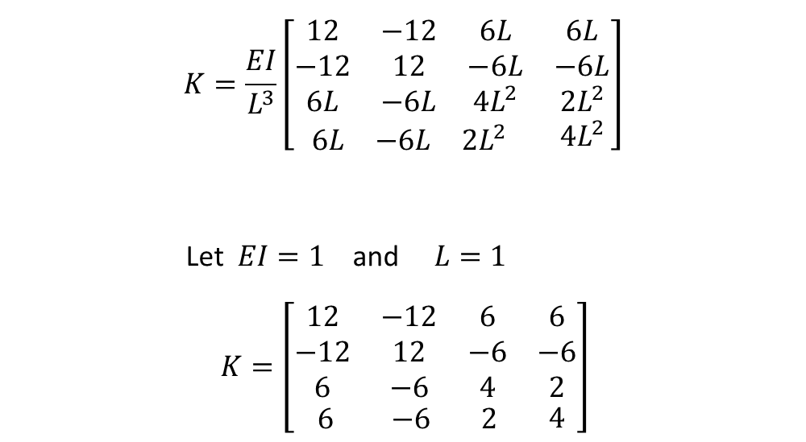

Numerical example : A beam element with a dummy link
$$u_{1}$$
$$u_{2}$$
$$u_{3}$$
$$u_{4}$$
$$v_{2}=u_{2}$$
$$K=\frac{EI}{L^{3}}\left[\begin{matrix}\begin{matrix}12 & −12 & 6L \\ −12 & 12 & −6L \\ 6L & −6L & 4L^{2}\end{matrix} & \begin{matrix}6L \\ −6L \\ 2L^{2}\end{matrix} \\ \begin{matrix}6L & −6L & 2L^{2}\end{matrix} & 4L^{2}\end{matrix}\right]$$
Let $EI=1$ and $L=1$
$K=\left[\begin{matrix}\begin{matrix}12 & −12 & 6 \\ −12 & 12 & −6 \\ 6 & −6 & 4\end{matrix} & \begin{matrix}6 \\ −6 \\ 2\end{matrix} \\ \begin{matrix} 6 & −6 & 2\end{matrix} & 4\end{matrix}\right]$

Slide 9
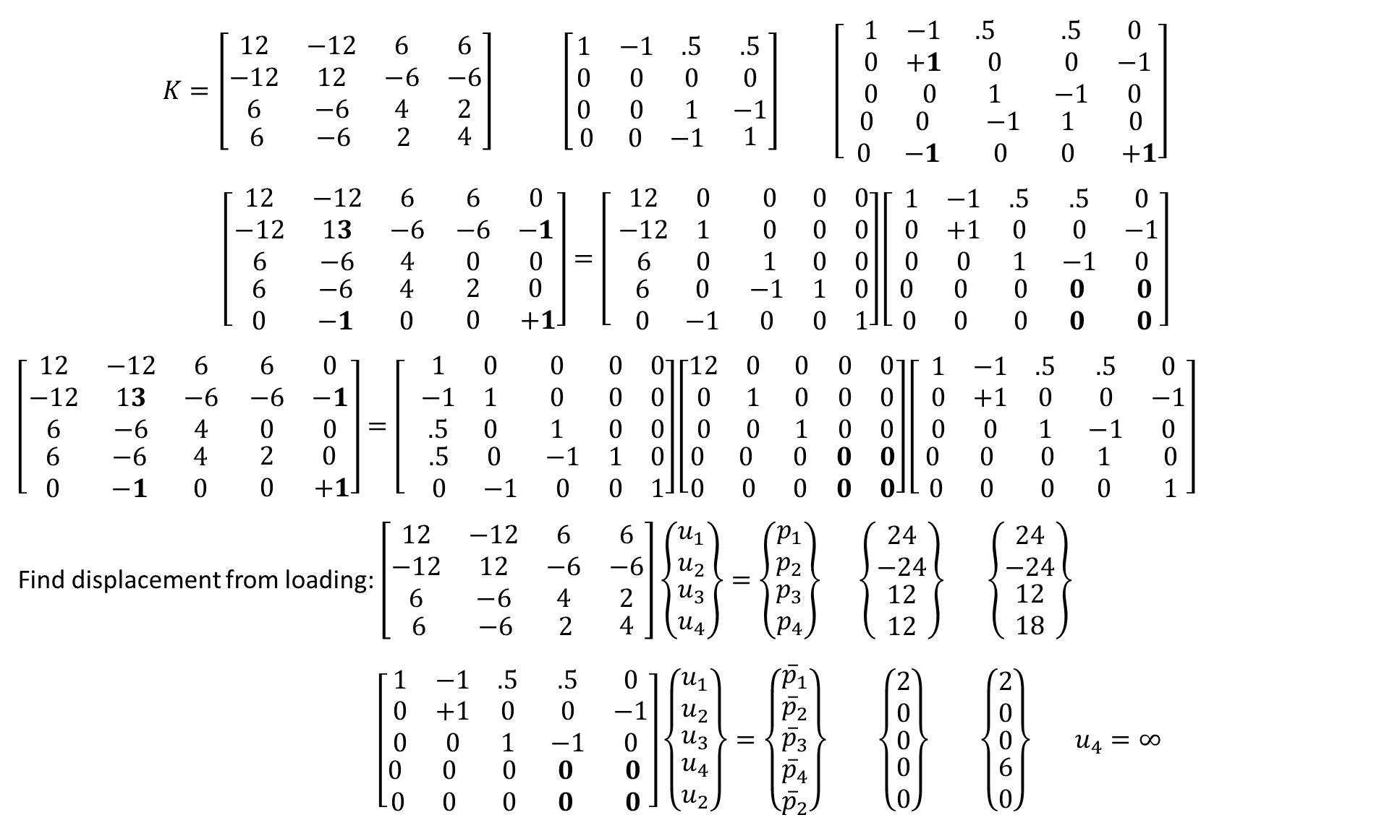
$K=\left[\begin{matrix}\begin{matrix}12 & −12 & 6 \\ −12 & 12 & −6 \\ 6 & −6 & 4\end{matrix} & \begin{matrix}6 \\ −6 \\ 2\end{matrix} \\ \begin{matrix} 6 & −6 & 2\end{matrix} & 4\end{matrix}\right]$ $\left[\begin{matrix}\begin{matrix}1 & −1 & .5 \\ 0 & 0 & 0 \\ 0 & 0 & 1\end{matrix} & \begin{matrix}.5 \\ 0 \\ −1\end{matrix} \\ \begin{matrix} 0 & 0 & −1\end{matrix} & 1\end{matrix}\right]$ $\left[\begin{matrix}\begin{matrix}1 & −1 & .5 \\ 0 & +1 & 0 \\ 0 & 0 & 1\end{matrix} & \begin{matrix}.5 & 0 \\ 0 & −1 \\ −1 & 0\end{matrix} \\ \begin{matrix} 0 & 0 & −1 \\ 0 & −1 & 0 \end{matrix} & \begin{matrix} 1 & 0 \\ 0 & +1\end{matrix}\end{matrix}\right]$
$$\left[\begin{matrix}\begin{matrix}12 & −12 & 6 \\ −12 & 13 & −6 \\ 6 & −6 & 4\end{matrix} & \begin{matrix}6 & 0 \\ −6 & −1 \\ 0 & 0\end{matrix} \\ \begin{matrix} 6 & −6 & 4 \\ 0 & −1 & 0 \end{matrix} & \begin{matrix}2 & 0 \\ 0 & +1\end{matrix}\end{matrix}\right]=\left[\begin{matrix}\begin{matrix}12 & 0 & 0 \\ −12 & 1 & 0 \\ 6 & 0 & 1\end{matrix} & \begin{matrix}0 & 0 \\ 0 & 0 \\ 0 & 0\end{matrix} \\ \begin{matrix} 6 & 0 & −1 \\ 0 & −1 & 0\end{matrix} & \begin{matrix}1 & 0 \\ 0 & 1\end{matrix}\end{matrix}\right]\left[ \begin{matrix}\begin{matrix}1 & −1 & .5 \\ 0 & +1 & 0 \\ 0 & 0 & 1\end{matrix} & \begin{matrix}.5 & 0 \\ 0 & −1 \\ −1 & 0\end{matrix} \\ \begin{matrix}0 & 0 & 0 \\ 0 & 0 & 0 \end{matrix} & \begin{matrix}0 & 0 \\ 0 & 0\end{matrix}\end{matrix}\right]$$
$\left[\begin{matrix}\begin{matrix}12 & −12 & 6 \\ −12 & 13 & −6 \\ 6 & −6 & 4\end{matrix} & \begin{matrix}6 & 0 \\ −6 & −1 \\ 0 & 0\end{matrix} \\ \begin{matrix} 6 & −6 & 4 \\ 0 & −1 & 0 \end{matrix} & \begin{matrix}2 & 0 \\ 0 & +1\end{matrix}\end{matrix}\right]=\left[\begin{matrix}\begin{matrix}1 & 0 & 0 \\ −1 & 1 & 0 \\ .5 & 0 & 1\end{matrix} & \begin{matrix}0 & 0 \\ 0 & 0 \\ 0 & 0\end{matrix} \\ \begin{matrix} .5 & 0 & −1 \\ 0 & −1 & 0\end{matrix} & \begin{matrix}1 & 0 \\ 0 & 1\end{matrix}\end{matrix}\right]\left[\begin{matrix}\begin{matrix}12 & 0 & 0 \\ 0 & 1 & 0 \\ 0 & 0 & 1\end{matrix} & \begin{matrix}0 & 0 \\ 0 & 0 \\ 0 & 0\end{matrix} \\ \begin{matrix}0 & 0 & 0 \\ 0 & 0 & 0\end{matrix} & \begin{matrix}0 & 0 \\ 0 & 0\end{matrix}\end{matrix}\right]\left[ \begin{matrix}\begin{matrix}1 & −1 & .5 \\ 0 & +1 & 0 \\ 0 & 0 & 1\end{matrix} & \begin{matrix}.5 & 0 \\ 0 & −1 \\ −1 & 0\end{matrix} \\ \begin{matrix}0 & 0 & 0 \\ 0 & 0 & 0 \end{matrix} & \begin{matrix}1 & 0 \\ 0 & 1\end{matrix}\end{matrix}\right]$
Find displacement from loading: $\left[\begin{matrix}\begin{matrix}12 & −12 & 6 \\ −12 & 12 & −6 \\ 6 & −6 & 4\end{matrix} & \begin{matrix}6 \\ −6 \\ 2\end{matrix} \\ \begin{matrix} 6 & −6 & 2\end{matrix} & 4\end{matrix}\right]\left\{\begin{matrix}\begin{matrix}u_{1} \\ u_{2}\end{matrix} \\ \begin{matrix}u_{3} \\ u_{4}\end{matrix}\end{matrix}\right\}=\left\{\begin{matrix}\begin{matrix}p_{1} \\ p_{2}\end{matrix} \\ \begin{matrix}p_{3} \\ p_{4}\end{matrix}\end{matrix}\right\}$ $\left\{\begin{matrix}\begin{matrix}24 \\ −24\end{matrix} \\ \begin{matrix}12 \\ 12\end{matrix}\end{matrix}\right\}$ $\left\{\begin{matrix}\begin{matrix}24 \\ −24\end{matrix} \\ \begin{matrix}12 \\ 18\end{matrix}\end{matrix}\right\}$
$\left[\begin{matrix}\begin{matrix}1 & −1 & .5 \\ 0 & +1 & 0 \\ 0 & 0 & 1\end{matrix} & \begin{matrix}.5 & 0 \\ 0 & −1 \\ −1 & 0\end{matrix} \\ \begin{matrix}0 & 0 & 0 \\ 0 & 0 & 0 \end{matrix} & \begin{matrix}0 & 0 \\ 0 & 0\end{matrix}\end{matrix}\right]\left\{\begin{matrix}\begin{matrix}u_{1} \\ u_{2}\end{matrix} \\ \begin{matrix}u_{3} \\ \begin{matrix}u_{4} \\ u_{2}\end{matrix}\end{matrix}\end{matrix}\right\}=\left\{\begin{matrix}\begin{matrix}{\overline{p}}_{1} \\ {\overline{p}}_{2}\end{matrix} \\ \begin{matrix}\begin{matrix}{\overline{p}}_{3} \\ {\overline{p}}_{4}\end{matrix} \\ {\overline{p}}_{2}\end{matrix}\end{matrix}\right\}$ $\left\{\begin{matrix}\begin{matrix}2 \\ 0\end{matrix} \\ \begin{matrix}0 \\ \begin{matrix}0 \\ 0\end{matrix}\end{matrix}\end{matrix}\right\}$ $\left\{\begin{matrix}\begin{matrix}2 \\ 0\end{matrix} \\ \begin{matrix}0 \\ \begin{matrix}6 \\ 0\end{matrix}\end{matrix}\end{matrix}\right\}$ $u_{4}=∞$

Slide 10
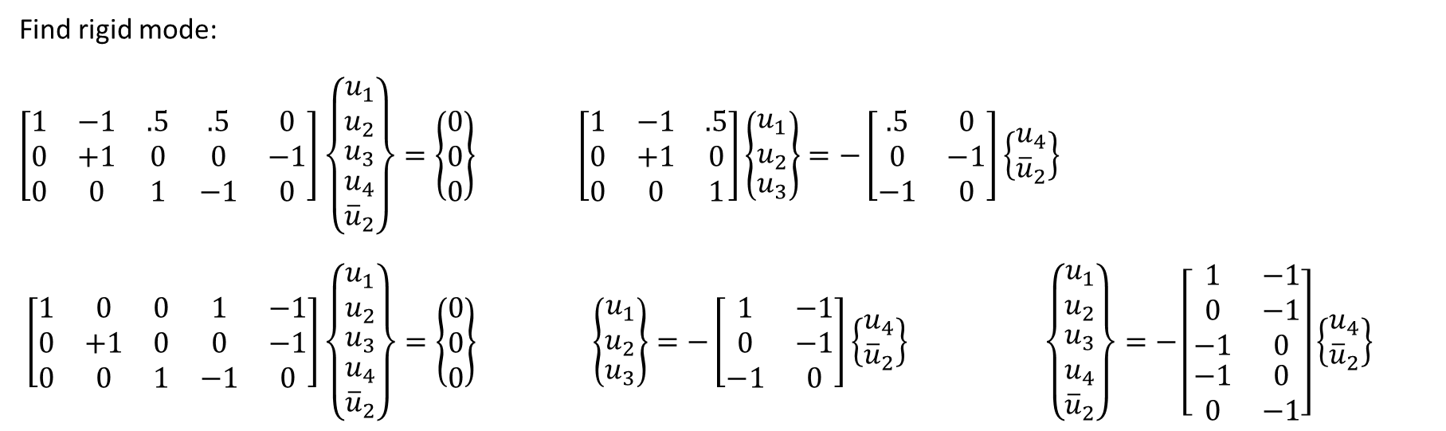
Find rigid mode:
$\left[\begin{matrix}\begin{matrix}1 & −1 & .5 \\ 0 & +1 & 0 \\ 0 & 0 & 1\end{matrix} & \begin{matrix}.5 & 0 \\ 0 & −1 \\ −1 & 0\end{matrix}\end{matrix}\right]\left\{\begin{matrix}\begin{matrix}u_{1} \\ u_{2}\end{matrix} \\ \begin{matrix}u_{3} \\ \begin{matrix}u_{4} \\ {\overline{u}}_{2}\end{matrix}\end{matrix}\end{matrix}\right\}=\left\{\begin{matrix}0 \\ 0 \\ 0\end{matrix}\right\}$ $\left[\begin{matrix}1 & −1 & .5 \\ 0 & +1 & 0 \\ 0 & 0 & 1\end{matrix}\right]\left\{\begin{matrix}\begin{matrix}u_{1} \\ u_{2}\end{matrix} \\ u_{3}\end{matrix}\right\}=−\left[\begin{matrix}.5 & 0 \\ 0 & −1 \\ −1 & 0\end{matrix}\right]\left\{\begin{matrix}u_{4} \\ {\overline{u}}_{2}\end{matrix}\right\}$
$\left[\begin{matrix}\begin{matrix}1 & 0 & 0 \\ 0 & +1 & 0 \\ 0 & 0 & 1\end{matrix} & \begin{matrix}1 & −1 \\ 0 & −1 \\ −1 & 0\end{matrix}\end{matrix}\right]\left\{\begin{matrix}\begin{matrix}u_{1} \\ u_{2}\end{matrix} \\ \begin{matrix}u_{3} \\ \begin{matrix}u_{4} \\ {\overline{u}}_{2}\end{matrix}\end{matrix}\end{matrix}\right\}=\left\{\begin{matrix}0 \\ 0 \\ 0\end{matrix}\right\}$ $\left\{\begin{matrix}\begin{matrix}u_{1} \\ u_{2}\end{matrix} \\ u_{3}\end{matrix}\right\}=−\left[\begin{matrix}1 & −1 \\ 0 & −1 \\ −1 & 0\end{matrix}\right]\left\{\begin{matrix}u_{4} \\ {\overline{u}}_{2}\end{matrix}\right\}$ $\left\{\begin{matrix}\begin{matrix}\begin{matrix}u_{1} \\ u_{2}\end{matrix} \\ \begin{matrix}u_{3} \\ u_{4}\end{matrix}\end{matrix} \\ {\overline{u}}_{2}\end{matrix}\right\}=−\left[\begin{matrix}\begin{matrix}1 & −1 \\ 0 & −1 \\ −1 & 0\end{matrix} \\ \begin{matrix}−1 & 0 \\ 0 & −1\end{matrix}\end{matrix}\right]\left\{\begin{matrix}u_{4} \\ {\overline{u}}_{2}\end{matrix}\right\}$

