Slide 1
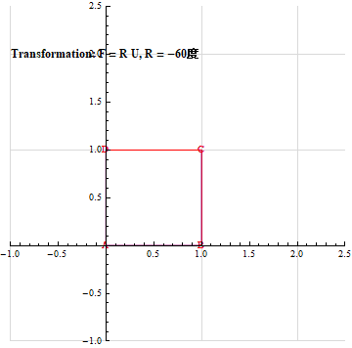
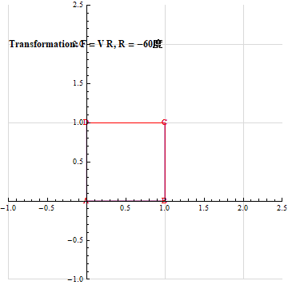
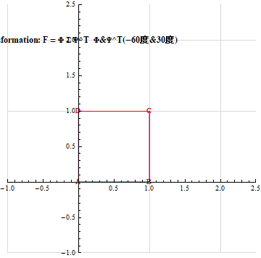

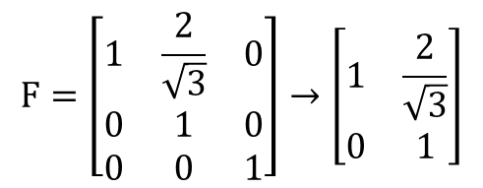
2025 Summer Plan
SVD 3D to 2D
$$F=\left[\begin{matrix}1 & \frac{2}{\sqrt{3}} & 0 \\ 0 & 1 & 0 \\ 0 & 0 & 1\end{matrix}\right]→\left[\begin{matrix}1 & \frac{2}{\sqrt{3}} \\ 0 & 1\end{matrix}\right]$$
$$Φ, Ψ,λ_{1},λ_{2}動畫$$
Summer Plan 完成後，可投稿中研院數學傳播期刊
參考文獻:
Continuum Mechanics and Plasticity 1990 Han-Chin Wu
Continuum Mechanics and Plasticity 2005 Han-Chin Wu
A NEW POINT OF VIEW FOR THE POLAR DECOMPOSITION USING SINGULAR VALUE DECOMPOSITION 2002 JTChen
從幾何觀點推導二階逆矩陣公式 周伯欣· 李依淳

