Slide 1


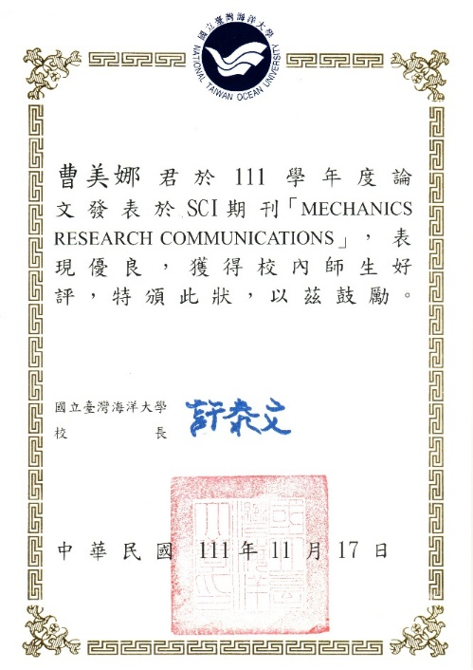
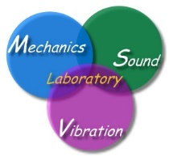

NTOU/MSV 大學生SCI論文成功案例(1994-2026) 小兵立大功
鄭岳世 | Dual series representation and its applications to a string subjected to support motions (1996) | ADV
陳桂鴻* | Analytical study and numerical experiments for Laplace equation with overspecified BCs (1998) | AMM
劉立偉** | On the free terms of the dual BEM for the two and three- dimensional Laplace problems (2000) | JMST
林盛益 | A new point of view for the polar decomposition using singular value decomposition (2002) | IJCN
李應德***、葉雅婷 | A meshless method for free vibration analysis of circular and rectangular clamped plates using radial basis function (2004) | EABE
蔡明宏 | Conformal mapping and bipolar coordinate for eccentric problems (2008) | CAEE
高聖凱 | Waves in string using diamond rule and Mathematica software (2008) | CAEE
謝正昌 | Derivation of stiffness and flexibility for rods and beams by using dual integral equations (2008) | EABE
吳國綸 | Regularized meshless mathod for Cauchy problems (2008) | CM
李家瑋 **** | On the spurious eigensolutions for the real-part boundary element method (2008) | EABE
余尚儒 | Equivalence between Trefftz method and method of fundamental solution for the annular Green’s function (2008) | EABE
蕭宇志 | Analysis of water wave problems containing single and multiple cylinders by using the degenerate kernel method (2010) | ISOPE
高怡絹 | Eigenanalysis for a confocal prolate spheroidal resonator using the null-field BIEM in conjunction with degenerate kernels (2014) | Acta Mechanica
凃雅瀞 | A self-regularized approach for deriving the free-free flexibility and stiffness matrices (2014) | CS
黃乙玲 | Revisit of the degenerate scale for an infinite plane problem containing two circular holes using conformal mapping (2019) | AML
邵程祥、呂政軒 | On the linkage between influence matrices in the BIEM and BEM to explain the mechanism of degenerate scale (2021) | JOM
周彥廷 | On the path independence and invariant of the J-integral for a slant crack and rigid-line inclusion using degenerate kernels and the dual BEM (2021) | EABE
周彥廷 | Construction of a curve by using the state equation of Frenet formula (2021) | JOM
戴暐宸 | An indirect BIE free of degenerate scales (2021) | CPAA
邵程祥、戴暐宸 | On the role of singular and hypersingular BIEs for the BVPs containing a degenerate boundary (2021) | EABE
高浩真 | Support motion of a finite bar with an external spring (2022) | JLFNVAC
曹美娜 | Analytical solutions for the Laplace problem of an eccentric annular domain (2022) | MRC
楊佳穎 臧紀甯 | Animation of cycloid and spiral curves in companion with instantaneous center 2 of rotation and radius of curvature (2023) | JCIE
楊佳穎 | Numerical instability and its treatment for steady state heat conduction problems in exchanger tubes using the dual boundary element method (2023) | NHT
楊佳穎 | Analytical study for numerical instability of steady-state heat conduction problems in exchanger tubes using degenerate kernels in the null-field boundary integral equation method (2024) | IJHMT
臧紀甯 | Thermal stress analysis of free-free trusses under temperature change using selfregularized approach (2025) | ASCE. JAE
* : 陳桂鴻現任於國立宜蘭大學土木工程學系正教授
** : 劉立偉現任於國立台灣大學土木系(國立成功大學工程科學系副教授)
*** : 李應德現任於國立台灣海洋大學河海工程學系副教授
**** : 李家瑋現任於淡江大學土木工程學系副教授
一個教授的養成教育都是從大學部就一點一滴的栽培方能奏功

Slide 2
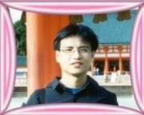
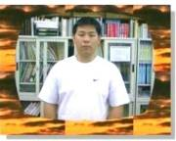
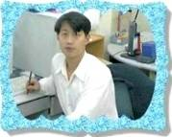
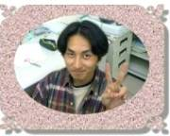
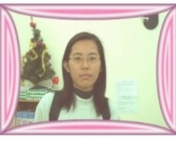
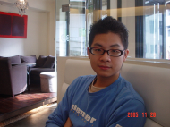
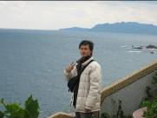
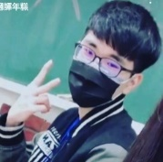
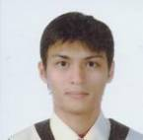

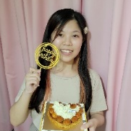
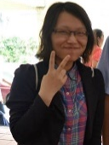
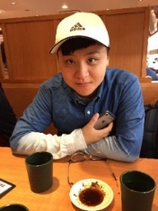
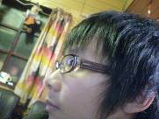
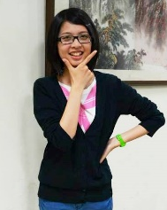
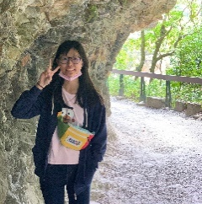


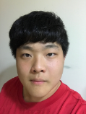

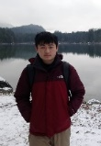

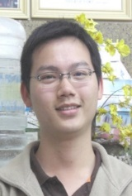
以前海洋大學部河工學長姊(帥哥美女)做的到，學弟妹們一定行
NTOU/MSV 大學部 SCI 論文發表榮譽榜(1994-2026)
鄭岳世
(ADV, 1996)
劉立偉
(JMST, 2000)
葉雅婷
(EABE, 2004)
謝正昌
(EABE, 2008)
陳桂鴻
(AMM, 1998)
林盛益
(IJCN, 2002)
蔡明宏
(CAEE, 2008)
臧紀甯 (JCIE, 2023)
楊佳穎 (JCIE®, 2023)
臧紀甯 (ASCE, JAE, 2025)
吳國綸
(CM, 2008)
高聖凱
(CAEE, 2008)
凃雅瀞
(CS, 2014)
黃乙玲
(AML, 2019)
余尚儒
(EABE, 2008)
李家瑋
(EABE, 2008)
高怡絹
(Acta Mechanica, 2014)
高浩真
(JLFNVAC, 2022)
曹美娜
(MRC, 2022)
邵程祥&呂政軒 戴暐宸 周彥廷
(JOM, 2021) (CPAA, 2021) (EABE2021)
曹美娜 (MRC, 2023)
蕭宇志
(ISOPE, 2010)

Slide 3
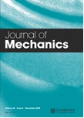
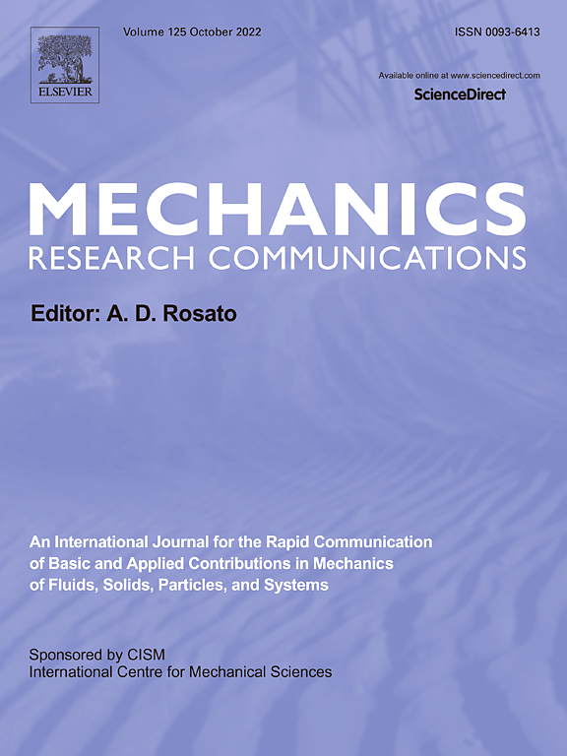

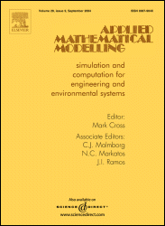
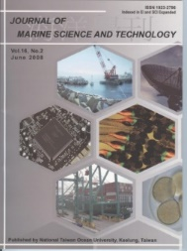
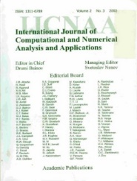
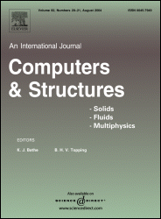
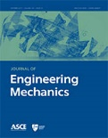
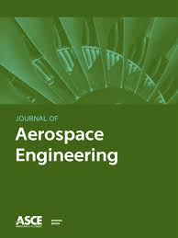
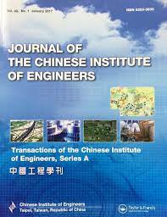
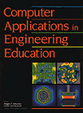

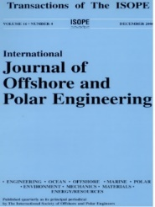

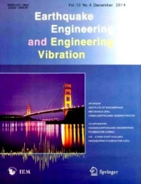

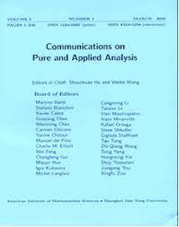

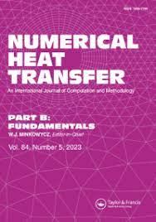
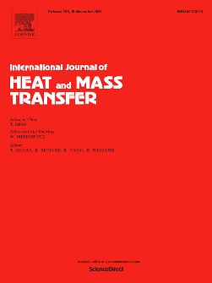
-目前已有26篇文章刊登，遍及20種期刊-
NTOU MSV 大學生SCI論文成功案例(1984-2026) 小兵立大功
SCI
2022 曹美娜
1996 鄭岳世
1998 陳桂鴻
2000 劉立偉
2002 林盛益
2014 凃雅瀞
2018 陳聖劻
2021 周彥廷
2021 邵程祥 呂政軒
2023 楊佳穎 臧紀甯
臧紀甯 (ASCE, JAE, 2025)
2010 蕭宇志
2014 高怡絹
2016 凃雅瀞
2004 葉雅婷
2008 謝正昌
2008 李家瑋
2008 余尚儒
2021 周彥廷 2021 邵程祥
2008 蔡明宏
2008 高聖凱
2008 吳國倫
2021 戴暐宸
2022 高浩真
有為者，亦若是
2023 楊佳穎
2023 楊佳穎
2022/01/10

