Slide 1


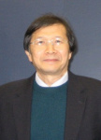
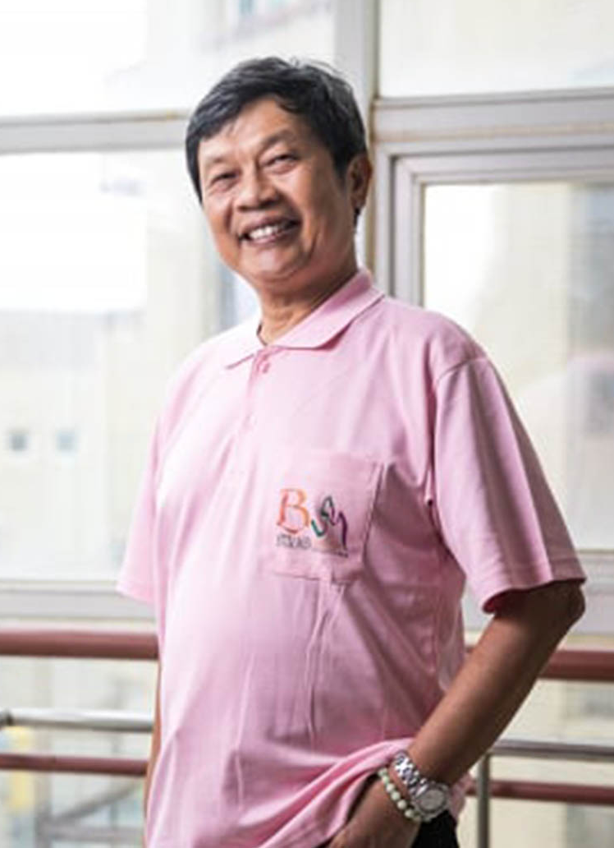
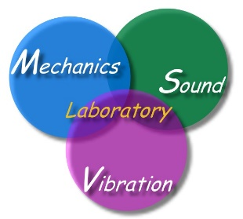

Stanford Top 2%
Civil professor
Applied physics | Applied math
陳東陽 | 陳正宗
Piezoelectricity-----0.29% | Boundary Element method-----0.23%
Stanford rank745 -----0.49% | Stanford rank174 -----0.77%

