Slide 1

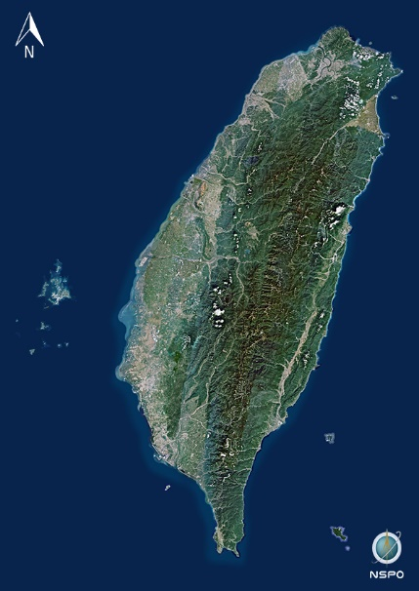





Solutions of antiplane shear problems with a crack or a rigid line inclusion by using the indirect BIE
Keelung
Author: Jeng-Hong Kao, Ting-An Wu, Wei-Chen Tai, Yen-Ting Chou, Jeng-Tzong Chen
Location: Section II Room A
Presentation time: 14:15~14:30 p.m.
Date：Nov. 12, 2022
Notes:
I am Dr. Kao, Jeng-Hong.
I come from National Taiwan Ocean University.
Today, I will share our research results.
The title is solutions of antiplane shear problems with a crack or a rigid line inclusion by using the indirect BIE.
The co-authors are Wu, Ting-An, Tai, Wen-Chen, Chou, Yen-Ting, and Prof. Chen, Jeng-Tzong.

Slide 2
Outline
Introduction
Analytical tool：the degenerate kernel in the elliptical coordinates
Indirect BIE formulation
Analytical solution
Conclusions
Notes:
This is the outline of my presentation.
First, I will review our series research on the antiplane shear problem.
Next, I will introduce two analytical tools we used in the study, degenerate kernel and indirect BIE.
And then, I will talk about the formulation of the study
The final are our results and conclusions.

Slide 3
Introduction
Notes:
Now I’m going to talk about the introduction.

Slide 4

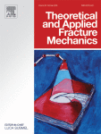

Literature review of MSV for antiplane shear problem
Introduction
Analytical tool：the degenerate kernel in the elliptical coordinates
Indirect BIE formulation
Analytical solution
Conclusions
AAM, 2021
TAFM, 2021
J.T. Chen,
J.H. Kao,
Y.L. Huang,
S.K. Kao
J.T. Chen,
J.H. Kao,
Y.L. Huang,
S.K. Kao
SCF
SIF
EABE, 2021
EABE, 2021
Present
J.T. Chen,
J.H. Kao,
S.K. Kao,
Y.L. Huang,
Y.T. Chou
J.T. Chen,
J.H. Kao,
S.K. Kao,
C.H. Shao,
W.C. Tai
Extend
direct BIE
Indirect BIE
Notes:
In recent year, our group have done series research on anti-plane problems by using direct BIE. We start from circle case and ellipse case.
These results have been published in AAM.
Then we study the line cases and discussed its J integral.
In the study, we use the present method to explain the mechanism of degenerate boundary analytically, the results have been published in TAFM and EABE.
Finally, we discussed the role of singular BIE and hyper-singular BIE in degenerate boundary problem from analytical and numerical aspect.

Slide 5
Problem Statement
Introduction
Analytical tool：the degenerate kernel in the elliptical coordinates
Indirect BIE formulation
Analytical solution
Conclusions
Degenerate boundary | Crack |  | Rigid line inclusion
Problem
G.E.
B.C.
Trivial
Trivial
Notes:
In our present work, we revisited anti-plane problems by using the indirect BIE.
The governing equation is Laplace equation.
The first problem is crack under anti-plane shear since the traction on the boundary is free, the corresponding b.c. is given by Neumann b.c..
The other one is rigid line inclusion under anti-plane shear, the given boundary condition is Dirchelet b.c. since the displacement on the boundary is zero.
We found that each has a trivial case in the crack problem and the rigid inclusion problem.

Slide 6
Analytical tool： the degenerate kernel in the elliptical coordinates
Notes:
So now I’m going to introduce the analytical tool we used in this study

Slide 7
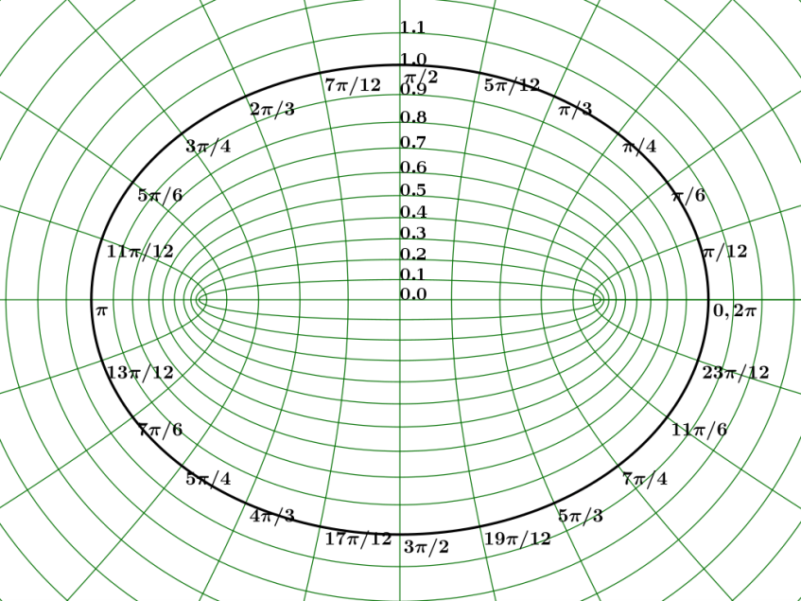
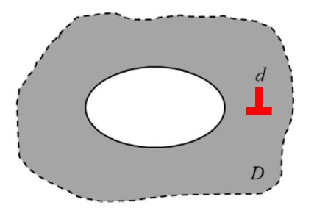
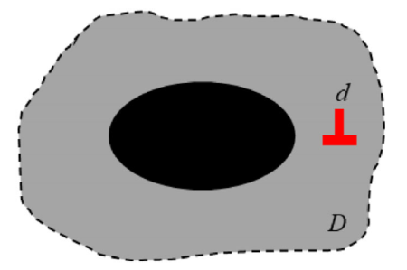
Introduction
Analytical tool：the degenerate kernel in the elliptical coordinates
Indirect BIE formulation
Analytical solution
Conclusions
What is elliptical coordinates?
y
(x,y)
x
2c
Cartesian coordinates
Elliptical coordinates
(source from Wikipedia)
screw dislocation problem with elliptical hole/inclusion
JT Chen et al., ZAMM, 2022
Anti-plane shear problem with elliptical hole/inclusion
JT Chen et al., AAM, 2021
Anti-plane shear problem with crack/rigid line inclusion
JT Chen et al., TAFM, 2021
Notes:
Since the boundary is ellipse, we employed the elliptical coordinates to analyze the problem.
The elliptical coordinates is an orthogonal coordinate system.
The system is based on two focus.
Like polar coordinates, it describes a point by radial coordinate and angular coordinate.
The coordinates system can be adopted naturally to solve the elliptical problem.
When $ξ_{0}$ equal to zero, it can describe a line geometry.
These are the successful cases done by the elliptical coordinates.

Slide 8
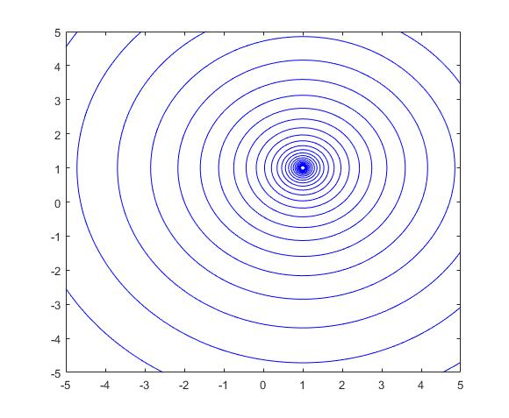
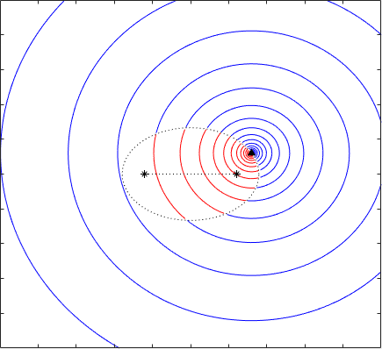
Introduction
Analytical tool：the degenerate kernel in the elliptical coordinates
Indirect BIE formulation
Analytical solution
Conclusions
What is the degenerate kernel ?
Close-form
Series form
Fundamental solution
Degenerate kernel
Notes:
The other analytical tool is degenerate kernel.
It is a technique that expanding the closed-form fundamental solution into series form, and separate the variables in the kernel function.
The usage of the degenerate kernel I will talk about later.

Slide 9
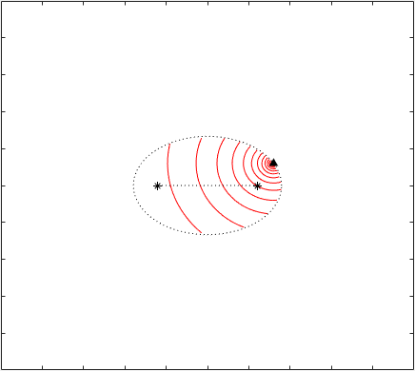
Degenerate kernel in the elliptical coordinates
Introduction
Analytical tool：the degenerate kernel in the elliptical coordinates
Indirect BIE formulation
Analytical solution
Conclusions
Notes:
This is the elliptical degenerate kernel of fundamental solution.
It has been divided to two formulations.
Each formulation represents a region and is shown in the figure.
From the plot we can see that, even expanding to the degenerate kernel, the contour line is same as the closed-form fundamental solution.
This is the degenerate kernel form of T kernel.

Slide 10
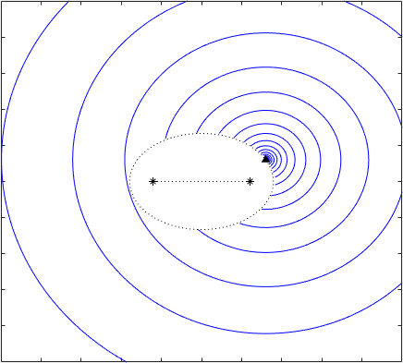
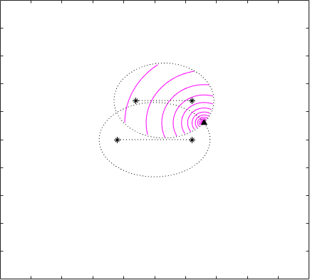
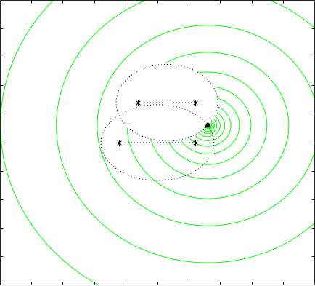
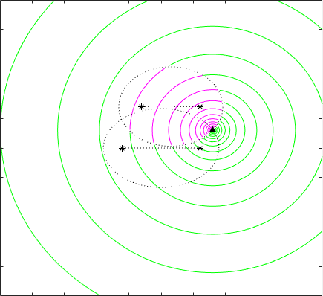
Introduction
Analytical tool：the degenerate kernel in the elliptical coordinates
Indirect BIE formulation
Analytical solution
Conclusions
Objectivity of the degenerate kernel
Frame in difference
Notes:
In this slide, we show the contour line distribution in different objective coordinates.
We can see the contour line distribution is not changed even the observer system is moved.

Slide 11
Indirect BIE formulation
Notes:
Now I’m going to talk about the formulation and the key technique.

Slide 12
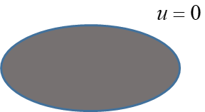
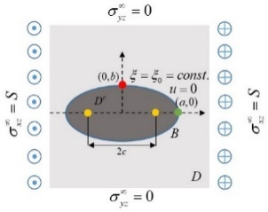
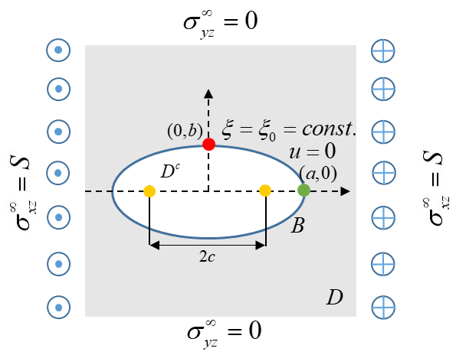
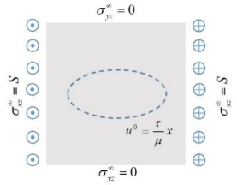
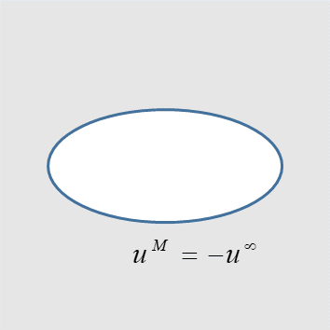
Decomposition of the problem
Introduction
Analytical tool：the degenerate kernel in the elliptical coordinates
Indirect BIE formulation
Analytical solution
Conclusions
An elliptic inclusion
The original problem
Anti-plane shear with a hole
Anti-plane shear with a virtual boundary
The displacement due to infinite plane subject to Dirichlet B.C.
Notes:
Since it is a linear problem, the problem is decomposed into two parts.
One is antiplane shear problem with a hole.
The other is a rigid inclusion.
The antiplane shear problem with a hole is decomposed into two problems.
One is antiplane shear with a virtual boundary.
The other is a BVP subjected to the Dirichlet b.c.

Slide 13
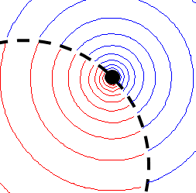
Introduction
Analytical tool：the degenerate kernel in the elliptical coordinates
Indirect BIE formulation
Analytical solution
Conclusions
Null-field BIE for the well-posed BVP
Indirect BIE formulation
Indirect BIE + Degenerate kernel
Relation of kernel functions
Single-layer potential
Double-layer potential
Eigenfunction expansion for unknown boundary densities
Advantage of using degenerate kernel:
The BIE is nothing more than the linear algebraic system (Cochran, 1982)
Avoiding the calculating the principal value
Degenerate kernel
Notes:
The indirect BIE includes single-layer potential and double-layer potential.
U, T, L ,M are kernel functions.
The relation of four kernel functions is shown in the slide.
The unknown boundary densities $α$ and $β$ are written in series form by using eigenfunction expansion.
Where c0, cn, dn and r0, rn, dn are unknown coefficients.
The unknown coefficients can be determined by using the boundary condition.
By using the BIE in conjunction with the degenerate kernel, we can obtain two advantages.
The first one is the BIE is nothing more than the linear algebraic system.
The second one is avoiding the calculating the principal value.

Slide 14




Introduction
Analytical tool：the degenerate kernel in the elliptical coordinates
Indirect BIE formulation
Analytical solution
Conclusions
Approximate degenerate boundary by
using the two ways
Analytical solution
$$u\left(ξ,η;ξ_{0}\right)$$
Indirect BIE
First way
$$ξ_{0}=0$$
Degenerate kernel
$$u\left(ξ,η\right)$$
Degeneracy mechanism
Degenerate scale
Second way
$$ξ_{0}=0$$
Indirect BIE
Degeneracy mechanism
Degenerate boundary
Degenerate scale
Degenerate kernel
Notes:
We have two ways to deal with the line cases.
One is setting $ξ_{0}$ to zero after obtaining the solution of elliptical case.
The other one is setting $ξ_{0}$ to zero before deriving solution.
This process is to simulate the numerical calculating.
The difference of these two way will be address later.

Slide 15
Analytical solution
Notes:
Now I’m going to talk about the resutls.

Slide 16
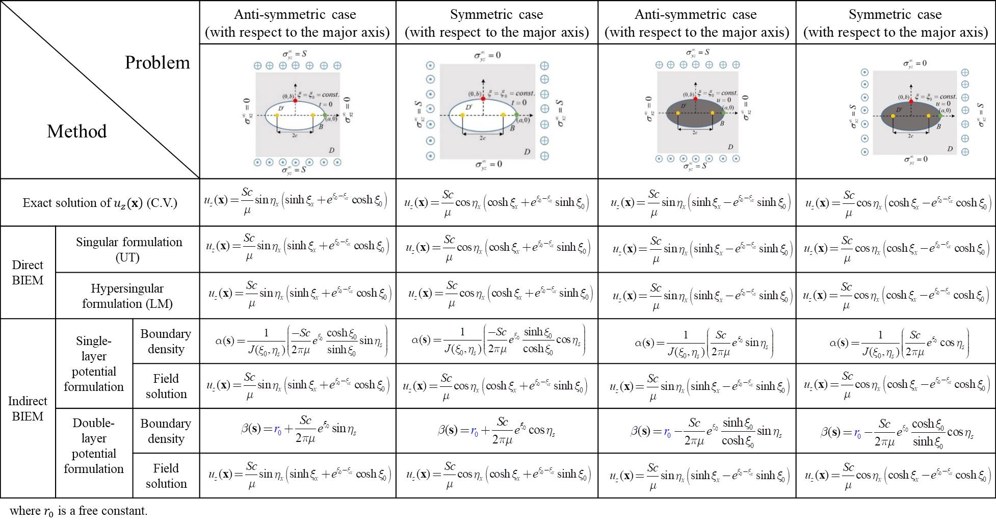
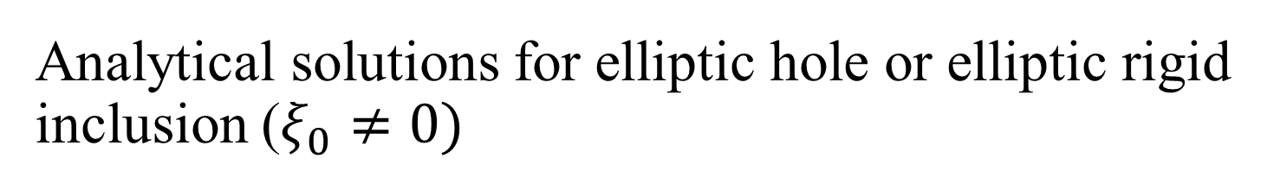
Analytical solutions for elliptic hole or elliptic rigid inclusion ($ξ_{0}≠0)$
Introduction
Analytical tool：the degenerate kernel in the elliptical coordinates
Indirect BIE formulation
Analytical solution
Conclusions
Notes:
We compare the results which derived from the direct BIE and complex variable.
Good agreement is made.

Slide 17
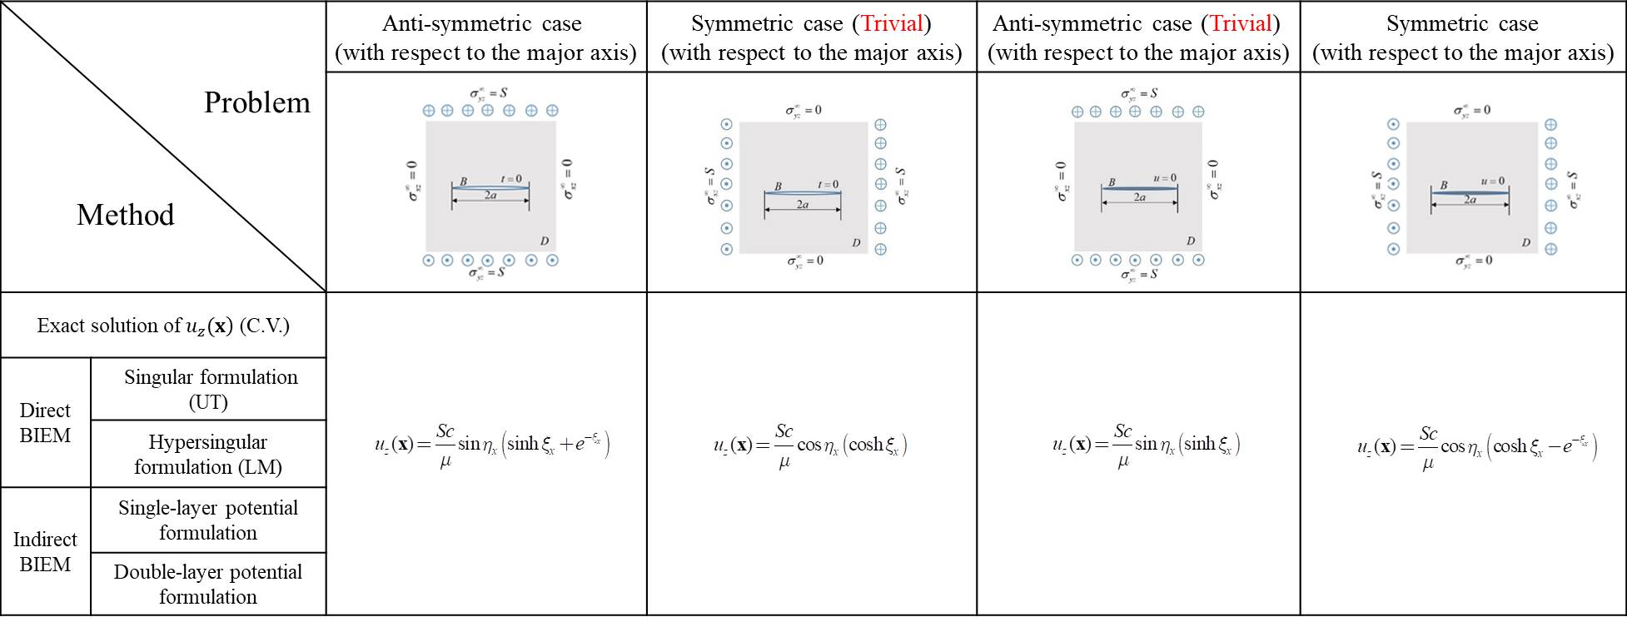
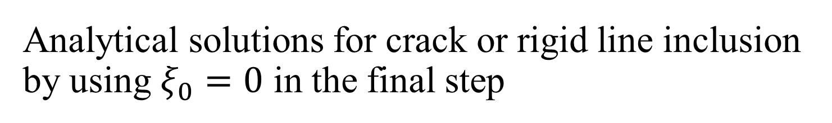
Analytical solutions for crack or rigid line inclusion by using $ξ_{0}=0$ in the final step
Introduction
Analytical tool：the degenerate kernel in the elliptical coordinates
Indirect BIE formulation
Analytical solution
Conclusions
Notes:
For the line cases, the results done by the first way are also same with the results done by the direct BIE and complex variable.

Slide 18
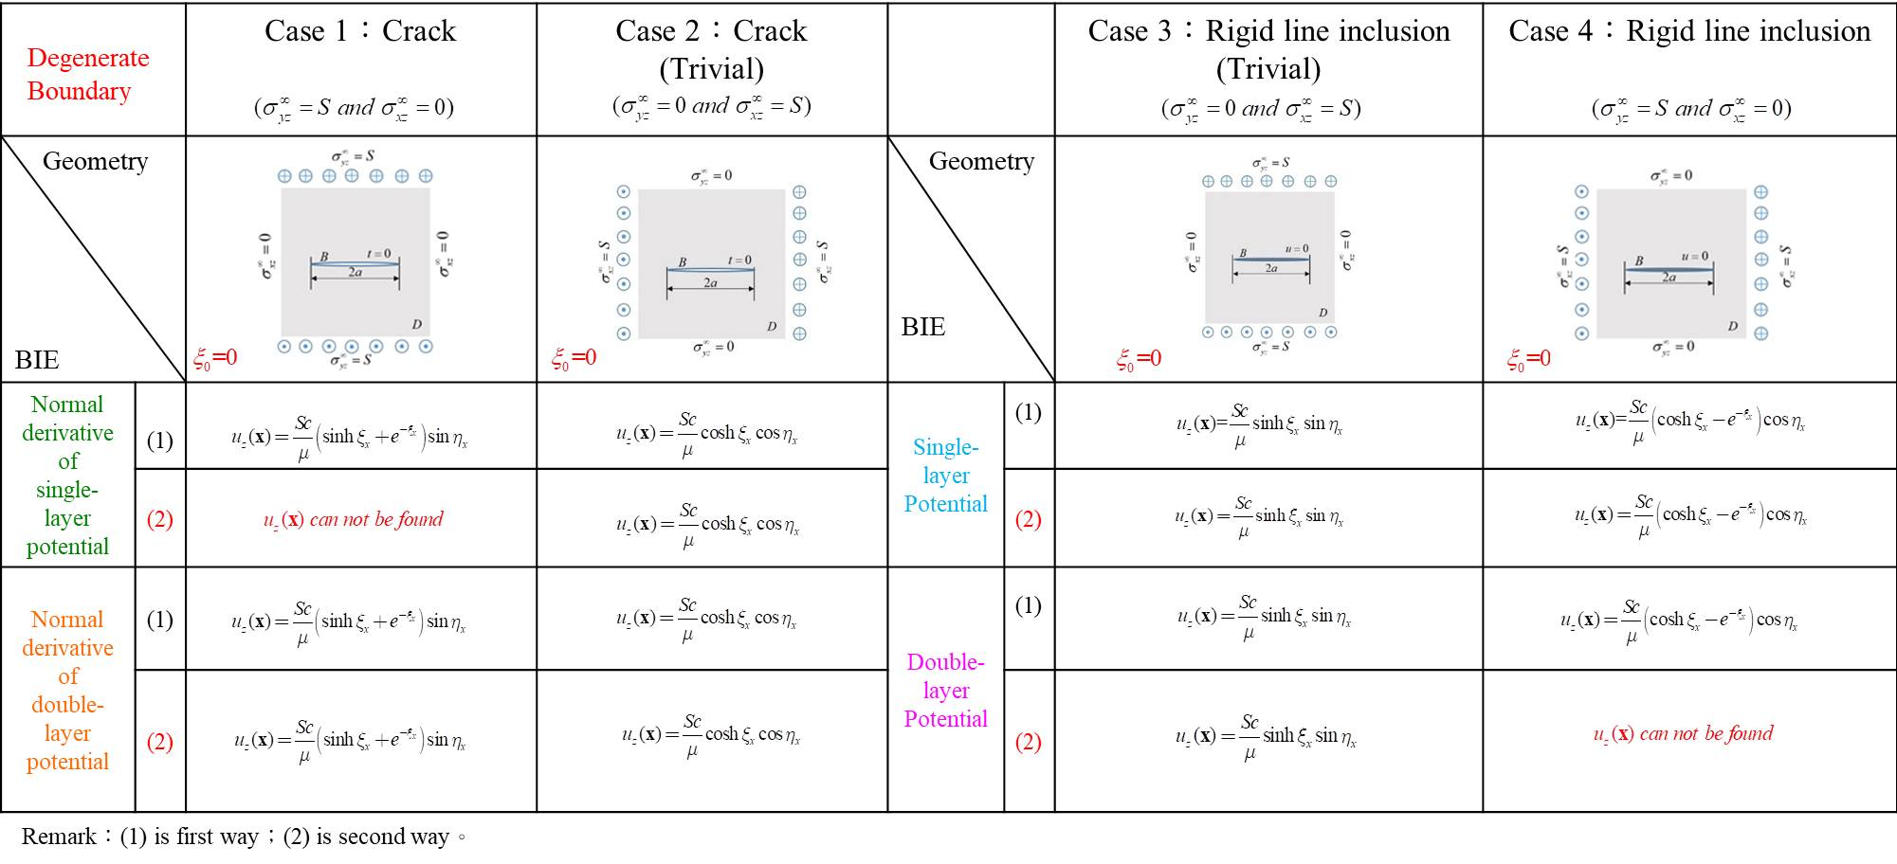
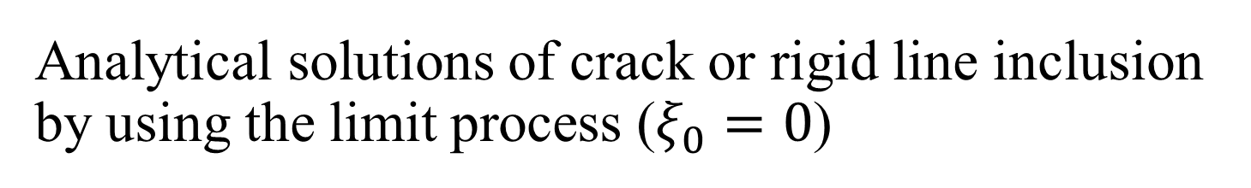
Analytical solutions of crack or rigid line inclusion by using the limit process ($ξ_{0}=0$)
Introduction
Analytical tool：the degenerate kernel in the elliptical coordinates
Indirect BIE formulation
Analytical solution
Conclusions
solvable
solvable
Notes:
For the second way of limiting $ξ_{0}=0$.
Case 1 and 2 are the crack under the different directions antiplane shear.
Case 3 and 4 are the rigid line inclusion under the different directions antiplane shear.
Case 2 and 3 are trivial cases as we mentioned before.
Comparing with the direct BIE, we found that the double-layer potential matches the same results in case 1.
The single-layer potential matches the same results in case 4.

Slide 19
Conclusions
Notes:
Now I’m going to do conclusion remarks.

Slide 20
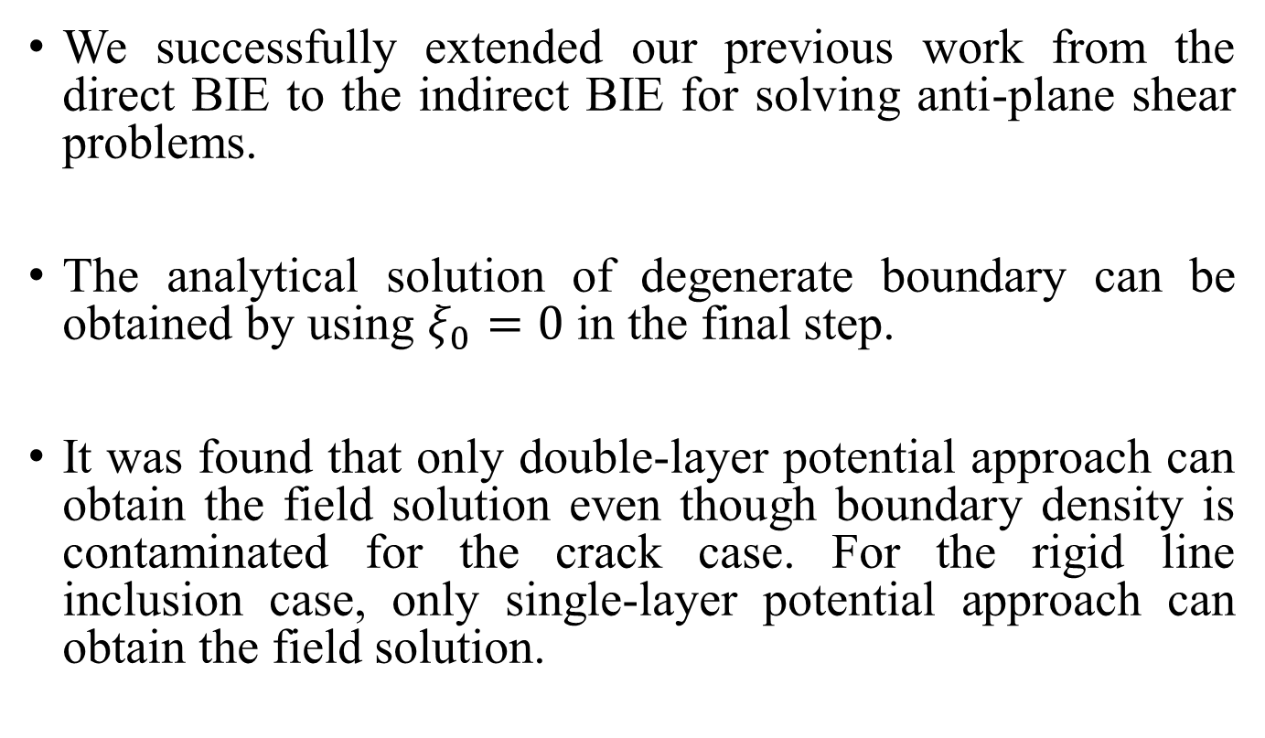
Conclusions
We successfully extended our previous work from the direct BIE to the indirect BIE for solving anti-plane shear problems.
The analytical solution of degenerate boundary can be obtained by using $ξ_{0}=0$ in the final step.
It was found that only double-layer potential approach can obtain the field solution even though boundary density is contaminated for the crack case. For the rigid line inclusion case, only single-layer potential approach can obtain the field solution.
Notes:
We successfully extended our previous work from the direct BIE to the indirect BIE for solving anti-plane shear problems.
The analytical solution of degenerate boundary can be obtained by using $ξ_{0}$=0 in the final step.
It was found that only double-layer potential approach can obtain the field solution even though boundary density is contaminated for the crack case.
For the rigid line inclusion case, only single-layer potential approach can obtain the field solution.

Slide 21
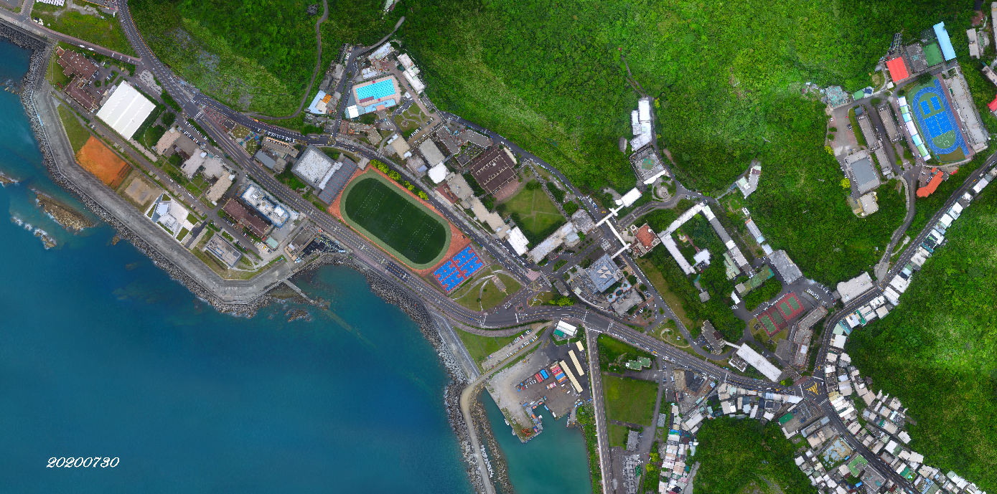
Thanks for your attention
My office
Keelung
Notes:
Thanks for your attention

