Slide 1
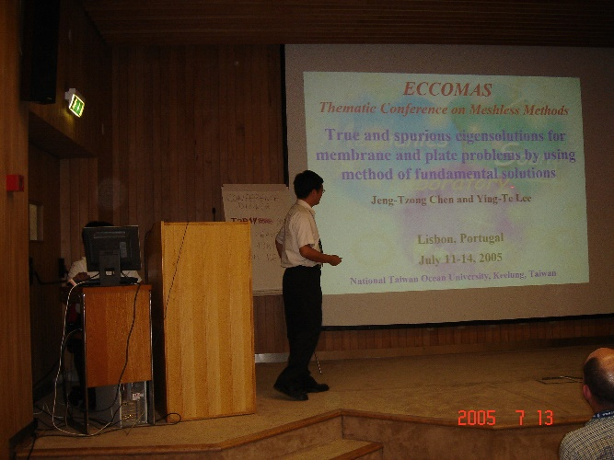
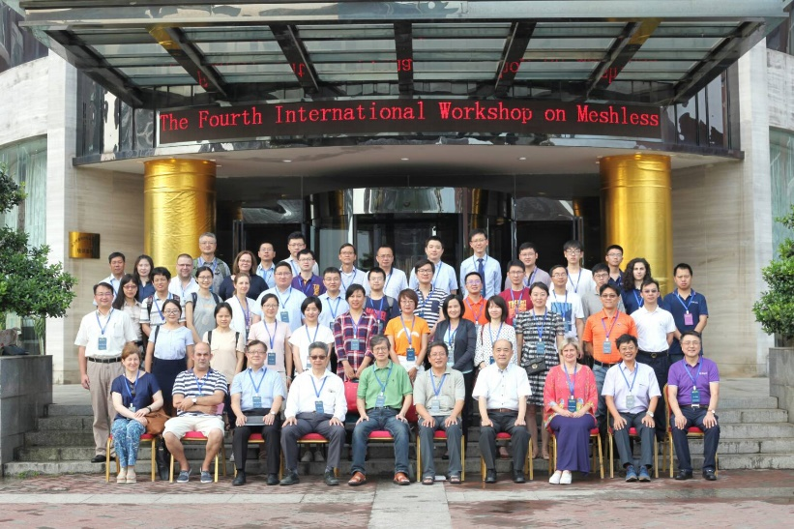
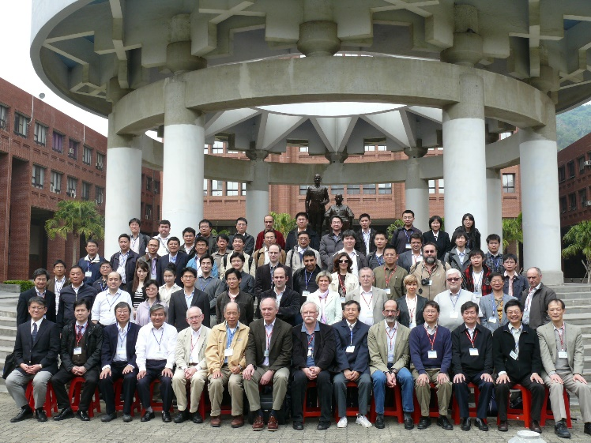
相逢自是有緣
Taiwan NTOU/MSV versus Portugal
Year | Event
1993 | Betech 1993 in Alagarve
2003 | Alves invited Chen to Meshless meeting (Sorry absence)
2005 | Chen attended ECCOMAS Meshless Method (Alves invited again)
2011 | Trefftz/MFS Invited Alves to Taiwan (Alves attended)
2013 | Met Pedro in Singapore APCOM 2013 (Alves former PhD student)
2018 | Pedro (Alves former PhD student) visited our MSV
2018 | Alves family attended IWMM4 meeting in Changsha, China
2021 | Alves passed away due to earlier heart attack.
Taiwan NTOU/MSV versus Portugal.ppt 志忠製表

