Slide 1
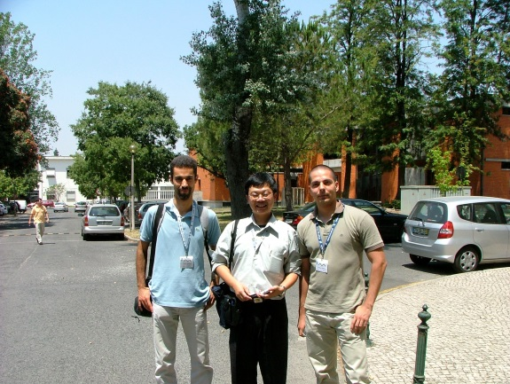
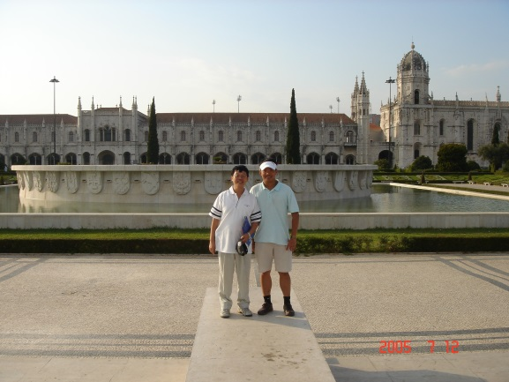
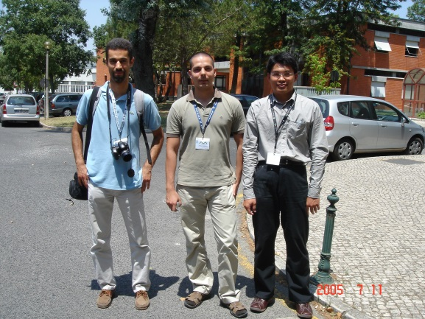
相逢自是有緣
Taiwan NTOU/MSV versus Portugal
Year | Event
1993 | Betech 1993 in Alagarve
2003 | Alves invited Chen to Meshless meeting (Sorry absence)
2005 | Chen & Lee attended ECCOMAS Meshless Method (Alves invited again)
2011 | Trefftz/MFS Invited Alves to Taiwan (Alves attended)
2013 | Meet Pedro in Singapore APCOM 2013 (Alves former PhD student)
2018 | Pedro visit our MSV
2018 | Alves family attended IWMM4 meeting in Changsha, China
2019 | Welcome to Taiwan again APCOM 2019
Taiwan NTOU/MSV versus Portugal.ppt 志忠製表

