Slide 1




SH-wave scattering problem of an arbitrary shaped hill by using the boundary integral quadrature method
Jia-Wei Lee, Yu-Wei Wang, Shing-Kai Kao & Jeng-Tzong Chen
Date: July 03, 2025
Time: 16:30~16:50
Place: Room 503,
Kobe International Conference Center
Kobe, JAPAN
Notes:
My name is Jia-Wei Lee. I come from Tamkang University, and I am delighted to be here today to talk about my resent research work.
The title of my presentation is SH-wave scattering problem of an arbitrary shaped hill by using the boundary integral quadrature method.

Slide 2

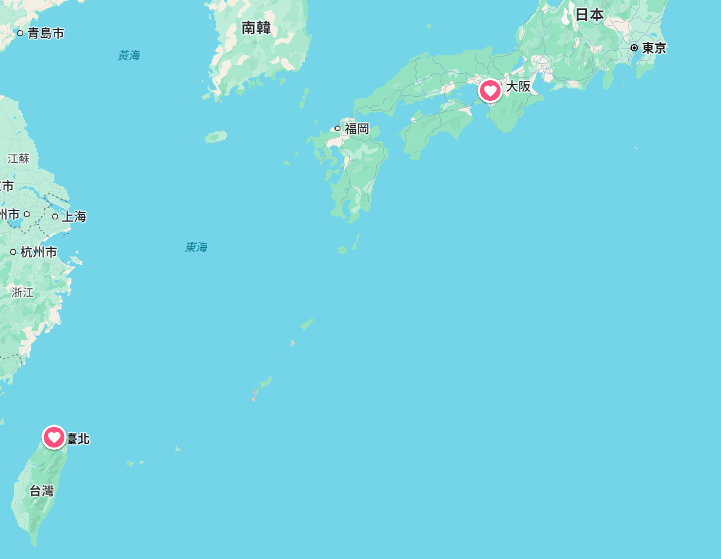
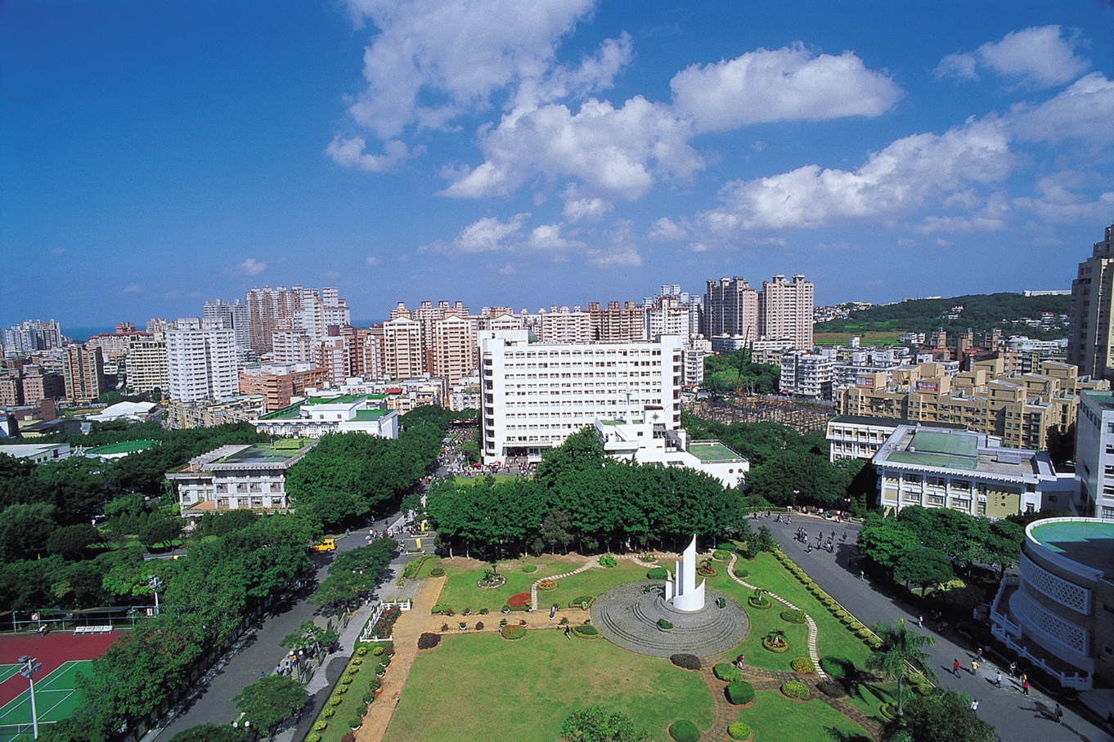
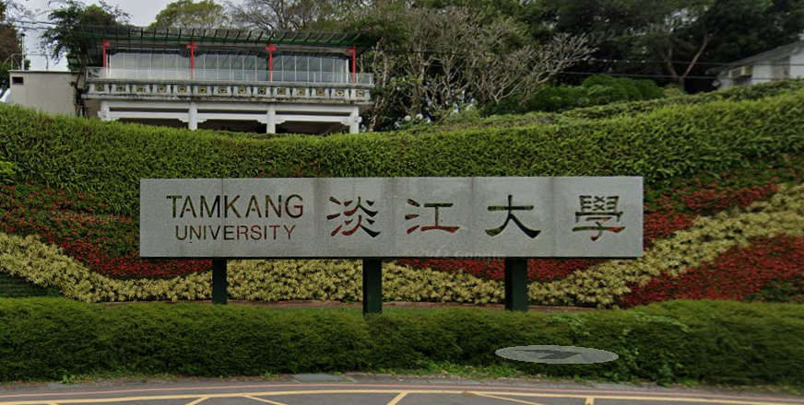
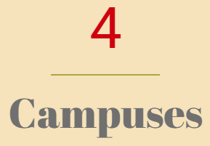


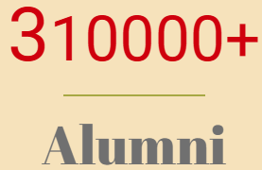
Tamkang University
Private university
Kobe
TKU
NTOU
Taiwan
Notes:
Before my talk, please let me introduce my university.
Tamkang University is a private university in Taiwan.
We have 4 campuses, more than 2000 staff, 22,000 students and 310,000 alumni.

Slide 3
Outline
Introduction
Problem statement
Present approach
Numerical results
Conclusions
Notes:
There are five parts in my talk.

Slide 4
Outline
Introduction
Problem statement
Present approach
Numerical results
Conclusions
Notes:
First, I would like to talk about the introduction.

Slide 5
Motivation
 | Null-field BIEM (2003 NTOU/MSV) | Conventional BEM
Pros | Meshless Well-posed Free of boundary layer effect Exponential rate of convergence Free of principal values | Arbitrary geometry
Cons | Only special geometry (circle or ellipse) | Need mesh generation in model preparation
Boundary
Nodes
Degenerate kernel
Fourier series
Boundary elements
Closed-form fundamental solution
Interpolation function
We proposed the BIQM that have both advantages of these two methods since 2021
Notes:
Since 2003, Prof. Chen’s group NTOU/MSV developed the null-field boundary integral equation method.
The two key points are using the degenerate kernel and the Fourier series to represent the closed-form fundamental solution and boundary density.
Therefore, five advantages are gained such as Meshless, Well-posed, Free of boundary layer effect, Exponential rate convergence and, free of principal values.
However, it is only suitable for special geometry.
The conventional BEM does not have the above five advantages and need mesh generation on the boundary, but the most advantage is suitable for the arbitrary geometry.
In this study, we would like to develop a BIEM that have two advantages such as meshfree and suitability for the arbitrary geometry.

Slide 6
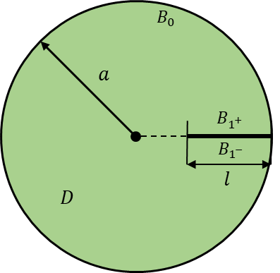
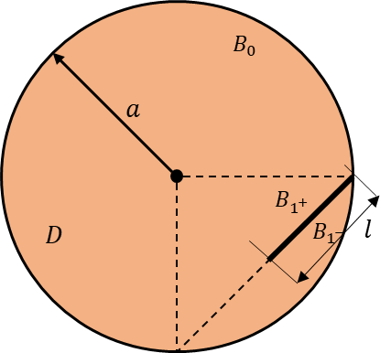
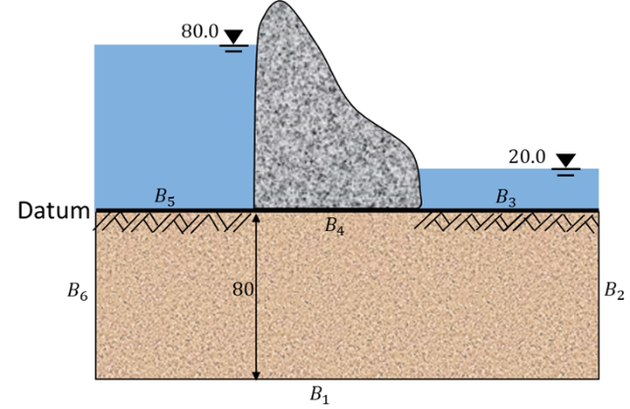
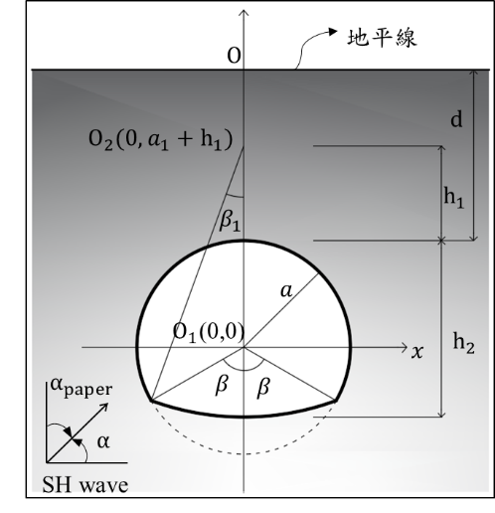

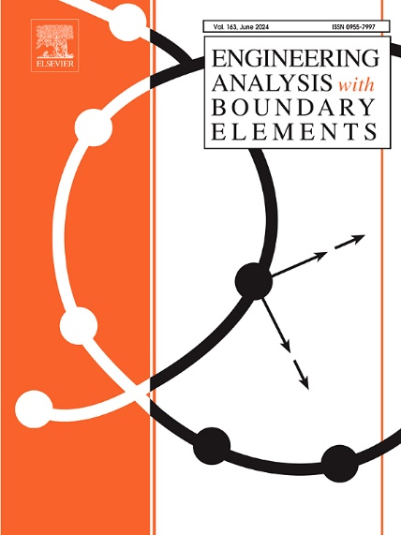

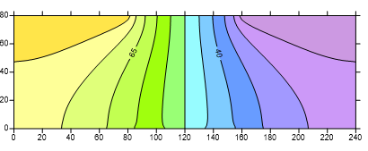
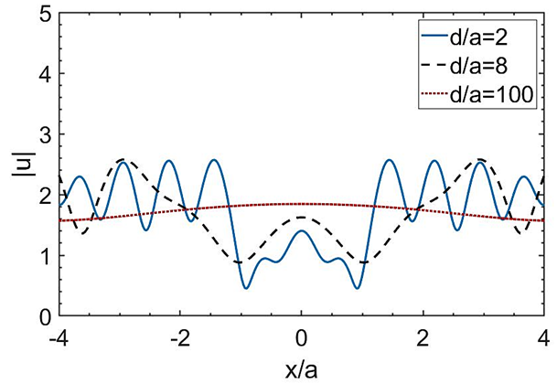
Development of BIQM
Since 2021 |  | 2023-2024 |  | 2024
Interior potential problem | Membrane free vibration problem | Steady state heat conduction problem |  | Torsion problem
Exterior anti-plane problem | SH-wave scattering problem
Simply-connected domain |  | Multiply-connected domain | Degenerate boundary
Laplace equation | Helmholtz equation | Laplace equation
Singular integral (Adaptive exact solution) Nearly singular integral (Adaptive exact solution) Meshfree (Gaussian quadrature) |  | Singular integral (Adaptive exact solution) Nearly singular integral (Adaptive exact solution) Meshfree (Gaussian quadrature) Degenerate scale (CLEEF) Degenerate boundary (Dual BIEM) Singular integral on slit (Adaptive exact solution for slit)

Slide 7
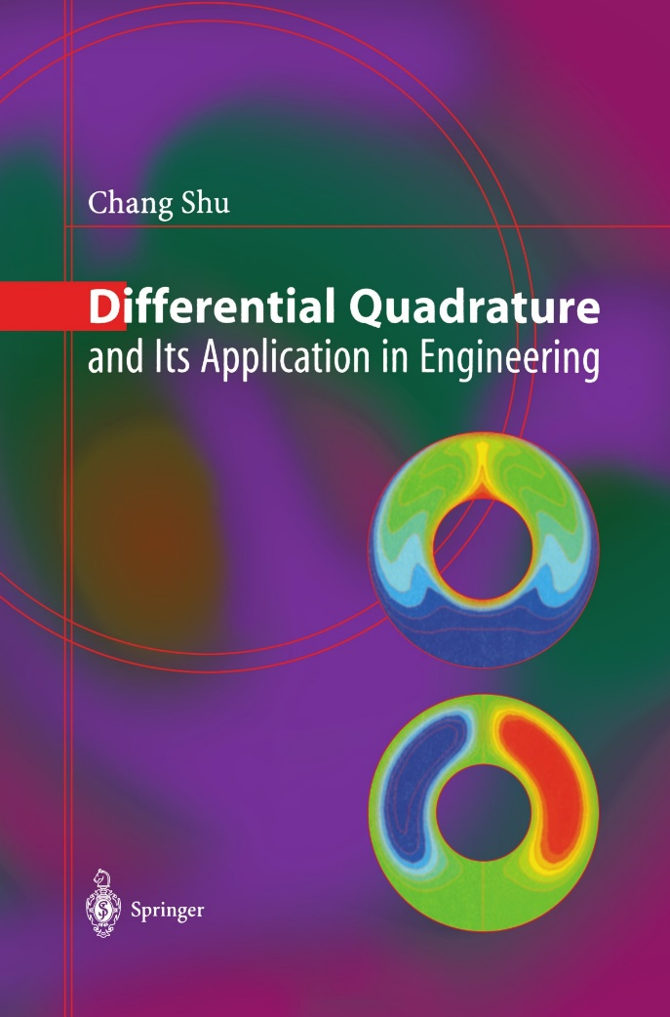
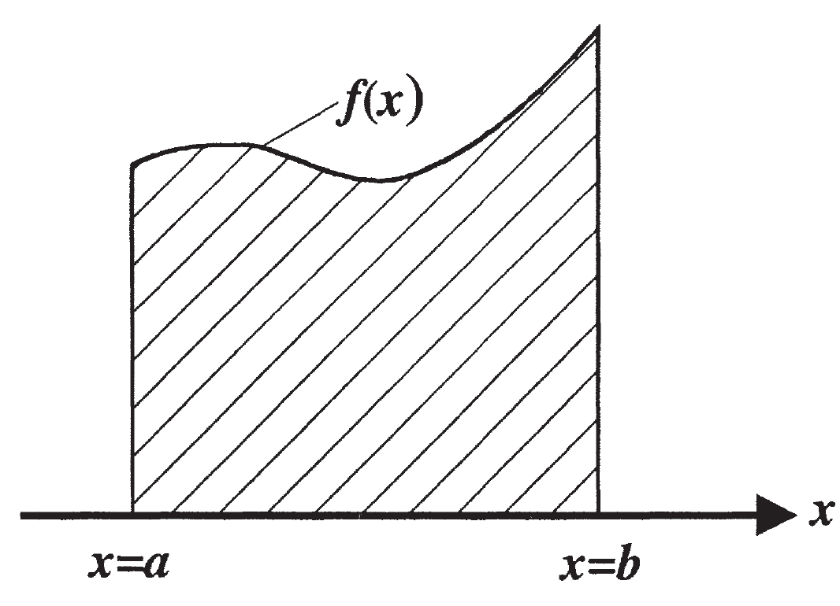
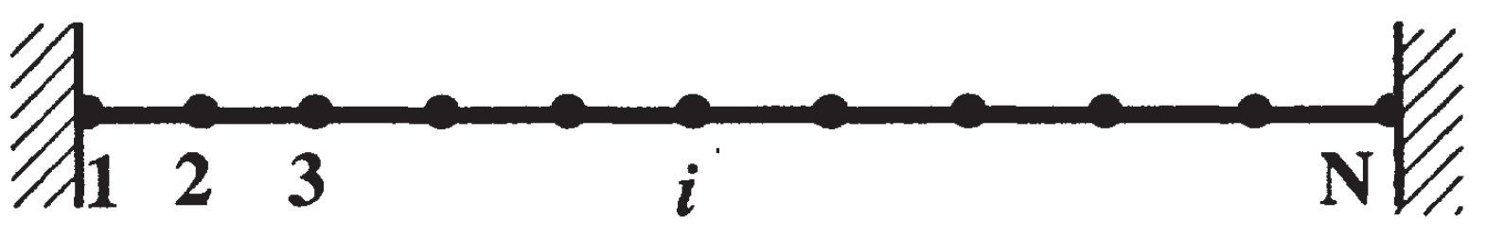
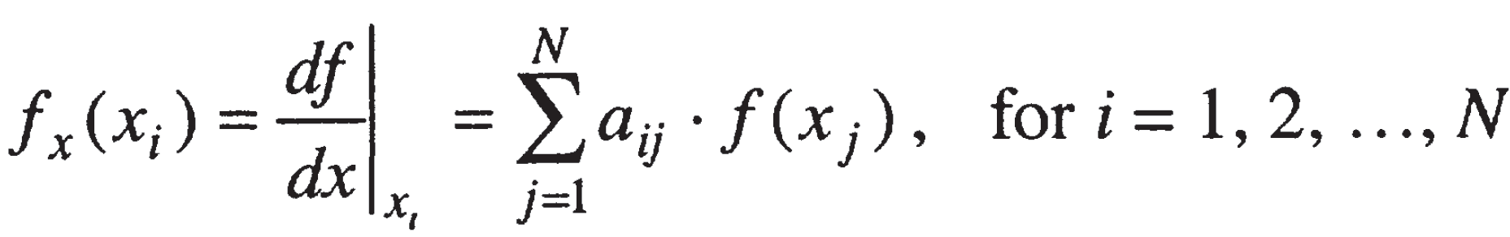
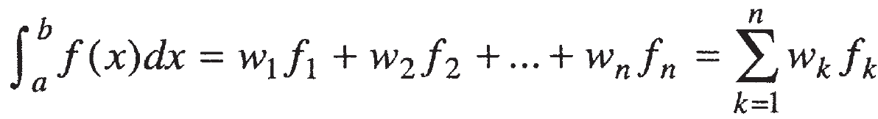
Differential quadrature vs. Integral quadrature
DQ
IQ
The differential quadrature (DQ) method was presented by R. E. Bellman and his associates in the early 1970's.
The DQ method was initiated from the idea of conventional integral quadrature.
Differential
Linear sum
Integral
Notes:
Why our method is called as boundary integral quadrature method (BIQM).
Because, the treatment of the integral term is similar to the differential quadrature method.
The integral term is transformed into a linear sum by using the Gaussian quadrature.
For the DQM, the differential term is also transformed into a linear sum with a specified weighting.

Slide 8
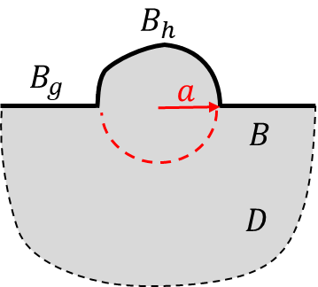
Main goal of this work
Interior problem
Exterior problem
SH-waves
Verifying the validity of the boundary integral quadrature method (BIQM) for solving the SH-wave scattering problem is the main goal.

Slide 9
Outline
Introduction
Problem statement
Present approach
Numerical results
Conclusions
Notes:
The second part is the problem statement.

Slide 10
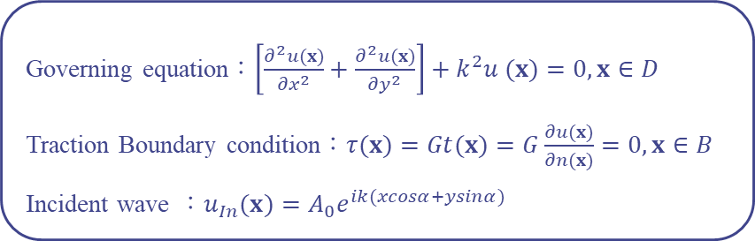

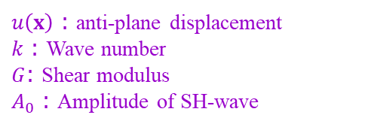
Problem statement
Materials Assumptions
Linear elastic
Isotropic
Homogeneous
SH-wave scattering problem
Two-dimensional Helmholtz equation
Governing equation：$\left[\frac{∂^{2}u(x)}{{∂x}^{2}}+\frac{∂^{2}u(x)}{{∂y}^{2}}\right]+k^{2}u (x)=0, x∈D$
Traction Boundary condition：$τ(x)=Gt(x)=G\frac{∂u(x)}{∂n(x)}=0, x∈B$
Incident wave ：$u_{In}(x)=A_{0}e^{ik(xcosα+ysinα)}$
SH-waves
$u\left(x\right)$ : anti-plane displacement
$k$ : Wave number
$G$: Shear modulus
$A_{0}$ : Amplitude of SH-wave
$α$ : Incident angle
$D$ : Domain
$B$ : Boundary
$$B=B_{h}∪B_{g}$$
Notes:
Regarding SH-wave scattering problems containing a hill of arbitrary shape, the time harmonic motion is considered.
The material properties are linear elastic, isotropic and homogeneous.
Therefore, the displacement field satisfies the 2D Helmholtz equation.
And the boundary condition is traction free.
mu is the shear modulus.
This incident plane SH-wave is exp I k
alpha is the incident angle.

Slide 11
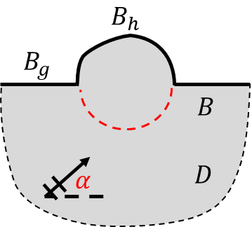
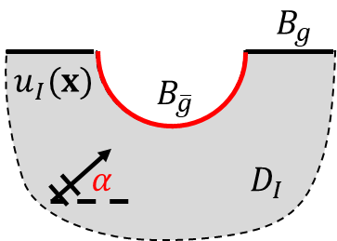
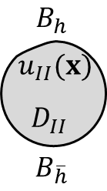
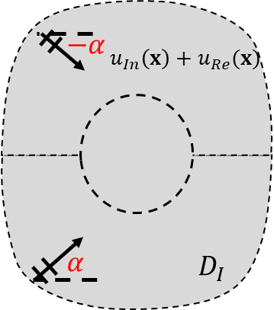
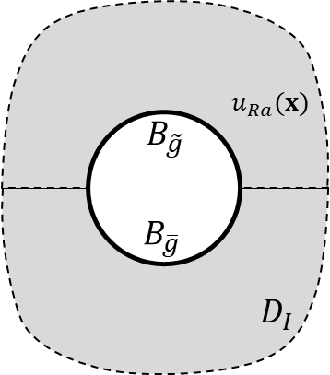
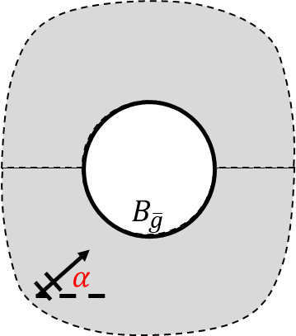


Decomposition of hill problem
Artificial interface
Half-plane
+
=
Domain
decomposition
Image method
=
+
Superposition
principle
$$u_{In}\left(x\right)+u_{Re}(x)$$
$$u_{Ra}(x)$$
Infinite-plane
Free field
Radiation field
Notes:
For the half-plane problem with a convex topography, an artificial boundary below the hill is introduced.
The original domain is decomposed into two subdomains.
One is the half-plane problem with a semi-circular concave boundary.
The other is an interior problem.
Next, the image method is adopted to map the half-plane problem into an infinite-plane problem containing a circular boundary.
In this way, the traction free boundary condition along the horizontal ground surface can be automatically satisfied.
Then, the infinite-plane problem can also be decomposed into a free field and radiation field.
The free field contains both the incident wave and the reflective wave.
Finally, we employ the BIQM to deal with the radiation field and the interior problem.

Slide 12
Outline
Introduction
Problem statement
Present approach
Numerical results
Conclusions
Notes:
Next, I would like to talk about the present approach

Slide 13
Boundary integral equation
Interior problem
in the domain
in the complementary domain
on the boundary
Notes:
There are three representations of boundary integral formulation according to the location of the field point.
One is the boundary integral representation for the domain point.
Another is Null-field boundary integral equation for the complementary domain.
And the other is the boundary integral equation for the boundary point.
To solve the unknown boundary densities, it is required to employ the boundary integral equation.
So, the singular integral in the Cauchy principal value sense may be encountered.
And the field and it normal flux are discontinuous across the boundary.

Slide 14
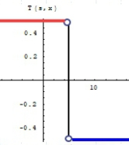
Who is responsible for the discontinuity of the
double-layer potential? (boundary, kernel or density?)
邊界密度函數的解析延拓。
(Taylor expansion)
Okada et al. ASME. JAM 1988, Displacement gradient
(Kisu, 1988)
Gauss’ theorem
Residue Theorem
p(x) jump from De to D^{i}.
CPV (Cauchy)
s
x
x
s
Degenerate kernel
discontinuity
山不轉。路轉。
Bump contour
山不轉。路不轉。人轉。
Notes:
Generally speaking, there are three ways to treat the singular integral in the literature.
Boundary, kernel or density
One is using the Taylor expansion and order analysis for the boundary density.
Also, the idea of displacement gradient proposed by Prof. Okada is focused on the boundary.
The second is the bump contour approach in companion with the principal value.
The third is the degenerate kernel expression for the closed-form fundamental solution. In this way, the double layer potential can be described into two parts, inside the domain and outside the domain.
The present approach focuses on the boundary density.

Slide 15
Adaptive exact solution
subtracting
Discontinuous
Notes:
The above one is the original BIE.
The boundary density and its normal flux are discontinuous across the boundary.
Now we introduce an adaptive exact solution.
The middle one is the BIE of the exact solution.
The domain of the exact solution is totally the same with the domain of the corresponding problem.
By subtracting the BIE of the adaptive exact solution from the original BIE, we obtain the below BIE.

Slide 16
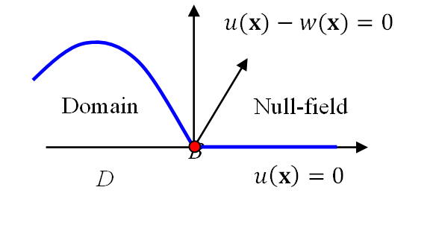
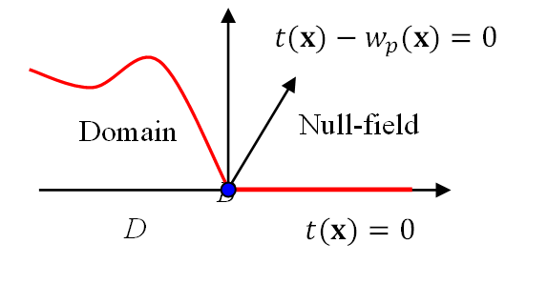



Adaptive exact solution
To enforce the smoothness and continuity of potential and its normal flux across the boundary, we introduce the adaptive exact solution.
w$hen n\left(x\right)$=($n_{x}\left(x\right),n_{y}\left(x\right)$) &$s=(s_{x},s_{y})$
$$\left(u\left(s\right)−w\left(s\right){\left)|\right.}_{s=x}=0\right.$$
Discontinuous
Continuous
$$\left(t\left(s\right)−w_{p}\left(s\right){\left)|\right.}_{s=x}=0\right.$$
$$0=\int_{B}{T\left(s,x\right)\left[u\left(s\right)−w\left(s\right)\right]dB\left(s\right)}−\int_{B}{U\left(s,x\right)\left[t\left(s\right)−w_{p}\left(s\right)\right]dB\left(s\right)},x∈B$$
Skillful calculation of singular integral
computation of solid angle is free
Not required
Notes:
To enforce the smoothness and continuity of potential and its normal flux across the boundary, two continuity conditions can be obtained.
According to two continuity conditions, the adaptive exact solution can be obtained.
Therefore, the BIE can be rewritten as shown here.
In this way, the singular integral in the sense of Cauchy principal value can be skillfully determined without using the bump contour approach or the degenerate kernel expansion.
And, the computation of solid angle is also free.

Slide 17
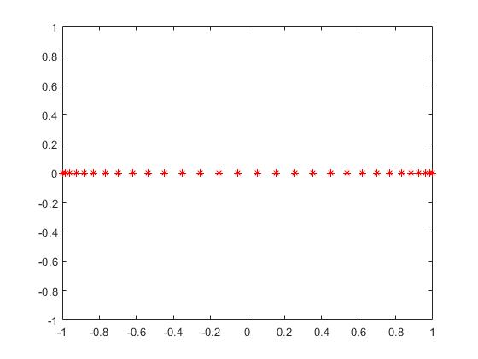
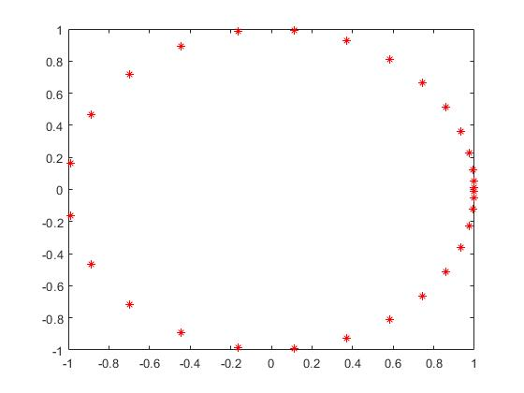
Integral equation to algebraic equation
Parametric representation for each boundary
Gaussian quadrature
IE -> AE
Gaussian points
Boundary node points
Notes:
By introducing the adaptive exact solution, the remainder BIE is a standard integral equation.
After using the parametric representation for each boundary, we can employ the Gaussian quadrature to transform the BIE into the algebraic equations as shown that. All unknown boundary densities are corresponding to the Gaussian quadrature points on the boundary.
The left one is the general distribution of Gaussian quadrature points. The right one is the distribution of those Gaussian quadrature points on the real boundary.
Finally, arranging the algebraic equations, the linear matrix form Tu=Ut is obtained.

Slide 18
Boundary integral equation
Exterior problem
It is difficult
belongs to the exterior problem
Adding
Notes:
For the exterior problem, it is difficult to derive an adaptive exact solution that satisfies the Sommerfeld radiation condition.
So, we also introduce the adaptive exact solution, and its domain is corresponding to the complementary domain of the exterior problem.
This one is the BIE for the exterior problem.
The second one is the BIE of the corresponding adaptive exact solution.
After adding these two BIEs, we can obtain the BIE without other regularization approach to treat singular integral.

Slide 19
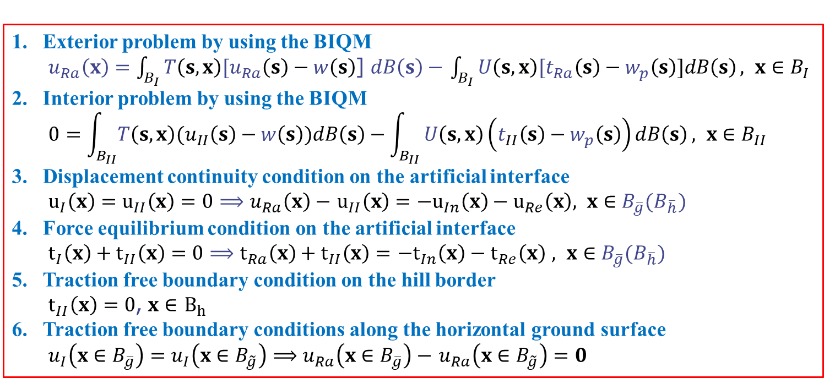


Decomposition of scattering problem
Boundary Integral Quadrature Method
Exterior problem by using the BIQM
$u_{Ra}\left(x\right)=$ $\int_{B_{I}}{T\left(s,x\right){[u}_{Ra}\left(s\right)−w\left(s\right)}$] $dB\left(s\right)−$ $\int_{B_{I}}{U\left(s,x\right){[t}_{Ra}\left(s\right)−w_{p}\left(s\right)]dB\left(s\right)}, x∈B_{I}$
Interior problem by using the BIQM
$$0=\int_{B_{II}}{T\left(s,x\right)(u_{II}\left(s\right)−w\left(s\right))dB\left(s\right)}−\int_{B_{II}}{U\left(s,x\right)\left(t_{II}\left(s\right)−w_{p}\left(s\right)\right)dB\left(s\right)}, x∈B_{II}$$
Displacement continuity condition on the artificial interface
$u_{I}\left(x\right)=u_{II}\left(x\right)=0$ $⟹$ $u_{Ra}\left(x\right)−$ $u_{II}\left(x\right)=−u_{In}\left(x\right)−u_{Re}\left(x\right), x∈B_{\overline{g}}(B_{\overline{h}})$
Force equilibrium condition on the artificial interface
$t_{I}\left(x\right)+t_{II}\left(x\right)=0⟹$ $t_{Ra}\left(x\right)+t_{II}\left(x\right)=$ $−t_{In}\left(x\right)−t_{Re}\left(x\right)$ $, x∈B_{\overline{g}}(B_{\overline{h}})$
Traction free boundary condition on the hill border
$t_{II}\left(x\right)=0$, $x∈$ $B_{h}$
Traction free boundary conditions along the horizontal ground surface
$u_{I}\left(x∈B_{\overline{g}}\right)=u_{I}\left(x∈B_{\tilde{g}}\right)⟹u_{Ra}\left(x∈B_{\overline{g}}\right)−$ $u_{Ra}\left(x∈B_{\tilde{g}}\right)=0$
$$\left[A\right] \left\{x_{b}\right\}=\left\{b\right\}$$
$$\left\{x_{b}\right\}={\left[A\right]}^{−1}\left\{b\right\}$$
Notes:
Since the domain decomposition is used, we have six simultaneous equations for solving the hill problem.

Slide 20
Influence coefficient matrix
Notes:
After collocating point on the boundary for the above six equations, the final matrix equation can be obtained.

Slide 21
SH-waves
PDE model
Analytical
Adaptive exact solution
Boundary integral equation
Singular integral can be regularized
Computation of solid angle is not required
Parametric representation
Gaussian quadrature
Linear algebraic equation
Numerical
Collocation point
BIQM is a semi-analytical method
Notes:
The BIQM is also a semi-analytical method.
Since the process of the BIQM from the PDE model to obtain the linear algebraic equation is analytical.
Only using the collocation method to obtain the matrix equation and calculating the inverse matrix is numerical.

Slide 22
Outline
Introduction
Problem statement
Present approach
Numerical results
Conclusions
Notes:
Next, I would like to show some numerical results to check the validity of present approach.

Slide 23
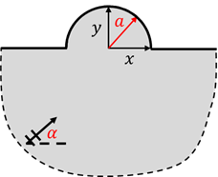
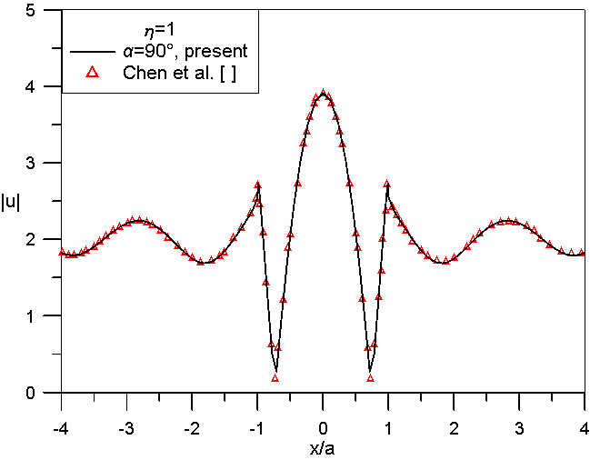
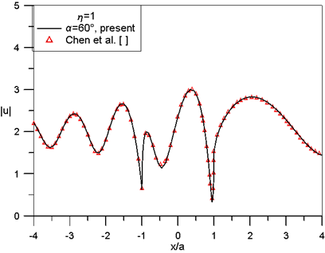
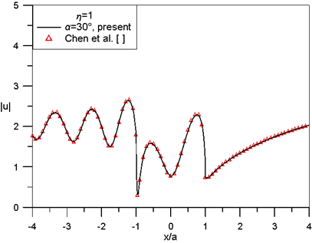
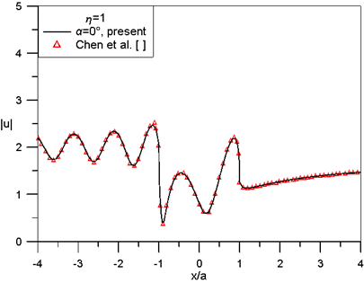
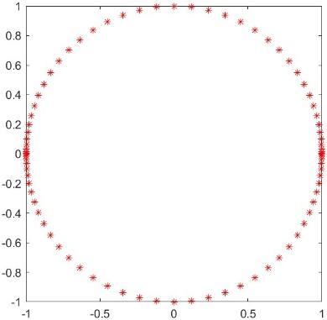



Surface displacement amplitudes
Case 1 (Semi-circular hill)
$$a=1$$
$$η=\frac{ka}{π}=1$$
$$N_{g}=82$$
J. T. Chen, J. W. Lee, C. F. Wu and I. L. Chen, SH-wave diffraction by a semi-circular hill revisited: A null-field boundary integral equation method using degenerate kernels, Soil Dyn. Earthq. Eng., Vol. 31, pp. 729-736, 2011.
Notes:
The BIQM is an efficient method to obtain the consistent results.
Only collocation points are required without mesh generation on the boundary.

Slide 24
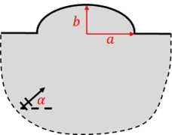
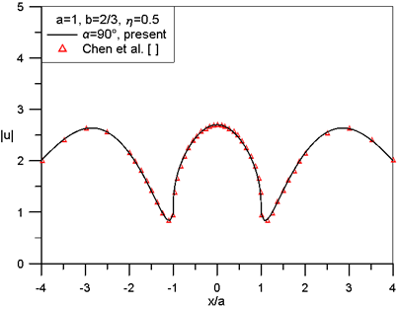
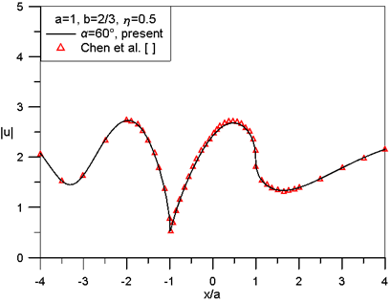
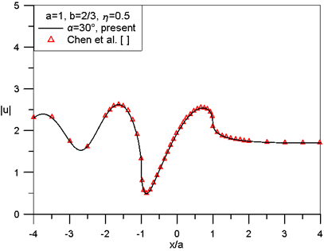
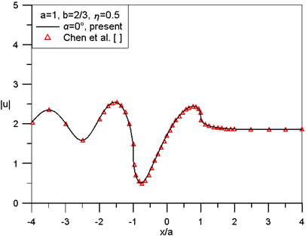
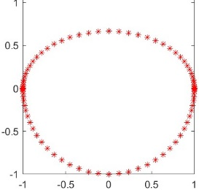

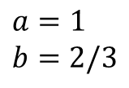

Surface displacement amplitudes
Case 2 (Shallow semi-elliptical hill)
$$a=1$$
$$b=2/3$$
$$η=\frac{ka}{π}=0.5$$
$$N_{g}=82$$
J. T. Chen, J. W. Lee and W. S. Shyu, SH-wave scattering by a semi-elliptical hill using a null-field boundary integral equation method and a hybrid method. Geophysical Journal International, Vol. 188, pp. 177-194, 2012.
Notes:
The second case is the semi-elliptical case.

Slide 25
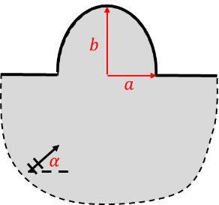
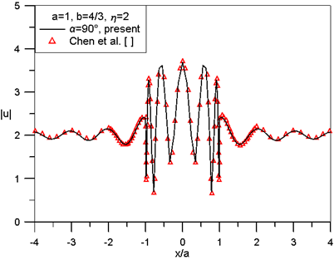
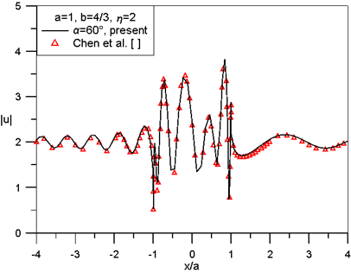
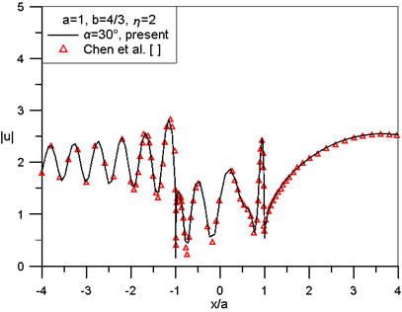





Surface displacement amplitudes
Case 2 (Deep semi-elliptical hill)
$$a=1$$
$$b=4/3$$
$$η=\frac{ka}{π}=2$$
$$N_{g}=82$$
J. T. Chen, J. W. Lee and W. S. Shyu, SH-wave scattering by a semi-elliptical hill using a null-field boundary integral equation method and a hybrid method. Geophysical Journal International, Vol. 188, pp. 177-194, 2012.

Slide 26









Surface displacement amplitudes
Case 3 (Isosceles triangular hill)
$$a=1$$
$$h=0.6 \& 1.6$$
$$η=\frac{ka}{π}=1$$
$$N_{g}=123$$
Y. Q. Song, X. Z. Li, Z. L. Yang, Y. Yong and M. H. Sun: Seismic response for an isosceles triangle hill subjected to anti-plane shear waves, Acta Geotechnica, Vol. 17(1), pp.275-288, 2022.

Slide 27










Surface displacement amplitudes
Case 4 (Isosceles trapezoidal hill)
$$a=1$$
$$b=0.5$$
$$γ={30}^{°} \& {60}^{°}$$
$$η=\frac{ka}{π}=1$$
$$N_{g}=164$$
Z. L. Yang, Y. Q. Song, X. Z. Li, G. X. Jiang and Y. Yang: Scattering of plane SH waves by an isosceles trapezoidal hill, Wave Motion, Vol.92, 102415, 2020.

Slide 28








Surface displacement amplitudes
Case 4 (Isosceles trapezoidal hill)
$$a=1$$
$$b=0.7 \& 0.3$$
$$γ={60}^{°}$$
$$η=\frac{ka}{π}=1$$
$$N_{g}=164$$
Z. L. Yang, Y. Q. Song, X. Z. Li, G. X. Jiang and Y. Yang: Scattering of plane SH waves by an isosceles trapezoidal hill, Wave Motion, Vol.92, 102415, 2020.

Slide 29









Focusing phenomenon
Semi-circular hill & Semi-elliptical hill
$$a=1, η=3.0, α={90}^{°}$$
$$a=1, b=\frac{2}{3},η=3.5, α={90}^{°}$$
$$a=1, b=\frac{4}{3},η=3.5, α={90}^{°}$$
Displacement magnify more than 4 times
Displacement magnify more than 4 times
Displacement magnify more than 4 times
J. T. Chen, J. W. Lee, C. F. Wu and I. L. Chen, SH-wave diffraction by a semi-circular hill revisited: A null-field boundary integral equation method using degenerate kernels, Soil Dyn. Earthq. Eng., Vol. 31, pp. 729-736, 2011.
J. T. Chen, J. W. Lee and W. S. Shyu, SH-wave scattering by a semi-elliptical hill using a null-field boundary integral equation method and a hybrid method. Geophysical Journal International, Vol. 188, pp. 177-194, 2012.
Notes:
It is interesting that the focusing phenomenon of the displacement amplitude can be found.
If the amplitude of the incident wave is one, the displacement amplitude is magnified more than 4 times at the local area for the special wavenumber.

Slide 30


Focusing phenomenon
Isosceles triangular hill
$h/a=0.6$ and $η=1.25$
$h/a=1.6$ and $η=2.5$
Displacement magnify more than 3 and 7 times
Notes:
For the Isosceles triangular hill, the possible focusing phenomenon is also found at the hilltop.

Slide 31




Focusing phenomenon
Isosceles trapezoidal hill
$a=1, b=0.5, γ={30}^{°}$
and $η=4.8$
$a=1, b=0.7, γ={60}^{°}$
and $η=4$
Displacement magnify more than 3 times
Notes:
For the Isosceles trapezoidal hill, the possible focusing phenomenon is found at the below of the hilltop.

Slide 32
Outline
Introduction
Problem statement
Present approach
Numerical results
Conclusions

Slide 33
Conclusions
We have successfully applied the BIQM to the SH-wave scattering problem of a hill with various shapes.
Based on the present method, 40 years ago, mathematical regularization methods for calculating the weakly singular integral, strong singular integral and hypersingular integral are not necessary.
The calculation of the solid angle is also not required.
By using the Gaussian quadrature and parametric representation for the boundary integral and boundary contour, the boundary integral equation is nothing more than linear algebraic equation.
The BIQM is a semi-analytical method.

Slide 34




Conclusions
Some results show that when the incident angle is ${α=0}^{°}$, the hill has a barrier effect and the displacement on the right side of the hill surface may decrease.
We also observe the focusing phenomenon in the cases of different-shaped hills.
SH-waves
Semi-circular hill
Semi-elliptical hill
Isosceles triangular hill
Isosceles trapezoidal hill

Slide 35


Related papers
if anyone has interest on the BIQM, three papers are now available.
The pdf file is upon your request.
JOM
(Torsion)
2024
ASME
JHMT
(CSF)
2023
EABE
(CSF)
2024
Notes:
If anyone has interest on the BIQM, three papers are now available.
The pdf file is upon your request.

Slide 36

The end
Thanks for your kind attentions

Slide 37
Conclusions
We have successfully applied the BIQM to the SH-wave scattering problem of a hill with various shapes.
By using the adaptive exact solution, the singular integral in the sense of the Cauchy principal value can be calculated skillfully and calculation of the solid angle is also not required.
By using the Gaussian quadrature and parametric representation for the boundary integral and boundary contour, the boundary integral equation is nothing more than linear algebraic equation.
The BIQM is a semi-analytical method.
Notes:
結論:
1.延伸應用邊界積分求積法(BIQM)，進一步求解不同形狀的山峰受SH波的散射問題
2.藉由引入自適性正確解，技巧性地計算奇異積分，也免於固體角計算
3.高斯求積以及參數表示法的使用，邊界積分方程只不過是線性代數方程
4.在水平入射時（α=0°），山峰右側的地表上的地表位移振幅有較明顯的衰退作用

Slide 38
Conclusions
Based on the present method, 40 years ago, mathematical regularization methods for calculating the weakly singular integral, strong singular integral and hypersingular integral are not necessary.
Notes:
結論:
1.延伸應用邊界積分求積法(BIQM)，進一步求解不同形狀的山峰受SH波的散射問題
2.藉由引入自適性正確解，技巧性地計算奇異積分，也免於固體角計算
3.高斯求積以及參數表示法的使用，邊界積分方程只不過是線性代數方程
4.在水平入射時（α=0°），山峰右側的地表上的地表位移振幅有較明顯的衰退作用

Slide 39





Surface displacement amplitudes
Case 1 (Semi-circular hill)
$$η=\frac{ka}{π}$$
$$N_{g}=82$$
$$a=1$$
J. T. Chen, J. W. Lee, C. F. Wu and I. L. Chen, SH-wave diffraction by a semi-circular hill revisited: A null-field boundary integral equation method using degenerate kernels, Soil Dyn. Earthq. Eng., Vol. 31, pp. 729-736, 2011.

Slide 40
Conclusions
The BIQM is successfully extended to orthotropic cases.
By introducing the adaptive exact solution, the singular integral in the sense of Cauchy principal value was skillfully calculated.
The mesh generation on the boundary was not required in the mode preparation.
The algebraic equation was obtained by collocating only the boundary points through the use of the Gaussian point.
The BIQM is a semi-analytical method.

Slide 41








Decomposition of scattering problem
Boundary Integral Quadrature Method
Interior problem
$$0=\int_{B}{T\left(s,x\right)\left[u\left(s\right)−w\left(s\right)\right]dB\left(s\right)}−\int_{B}{U\left(s,x\right)\left[t\left(s\right)−w_{p}\left(s\right)\right]dB\left(s\right)}, x∈B$$
Exterior problem
$$u(x)=\int_{B}{T\left(s,x\right)\left[u\left(s\right)−w\left(s\right)\right]dB\left(s\right)}−\int_{B}{U\left(s,x\right)\left[t\left(s\right)−w_{p}\left(s\right)\right]dB\left(s\right)}, x∈B$$
$$w\left(s\right)=\cos\left[k\left(s_{x}−x\right)\right]u\left(x\right)+\frac{1}{k}\left\{\sin\left[k\left(s_{x}−x\right)\right]n_{x}\left(x\right)+\sin\left[k\left(s_{y}−y\right)\right]n_{y}\left(x\right)\right\}t(x)$$
$$w_{p}\left(s\right)=\frac{∂w(s)}{∂n(s)}$$
Parametric representation 、
Gaussian quadrature
$U\left(s,x\right)=−\frac{i}{4}H_{0}^{\left(1\right)}\left(kr\right)$ ， $T\left(s,x\right)=\frac{∂U\left(s,x\right)}{∂n\left(s\right)}$ ， $r=|x−s|$
Interior problem
$$0=\sum_{j=1}^{N}{ω_{j} T\left(s_{j},x_{i}\right) J\left(ξ_{j}\right) [u_{j}−w_{j}^{i}]}−ω_{j} U\left(s_{j},x_{i}\right) J\left(s_{j}\right)[t_{j}−{w_{p}}_{j}^{i}]$$
Exterior problem
$$u_{i}=\sum_{j=1}^{N}{ω_{j} T\left(s_{j},x_{i}\right) J\left(ξ_{j}\right) [u_{j}−w_{j}^{i}]}−ω_{j} U\left(s_{j},x_{i}\right) J\left(s_{j}\right)[t_{j}−{w_{p}}_{j}^{i}]$$
Notes:
那這一頁是以Isotropic的case去作範例
這兩條式子為內、外域問題的BIQM積分方程，
透過參數表示法、高斯求積法，可以將積分方程式轉換為代數方程式

Slide 42










Treatment of the nearly singular integral by adaptive exact solution
$$x in the domain$$
Boundary layer effect due to the nearly singular
$$U(s,x)=\frac{1}{2π\sqrt{G_{xz}G_{yz}}}\ln{(r)}$$
$x$ out of domain
$$x$$
$$\left.x_{b}=(x_{b},y_{b}\right)$$
$$r=\left|x−s\right|$$
$$u\left(x\right) =\int_{B}{T\left(s,x\right)u(s)−U\left(s,x\right)t(s)dB\left(s\right)}, x∈D$$
$$w\left(x\right) =\int_{B}{T\left(s,x\right)w(s)−U\left(s,x\right)w_{p}(s)dB\left(s\right)}, x∈D$$
Adaptive exact solution
Subtract
$$w\left(s\right)=u\left(x_{b}\right)+\left[{\frac{\left(s_{x}−x_{b}\right)}{G_{xz}}n}_{x}\left(x_{b}\right)+{\frac{\left(s_{y}−y_{b}\right)}{G_{yz}}n}_{y}\left(x_{b}\right)\right]t\left(x_{b}\right),_x_{b}∈B$$
$$u\left(x\right) =\int_{B}{\left.T\left(s,x\right)[u(s\right)−w(s)]−U\left(s,x\right)[t\left(s\right)−w_{p}(s)]dB\left(s\right)}+w(s),_{}x∈D$$

Slide 43
Integral equation to algebraic equation
Discretization
Line
element
Constant element
Linear element
interpolation function

Slide 44
Integral equation to algebraic equation
Gaussian quadrature for an integral
For an integral equation
Gaussian quadrature points
Without the mesh distribution to calculate the boundary integral

Slide 45









Surface displacement amplitudes
$$N_{g}=205$$
Case 5 (Semi-circular hill with a underground cavity)
Surface displacement amplitudes versus $x/a$ for the incident angle $α=90°$
(a) $η=0.5$ | (b) $η=1.0$ | (c) $η=2.0$
$$a=1$$
$$a_{c}=0.1$$
$$d/a=2$$
$$l/a=0$$
$$N_{g}=164$$
Z. L. Li, J. C. Li and X. Li: Seismic interaction between a semi-cylindrical hill and a nearby underground cavity under plane SH waves, Geomechanics and Geophysics for Geo-Energy and Geo-Resources, Vol.5(4), pp. 405-423, 2019.
Notes:
半徑

Slide 46






Surface displacement amplitudes
Case 5 (Semi-circular hill with a underground cavity)
Surface displacement amplitudes versus $x/a$ for the dimensionless frequency $η=1.0$
(a) $α=90°$ | (b) $α=0°$
Surface displacement amplitudes versus $x/a$ for the dimensionless frequency $η=2.0$
(c) $α=30°$ | (d) $α=60°$
$$a=1$$
$$a_{c}=0.1$$
$$d/a=2000$$
$$l/a=0$$

Slide 47
BIQM vs. Nyström method
 | BIQM | Nyström method
Same | Boundary integral equation Linear algebraic equation quadrature
Different | Singular integral Adaptive exact solution | Special weight coefficients For smooth boundary, non-smooth boundary, corner smooth boundary and piece-wise smooth boundary

Slide 48







Convergence test of Isosceles triangular hill
$$(0,h)$$
$$|u|$$
$$h/a=0.4,η=5,α=0^{°}$$
$$(−2,0)$$
$$(2,0)$$
$$M_{g}$$

