Slide 1
Elevated temperatures and prestresses on evolving yield surfaces for modeling experimental data
Hong-Ki Hong, Kai-Min Hou
Department of Civil Engineering, National Taiwan University, Taipei 10617, Taiwan

Slide 2
A long journey through experiments and modeling of the thermo-elasto-plasticity
a long journey through experiments, modeling, identification, and development of the elastoplastic model with cubic distortional yield surface.
Phillips and his associates (1972, 1974) obtained a series of experimental data from thin-walled tubular specimens of commercially pure aluminium 1100-0 at room and at elevated temperatures. These data were neatly recoded in many aspects, executed faithfully in stress-controlled experiments and well known already for five decades; however, modeling these experimental data encountered either tremendous difficulties or over complications regardless of various attempts.
A. Phillips and J.-L. Tang, The effect of loading path on the yield surface at elevated temperatures. International Journal of Solids and Structures, 8(4):463-474, 1972.
A. Phillips, C.S. Liu, and J.W. Justusson. An experimental investigation of yield surfaces at elevated temperatures. Acta Mechanica, 14:119-146, 1972.
A. Phillips, J.-L. Tang, and M. Ricciuti. Some new observations on yield surfaces. Acta Mechanica, 20:23-39, 1974.

Slide 3
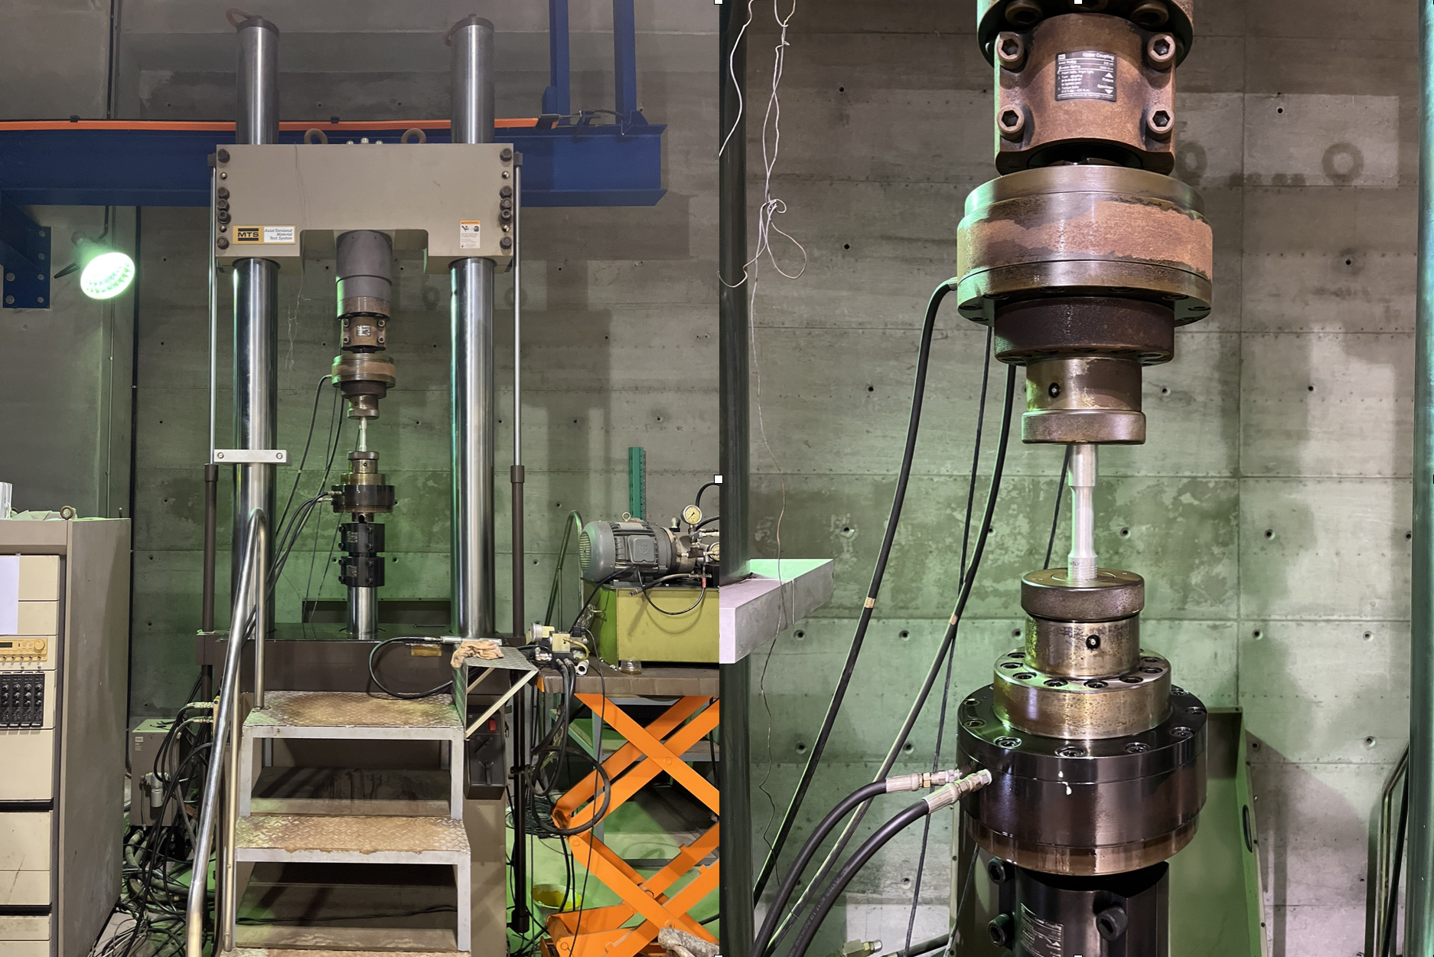
Pulley & Weight :
Stress control
Thermal chamber
1972
1974
2023
2022
Feedback :
Strain control
Modeling
Modeling
Hong-Ki Hong, Li-Wei Liu, Ya-Po Shiao, and Shao-Fu Yan, Yield Surface Evolution and Elastoplastic Model with Cubic Distortional Yield Surface. ASCE Journal of Engineering Mechanics, 148(6):04022027, 2022.
A. Phillips and J.-L. Tang, The effect of loading path on the yield surface at elevated temperatures. International Journal of Solids and Structures, 8(4):463-474, 1972.
A. Phillips, C.S. Liu, and J.W. Justusson. An experimental investigation of yield surfaces at elevated temperatures. Acta Mechanica, 14:119-146, 1972.
A. Phillips, J.-L. Tang, and M. Ricciuti. Some new observations on yield surfaces. Acta Mechanica, 20:23-39, 1974.

Slide 4
Closed-form exact solution
Hong-Ki Hong and Chein-Shan Liu, Internal symmetry in the constitutive model of perfect elastoplasticity, International Journal of Non-Linear Mechanics, 35(3):447-466, 2000.
Characteristic of internal symmetry of two elements of the projective proper orthochronous Poincare group in the plastic phase, is proposed. Associated with each Mises hypersphere in stress space is a normality plastic flow rule and a mixed-exp-AF’s rule, referring to a combined isotropic-kinematic rule of hardening-softening, which combines the isotropic exponential rule of degree 2 and the kinematic rule of Armstrong-Frederick.

Slide 5
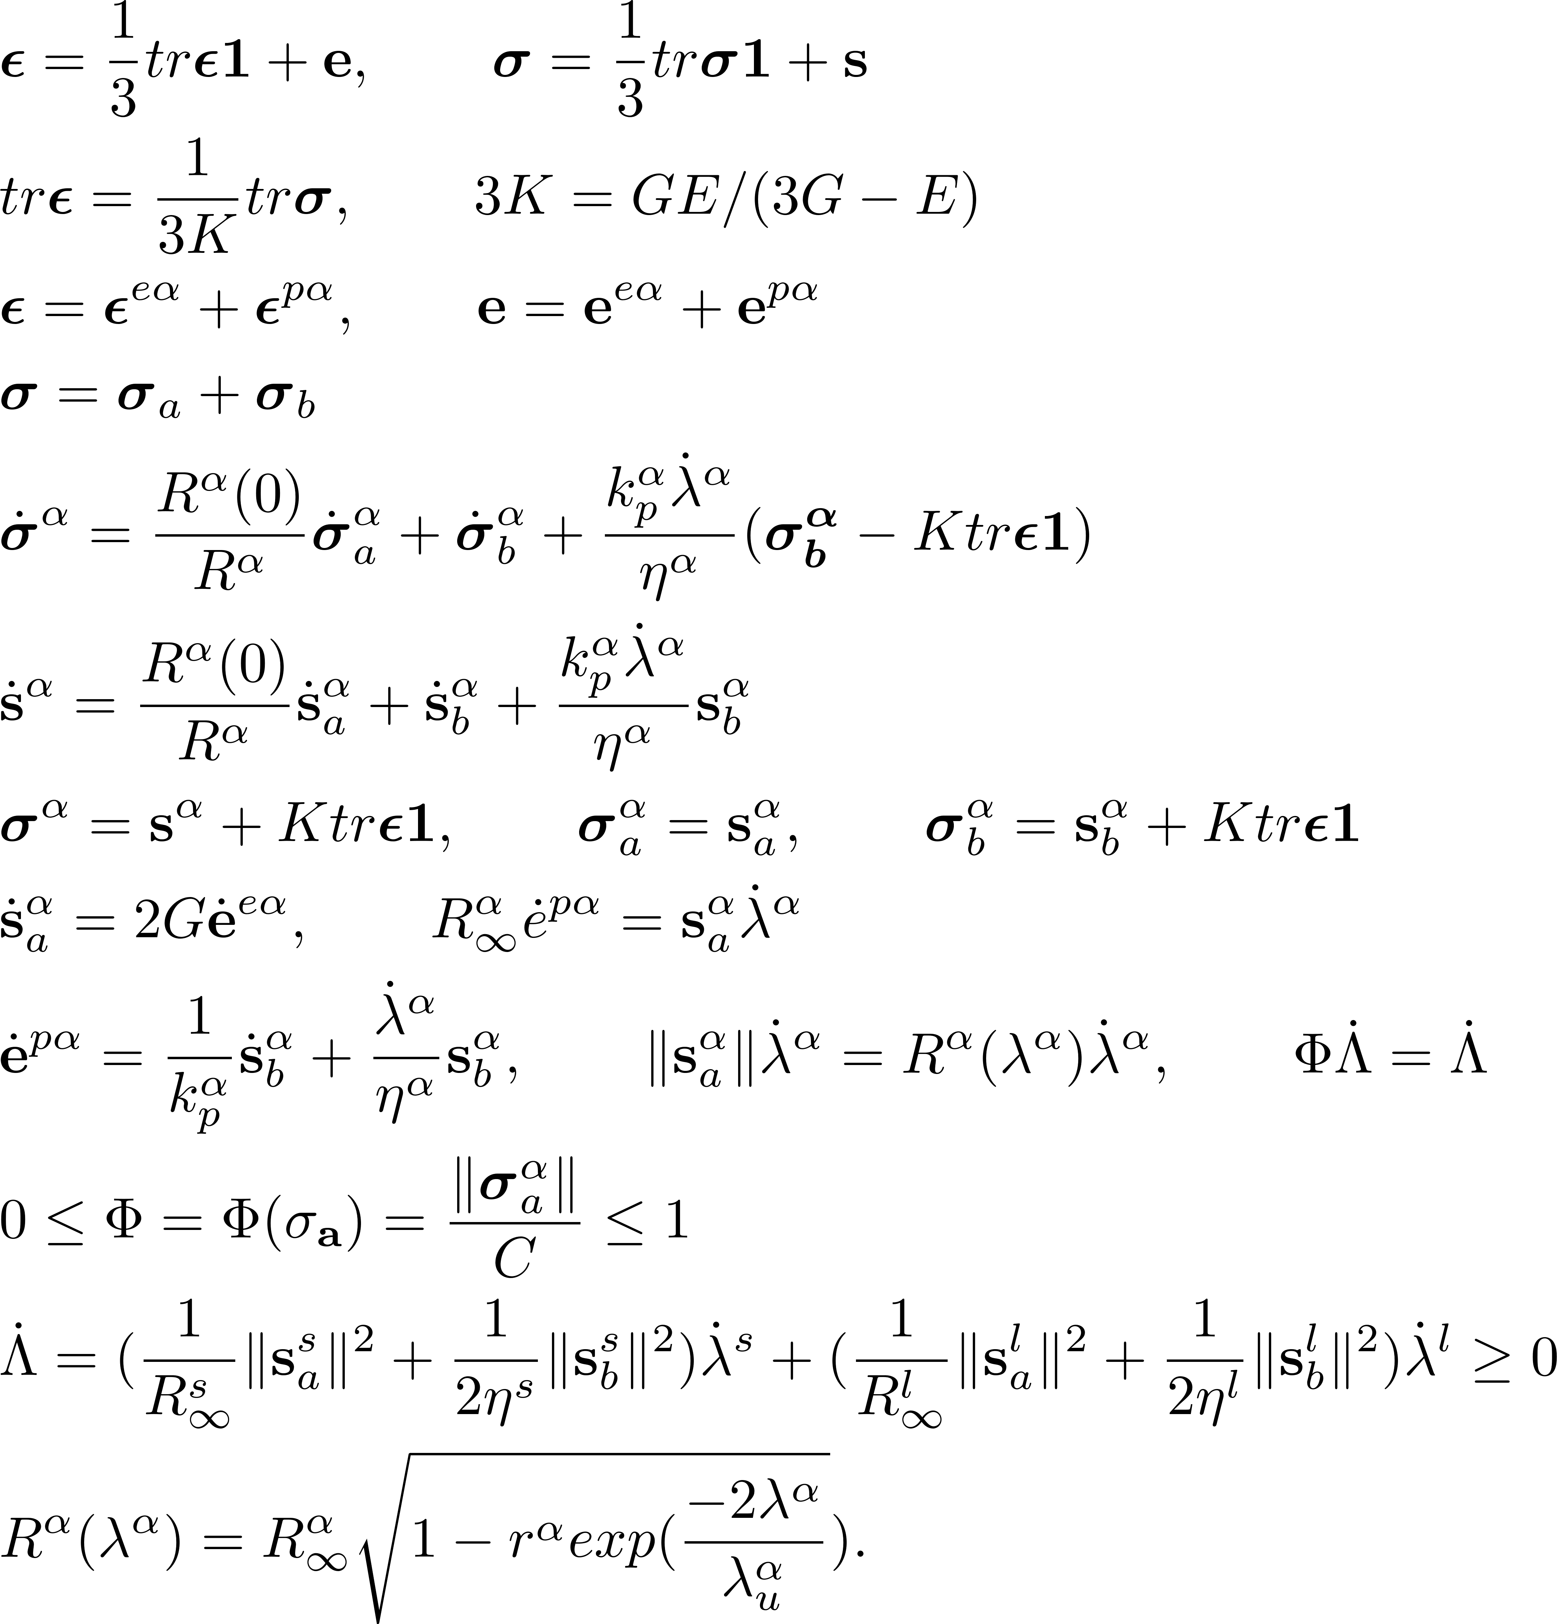
ϵ
σ
e and s
1
0
K, G, E
superscript α
superscript l
superscript s
superscripts e and p
subscripts a and b
strain tensor
stress tensor
deviatoric parts of ϵ and σ, tr standing for trace
the identity tensor
the zero tensor
bulk, shear, Young’s moduli
two copies l, s
large hypersphere, longitudinal, or long range
small hypersphere, shear, or short range
elastic and plastic
active and back
The proposed model slightly adjusts and extends the validity of our 2022 model*, which proves fitting well the strain-controlled axial-torsional experimental data performed in our lab and supported by (NSC, MOST) NSTC for more than a decade.
*Hong-Ki Hong, Li-Wei Liu, Ya-Po Shiao, and Shao-Fu Yan, Yield Surface Evolution and Elastoplastic Model with Cubic Distortional Yield Surface. ASCE Journal of Engineering Mechanics, 148(6):04022027, 2022.

Slide 6
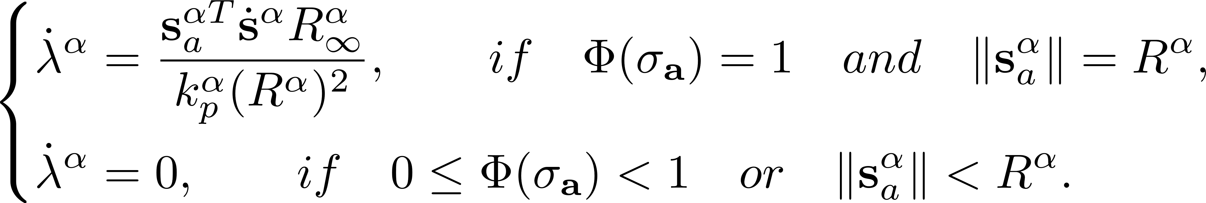
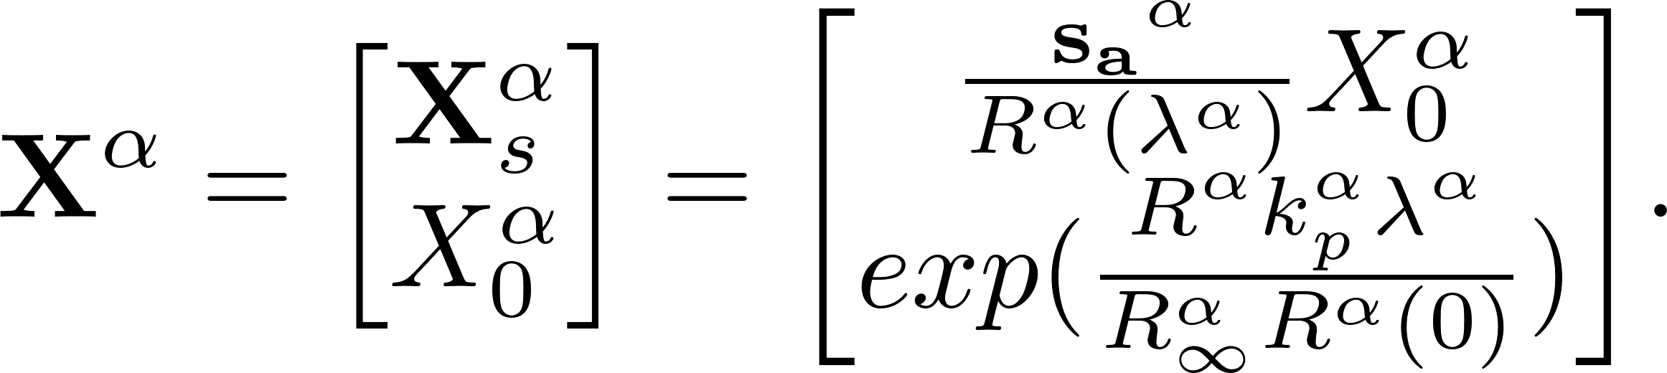
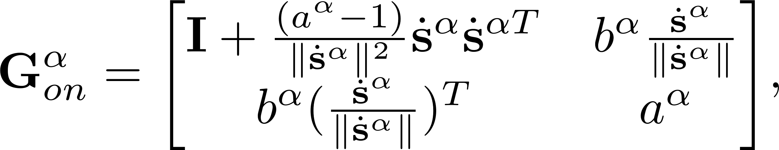
Closed-form exact solution
The off phase (the elastic state) or the on phase (the elastoplastic state)
Minkowski spacetime :
The state transition matrix

Slide 7
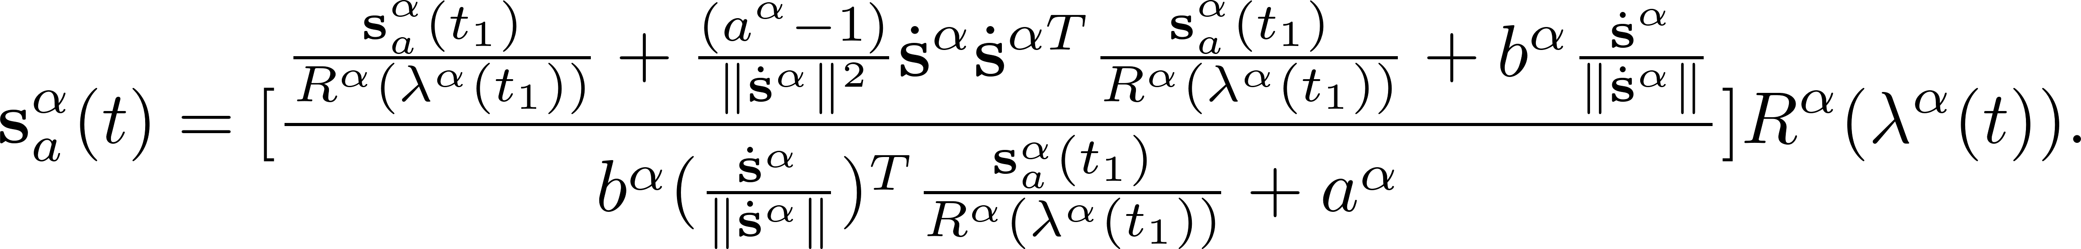
Closed-form exact solution
The active deviatoric stress tensors
The back deviatoric stress tensors
The equivalent plastic strain

Slide 8
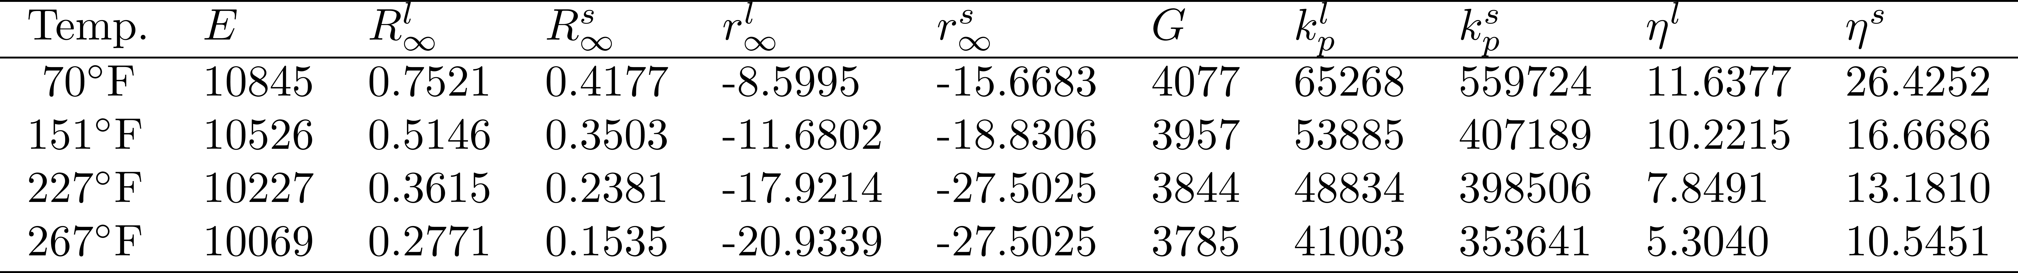
For each temperature a unique set of material constants along an entire path however complicated in stress space.
We conducted a series of axial-torsional strain-controlled experiments on thin-walled tubular specimens of aluminum alloy in our lab. On the basis of the experimental findings, a rate-independent flow elastoplastic material model featuring an evolving cubic distortional yield hypersurface, which is articulated with two Mises hyperspheres, The model needs a total of 10 material constants.

Slide 9
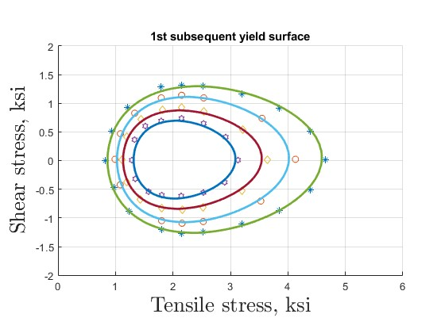
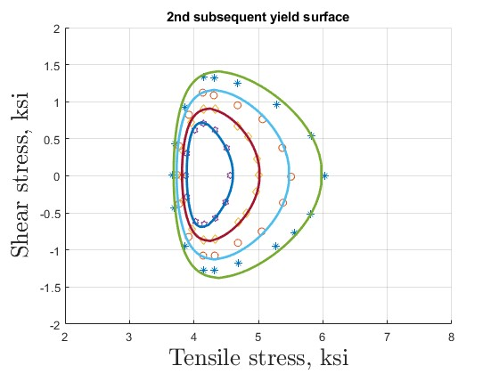
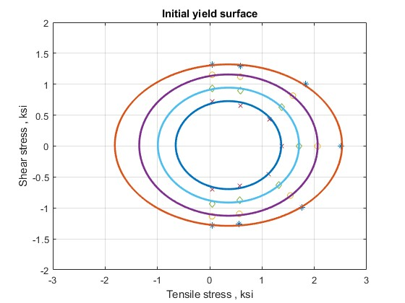
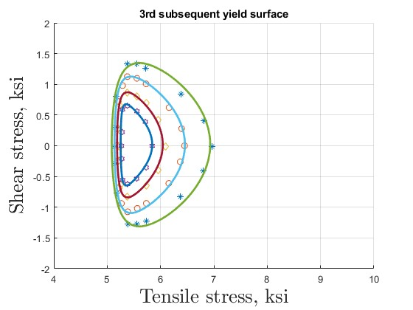
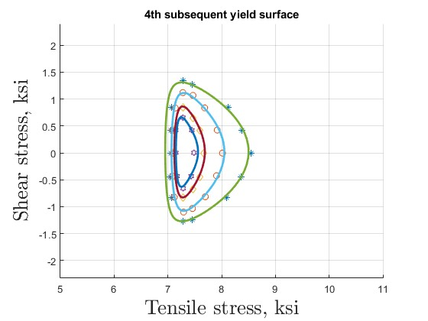
(a)
(b)
(c)
(d)
(e)
First pull/apply axial stress from (a) initial yield surface (b) 1st subsequent yield surface (c) 2nd s.y.s. (d) 3rd s.y.s. to (e) 4th s.y.s.

Slide 10
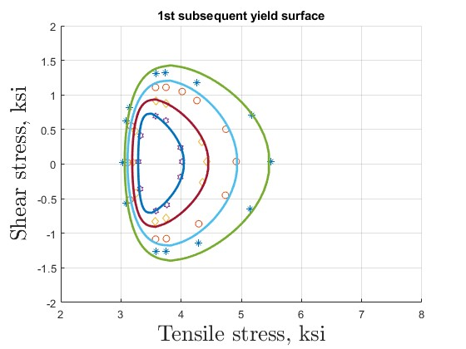
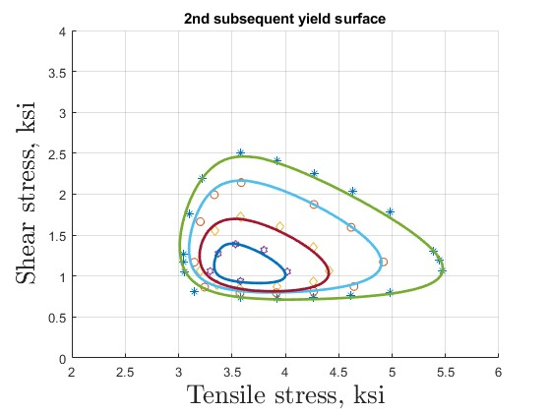
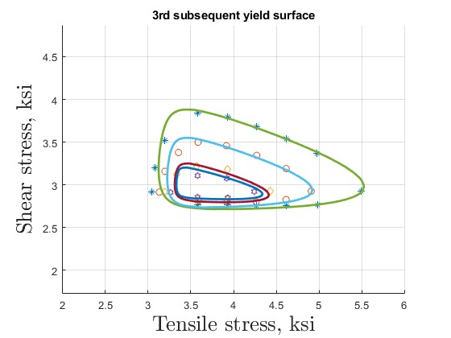
(f)
(g)
(h)
And twist/apply additional torsional stress from (f) axial-torsional subsequent yield surface (g) axial-torsional 2nd s.y.s. to (h) axial-torsional 3rd s.y.s.

Slide 11
Conclusions
1.In this presentation, we briefly overview a long journey of thermo-elasto-plasticity.
2.By selecting prominent test evidences based upon experiences on aluminium alloy Al6061 gained in our lab [ASCE Journal of Engineering Mechanics 148(6):04022027, 2022] over the course of the years, we created a three-dimensional tensor model of flow elastoplasticity, grasping all axial-torsional experimental features reported in the literature; in particular, in Phillips et al. at room and at elevated temperatures on commercially pure aluminium 1100-0.
3. For each temperature the model needs a total of 8 material constants in addition to Young’s modulus and shear modulus and presents an evolving cubic distortion yield hypersurface, which is articulated with two Mises hyperspheres, characteristic of internal symmetry of two elements of the projective proper orthochronous Poincare group in the plastic phase. Associated with each Mises hypersphere in stress space is a normality plastic flow rule of mixed-exp-AF, referring to a combined isotropic-kinematic rule of hardening-softening, which combines the isotropic exponential rule of degree 2 and the kinematic rule of Armstrong-Frederick.
4. By using the model and employing Lie group theory, closed-form exact solutions are derived and used to identify a unique set of parameters for fitting successfully evolving shapes of yield surfaces with clear physical meaning.

