Slide 1
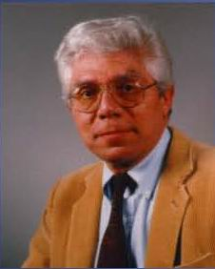
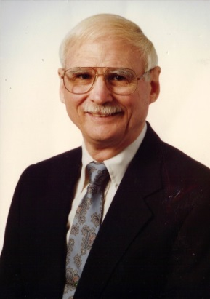
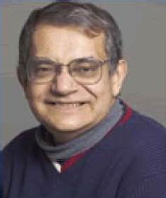
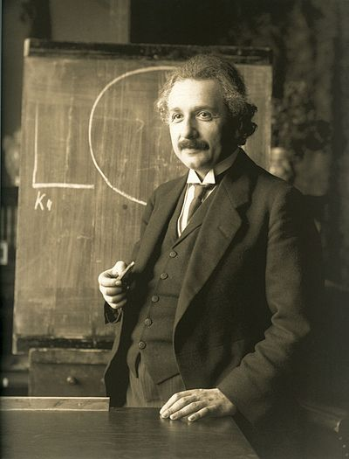
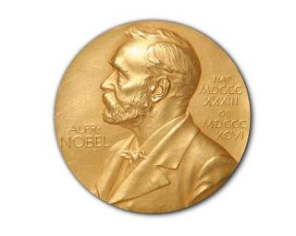
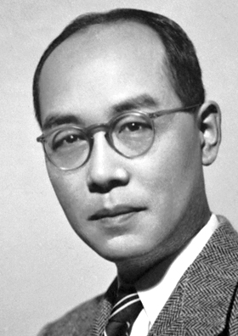
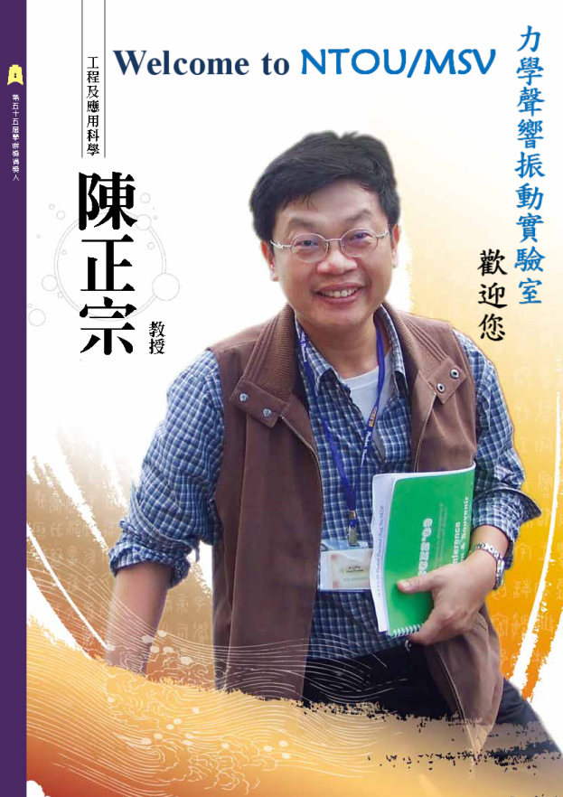
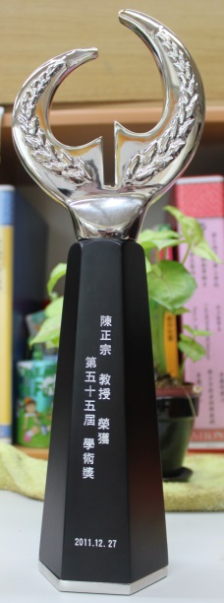
History (BEM Workshop in 1986)
I was a TA at that time (1986).
F. J. Rizzo
D. J. Shippy
S. Mukherjee
Albert Einstein
1922 lecture in Japan
湯川 秀樹1949 Nobel
ゆかわひでき
MOE
Academic Award Winner, 2011

