Slide 1
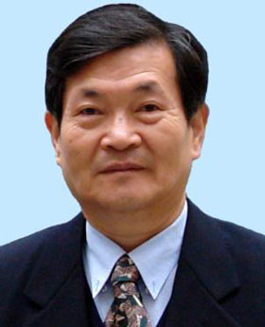
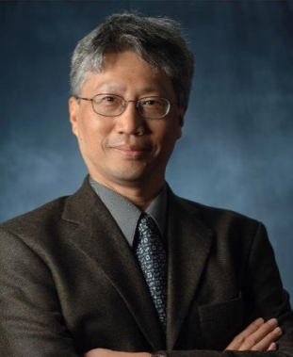

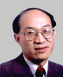
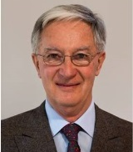
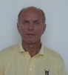
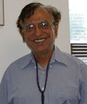
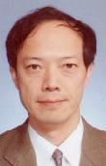
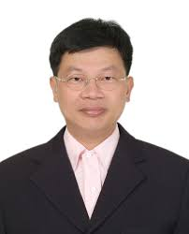
IABEM 邊界元素法 國際學校
9 speakers
姚振漢
Personal experiences on BEM research and education
Alex Cheng
History of integral equations and BEMs
Xiaobo Chen
Green’s functions and integral equations for water wave problems
Chuanzeng Zhang
BEM to wave and dynamic problems
Francis Noblesse
Green’s functions and integral equations for water wave problems
Jan Sladek
Meshless related methods
Vinod Tewary
Green’s functions and applications (to physics and materials)
Naoshi Nishimura
Fast multipole method
JT Chen
Mathematics of various BEM formulations

