Slide 1


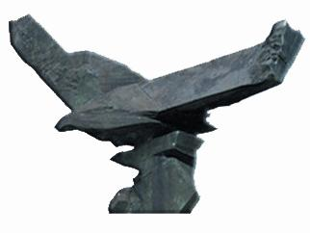
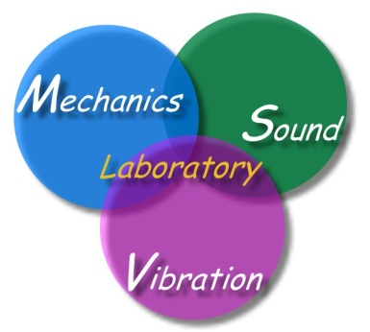

Rank-deficient systems in the BIEM/BEM
Japan-Taiwan Workshop
on inverse problems 2017
Jeng-Tzong Chen
海洋大學河工系 陳正宗終身特聘教授
Vice president, TwSIAM
Fellow of STAM, ROC
Life-time Distinguished Professor
Dept. Harbor and River Engineering
Dept. Mechanical and Mechatronic Engineering
Taiwan Ocean University
11:00-11:30, Nov.18, 2017
Kanazawa Univ. Satellite Plaza
3F Meeting Room
(Kanazawa2017-msv.ppt)

Slide 2
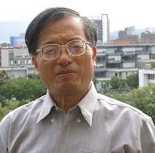
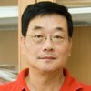








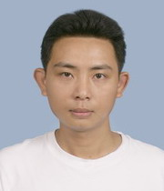
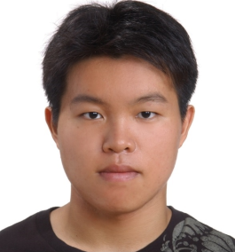
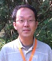


Taiwan Team (2017)
李志豪
林文偉
楊德良
陳正宗
中央研究院
交通大學
台灣大學
海洋大學
王振男
台灣大學
李國明
林景隆
劉聚仁
陳鵬文
成功大學
成功大學
成功大學
中興大學

Slide 3
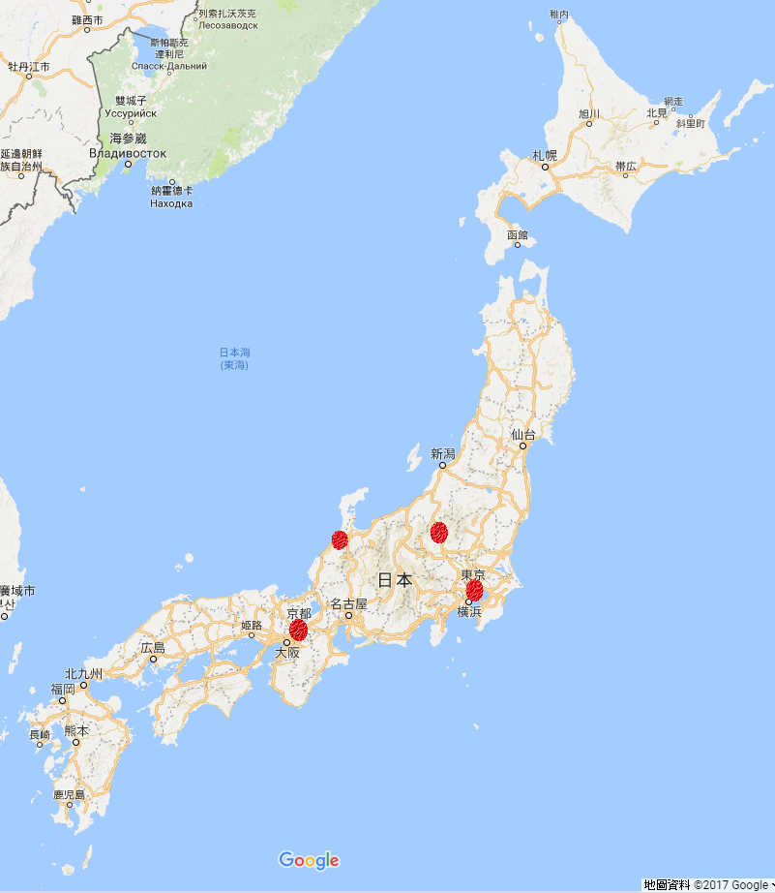
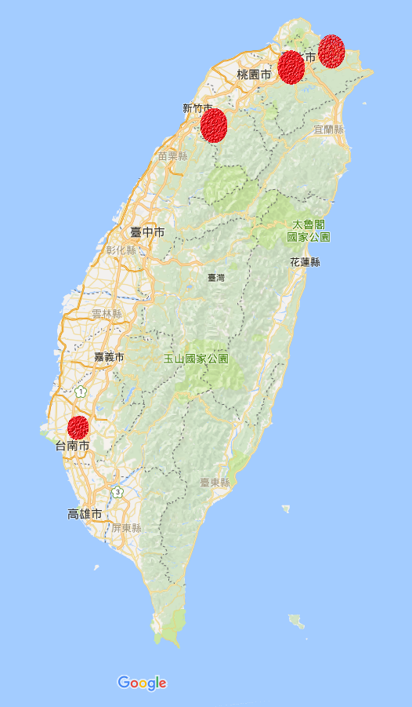
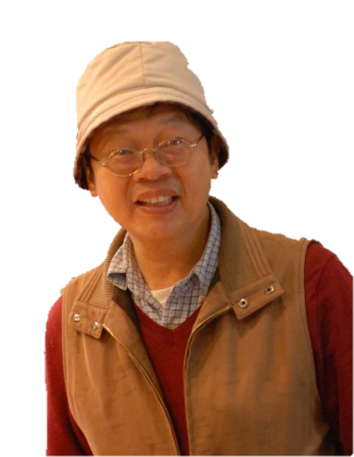
基隆
台北
新竹
J
Japan
Taiwan
T
金澤Kanazawa shi
群馬県Gunma ken
台南
東京Tokyo
京都Kyōto
. . Chen
Taiwan
Japan
- Joint Workshop
on Inverse Problems in Kanazawa 2017

Slide 4
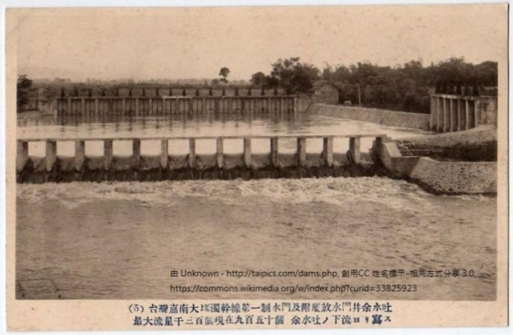

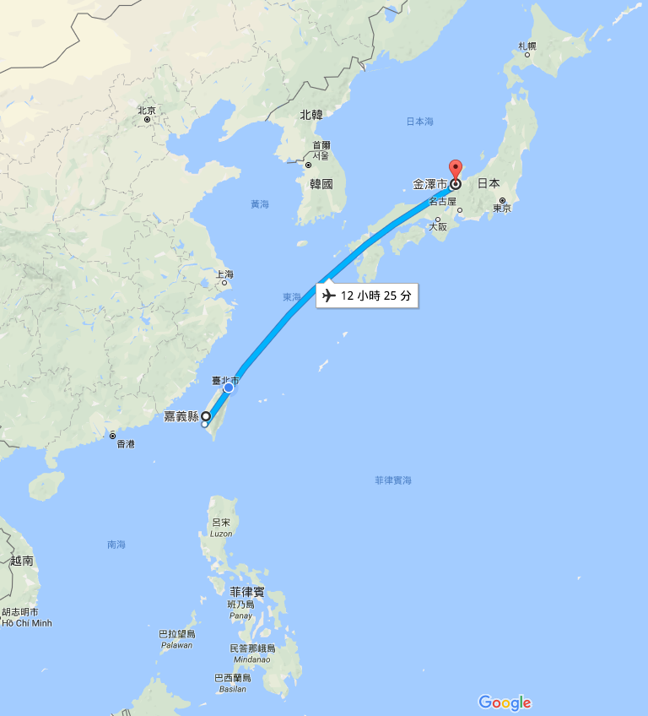
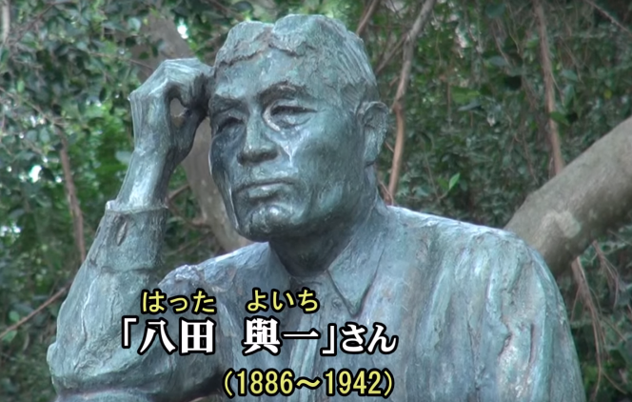
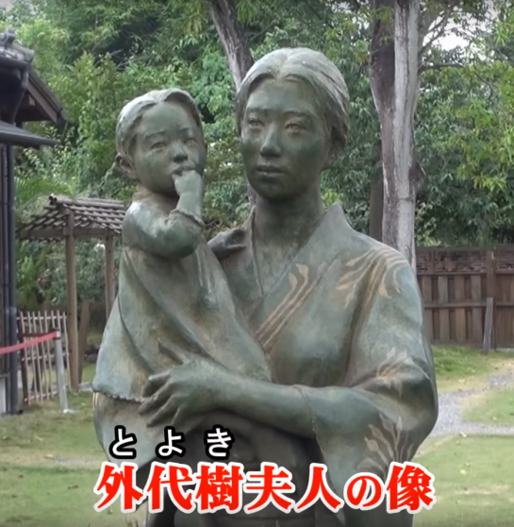
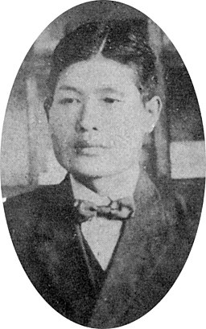
Kanazawa
Wu Shan Tou reservoir
烏山頭水庫
Chia-Nan Irrigated System
嘉南大圳
Hatta Yoichi
Chiayi
Philippines
金澤市今町人

Slide 5
Outline
1.
Overview of TwSIAM
2.
Overview of Taiwan BEM development
3.
Rank deficient systems in BIEM/BEM with focus on degenerate scale for an infinite domain containing two equal circular holes
Using bipolar coordinates

Slide 6
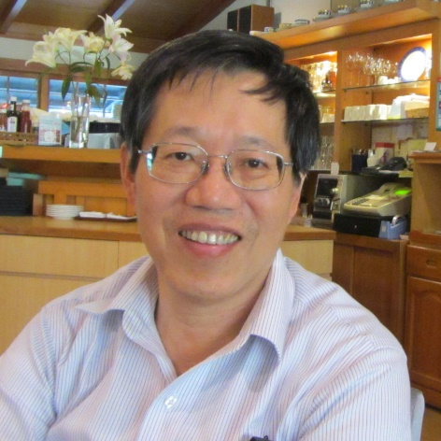





陳宜良
President
We love Taiwan!
We promote math to industries!
We speak the same language: math!
陳正宗
Vice President

Slide 7
TWSIAM
Establish: non-profit academic society established on June 26, 2012
Aim:
  To promote research and education of applied mathematics
  To bridge mathematics and industry communities
Members (2017):
  Regular members: 102
  Group members: 16
  Student members: 53
Web address: www.twsiam.org

Slide 8














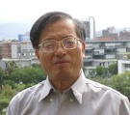




History & Background (1986-2017)
Year | The host unit | The organizer | Ceremony | Keynote
1986 | NTU IAM | Prof. Y H Pao | Establishment of NTU IAM | Prof. F J Rizzo
1998 | NSC | Prof. J T Chen | NCHC | Prof. A H D Cheng
2010 | NTOU-HRE-MSV | Prof. J T Chen | NTOU-HRE 50th anniversary | Prof. Z C Li
2011 | NCTS(South) | Prof. K M Lee | NCKU 80th anniversary | NCKU
2012 | Feng Chia University | Prof. Y C Shiah | Prof. Hong’s 60th birthday | Prof. H-K Hong
2013 | National Chung Hsing University | Prof. K J Shou | Congratulations for Academicain | Dean S L Crouch Academician,NAE
2014 | National SYS University | Prof. T T Lu | Prof. Young’s 70th birthday | Prof. D L Young
2015 | NCREE (cross strait) | Dr. R Z Wang | NCREE | Cross strait ceremony
2016 | NCTS (Japan-Taiwan) | Prof. J H Lee | NCTS | Prof. H-K Hong Prof. W-W Lin
2017 | NIU | Prof. I L Chern Prof. K H Chen | Ilan Univ | Prof. H-K Hong Prof. W-C Wang

Slide 9
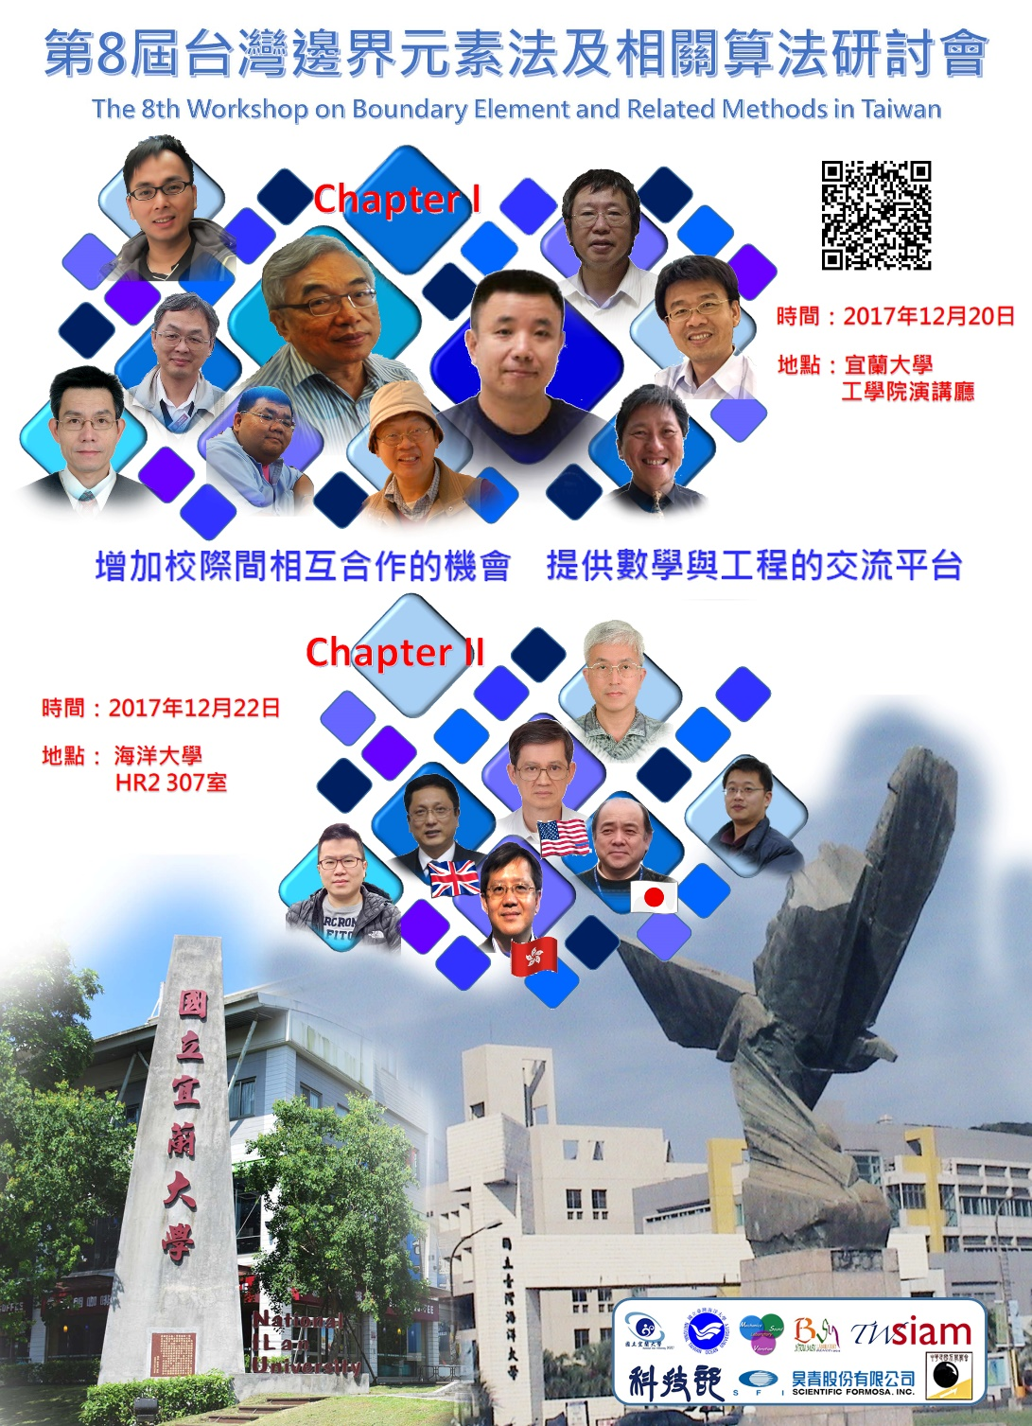
BEM-8 Workshop in 2017

Slide 10


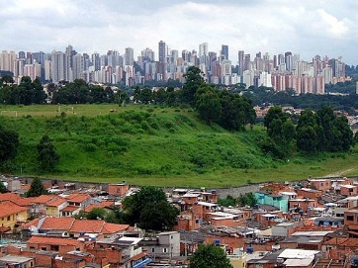
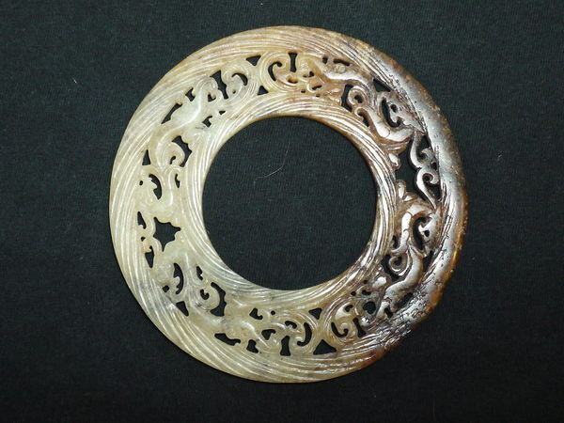
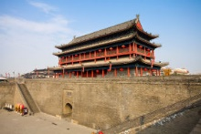
BEM/BIEM與``辟``法
邊界元素法 境界要素法
辟法
避
僻
壁
璧
臂

Slide 11
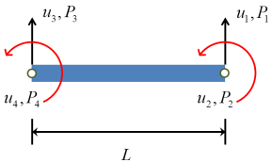
MODELING
Graduate
Engineering
ill-posed
Spurious eigenvalue
半盲
math
Degenerate scale
Fictitious frequency
singular
AMC 2012
ISOPE 2010
Direct problem
Inverse problem
Trapped-mode
physical
Free-Free
?
EJMB 2012
CS 2014
well-posed
Research
Undergraduate
nonsingular

Slide 12



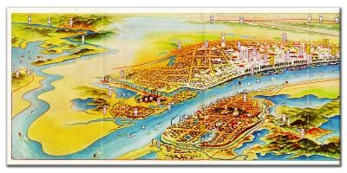
Paradise or parasite
In the sky, there is a paradise
In the earth, there is Suchou and Hangzhou
上有天堂 下有蘇杭
BEM always needs fundamental solution or Green function
邊界元素法有格林函數與基本解
天堂(paradise)?? 寄生蟲(parasite)??
Fundamental solution
BEM
Suzhou
2008
Hangzhou
2015
Green function
Paradise in the Earth
Parasite in the BEM

Slide 13
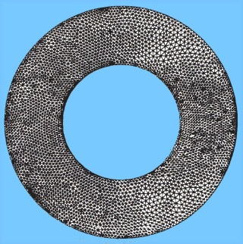


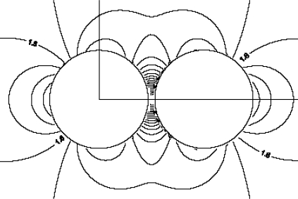
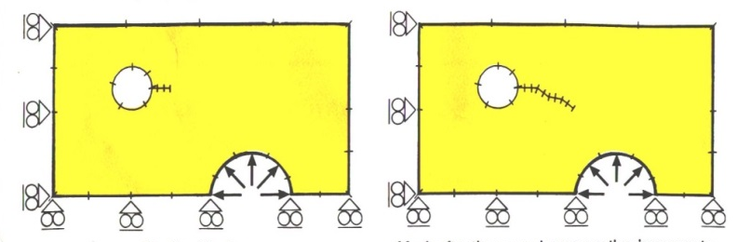
Paradise of BEM (1984-2000)
刪繁就簡三秋樹
3D→2D
Infinite domain
Paradise
領異標新二月花
鄭板橋
Stress concentration
Fracture and fatigue

Slide 14
Parasite of BEM (2000-2017)
Focus
Minimum singular value
t(a,0)
Rank-deficient systems
0/0
Radius
Mechanics Research Communications
Fictitious frequency
Pitfall
Parasite
Degenerate scale
Engineering Analysis with Boundary Elements
Dependency
Spurious eigenvalue
Degenerate boundary
International Journal for Numerical Methods in Engineering
Thermochimita Acta
Parasite of BEM.pptx made by York

Slide 15
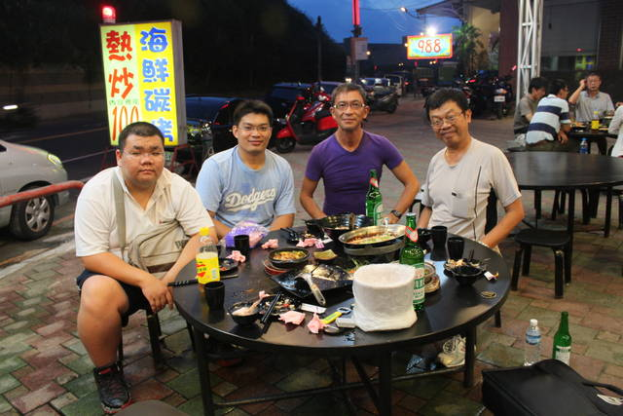
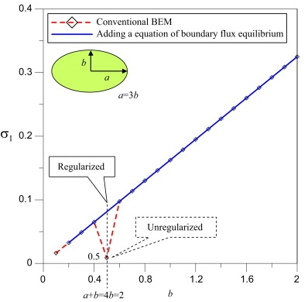
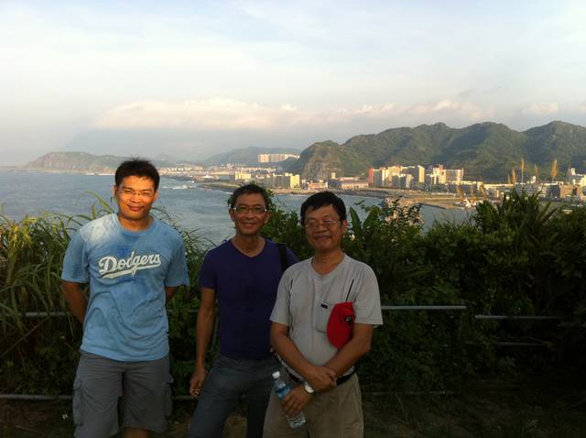
Three ways to detect the degenerate scale
Numerical study
Analytical study
Complex variables
Riemann conformal mapping
Logarithmic capacity
Degenerate kernel
(elliptical coordinates)
BEM

Slide 16
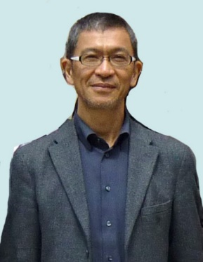
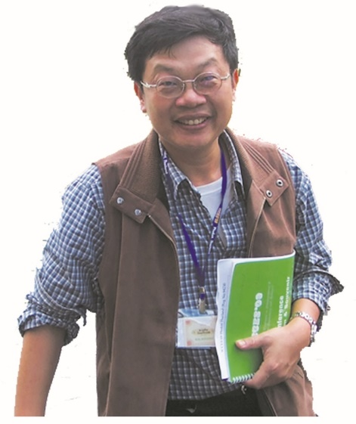
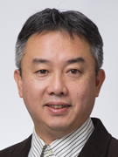
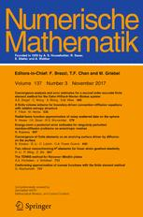
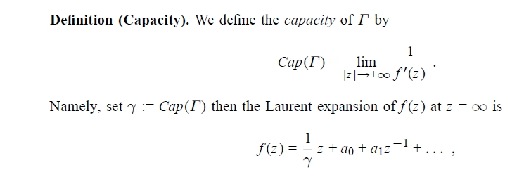
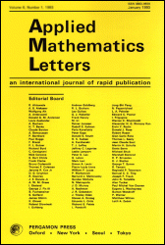



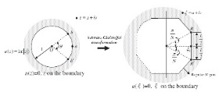

Japan Taiwan Interaction to J T
磯 祐介
Iso, Yuusuke
木村 正人
KIMURA, Masato
2013
2013
2015
1996

Slide 17
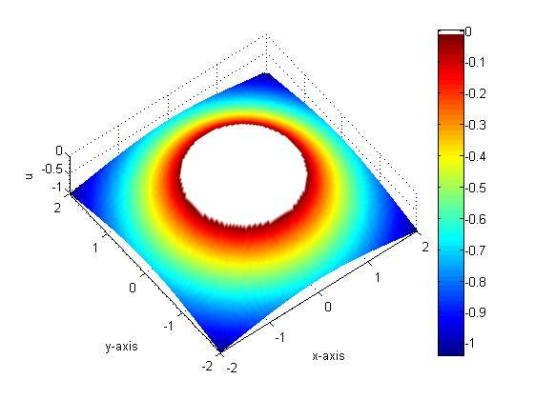
z-plane
w-plane
1
Riemann Conformal mapping
Log capacity=1 (degenerate scale)
Riemann conformal mapping
Geometry
Mapping
Field

Slide 18
Degenerate scale by NTOU/MSV
Domain
Log. capacity (C)
Degenerate scale (C=1) | a=1 | a+b=2 | a=1.69443 | a=1.29904
Conformal mapping
Normal scale (null outside)
Degenerate scale (null inside)
References | EABE 2001,2002 IJNME 2002, 2005 CS 2003, CM 2006 MRC 2007
a
b
a
(n=4)
a
a
, where

Slide 19
w plane
z plane
Unit circle in w
General shape in z

Slide 20
Riemann conformal mapping
1
(Schwarz-Christoffel transformation)
1
(n=3)
(a=2.37105)
1

Slide 21
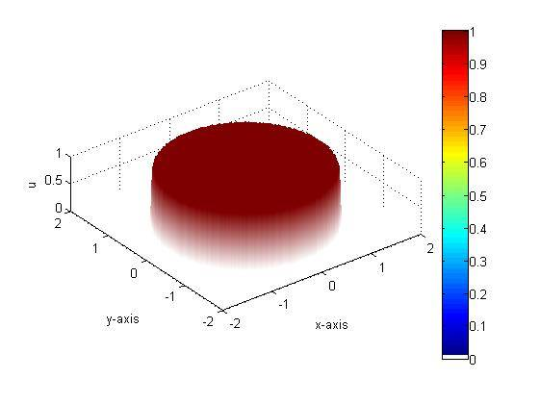
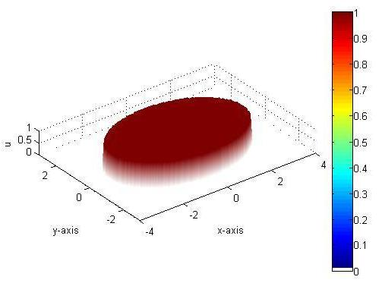
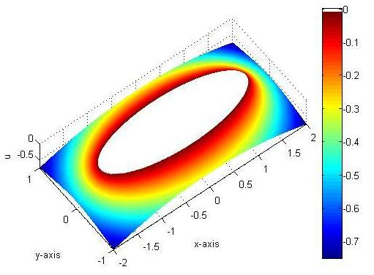
Nonzero and null fields (3-D plots)
 | Different shapes
Ordinary scale
Degenerate scale
l
b
a
a
a=3b
(null)
(null)
(null)
(null)
(null)
(null)

Slide 22
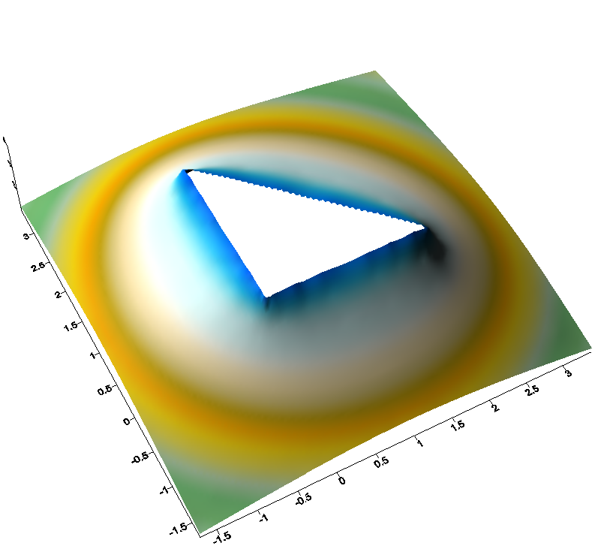
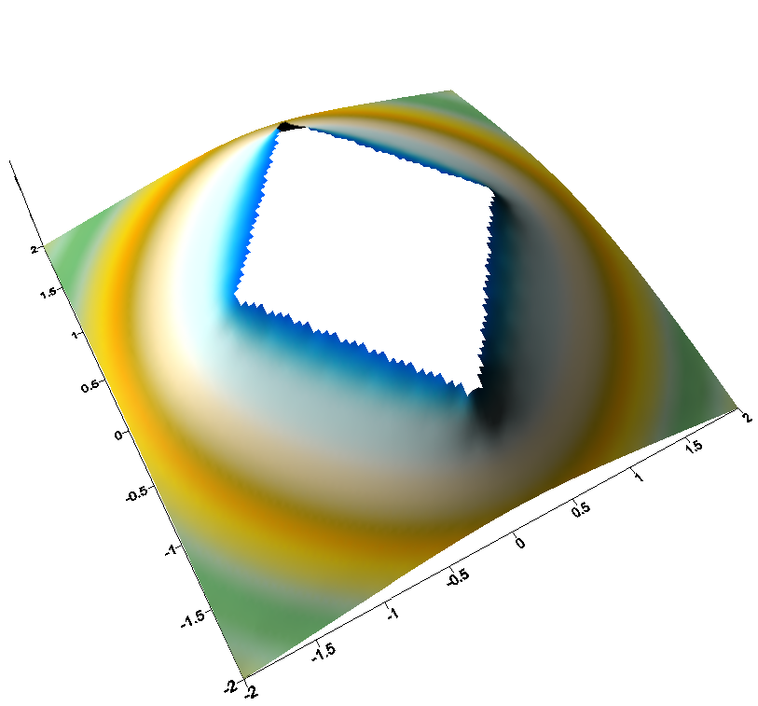
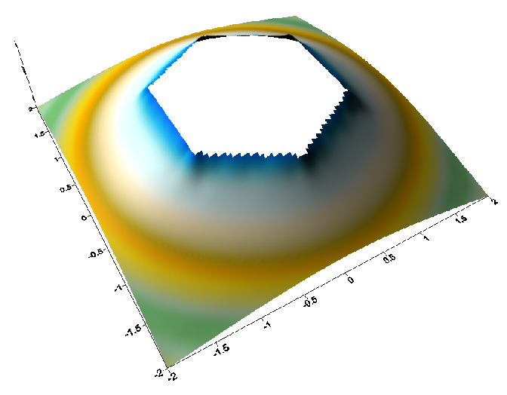
Nonzero and null fields (3-D plots)
 | Different shapes
Ordinary scale
Degenerate scale
l
l
l
a
απ
(N=3)
(N=6)
a
a
l
(null)
(null)
(null)
(null)
(null)
(null)
(null)
(null)

Slide 23




Researches about the degenerate scale in NTOU/MSV
2002 | Circle |  | EABE
2012 | Ellipse |  | EABE
2013 | Regular polygon |  | AMC
2013 | All |  | AML
2015 | Semicircle |  | JCAM
2017 | Infinite plane containing two circular holes
EABE

Slide 24
(a)
(b)
(c)
(d)
(e)
(f)
(g)
(h)
(i)

Slide 25
Degenerate (separable) form of fundamental solution (2D Laplace case)
Closed-form
Polar coordinates
Elliptic coordinates

Slide 26
Extension to problem containing two circular holes
Multiply-connected
Simply-connected
a

Slide 27
Degenerate kernel in the bipolar coordinates
x
x
s
x

Slide 28
Bipolar coordinates for circle, eccentric annulus and infinite plan with two circular holes
Outer radius = 1
Radius = 1

Slide 29
Radius = 1

Slide 30
Outer radius = 1

Slide 32
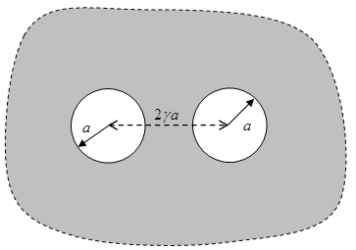

Slide 33
Numerical result
 | 2 | 4 | 6 | 8 | 10
 | 0.48513 | 0.35082 | 0.28768 | 0.24951 | 0.22332
 | 1.31696 | 2.06344 | 2.47789 | 2.76866 | 2.99322
 | 0.84027 | 1.35874 | 1.70193 | 1.98045 | 2.22208
Method | 2 | 4 | 6 | 8 | 10
Present (Analytical data) | 0.48513 | 0.35082 | 0.28768 | 0.24951 | 0.22332
BEM (Numerical data) ( ) | 0.4856 | 0.3511 | 0.2879 | 0.2497 | 0.2235 | 0.02238 ( )
Chen [24] (Null field BIE) | 0.4852 | 0.3509 | 0.2877 | 0.2496 | 0.2234 | NA
Corfder & Bonnet [23] (Asymptotic result) | 0.5000 | 0.3536 | 0.2887 | 0.2500 | 0.2236

Slide 34
Nonzero and null fields (3-D plots)
l
Ordinary scale
(null)
Degenerate scale
(null)

Slide 35
Numerical solution (BEM)
Analytical solution
Ordinary scale
Degenerate scale

Slide 36
Numerical solution (BEM)
Analytical solution
Ordinary scale
Null
Null
Null
Null
Degenerate scale
Null
Null
Null
Null

Slide 37
Ordinary scale
Numerical solution (BEM)
Analytical solution
Symmetric
Dirichlet BC
Anti-Symmetric
Dirichlet BC
Null
Null
Null
Null

Slide 38
Numerical solution (BEM)
Analytical solution
Degenerate scale

Slide 39
Conclusions
1.
Overview of TwSIAM
2.
Overview of Taiwan BEM development
3.
Rank deficient systems in BIEM/BEM with focus on degenerate scale for an infinite domain containing two equal circular holes
Using bipolar coordinates

Slide 40
Future work
Numerical study
Analytical study
Complex variables
Riemann conformal mapping, Mobus tranfomation
Logarithmic capacity
BEM
Degenerate kernel
(bipolar coordinates)
0.48513 (Analytical data)
0.4856 (BEM result)
0.4852 [24]
0.5000 [23]
?
?
We need help from mathematicians

Slide 41

Thanks for invitation. 感謝Iso Kimura教授邀請
Thanks for your kind attentions
Welcome to visit the web site of MSVLAB/NTOU
http://msvlab.hre.ntou.edu.tw/ Since 1999

Slide 42
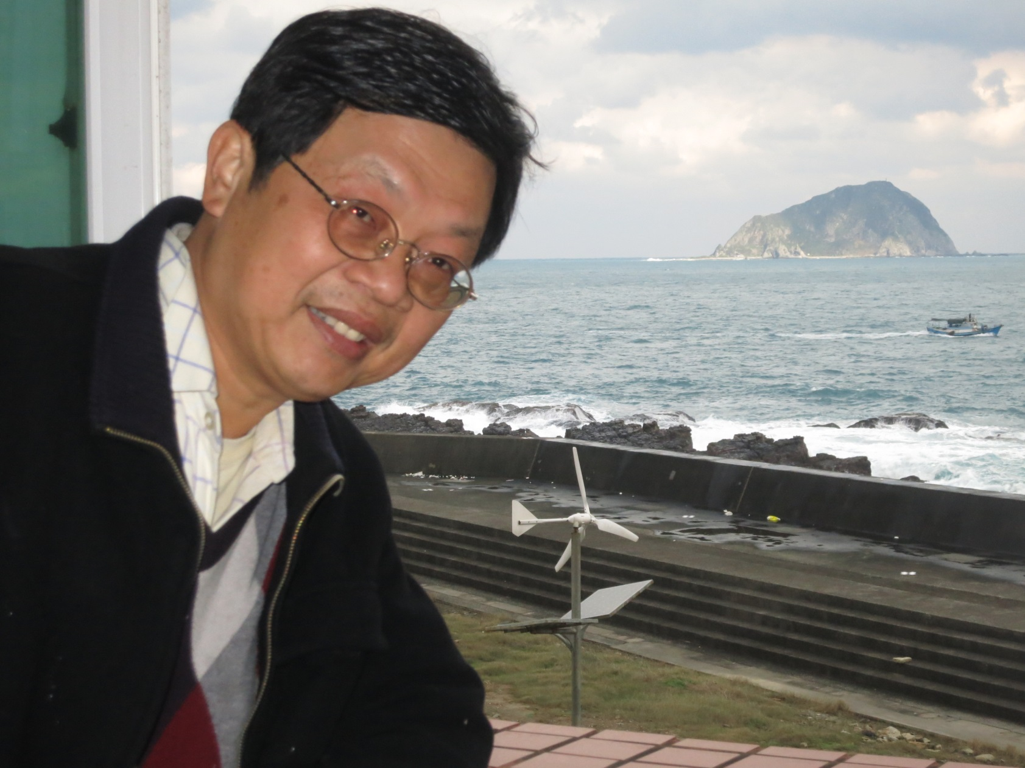
Welcome to visit NTOU/MSV
MSV
窗外

Slide 43





















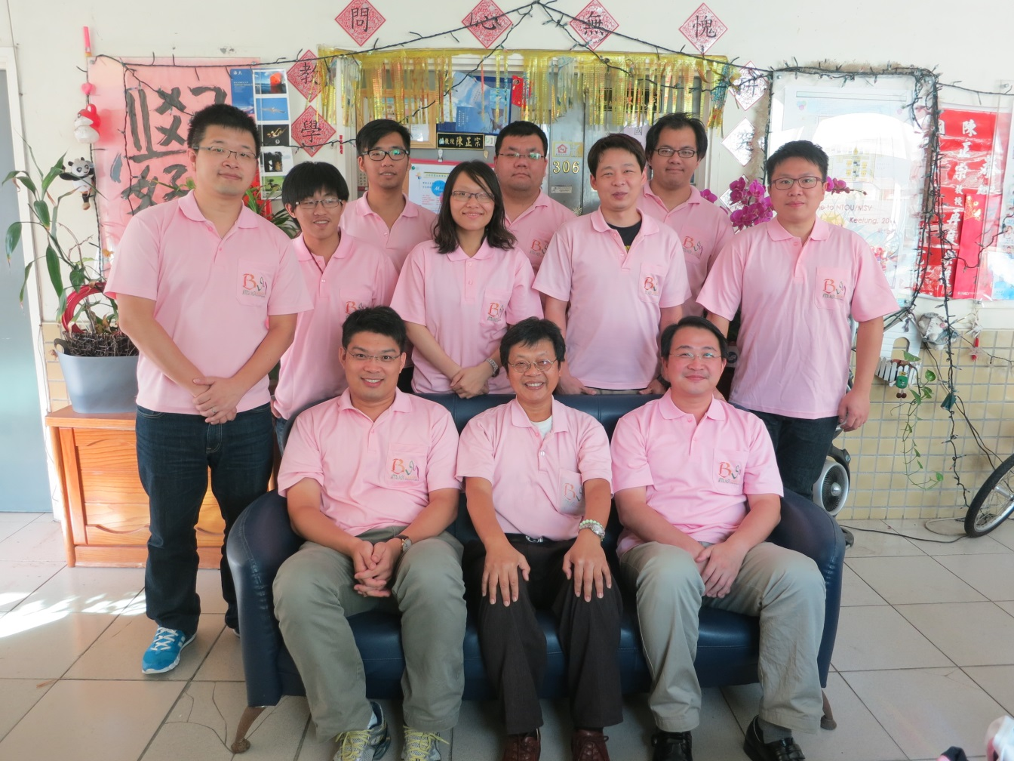






























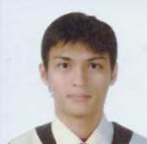


http://msvlab.hre.ntou.edu.tw/ Since 1999
台灣製造 輸出中國
NTOU/MSV 有您真好
Welcome to visit the web site of MSVLAB/NTOU
台灣天下
捨我其誰
E mail: jtchen@mail.ntou.edu.tw

Slide 44
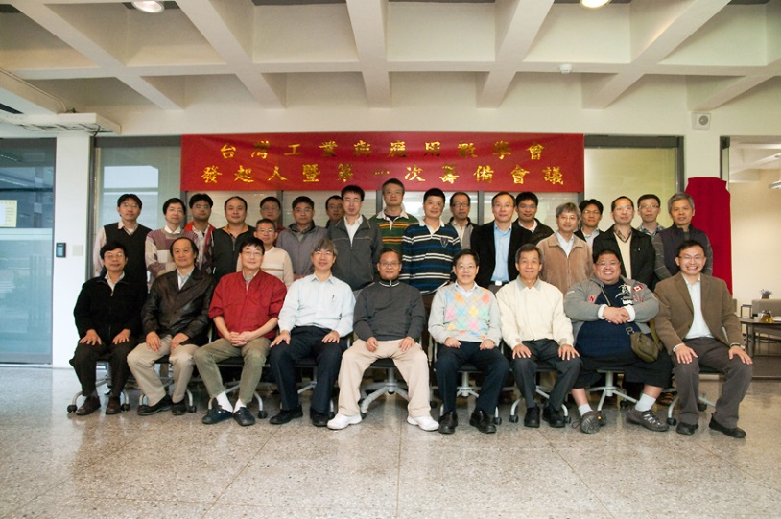
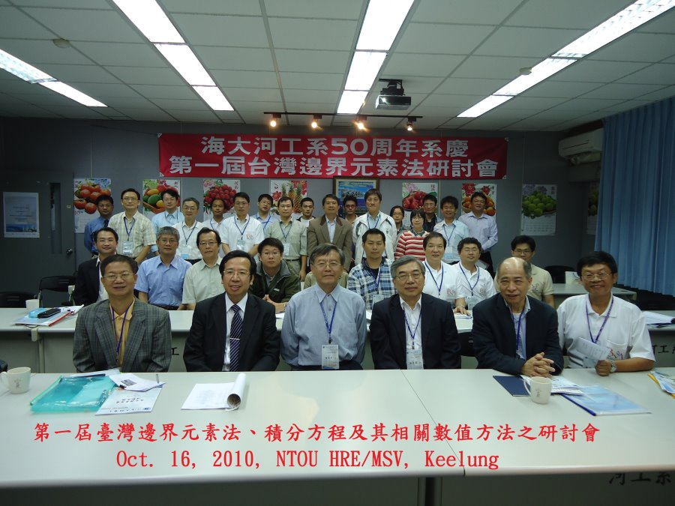
臺灣數學與工程互動(Bridge: computational mechanics)
Taiwan SIAM 扮演的角色
  建立數學與工程的連接橋樑
  Mathematics與Engineering並重
研究強度
數學
工程
(由數學界發起的)
Mathematics & Engineering
(Taiwan SIAM) may bridge the gap
研究強度
Time Evolution
Taiwan BEM
series meeting
(由工程界發起的)
44
數學
工程
Filename: NTOUMSV交叉.ppt

