Slide 1


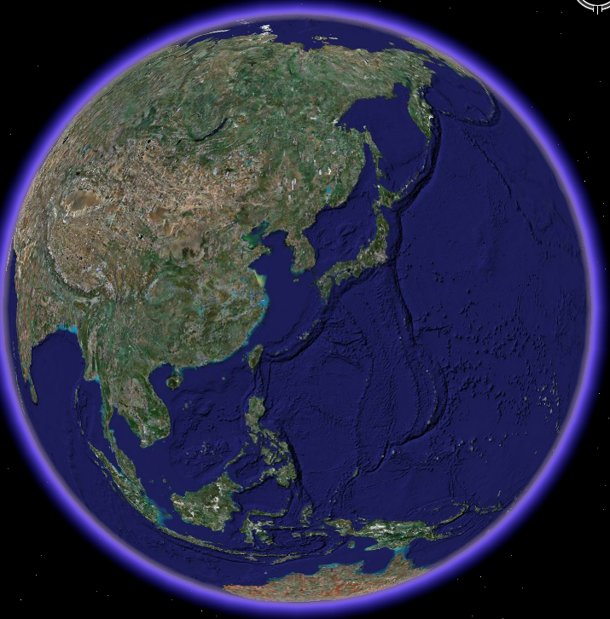
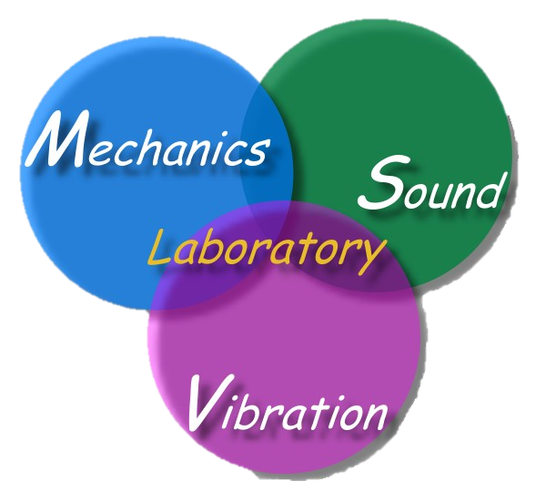
Recent development on the double-degeneracy mechanism of the BEM/BIEM
Chen J T
Distinguished Chair Prof.
Taiwan Ocean University
Guest Prof. , Taiwan University (2023)
Adj. Prof., Cheng-Kung University
NME 2024
10:10 am to 11:00 am
July 29, 2024
Ramada Bell Tower Hotel Xi'an , China
NME2024-xian.ppt

Slide 2
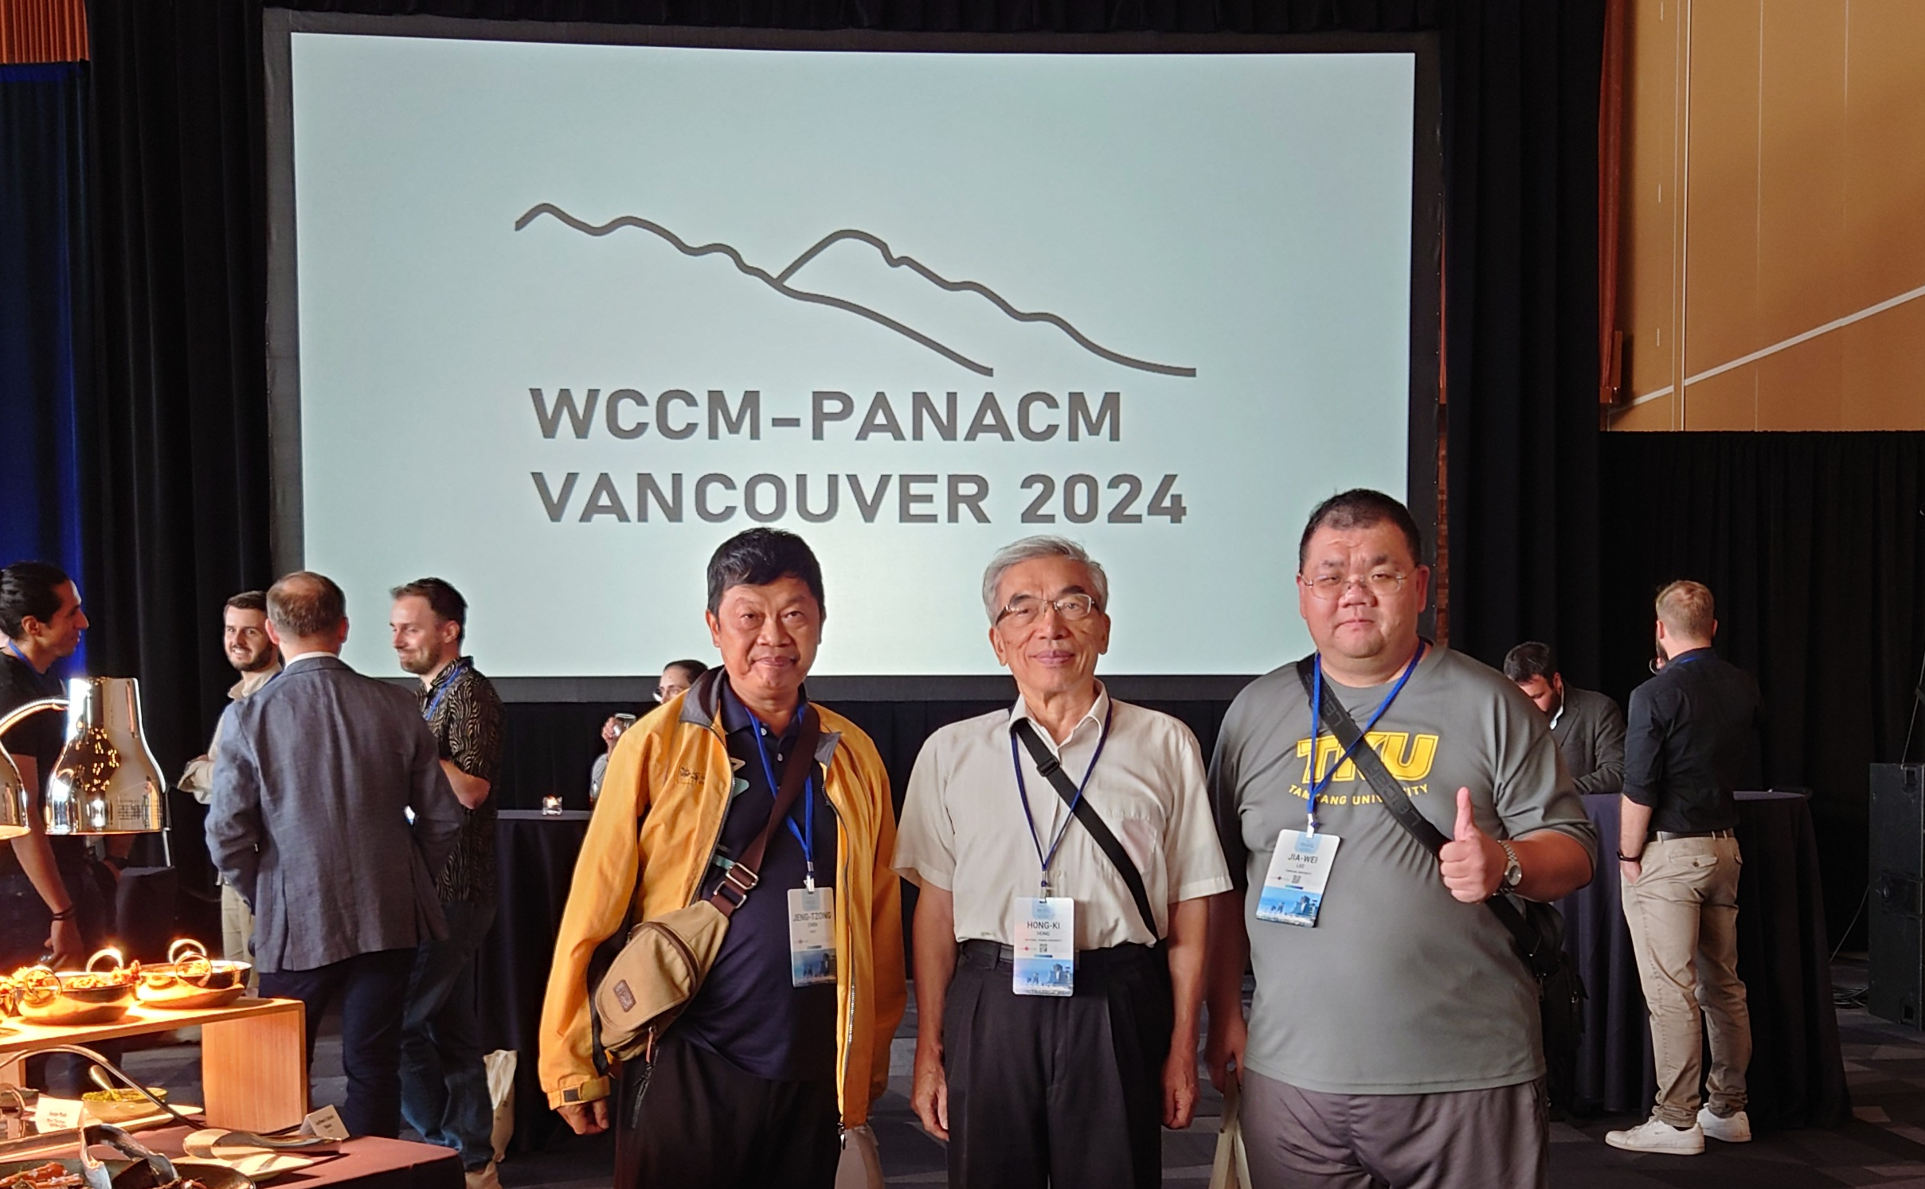
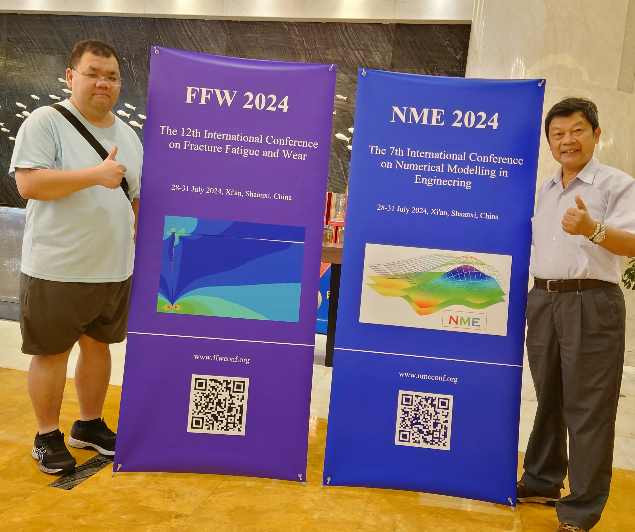
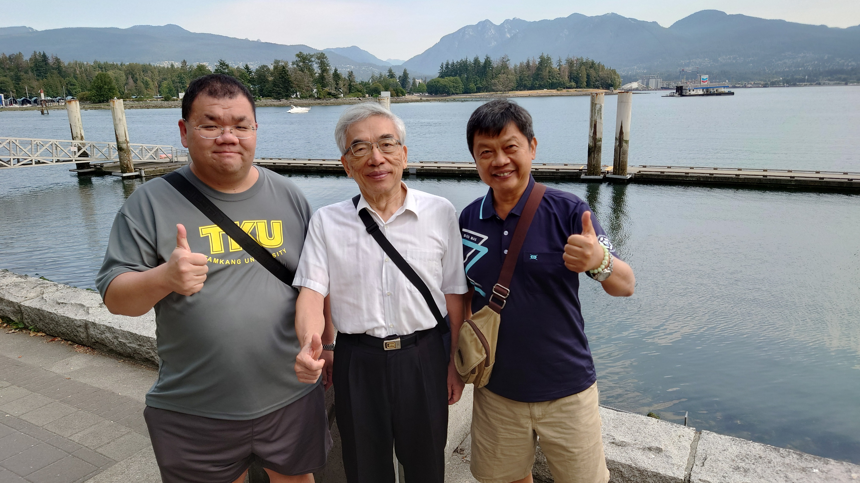
Last week
WCCM 2024 & PANACM 2024
Vancouver,Canada
This week
NME 2024 & FFW 2024
Xian, China

Slide 3
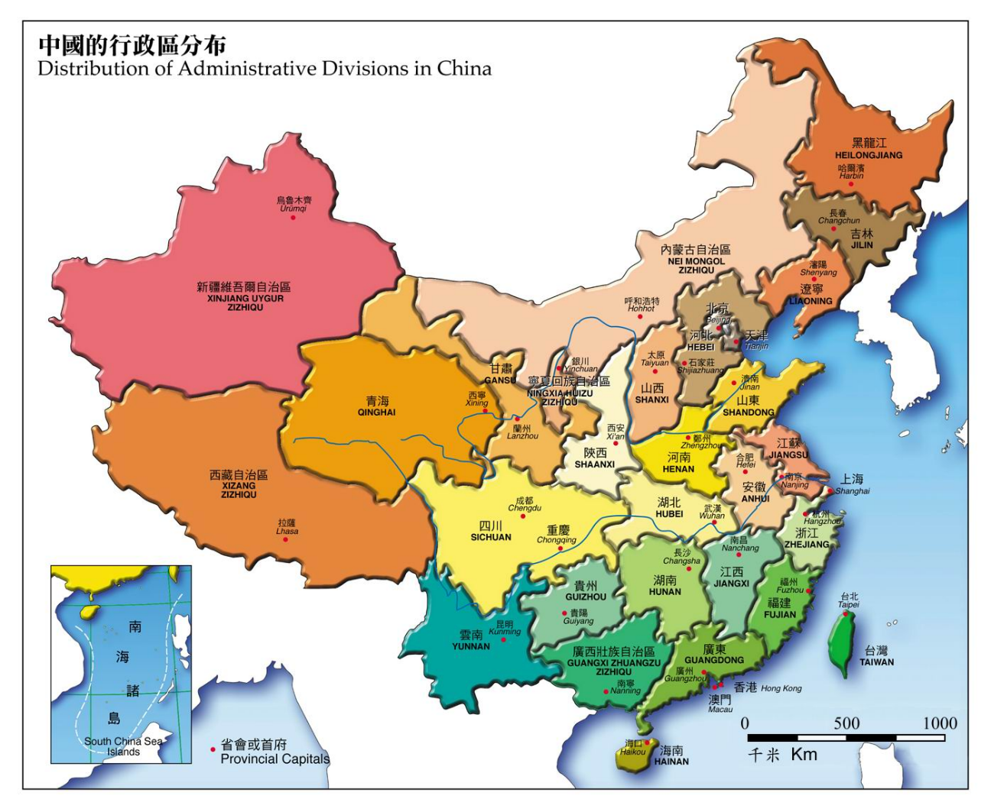
大陸行腳
我已登陸成功 歡迎您來登台
(Mainland China) since 2002 Welcome to Taiwan
北京, 2002, 2013, 2014
秦皇島, 2003
太原, 2016
瀋陽, 2013
大連, 2013
NME 024
FFW 2024
西安, 2024
重慶, 2016
旅順, 2013
成都, 2016
鄭州, 2014
青島, 2019
合肥, 2006
南京, 2006
鎮江, 2008
蘇州, 2008
揚州, 2009
常州, 2009
上海, 2016
NTOU/MSV
Keelung
杭州, 2015
寧波, 2012
廈門, 2010, 2023
長沙, 2012, 2018
湘潭, 2014
桂林, 2017
香港, 1992, 2010
大陸行腳.ppt 2018/08/15 By YL

Slide 4

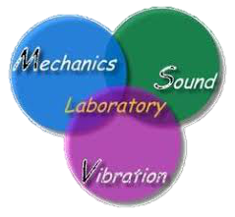




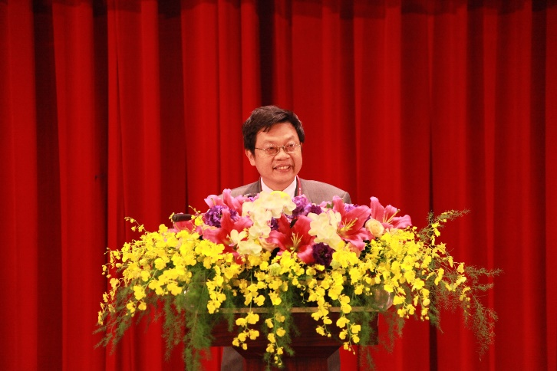




海洋大學
陳正宗
特聘講座教授
NTOU Dist. Chair Prof.
NTU Guest Prof.
(2023)
NCKU, Adj. Prof.
台灣大學
陳正宗
客座教授
陳正宗
合聘教授
成功大學
File name:三校五系合聘教授 by Mei-Na

Slide 5


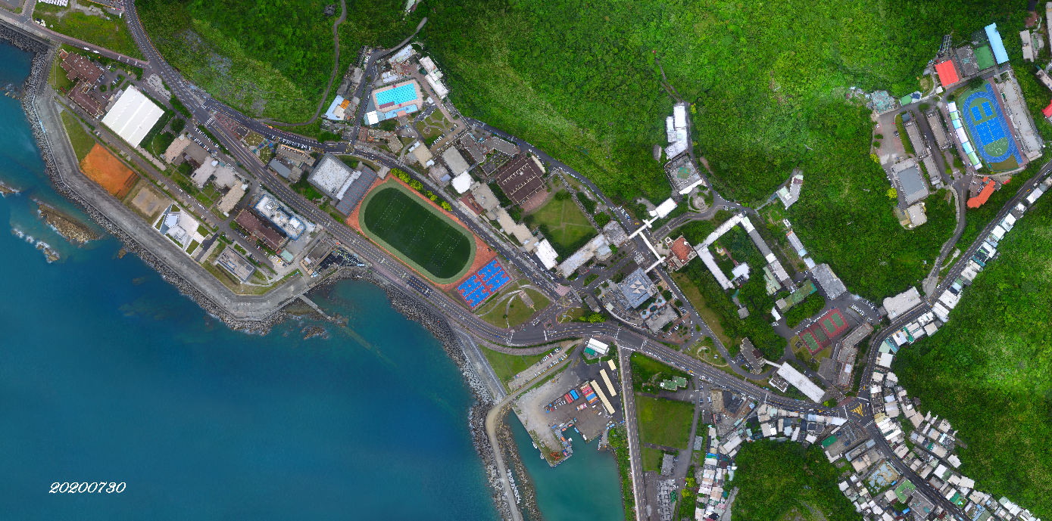
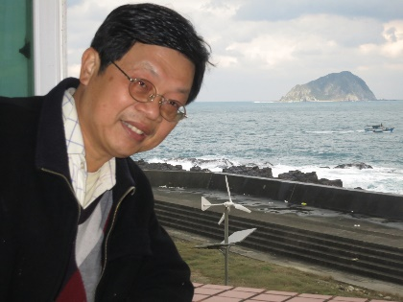

NTOU campus (1994-2024)
National Taiwan Ocean University
Harbor & River Engineering

Slide 6
Outline
Paradise, parasite and paradox
Objectivity
Analytical tool:degenerate kernel
Rank-deficiency mechanism
Double degeneracy

Slide 7
Outline
Paradise Parasite Paradox
Degenerate boundary
Degenerate scale
Spurious eigenvalue
Fictitious fequency
Double degeneracy
Degenerate kernel

Slide 8
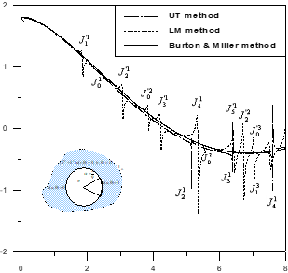
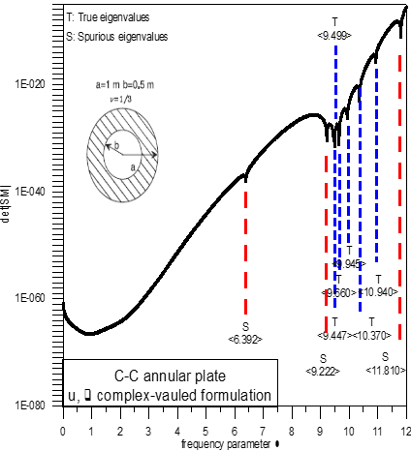

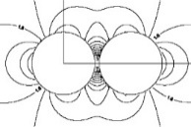
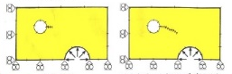
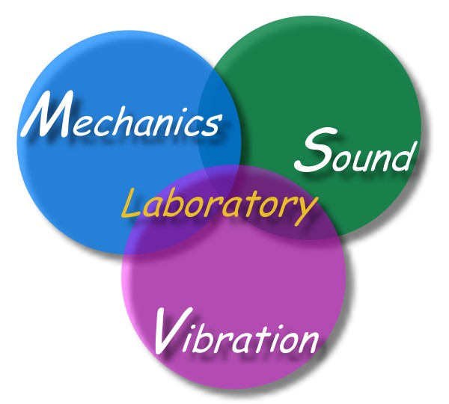


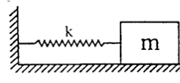
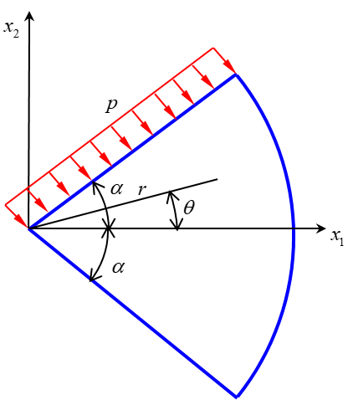

3 Para~ over 39 years (1984-2023)
Fictitious frequency
Spurious eigenvalue
3D→2D
Infinite domain
Stress concentration
Fracture and fatigue
Paradise
(1988-1998)
Parasite
(1998-2008)
Dependency
Degenerate scale
Degenerate boundary
Resonance
Levy’s problem
( From T.C.T. Ting )
Paradox
(2008-2022)
Degenerate scale

Slide 9
Parasite of BEM (1998-2008)
Minimum singular value
t(a,0)
Rank-deficient systems
0/0
Radius
Mechanics Research Communications
Fictitious frequency
Pitfall
Parasite
Degenerate scale
Engineering Analysis with Boundary Elements
Dependency
Spurious eigenvalue
Degenerate boundary
International Journal for Numerical Methods in Engineering
Thermochimita Acta
Parasite of BEM.pptx made by York

Slide 10

Some Paradox (NTOU/MSV)
Scale degeneracy (BIEM)
Frequency degeneracy (Resonance)
Angle degeneracy
Displacement is infinite
Degenerate scale
Levy’s problem
Degenerate scale
( T.C.T. Ting)
Solution diverges.
0.78760
0.93040
Adding comp. solution, we have
Stress in the wedge infinite
everywhere
adding reasonable eigensolution
Unique solution
Nonunique solution

Slide 11
Outline
Paradise Parasite Paradox
Degenerate boundary
Degenerate scale
Degenerate kernel
Double degeneracy

Slide 12
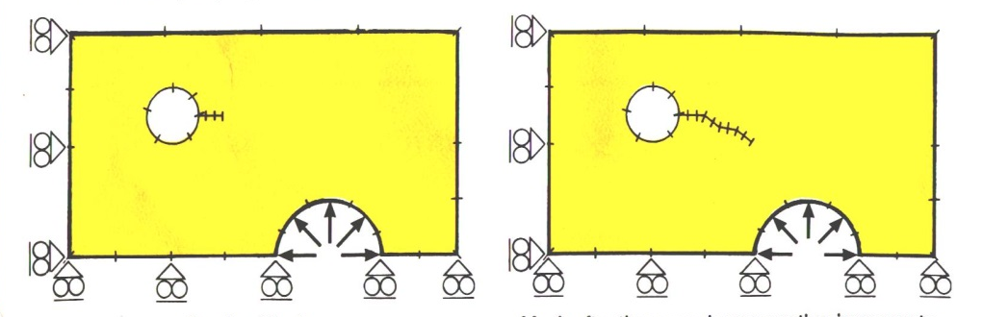
If there is no sufficient and necessary
BIE formulation, BEM involves a parasite for solving problems with degenerate boundaries.
Once the dual BEM
(Hong and Chen 1988) is available, the BEM is a paradise for solving problems with degenerate boundaries.

Slide 13
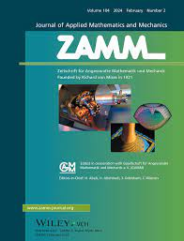
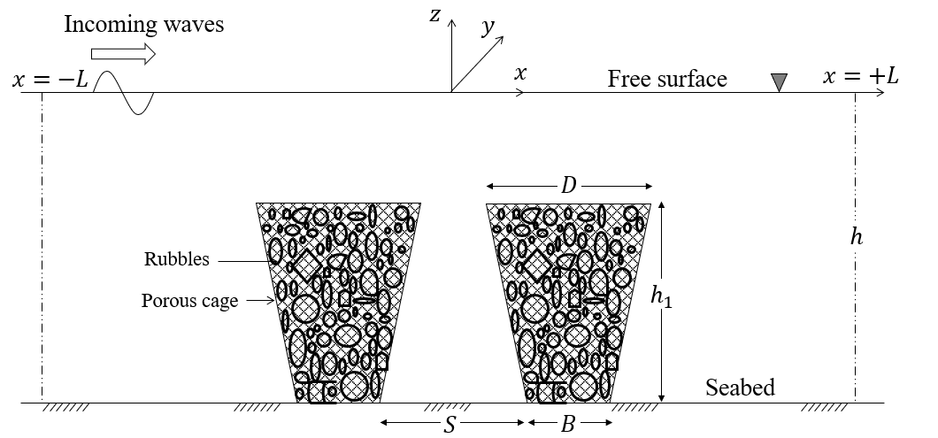

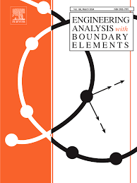
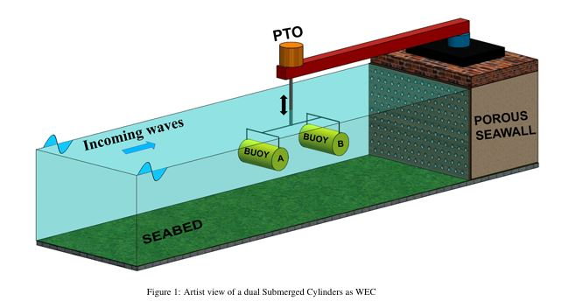
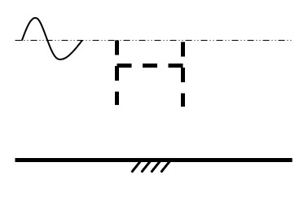
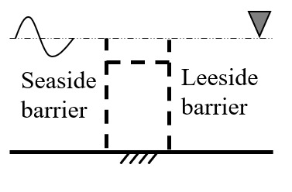
Taiwan-India joint work on breakwater using the dual BEM (2021-2024)
(ZAMM2023)
C.S. Nishad, S. Neelamani, J.T. Chen, and K.G. Vijay, 2023, Gravity Wave Interaction with Cage Enveloped Breakwaters using DBEM, Z Angew Math Mech (ZAMM), e202200064, https://doi.org/10.1002/zamm.202200064
(EABE2021)
K.G. Vijay, C. S. Nishad, S. Neelamani, and J.T. Chen, 2021, Dual BEM for Wave Scattering by a H-Type Porous Barrier with Nonlinear Pressure Drop, Engineering Analysis with Boundary Elements, Vol.131, pp.280-294.
(EABE2024)
R. Appandairaj, K.G.Vijay, K.Murali and J.T.Chen, 2024, Oblique Wave Interaction with Dual Submerged Oscillating Buoy as WEC near a Partially Reflecting Wall, Engineering Analysis with Boundary Elements, Vol.166, 105822.

Slide 14
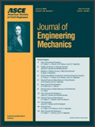

Citing records of dual BEM
(updated, July 12, 2024)
Hong and Chen, 1988
ASCE-EM
Chen and Hong, 1999
ASME-AMR
Google: 438
Google: 488

Slide 15
Outline
Paraddise Parasie Paradox
Degenerate boundary
Degenerate scale
Degenerate kernel
Double degeneracy

Slide 16
Outcome of numerical instability due to degeneracy when using the BIEM/BEM in computational mechanics !
Radar cross section (RCS) 電磁波
Conduction shape factor (CSF) 熱傳
Stress intensity factor (SIF) 破壞力學
Torsional rigidity (TR) 扭轉桿
Stress concentration factor (SCF) 孔洞應力
Transmission and reflection coefficient (TR) 海工
Stress relief (Rigid body motion) 航空
Degeneracy.ppt by JH 2024-06-26
Degeneracy.ppt by JH 2024-06-26

Slide 17


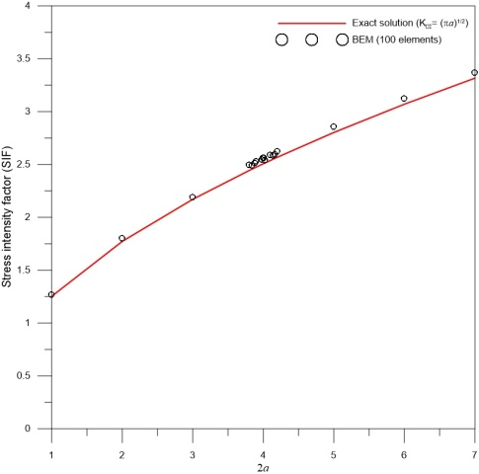
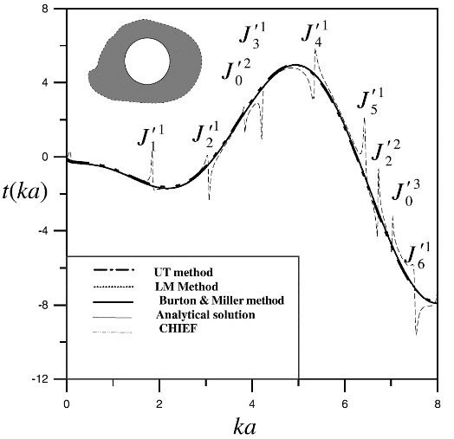

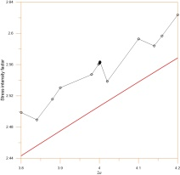
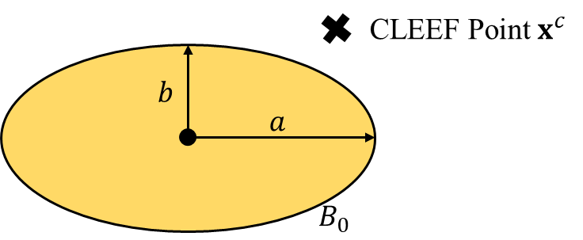
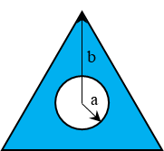
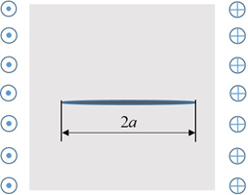
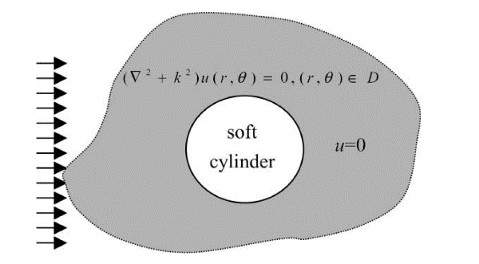





Numerical instability of BEM/BIEM
Torsional rigidity (torsion problem) 2D Laplace equation | Conduction shape factor (heat conduction) 2D Laplace equation | Stress intensity factor (rigid line inclusion) 2D Laplace equation | Exterior acoustics (time-harmonic) Helmholtz equation
Degenerate scale | Degenerate scale | Degenerate scale | Fictitious frequency
$$a+b=2$$
($l=2.37291$)
[$l=2.37105$]
Torsional rigidity
Exchanger tube
Conduction shape factor
Stress intensity factor
radiation and scattering
$$b/a=1/2$$
File name:Numerical instability of BEM or BIEM

Slide 18
2024 new reesult
邊界元素法
阿基里斯腱
Failure of
BEM/BIEM
for the special size
Achilles
tendon

Slide 19
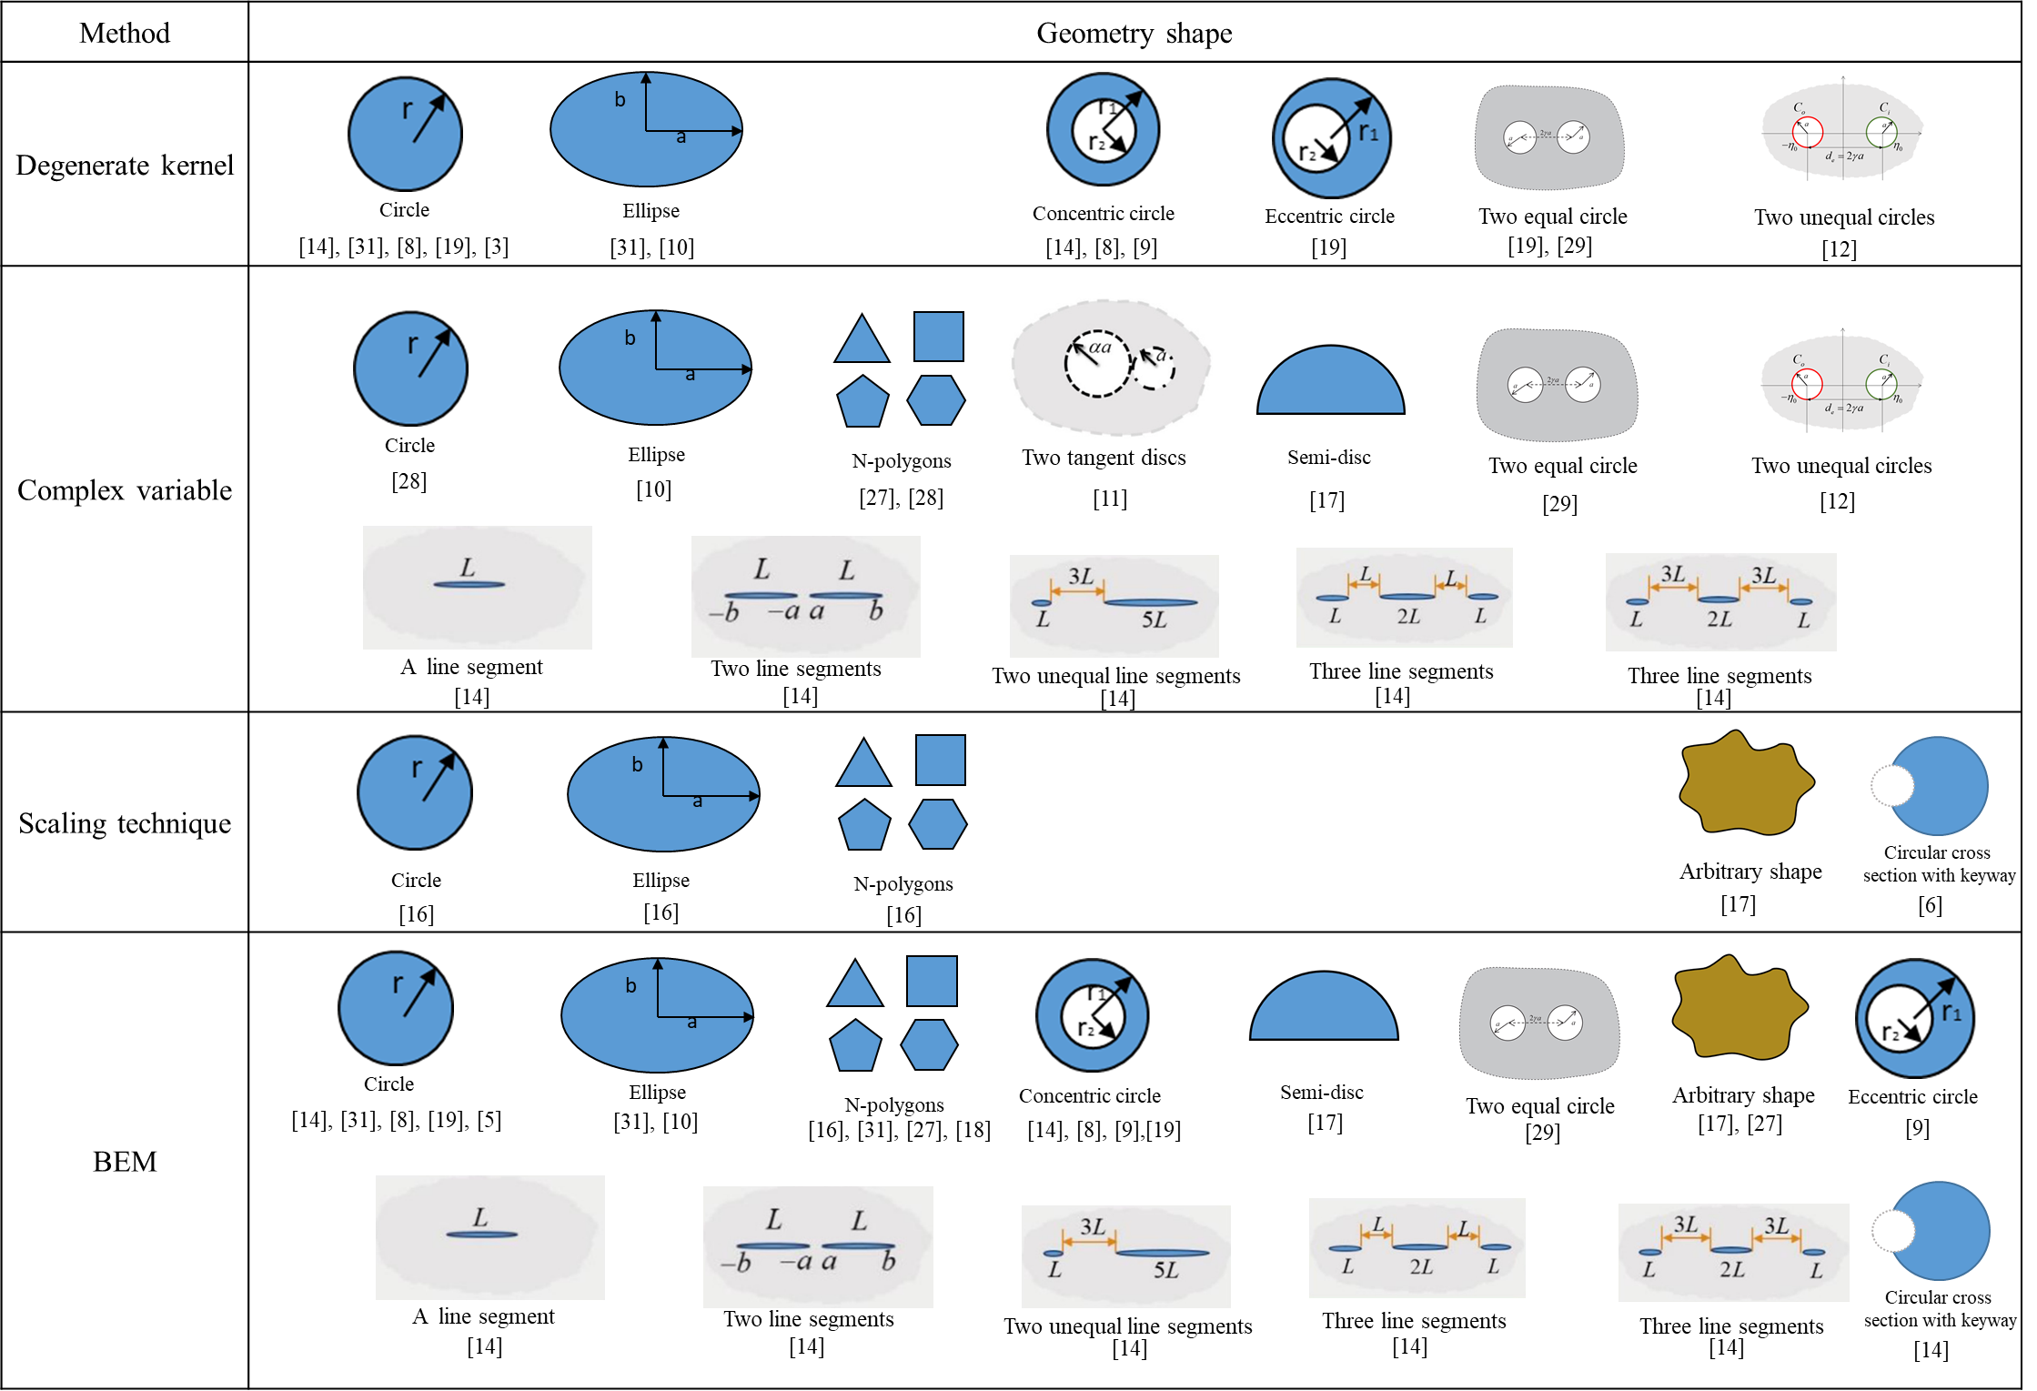
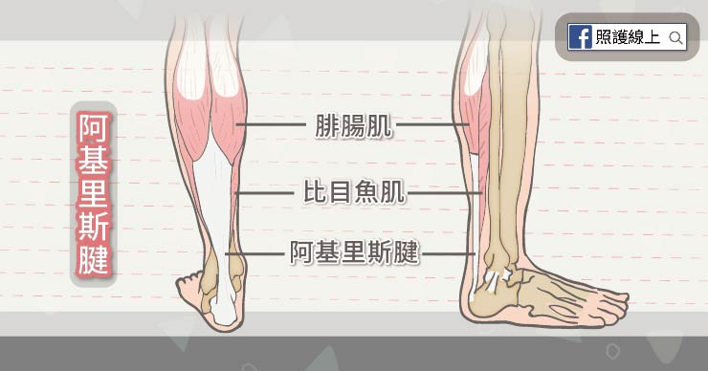
邊界元素法 阿基里斯腱 BEM/BIEM Achilles tendon
Failure of BIEM/BEM
for the special geometry
Double degeneracy :
degenerate scale and degenerate boundary
2024 new reesult

Slide 20



(Hangzhou: paradise in the world) (U(x,s):parasite in the BIEM/BEM)
BEM/BIEM (Disadvantage: Failure)
Match maker (ask for help)
Engineering
problems
Test function
Fundamental sol.
Green function
PDE and IE are
not equivalent
PDE model
IE model(BEM)
Existence
unique solution
Degenerate scale
Degenerate boundary
Spurious eigenvalues
Fictitious frequency
Nonunique solution
Fredholm alternative theorem
Range deficiency
Rank deficiency
Singular matrix
Infinite solution (Not sufficient)
引狼入室
(set a fox to keep geese)
No solution (Not necessary)

Slide 21
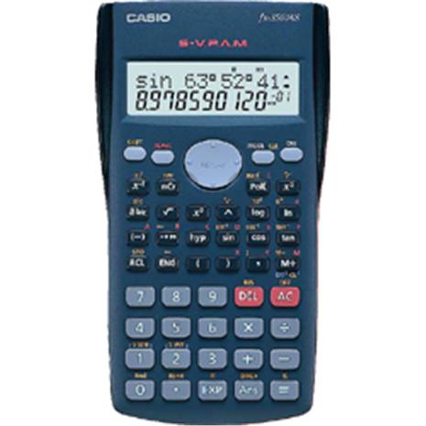
Analytical derivation (dimensional analysis)
(Objectivity)
dimensionless argument
Degrees
Rad
radius
arc
Laplace equation
Lin and Wu(2007), Journal of the Mathematical Society of the Philippines

Slide 22
Outline
Paradise Parasite Paradox
Degenerate boundary
Degenerate scale
Degenerate kernel
Double degeneracy

Slide 23
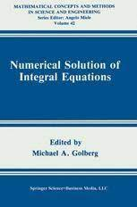
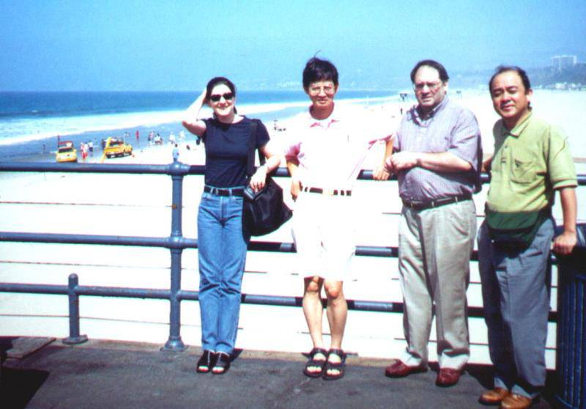
Degenerate kernel ?
(爹mathematician不疼 娘 engineer不愛)
Although degenerate kernel methods plays an important role in the
theory of Fredholm equations and give a natural type of approximation
method, their use in practical problems seems to have taken a back seat
to other methods such as collocation and quadrature. (Golberg, 1979)
Although degenerate kernel methods plays a fundamental role in the
the theoretical analysis of CSIES, little explicit practical use has
been made of them numerically. (Golberg, 1990)
(Prof. Golberg requested my reprint paper on degenerate kernel in 1995)
(I first met Golberg and CS in Univ. Winscosin, Madison, BEM 17, 1995)
The theory of Fredholm equations with degenerate kernels
involves nothing more than the linear algebra. (Cochran, 1982)
If you have interest to find the application of degenerate kernel, please visit the NTOU/MSV web site
where more than 251 sci papers can be found.
Golberg
CS
藤崎涉

Slide 24
Degenerate kernel
Objectivity for any observer
Various coordinates
(polar, bipolar and elliptical coordinates)
Different locations
(origin and focus)

Slide 25
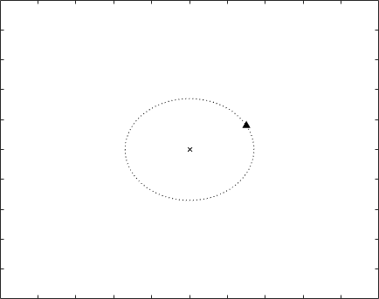
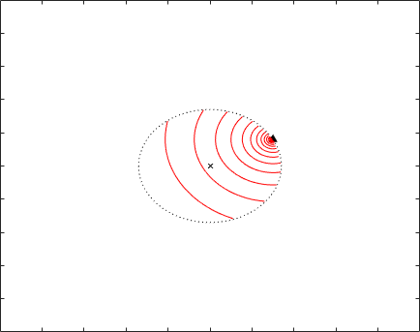
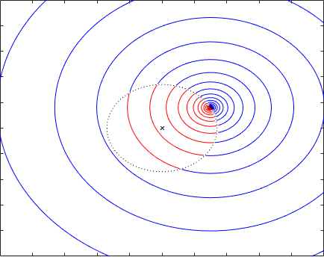
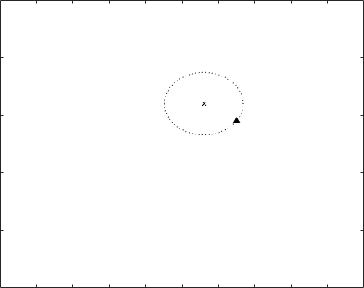
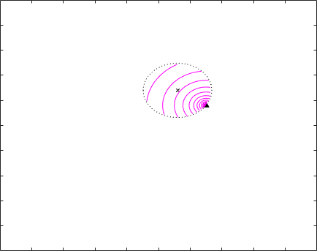

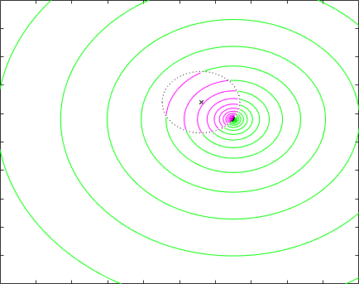
Polar coordinates for ln(r) and theta

Slide 26
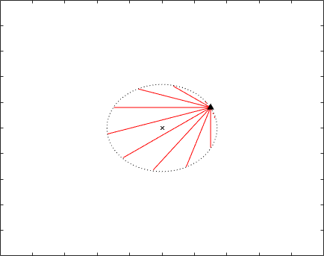
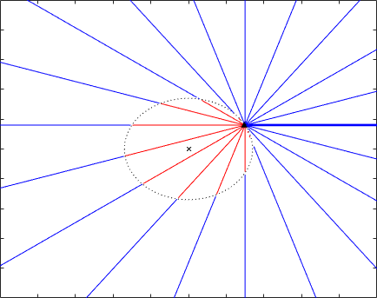
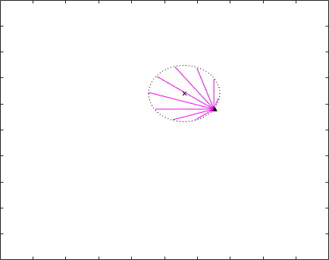
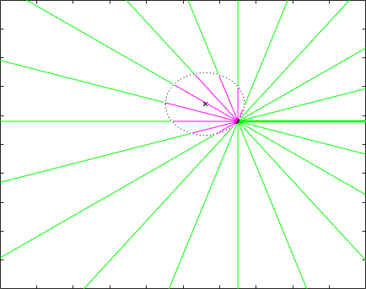

Polar coordinates for ln(r) and theta

Slide 27
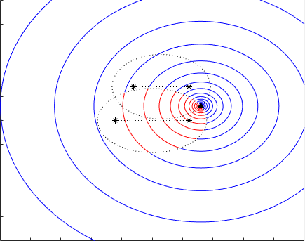
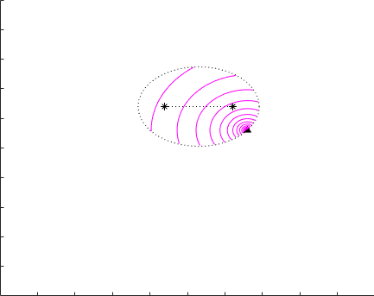
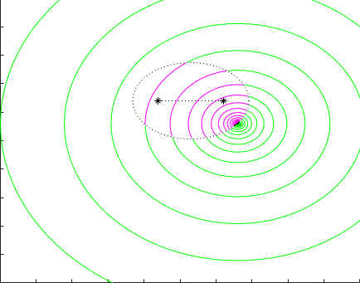




Elliptical coordinates for ln(r) and theta

Slide 28





Elliptical coordinates for ln(r) and theta

Slide 29









Bipolar coordinates for ln(r) and theta

Slide 30








Bipolar coordinates for ln(r) and theta

Slide 31

Polar, elliptical and bipolar coordinates
for ln(r) and theta

Slide 32
Degenerate kernel can explain the rank deficiency
Degenerate boundary
Degenerate scale
Spurious euigenvalue
Fictitious frequency
Double degeneracy

Slide 33





Double degeneracy
Rigid line inclusion (SIF)ＯO | Steady state heat conduction (CSF)Ｏ | Torsion problem (Torsional rigidity)Ｏ | Circular membraneＯ | Water wave problemＯ
1. J.T. Chen, J.H. Kao, Y.L. Huang and S.K. Kao, 2021, Theoretical and Applied Fracture Mechanics, 112, 102830. 2. J.T. Chen, J.H. Kao, S.K. Kao, Y.T. Lee and S.R. Kuo, 2022, Engineering Analysis with Boundary Elements, 136, 290-302. 3. J.T. Chen, J.H. Kao, S.K. Kao, and T.A. Wu, 2023, Engineering Analysis with Boundary Elements, Vol.157, pp.441-461. | 1. J.T. Chen, C.F. Lee, I.L. Chen and J.H. Lin, 2002, Engineering Analysis with Boundary Elements, 26, 559-569. 2. J.W. Lee, H.W. Yang and J.T. Chen, 2023, ASME Journal of Heat and Mass Transfer, Vol. 145 (11), p.110901. | Y.S. Hsieh, 2024, Master thesis, Tamkang University, Taiwan. | J.W. Lee, 2010, Master thesis, National Taiwan Ocean University, Taiwan. | 1. J.W. Lee and J.T. Chen, 2019, 第26屆全國計算流體力學學術研討會, 基隆. 2. J.W. Lee, 2010, Master thesis, National Taiwan Ocean University, Taiwan.
Degenerate boundary + degenerate scale
Degenerate
boundary
2a=4
Degenerate scale
File Name: Double degeneracy

Slide 34
Double-degeneracy (BIEM/BEM)
 | Degenerate scale (statics) (interior and exterior) | Spurious eigenvalue (dynamics) (interior) | Fictitious frequency (dynamics) (exterior) | Degenerate boundary (statics) or (dynamics)
Degenerate scale (statics) | ­－ | Ｘ | Ｘ | ＯO (same geometry)
Spurious eigenvalue (dynamics) (interior) | Ｘ | － | Ｘ | Ｏ
Fictitious frequency (dynamics) (exterior) | Ｘ | Ｘ | － | Ｏ
Degenerate boundary (statics) or (dynamics) | ＯO (same geometry) | Ｏ | Ｏ | －
Double degeneracy :
degenerate scale and degenerate boundary
Ｏ：possible appearance; Ｘ：impossible appearance

Slide 35

Two analytical ways for the crack in the elliptic coordinates

Slide 36

Two analytical ways for the rigid-line inclusion
elliptic coordinates

Slide 37

Stress intensity factor (SIF)
Three ways to determine SIF
Observation point Approach | Boundary density | Interior field | Field and boundary
Displacement
Stress
J-integral
is the infinitesimal distance near the crack tip either from the boundary or from the domain

Slide 38


Crack vs. rigid-line inclusion
Anti-plane elasticity problem | Crack | Rigid-line inclusion
Figure Function
Given B.C. | Neumann | Dirichlet
Total displacement
Stress
Stress
Stress intensity factor (SIF)
J-Integral

Slide 39





Numerical evidences
If
Boundary density
(Degenerate scale)

Slide 40






Numerical evidences of the SIF (asymptotic approx.)
a=1
Boundary-layer
effect
Boundary-layer
effect
a=2
(Degenerate scale)
(Ordinary scale)
Interior field
displacement
stress

Slide 41





Numerical evidences of the SIF (J integral)
a=1
a=2
(Ordinary scale)
(Degenerate scale)
J-integral

Slide 42

Numerical evidences of the SIF
 |  | SIF
 |  | Dual BEM (200 elements) | Exact solution ($\sqrt{πa}$, a=1) | Relative error
Boundary | Stress | 1.7784 | 1.7725 | 0.33%
Domain | Stress | 1.7834 |  | 0.61%
 | Displacement | 1.7835 |  | 0.62%
 |  |  |  | 0.02%
J-integral (80 interior points) |  | 1.7721
Better
Acceptable
Best

Slide 43



Degenerate scale
Dual BEM overcome degenerate boundary
Degenerate scale still exists
a=2
a=2
(Degenerate scale)
(Degenerate scale)

Slide 44


Boundary stress
using the self-regularization technique
a=2
a=2
(Degenerate scale)
(Degenerate scale)
200 elements

Slide 45
Rank-deficiency mechanism for double-degeneracy problem in the dual BIE
 | Crack | Rigid-line inclusion
Geometry BIE
Given B. C.
Unknown boundary density
Singular boundary integral equation (UT)
Hypersingular boundary integral equation (LM)
If
If
N+1 independent eqs.
2N+1 unknowns
N rank deficient
N independent eqs.
2N+1 unknowns
N+1 rank deficient!
N+1 independent eqs.
2N+1 unknowns
N rank deficient
(Degenerate boundary)
(Degenerate scale
+ degenerate boundary)
(Degenerate boundary)
N independent eqs.
2N+1 unknowns
N+1 rank deficient!
N independent eqs.
2N+1 unknowns
N+1 rank deficient
(Degenerate boundary)
(Rank deficiency mechanism due to the degenerate boundary only)

Slide 46










Rank-deficiency mechanism for double-degeneracy problem(BEM)
2a=4.434
Degenerate scale + Degenerate boundary
Take N=10 for example
$$6$$
$$7$$
$$8$$
$$9$$
$1$0
$$5$$
4
$$3$$
$$2$$
$$1$$
2a
Nonzeros
Order:
Caused by degenerate scale (only one)
Order:
Caused by degenerate boundary (total N/2)
Rank deficient:1+5

Slide 47















The singular value vs. the length of the rigid-line inclusion
10 elements
 | Degenerate Scale | Degenerate boundary (for any size)
BEM
Dual BEM
2a=4.3
<4>
2a=4.3
<4>

Slide 48




























The singular value and the left, right singular vectors
 |  | Degenerate scale | Degenerate boundary
BEM (UT)
Dual-BEM

Slide 49








The left and the right singular vectors
in the BEM and the dual BEM
BEM (50 elements) |  |  | Dual BEM (50 elements)
(Degenerate scale) |  |  | (Degenerate scale)
Jacobian* Jacobian* |  |  | Jacobian* Jacobian*

Slide 50
Rank in the ordinary scale, the degenerate scale, the degenerate boundary and double degeneracy
 | Number of nonzero singular values | Number of zero singular values
Ordinary scale (without any degeneracy) | 2N | 0
Degenerate boundary (without a degenerate scale) | N | N
Double degeneracy (with a degenerate boundary and a degenerate scale) | N-1 | N+1
Paradise, parasite and paradox in the dual BEM (U, T , L and M matrices)

Slide 51
Double-degeneracy (BIEM/BEM)
 | Degenerate scale (statics) (interior and exterior) | Spurious eigenvalue (dynamics) (interior) | Fictitious frequency (dynamics) (exterior) | Degenerate boundary (statics) or (dynamics)
Degenerate scale (statics) | ­－ | Ｘ | Ｘ | Ｏ (different geometry)
Spurious eigenvalue (dynamics) (interior) | Ｘ | － | Ｘ | Ｏ
Fictitious frequency (dynamics) (exterior) | Ｘ | Ｘ | － | Ｏ
Degenerate boundary (statics) or (dynamics) | Ｏ(different geometry) | Ｏ | Ｏ | －
Double degeneracy :
degenerate scale and degenerate boundary
Ｏ：possible appearance; Ｘ：impossible appearance

Slide 52








Conduction Shape Factor (CSF), 1913
$$CSF=\frac{\dot{Q}}{k(u_{1}−u_{0})}$$
Fellow of the American Academy of Arts and Sciences (1918)
Perkin Medal (1928)
Nobel Prize in Chemistry (1932)
Franklin Medal (1934)
Faraday Medal (1944)
$$\dot{Q}=kS(u_{1}−u_{0})$$
Irving Langmuir
$S_{o}=$outer boundary of overall
$B_{o}=$ outer boundary of section
$\dot{Q }$is heat transfer rate
$k$ is thermal conductivity of material
$u_{1}$ is temperature of inner boundary
$u_{0}$ is temperature of outer boundary $S$= $CSF$
$$\dot{Q}=−k\int_{S_{o}}{\frac{∂u\left(x\right)}{∂n\left(x\right)}}dA=−k\int_{0}^{L}{\int_{B_{o}}{\frac{∂u\left(x\right)}{∂n\left(x\right)}}}dB\left(x\right)dz \\ =−k\int_{0}^{L}{\int_{B_{o}}{t\left(x\right)}}dB\left(x\right)dz$$
$$\dot{Q}=−k\int_{0}^{L}{\int_{B_{o}}{t\left(x\right)}}dB\left(x\right)dz$$
$$S=\frac{\dot{Q}}{k(u_{1}−u_{0})}$$
It equals the total temperature flux around the outer surface with multiplying a negative k.

Slide 53



Double degeneracy problem
An elliptical tube containing a focal slit
$$\frac{∂^{2}u(x)}{∂x^{2}}+\frac{∂^{2}u(x)}{∂y^{2}}=0 ,x∈D$$
Governing equation
Boundary condition
$$\left\{\begin{aligned}u\left(x\right)=u_{1}=400K, \\ u\left(x\right)=u_{0}=300K, \end{aligned}\right.$$
Constant temperatures are specified on both boundaries.
Inner boundary
Slit
Degenerate boundary
Outer boundary
Ellipse
Degenerate scale
Rank-deficient problem
Rank-deficient problem
$$0=\int_{B}^{ }{T\left(s,x\right)u\left(s\right)dB\left(s\right)}−\int_{B}^{ }{U\left(s,x\right)t\left(s\right)dB\left(s\right)} ,x∈D^{c}$$
Only using the singular BIE to solve the double degeneracy problem may fail.

Slide 54







Dual BIE for the degenerate boundary
$$x^{+}$$
$$B_{1^{+}}$$
$$x^{−}$$
$$B_{1^{−}}$$
$$\frac{α}{2π}\left[u\left(x\right)−w\left(x\right)\right]=C.P.V.\int_{B}{\left.T\left(s,x\right)[u\left(s\right)−w(s\right)]dB\left(s\right)} \\ −R.P.V.\int_{B}{U\left(s,x\right)[t(s)−w_{p}\left(s\right)]dB\left(s\right)}, x∈B_{1^{+}}$$
UT
$$\frac{α}{2π}\left[u\left(x\right)−w\left(x\right)\right]=H.P.V.\int_{B}{\left.M\left(s,x\right)[u\left(s\right)−w(s\right)]dB\left(s\right)} \\ −C.P.V.\int_{B}{L\left(s,x\right)[t(s)−w_{p}\left(s\right)]dB\left(s\right)}, x∈B_{1^{−}}$$
LM
In addition, the dual BIE is also required for present problem.

Slide 55










Degenerate scale
The value of degenerate scale in the numerical result can be predicted by using the analytical derivation.
2D Laplace problem
Dirichlet BC
$$a$$
$$a=1$$
BEM/BIEM
$$u\left(x\right)=\int_{B}^{ }{T\left(s,x\right)u\left(s\right)dB\left(s\right)}$$
No solution or non-unique
$$a$$
$$−\int_{B}^{ }{U\left(s,x\right)t\left(s\right)dB\left(s\right)} ,x∈D$$
$$U\left(s,x\right)=\frac{1}{2π}ln\left|x−s\right|$$
$$T\left(s,x\right)=\frac{∂U\left(s,x\right)}{∂n(s)}$$
$a=1.$694

Slide 56










Treatments for degenerate scale
Method 1 | Method 2
Hypersingular boundary integral equation | CLEEF (UT or LM)
$$UT→LM$$
$$UT$$
$$UT or LM \\ equation$$
$$\left[U_{r}\right]\left\{t_{g}\right\}=\left[T_{r}\right]\left\{u_{g}\right\}$$
=CLEEF point
$$r=N_{g}×N_{g}$$
$${\left[U_{b}^{c}\right]}^{T}\left[U_{b}^{c}\right]\left\{t_{g}\right\}={\left[U_{b}^{c}\right]}^{T}\left[T_{b}^{c}\right]\left\{u_{g}\right\}$$
$$g=N_{g}×1$$
$$b=(N_{g}+1)×N_{g}$$
${\left\{t_{g}\right\}=({\left[U_{b}^{c}\right]}^{T}\left[U_{b}^{c}\right])}^{−1}$(${\left[U_{b}^{c}\right]}^{T} \left[T_{b}^{c}\right]\left\{u_{g}\right\})$

Slide 57

Treatment of
numerical instabilities due to
the degenerate scales
Elliptical tube containing a focal slit
Elliptical tube containing 3 radial slits
No matter how many slits in the domain, the degenerate scale is dominated by the size of outer boundary.

Slide 58

Double degeneracy
(Degenerate boundary and degenerate scale)
Inner boundary
Slit
Degenerate boundary
Dual BIE
Outer boundary
Ellipse
Degenerate scale
CLEEF & Dual BIE
Degenerate scale is dominated by the outer boundary instead of the inner boundary.
The dual BIE is the well-posed model for dealing with all degenerate problems.

Slide 59




Related CSF papers
If anyone has interesting to our work. There are four related papers can be found.
The pdf file is upon your request.
J. W. Lee*, H. W. Yang and J. T. Chen, 2023, ASME Journal of Heat and Mass Transfer, Vol. 145 (11), p.110901.
J. H. Kao, J. W. Lee*, J. Y. Young and J. T. Chen, 2023, Numerical Heat Transfer, Part B: Fundamentals, accepted.
J. W. Lee*, H. W. Yang and J. T. Chen, 2024, Engineering Analysis with Boundary Elements, Vol. 165, 105798.
J. H. Kao, C. Y. Yang, J. W. Lee*, J. T. Chen, 2024, International Journal of Heat and Mass Transfer, Accepted.

Slide 60
Double-degeneracy (BIEM/BEM)
 | Degenerate scale (statics) (interior and exterior) | Spurious eigenvalue (dynamics) (interior) | Fictitious frequency (dynamics) (exterior) | Degenerate boundary (statics) or (dynamics)
Degenerate scale (statics) | ­－ | Ｘ | Ｘ | ＯO
Spurious eigenvalue (dynamics) (interior) | Ｘ | － | Ｘ | Ｏ
Fictitious frequency (dynamics) (exterior) | Ｘ | Ｘ | － | Ｏ
Degenerate boundary (statics) or (dynamics) | ＯO | Ｏ | Ｏ | －
Double degeneracy :
degenerate scale and degenerate boundary
Ｏ：possible appearance; Ｘ：impossible appearance

Slide 61
Double-degeneracy (BIEM/BEM)
Degenerate boundary and spurious eigenvalue

Slide 62
Double-degeneracy (BIEM/BEM)
 | Degenerate scale (statics) (interior and exterior) | Spurious eigenvalue (dynamics) (interior) | Fictitious frequency (dynamics) (exterior) | Degenerate boundary (statics) or (dynamics)
Degenerate scale (statics) | ­－ | Ｘ | Ｘ | ＯO
Spurious eigenvalue (dynamics) (interior) | Ｘ | － | Ｘ | Ｏ
Fictitious frequency (dynamics) (exterior) | Ｘ | Ｘ | － | Ｏ
Degenerate boundary (statics) or (dynamics) | ＯO | Ｏ | Ｏ | －
Double degeneracy :
degenerate scale and degenerate boundary
Ｏ：possible appearance; Ｘ：impossible appearance

Slide 63



Double-degeneracy (BIEM/BEM)
Degenerate boundary and fictitious frequency

Slide 64
A water wave problem
impinging on
a circular, an elliptical
cylinder and
a thin breakwater

Slide 65




Null space of influence matrices in the BEM
SVD decomposition
Stupid Chen paid more than 40 years (from 1981 to 2023) to understand the book cover of Master Strang book
Paradise, parasite and paradox in the dual BEM (U, T , L and M matrices)

Slide 66






Mapping diagram of Strang
No. | Year | Author | Book or paper | Title | Status
1 | 2016 | Gilbert Strang | Book | Introduction to Linear Algebra (5th edition) | Appear
2 | 2021 | YL Huang | TAFM | Study on the stress intensity factor and the double-degeneracy mechanism in the BEM/BIEM for anti-plane shear problems (double degeneracy) | Appear
3 | 2021 | WC Tai | CPAA | An indirect BIE free of degenerate scales (degenerate scale) | Appear
4 | 2021 | CH Shao | EABE | On the role of singular and hypersingular BIEs for the BVPs containing a degenerate boundary (degenerate boundary) | Appear
5 | 2022 | JH Kao | JE | Study on the double-degeneracy mechanism of BEM/BIEM for a plane elasticity problem with the line segments (double degeneracy) | Appear
6 | 2023 | JH Kao | EABE | Are the direct and indirect BEM/BIEMs equivalent ? | Appear
1
2
3
4
5
6
File name: Mapping diagram of Strang Made by T.L.

Slide 67
Message from Gilbert Strang
(May 15, 2023 last MIT lecture)
Dear NTOU/MSV people,
Thank you for such a generous message ! I am very happy
that you approve of the final lecture -- I wasn't sure what to say . I am so fortunate to have the chance to teach at MIT and also to have the lectures for Math 18.06 and 18.065 on Opencourseware ocw.mit.edu . It is neat that you found applications for the 4 subspaces figure.
Linear algebra is a beautiful subject --- and teaching is a beautiful life.
I hope all your work and your life goes well !
Very best wishes
Gilbert Strang May 17, 2023

Slide 68







Degenerate Terminology 退化?
Degenerate eigenvalue | Degenerate scale | Degenerate boundary | Degenerate kernel
a<1
$${Γ }^{−}$$
$${Γ }^{+}$$
a=1
$$U\left(x,x\right)=\left\{\begin{aligned}P\left(x\right)Q\left(s\right), \left|x\right|>\left|s\right| \\ P\left(s\right)Q\left(x\right), \left|x\right|<\left|s\right|\end{aligned}\right.$$
$${Γ }^{+}$$
a>1
$$\iint{U\left(x,s\right)}db(x)db\left(s\right)=\int{P\left(x\right)}db(x)\int{Q\left(s\right)}db(s)$$
$${Γ }^{−}$$
(2.1) (1.2) modes eigenvalues 相同
eigen mode 不同

Slide 69
Conclusion
Paradise, parasite and paradox of BIEM/BEM
Successful experiences in India-Taiwan on the parasite of dual BEM
Degenerate boundary and degenerate scale may occur together for the same geometry and different geometry (double degeneracy)
Degenerate kernel is the key to explain what happens for the degeneracy mechanism in the BIEM/BEM
Objectivity of degenerate kernel was numerically verified.
All possible cases of double degeneracy were demonstrated.
The well-posed dual BIE model provides the key to solve the rank deficiency problems

Slide 70


Thank you for your attention

Slide 71












太極
Real variable
兩儀
Complex variable
四相Quaternion
八卦Clifford
ASCE, 1988
(324 citings)
2018
2016
2000
2013
NTOU/MSV
J. T. Chen
NCKU/MSV
L.W. Liu
ASME, 1999
(398 citings)
NTU/MSV
H.-K.Hong
TKU/MSV
J.W. Lee
2015

Slide 72


八卦邊界元
Bagua boundary element method
Real variable BEM
Complex variable BEM
八卦
BEM
Clifford algebra valued BEM
Quaternion valued BEM

Slide 73
Outline
Paradise, parasite and paradox
Objectivity
Analytical tool:
Singular and hypersingular integrals
Rank-deficiency mechanism
Double degeneracy

Slide 74




Three steps of NTOU/MSV for two circular boundary problems
(Numerical, semi-analytical to analytical approaches)
Hong
(closed-form kernel)
JT Chen and WC Shen
polar degenerate kernel
J T Chen and W C Dai
bipolar degenerate kernel
BEM
(Numerical)
Null-field BIE+ polar degenerate kernel
using adaptive observer
(Semi analytical)
Null-field BIE+
bipolar degenerate kernel
(Analytical)
Taiwan
MSV group
1982
2006
2024
NTU
NTOU
NTOU+TKU

Slide 75





BVP and Green’s function using degenerate kernels
2023
BVP
Green’s function
Green’s function
2022
2022
Success
Accepted
Screw dislocation
2022
Anti-plane remote shear

Slide 76

邊界元 來結緣 Line group 學術俱樂部
(我們不是邊緣人)
Academic line group of BEM club

Slide 77



Thanks for your kind attention
URL:http://msvlab.hre.ntou.edu.tw/ Since 1999
U tube: https://www.youtube.com/watch?v=1d3xr9zdFGg Since 2015
E mail: jtchen@mail.ntou.edu.tw
Google citing: http://scholar.google.com/citations?user=CcL1xQoAAAAJ&hl=en

Slide 79





Dual BEM, DDM and Dislocation theory
Dual BEM
Hong and Chen (ASCE, 1988)
-a
a
0
∞
DDM
Crouch S.L. (1983)
Dislocation theory
Neuber-Papkovitch function
Higher order element
by Shou K.J.

Slide 80





Paradox in mathematics and mechanics
(1986-2019)
Elasticity
BIEM
Harbor
Levy’s problem
Harbor resonance
Degenerate scale
( From T.C.T. Ting )
莊子 日取一半尺
Zeno 人賽不過龜
有限體積無限表面積

Slide 81
Some Paradox (NTOU/MSV)
Angle degeneracy
Scale degeneracy (BIEM)
Frequency degeneracy (Resonance)
質點位移 隨時無窮大
Degenerate scale
Degenerate scale
0.78760
0.93040
時，解為無限大.
wedge內應力處處無窮大
此時可加一補解，使得
補reasonable eigensolution
Unique solution
Nonunique solution

Slide 82
Taiwan role on BEM
Project | Roles
EABE IF=2.138 Best Paper Award since 2018 | Editor-in-Chief: Alexander H. D. Cheng Associate Editors: J. T. Chen (2008~2016, 2020~) Editorial Board: D.L. Young & C M Fan
Rizzo Award | Committee: J. T. Chen (only five in the world)
BEM/MRM | Committee: Alexander H. D. Cheng & J. T. Chen
Beteq | Y.C. Shiah
ICOME | J. T. Chen
Taiwan role on BEM.ppt by KT

Slide 83







NTOU/MSV Editorial Staff 2021
(Associate Editor: Chen J T)
Taylor & Francis
I.F. 0.667/Q4
Elsevier
I.F. 2.884/Q1
Oxford Univ. Press
I.F. 1.293/Q4
Elsevier, 2021
I.F. 1.293/Q4
Exective Editor
(1999-2001)
Secretary
Secretary
Secretary
Jeng-Hong Kao
高政宏
Yi-Ling Huang
黃乙玲
Shing-Kai Kao
高聖凱
Filename:Associate Editor-2020 by 蘇祉瑜 2020.10.13

Slide 84






BEM Power in the world (NTOU/MSV)
5
1
3
2
4
Top five
China | Iran | United States | Taiwan | United kingdom

Slide 85































History & Background Taiwan BEM workshop (1986-2020) see you in TKU (BEM 12-2021)
Year | The host unit | The organizer | Ceremony | (BEM 11)
1986 | NTU IAM | Prof. Y H Pao | Establishment of NTU IAM | Prof. F J Rizzo
1989 | NTU | Prof. D L Young | NSC | Prof. J A Liggett
1998 | NSC | Prof. J T Chen | NCHC | Prof. A H D Cheng
2010 | NTOU-HRE-MSV | Prof. J T Chen | NTOU-HRE 50th anniversary | Prof. Z C Li
2011 | NCTS(South) | Prof. K M Lee | NCKU 80th anniversary | NCKU
2012 | Feng Chia University | Prof. Y C Shiah | Prof. Hong’s 60th birthday | Prof. H-K Hong
2013 | National Chung Hsing University | Prof. K J Shou | Congratulations for Academicain | Dean S L Crouch Academician,NAE
2014 | National SYS University | Prof. T T Lu | Prof. Young’s 70th birthday | Prof. D L Young
2015 | NCREE (cross strait) | Dr. R Z Wang | NCREE | Cross strait ceremony
2016 | NCTS (Japan-Taiwan) | Prof. J H Lee | NCTS | Prof. H-K Hong Prof. W-W Lin
2017 | NIU | Prof. I L Chern Prof. K H Chen | Ilan Univ | Prof. H-K Hong Prof. W-C Wang
2018 | ISU | Prof. H T Huang Prof. I L Chen | Iso univ. | Prof. D L Young
2019 | NCKU | Prof. L W Liu | Cheng Kung Univ | Prof. J T Chen
2020 | NTOU | Prof. Y T Lee Prof. C M Fan | NTOU-HRE 60th anniversary | Prof. C B Hwu

Slide 86












Taiwan BEM/Meshless Meeting (2010-2020)

Slide 87



Taiwan BEM/Meshless Meeting (2021)

Slide 88


Citing:
Chen J T On Hadamard principal value
and boundary integral equation of fracture mechanics
M. Sc. Thesis (應力所碩士論文)
Institute of Applied Mechanics,
National Taiwan University, 1986. (洪宏基教授指導)
論文有機會
用英文寫
1986 NTU IAM 種的因
2003 St Petersburg 得善果
St. Petersburg 2003 (列寧格勒)

Slide 89
Dual BEM 走過三十年(1984-2022)
Yu D. H. (余德浩) | (1983) | 中國科學院博士論文(Chinese)
Takakuda K.(高久田) | (1985) | JSME
Chen J. T. (陳正宗) | (1986) | 台灣大學應力所碩士論文supervised by Prof. H. –K. Hong
Ugodchicoff and Khutoryanskiy | (1986) | Kazan Univ. Press (Russian)
Hu H. C.(胡海昌) | (1986) | 中國科學中文版(Chinese)
 | (1987) | 中國科學英文版(English)
Hong H. -K. and Chen J. T. (洪宏基與陳正宗) | (1988) | ASCE,EM
Portela and Aliabadi M. H. | (1992) | IJNME
Chen J T and H K Hong | (1999) | ASME-AMR

Slide 90
邊界元 來結緣 Line group 學術俱樂部
(我們不是邊緣人)

Slide 91
Thanks for your kind attention
感謝 方志中主任 邀請
URL:http://msvlab.hre.ntou.edu.tw/ Since 1999
U tube: https://www.youtube.com/watch?v=1d3xr9zdFGg Since 2015
E mail: jtchen@mail.ntou.edu.tw
Google citing: http://scholar.google.com/citations?user=CcL1xQoAAAAJ&hl=en

Slide 92























































http://msvlab.hre.ntou.edu.tw/ Since 1999
台灣製造 輸出中國
NTOU/MSV 有您真好
Welcome to visit the web site of MSVLAB/NTOU
台灣天下
捨我其誰
E mail: jtchen@mail.ntou.edu.tw

Slide 93

Welcome to visit NTOU/MSV
MSV
窗外

Slide 94
Taiwan BEM series (2017-2021)
屆數 | 年代 | 主持人 | 主辦地點
8 | 2017 | 陳桂鴻 吳清森 李洋傑 | 宜蘭大學(宜蘭)
9 | 2018 | 黃宏財 陳義麟 吳土城 | 義守大學(高雄)
10 | 2019 | 李國明 劉立偉 夏育群 胡潛濱 | 成功大學(台南)
11 | 2020 | 李應德 范佳銘 陳正宗 郭世榮 | 海洋大學(基隆) 河工系60周年慶
12 | 2021 | 李家瑋 李明恭 | 淡江大學(淡水)
Taiwan BEM series.ppt by KT
ICOME 2023 在台灣

Slide 95
Welcome to visit NTOU/MSV
MSV
窗外

Slide 96



21類學術領域中
工程類
全球 266人
台灣 5人
河海工程學系
Department of Harbor and River Engineering
海洋大學 工學院
陳正宗 特聘講座教授
Thomson Reuters
Highly Cited Researchers (Jan 2013)
2013.05.27 Norman製表

Slide 97



NTOU/MSV Web
Our publications
Conferences Information
NTOUMSV
News
27

Slide 98

NTOU/MSV 團隊(課題組) 歡迎您

Slide 99

NTOU/MSV 2020團隊(課題組) 歡迎您

Slide 100

NTOU/MSV 2020團隊(課題組) 歡迎您

Slide 101

NTOU/MSV 1994-2020

Slide 102


邊界元源於有限元的離散思路
諸元一統
為學最樂
特別解基本解徑向解由奇至簡千般好
有限元邊界元無單元從有到無萬事通
有限元邊界元無單元朝陽結缘
特別解基本解徑向解藍綠合解

Slide 103


一般邊界
(ordinary boundary)
選西瓜&煮貢丸都需邊界元
退化邊界
(degenerate boundary)

Slide 104
Citing:
Chen J T On Hadamard principal value
and boundary integral equation of fracture mechanics
M. Sc. Thesis (應力所碩士論文)
Institute of Applied Mechanics,
National Taiwan University, 1986. (洪宏基教授指導)
論文要用英文寫
St. Petersburg 2003 (列寧格勒)

Slide 105














History (BEM Workshop in 1986)
I was a TA at that time (1986).
MOE
Academic
Award
F. J. Rizzo
D. J. Shippy
S. Mukherjee
62
44
54
Albert Einstein
1922 lecture in Japan
55
63
58
湯川 秀樹1949 Nobel
ゆかわひでき

Slide 106





















Generation of BEM/BIE(E & M)
M
J.-C. Nédélec
祝家麟
袁政強
徐立偉
李小林
李茂軍
Students
李金
Students
Students
M
Iso
Students
Onishi
Kimura
Shoichi Kobayashi
Kazuki NiiNo
E
Yoshiji Niwa
Naoshi Nishimura
Hitoshi Yoshikawa
Ryota Misawa
E
沈士育
No.
M
李國明

Slide 107









































陳文, China
中國科學院
劉清泉
陳清祥
(C. S. Chen, USA)
程宏達
(Alex H.-D. Cheng, USA)
陳政清院士
Crouch院士
石钟慈院士
杜慶華院士
NTOU/MSV visitors
J Bona
A Borthwick院士
J Sladek院士
V Sladek院士
吳漢津
(H C Wu, Iowa, USA)
陳 鞏(Texas A M, USA)
祝家麟
(J. L. Zhu, China)
姚振漢
(Yao Z H, China)
余德浩
中國科學院
韓厚德
(Han, HD, China)
吳鼎文
(T. W. Wu, USA)
Arnost Marks
陳俊賢
(J S Chen, UCLA)
Jeong-Guon Ih (KAIST, Korea)
香港城大
韓耀宗
湖南大學
張見明
黃忠億
應文俊
劉東杰, China
(黃晉, China)
S Urushadze
Zozulya
S Pospíšil`
Jiří Plešek
Ivo Štěpánek
中村玄
(G Nakamura,
Japan)
107
田中正隆
(M.Tanaka, Japan)
蔦原道久
(M. Tsutahara)
木須博行
(H Kisu)
René Marek
Slavomír Parma
磯祐介(Y. Iso)

Slide 108
My Beginning Since 1994
教學 | 研究 | 服務
僅兩位同學來上課 ，且其中一個是陪另一位來的。 | 國科會計劃經費 NT$132,000元起。 研究室空間 3.5 坪 | (1)土木水利期刊助手 (洪宏基 教授) (2)中國水利學刊助手 (楊德良 教授) (3)海洋學刊執行編輯 (張順雄 教授) 目前 2 SCI 期刊副主編 5 SCI 期刊編委
無助理教授
6 學分 無6年條款 學生吃苦耐勞
得天下英才
教之

Slide 109


My Engng. Math (III),HRE, NTOU 1994
(Aug., 23, Chen, J T, 1962~)
(Jan 23, 1862-1943 複變一人)
(1994, 工數三)
(David Hilbert, 1862-1943)

Slide 110


工數一定要好好教(老師)
認真學(學生)
台灣製造 輸出中國
碩博指導成功案例(SCI)
學生念不下去了
工數選修 ?
人數不足 (開不成)
雞同鴨講
雞也難過 鴨也難受
微積分也
要變選修?
力學怎麼辦
台灣天下
捨我其誰

Slide 111


可以算的儘量算
不能算的也要想辦法算
Write what is writable, and make writable what is not so (科技論文寫作)
Measure what is measurable, and make measurable what is not so (SCI Impact factor)
Compute what is computable, and make computable what is not so (工數)
算出來的與量出來的僅供參考
什麼都會算 但不知算什麼 (對或錯?)

Slide 112
工數一定要好好教(老師)
認真學(學生)
台灣製造 輸出中國
碩博指導成功案例(SCI)
學生念不下去了
工數選修 ?
人數不足 (開不成)
雞同鴨講
雞也難過 鴨也難受
微積分也
要變選修?
力學怎麼辦
台灣天下
捨我其誰

Slide 113

Academica
Sinica
人才學術階梯
MOE
awards
President
award
Life-time
Disting
NSC awards
中央研究院院士
總統科學獎
教育部國家產學大師
(特聘)講座教授
教育部國家講座
終身國家講座
Full Prof.
Assoc.
教育部學術獎
Assi.
(終身)特聘教授
Ph.D
Master
科技部傑出獎二次
科技部傑出獎一次
Bachelor
科技部吳大猷獎
助理教授
教授
副教授
碩士
博士
學士

Slide 114





中國天下景，
學術樂交流
西湖
ICOME 2015
边界元法与降维方法进展与应用研讨会，2017
桂林
西湖天下景，
朝昏晴雨，四序總宜
周密
桂林山水甲天下，陽朔山水甲桂林

Slide 115
Double degeneracy
Rigid line inclusion (SIF)ＯO | Steady state heat conduction (CSF)Ｏ | Circular membraneＯ | Water wave problemＯ
1. J.T. Chen, J.H. Kao, Y.L. Huang and S.K. Kao, 2021, Study on the stress intensity factor and the double-degeneracy mechanism in the BEM/BIEM for anti-plane shear problems, Theoretical and Applied Fracture Mechanics, 112, 102830. 2. J.T. Chen, J.H. Kao, S.K. Kao, Y.T. Lee and S.R. Kuo, 2022, Study on the double-degeneracy mechanism of BEM/BIEM for a plane elasticity problem with line segments, Engineering Analysis with Boundary Elements, 136, 290-302. 3. J.T. Chen, J.H. Kao, S.K. Kao, and T.A. Wu, 2023, Are the direct and indirect BEM/BIEMs equivalent?, Engineering Analysis with Boundary Elements, Submitted. | 1. J.T. Chen, C.F. Lee, I.L. Chen and J.H. Lin, 2002, An alternative method for degenerate scale problems in boundary element methods for the two-dimensional Laplace equation, Engineering Analysis with Boundary Elements, 26, 559-569. 2. J.W. Lee, H.W. Yang and J.T. Chen, 2023, Steady state heat conduction in exchanger tubes by using the meshfree boundary integral equation method: conduction shape factor and degenerate scale, ASME Journal of Heat Transfer, Accepted. | J.W. Lee, 2010, Null-field boundary integral equations approach for solving Helmholtz problems of free vibration and water wave containing circular and elliptical boundaries, Master thesis, National Taiwan Ocean University, Taiwan. | 1. J.W. Lee and J.T. Chen, 2019, Null-field boundary integral equation approach for solving the water wave scattering containing a circular, an elliptical cylinders and a thin breakwater, 第26屆全國計算流體力學學術研討會, 基隆. 2. J.W. Lee, 2010, Null-field boundary integral equations approach for solving Helmholtz problems of free vibration and water wave containing circular and elliptical boundaries, Master thesis, National Taiwan Ocean University, Taiwan.
Degenerate boundary + degenerate scale
Degenerate
boundary
2a=4
Degenerate scale
File Name:斯斯有兩種雙退化有四種2023.ppt Date:7/4 By:JY

Slide 116

說好話
種善因
得良果
送花朵
留手香
出惡言
難兩全

