Slide 1






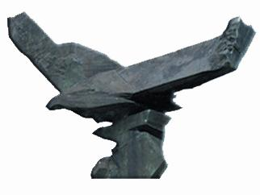
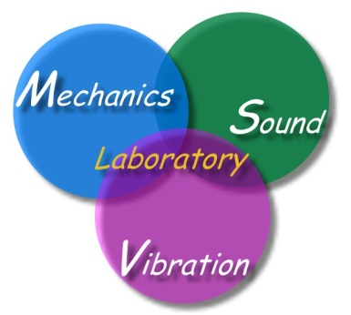

Overview of Taiwan BEM (1980-2018)
Paradise and parasite of BIEM/BEM
Jeng-Tzong Chen
Vice president, Taiwan SIAM
Convener of Civil & Hydraulic Engineering Program, MOST, Taiwan
Fellow of STAM, ROC
Life-time Distinguished Professor
Dept. Harbor and River Engineering
Dept. Mechanical and Mechatronic Engineering
Taiwan Ocean University
June 25, 2018
Navier Lab., Geotechnical Team (CERMES)
Paris, France
(paris2018.ppt)

Slide 2
Outline
1.
Overview of TwSIAM
2.
Overview of Taiwan BEM development
3.
Rank deficient systems in BIEM/BEM

Slide 3


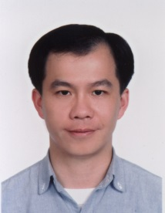
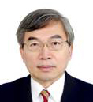

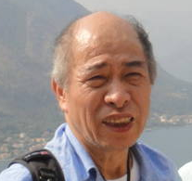
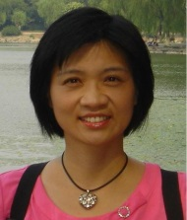
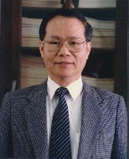






Research-8I
AI
SCI
陳良基
科技部長
海大陳正宗
終身特聘教授
I
Impact
Industry
徐碩鴻
工程司司長
台大洪宏基
教授
Innovation
International
廖婉君
前工程司司長
(105-106)
台大楊德良
教授
Income
Interest
台大林聰悟
名譽教授
國震中心吳安傑助理研究員

Slide 4

TWSIAM
Establish: non-profit academic society established on June 26, 2012
Aim:
  To promote research and education of applied mathematics
  To bridge mathematics and industry communities
Members (2017):
  Regular members: 102
  Group members: 16
  Student members: 53
Web address: www.twsiam.org

Slide 5

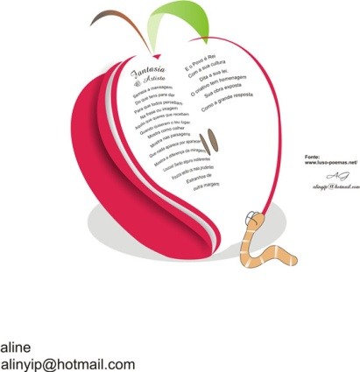

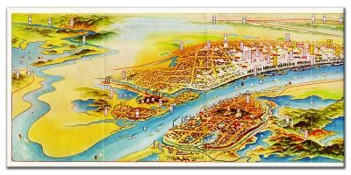
Paradise parasite
In the sky, there is a paradise
In the earth, there is Suchou and Hangzhou
上有天堂 下有蘇杭
BEM always needs fundamental solution or Green function
邊界元素法有格林函數與基本解
天堂(paradise)?? 寄生蟲(parasite)??
Fundamental solution
BEM
Suzhou
2008
Hangzhou
2015
Green function
Paradise in the Earth
Parasite in the BEM

Slide 6
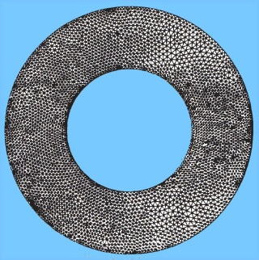


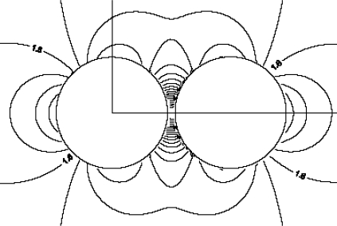
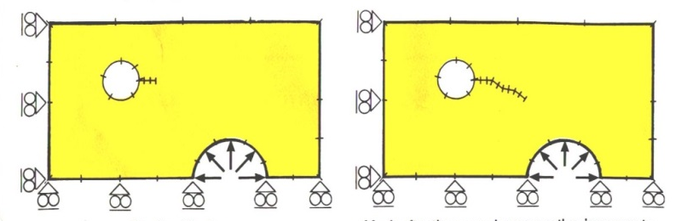
Paradise of BEM (1984-2000)
刪繁就簡三秋樹
3D→2D
Infinite domain
Paradise
領異標新二月花
鄭板橋
Stress concentration
Fracture and fatigue

Slide 7



Overview of numerical methods
Numerical Methods
Mesh Methods
Meshless Methods
Null-field BIEM
Finite Difference Method
Finite Element Method
Boundary Element Method
Degenerate kernels
Difference Equation
PDE- variational
Integral Equation
開刀
operation
把脈
Take
pulse
針
灸
Acupuncture
Page 7

Slide 8
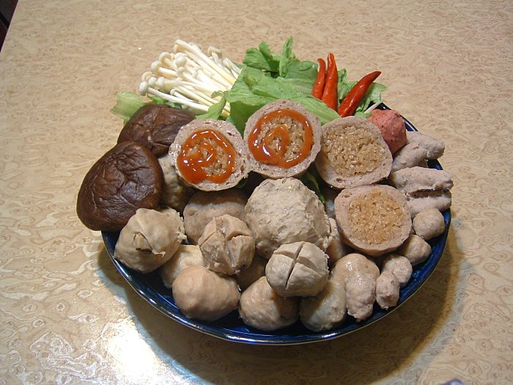
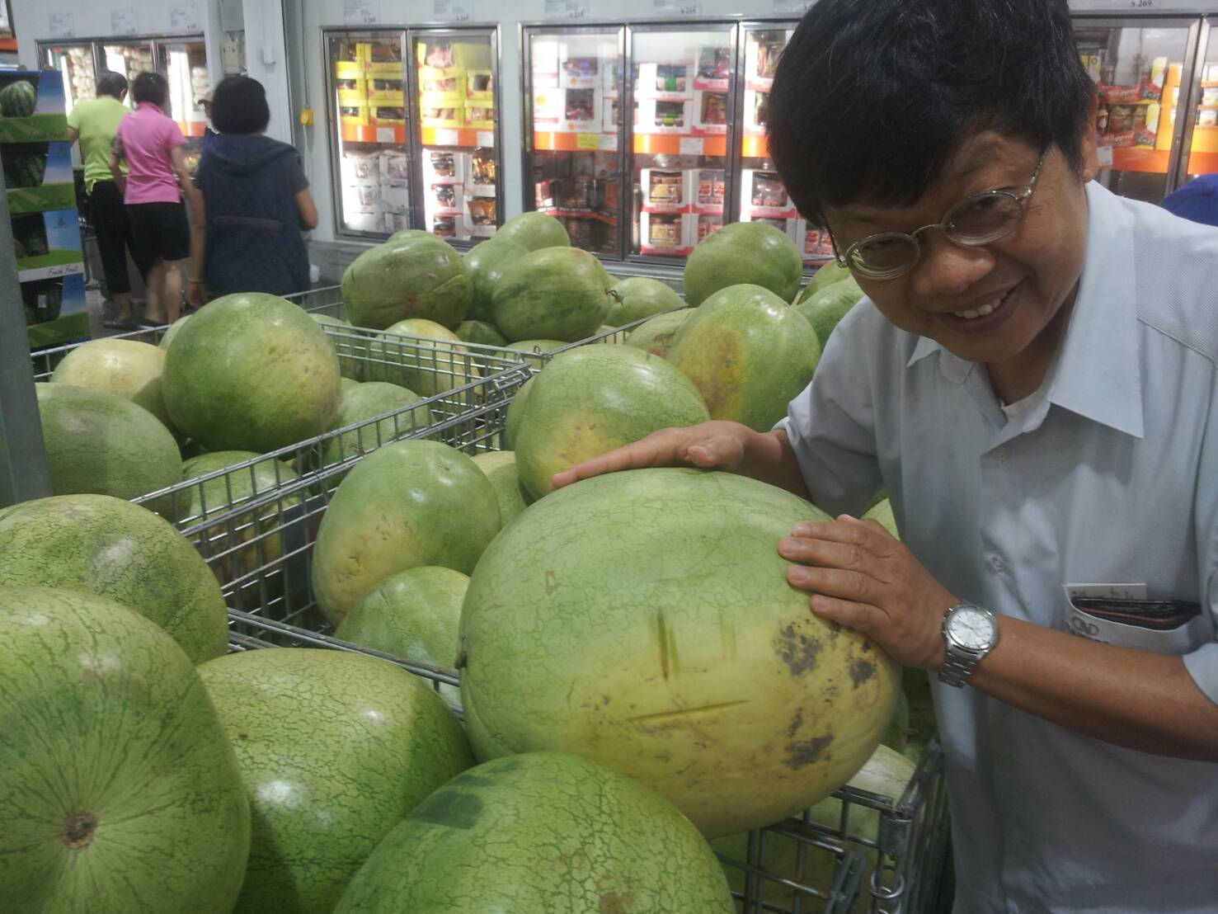
一般邊界
(ordinary boundary)
How to select melon and how to cook
退化邊界
(degenerate boundary)

Slide 9














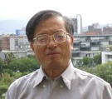






History & Background Taiwan BEM workshop (1986-2018)
Year | The host unit | The organizer | Ceremony | Keynote
1986 | NTU IAM | Prof. Y H Pao | Establishment of NTU IAM | Prof. F J Rizzo
1998 | NSC | Prof. J T Chen | NCHC | Prof. A H D Cheng
2010 | NTOU-HRE-MSV | Prof. J T Chen | NTOU-HRE 50th anniversary | Prof. Z C Li
2011 | NCTS(South) | Prof. K M Lee | NCKU 80th anniversary | NCKU
2012 | Feng Chia University | Prof. Y C Shiah | Prof. Hong’s 60th birthday | Prof. H-K Hong
2013 | National Chung Hsing University | Prof. K J Shou | Congratulations for Academicain | Dean S L Crouch Academician,NAE
2014 | National SYS University | Prof. T T Lu | Prof. Young’s 70th birthday | Prof. D L Young
2015 | NCREE (cross strait) | Dr. R Z Wang | NCREE | Cross strait ceremony
2016 | NCTS (Japan-Taiwan) | Prof. J H Lee | NCTS | Prof. H-K Hong Prof. W-W Lin
2017 | NIU | Prof. I L Chern Prof. K H Chen | Ilan Univ | Prof. H-K Hong Prof. W-C Wang
2018 | ISU | Prof. H T Huang Prof. I L Chen

Slide 10

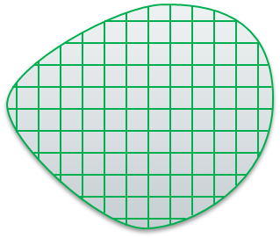
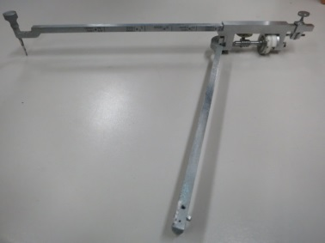
Never escape from te hand of Gauss
Why BEM (Advantage)
B
Gauss
1+2+3+...+100=?
$$\frac{(1+100)×100}{2}$$
Area = ?
Area
B
Planimeter
3D
BEM
2D
B
Gauss' theorem
Green's identities
Somigliana identity

Slide 11
Degenerate boundary
geometry node
(-1,0.5)
(1,0.5)
7
4
the Nth constant
or linear element
N
6
5
8
3
(0,0)
1
2
(-1,-0.5)
(1,-0.5)
5(+) 6(+)
5(+) 6(-)
5(+)
6(+)
dependency
5(+)
6(+)
5(+) 6(+)
5(+) 6(-)
5(+)
6(-)
5(+)
6(-)
Nonuniqueness

Slide 12
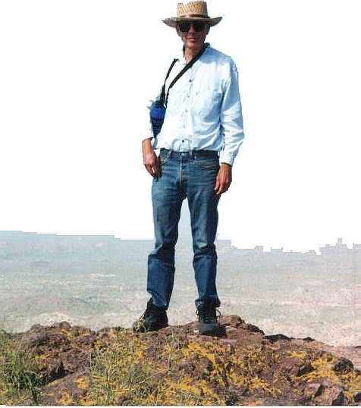
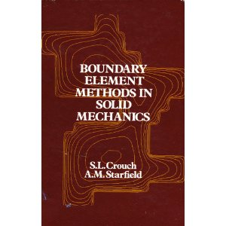
Liggett and Liu (1983)
The singularities that occur when the base point and field point coincide are not integrable ???
Multi-domain BEM, Ingraffea 1981
(before 1983)
J C Nedelec 1982
Google citing
1728
Google citing
574

Slide 13
How to get an additional constraint
The number of constraint equation is not enough to
determine coefficients of p and q.
Another constraint equation is obtained by differential operator
13

Slide 14
Dual Integral Equations by Hong and Chen(1984-1986)
Singular integral equation
Hypersingular integral equation
Cauchy principal value
Hadamard principal value
(Mangler principal value)
Boundary element method
Dual boundary element method
1969
1986
normal
boundary
degenerate
boundary
NTUCE
Ó

Slide 15
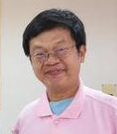
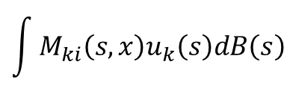

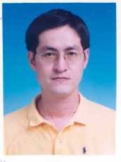
Dual BEM, DDM and Dislocation theory
Dual BEM
Hong and Chen (ASCE, 1988)
-a
a
0
∞
DDM
Crouch S.L. (1983)
Dislocation theory
Neuber-Papkovitch function
Higher order element
by Shou K.J.

Slide 16
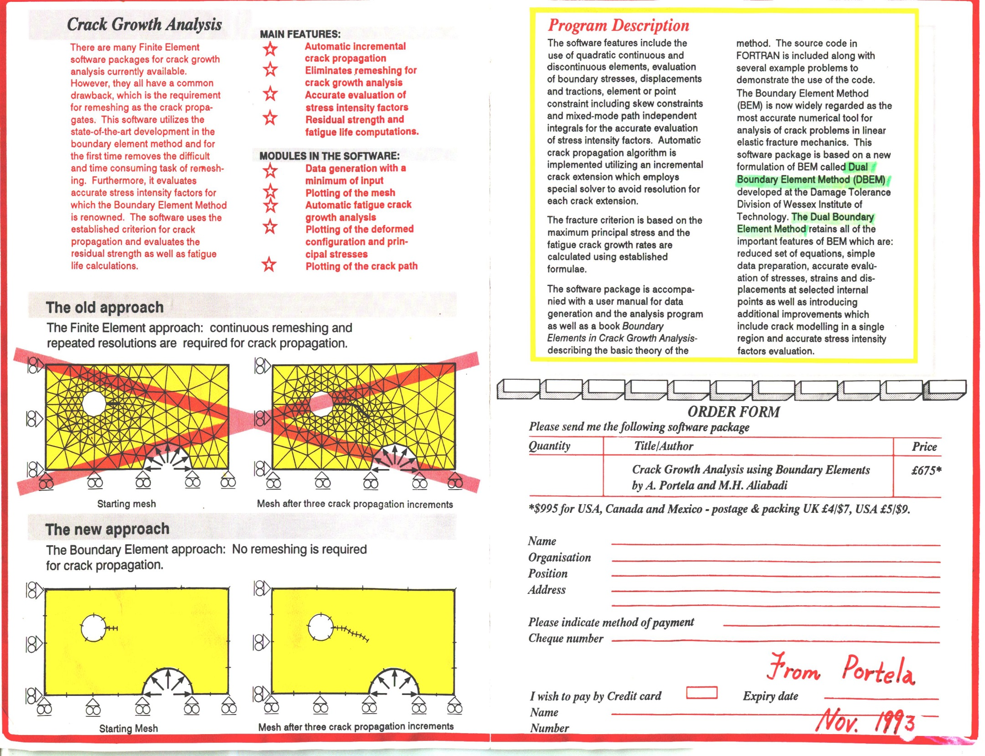
裂縫成長 Crack growth
FEM
Remesh near tip
Subdomain BEM
Ingraffea, 1981
Dual BEM (MIT)
Hong and Chen, 1988
Chen and Hong, 1999

Slide 17
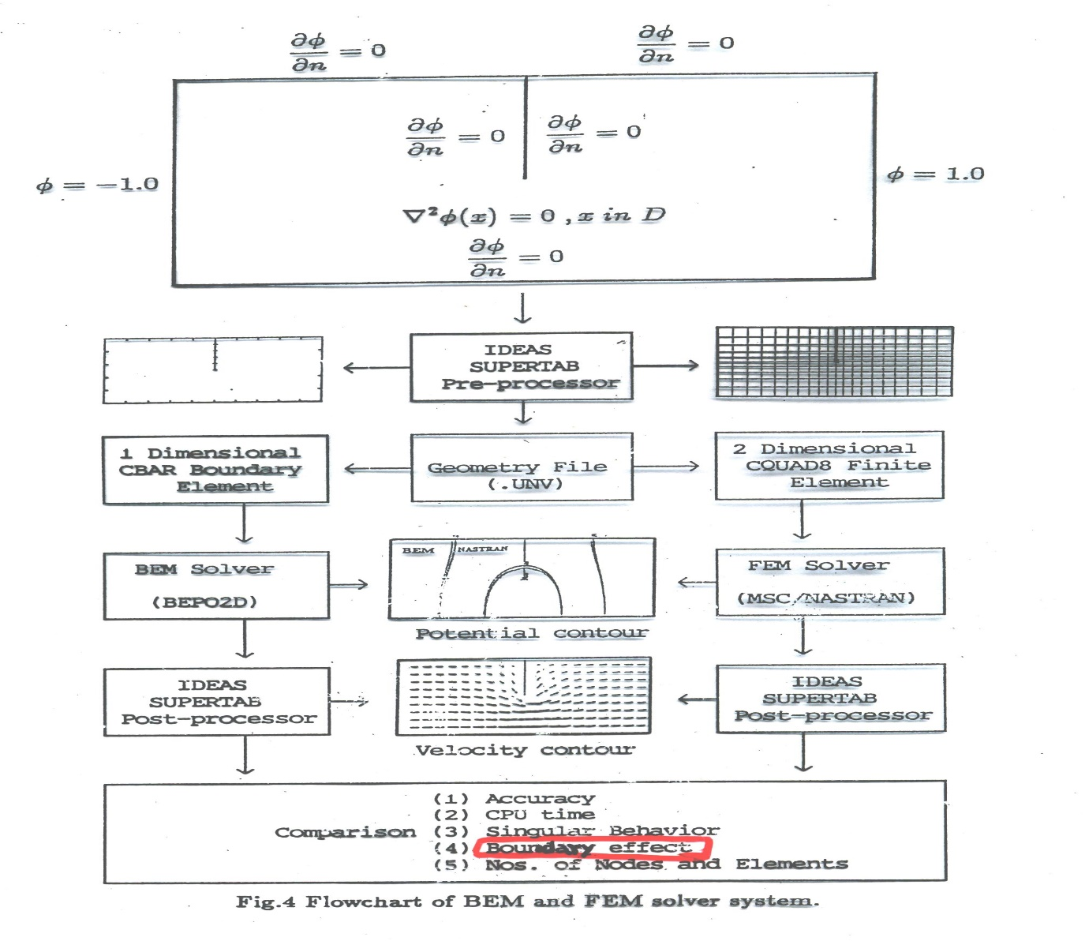

Seepage (sheet pile)
A K Chugh, US Bureau of Reclamation (USBR), USA

Slide 18
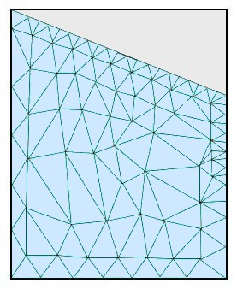
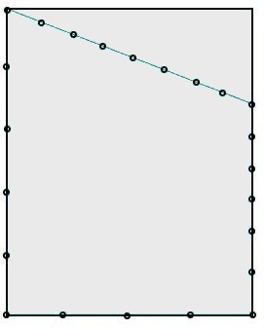
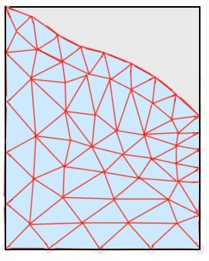
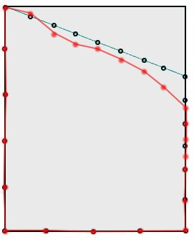
Seepage with free surface
FEM (iteration No.49)
BEM(iteration No.13)
Initial guess
Initial guess
After iteration
After iteration
Remesh area
Remesh line

Slide 19
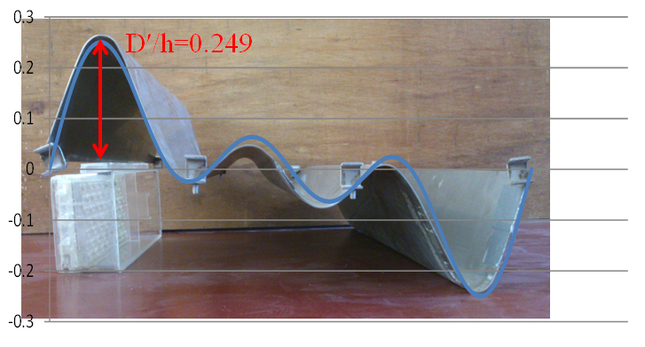
Dual BEM results and experiment data by NTOU
Thin breakwater
(degenerate
boundary)
W K Weng and C Y Yueh
(1.7-mm thick)
d/h = 0.2
BEM
Dual BEM

Slide 20
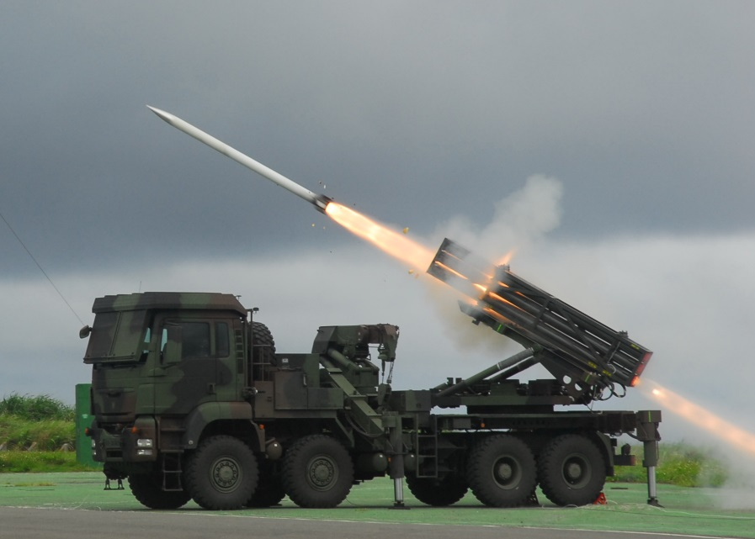
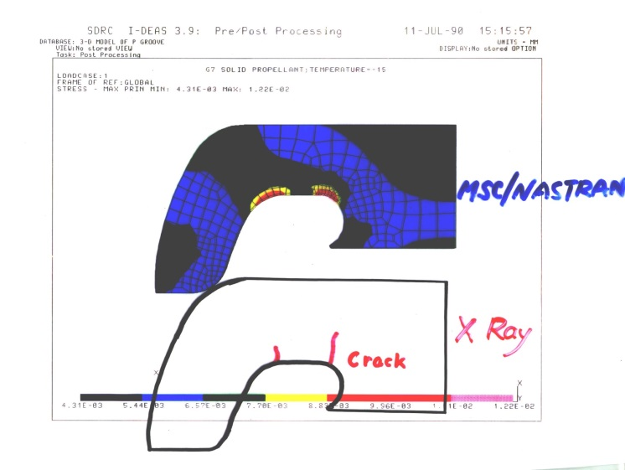
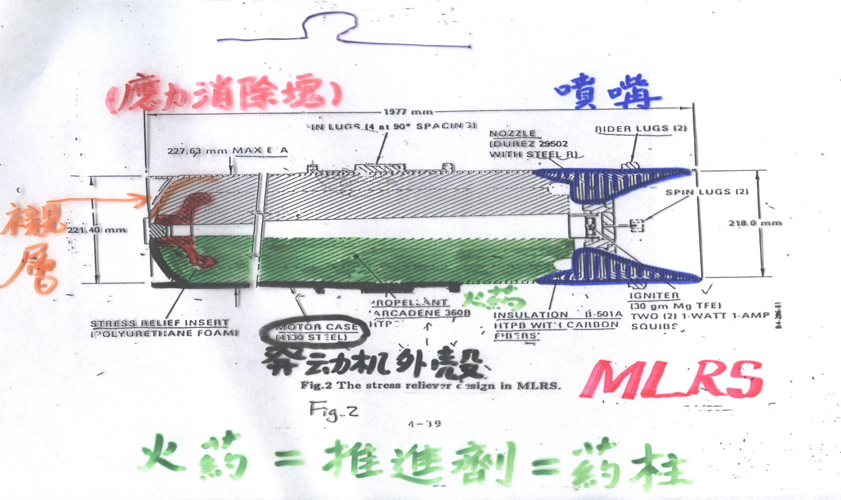
Solid rocket motor
(Army工蜂火箭)

Slide 21
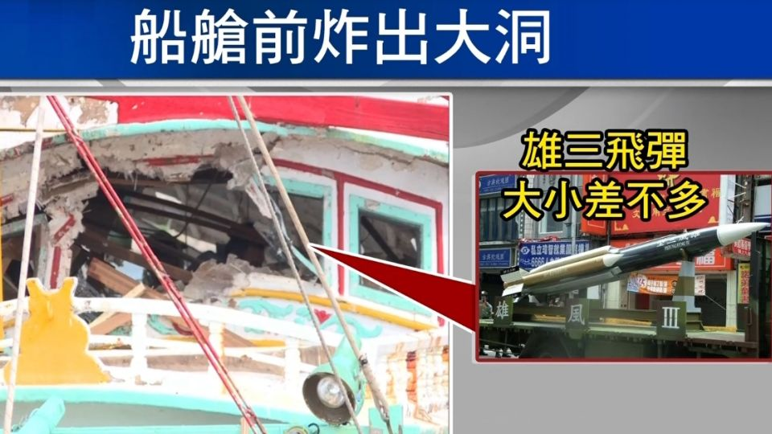
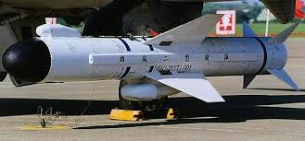
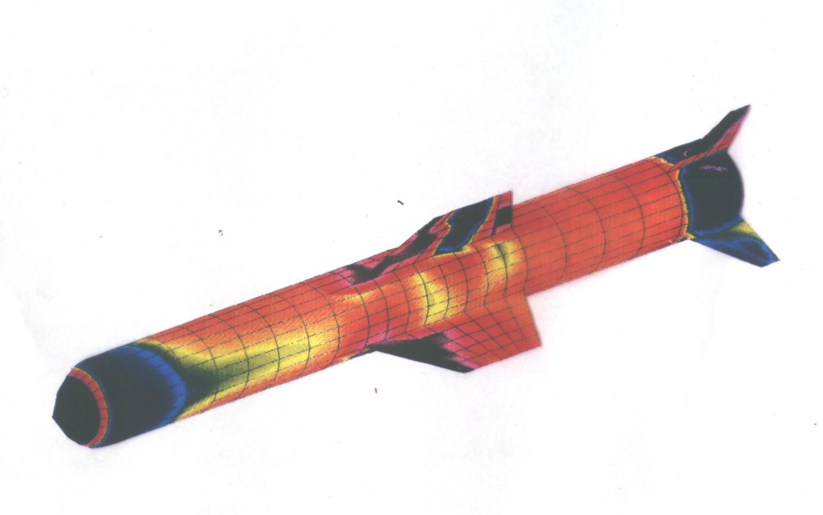
Shong-Fon II missile (Navy)
Thin airfoil
(degenerate boundary)

Slide 22
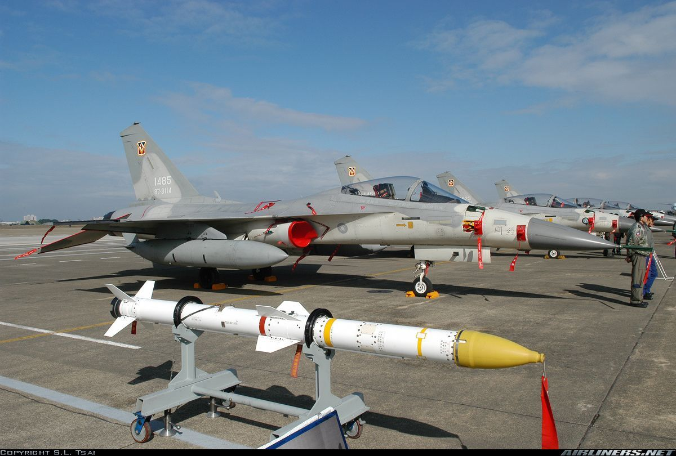
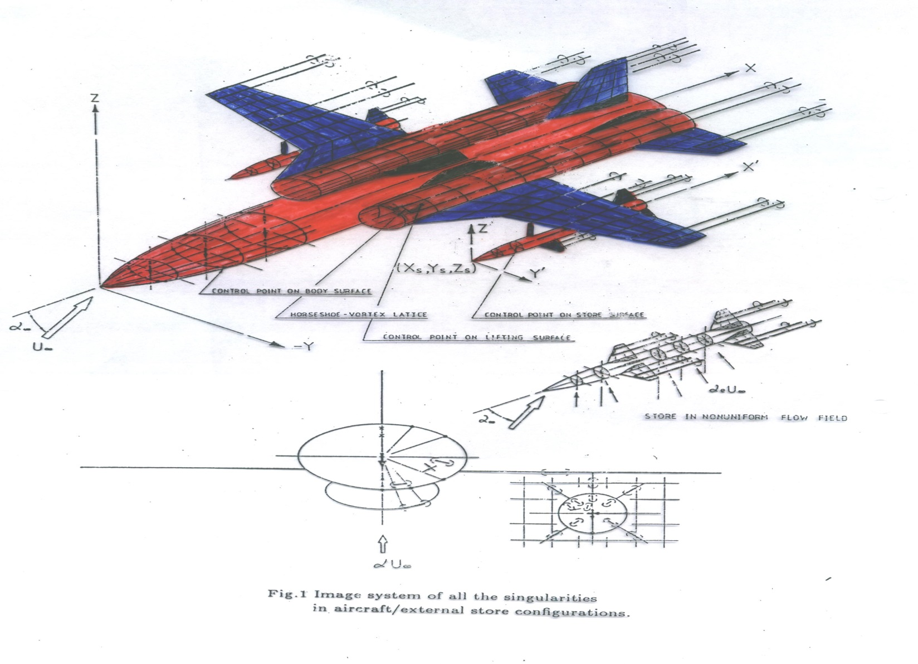
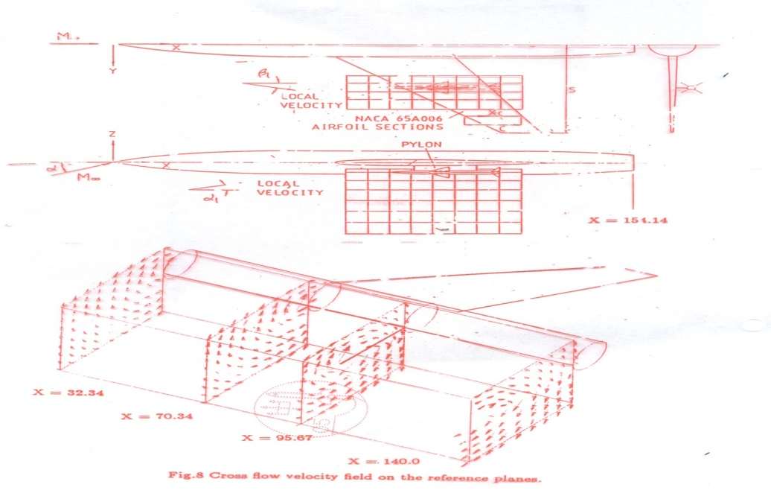
IDF (Air Force)
Thin airfoil
(degenerate boundary)

Slide 23
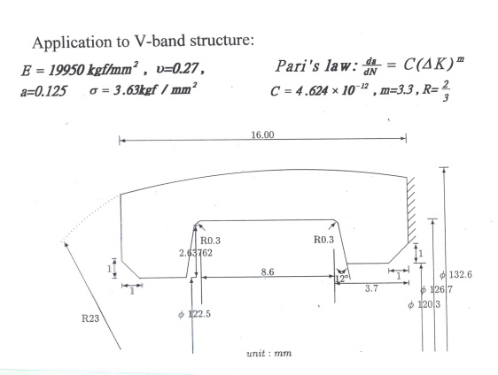
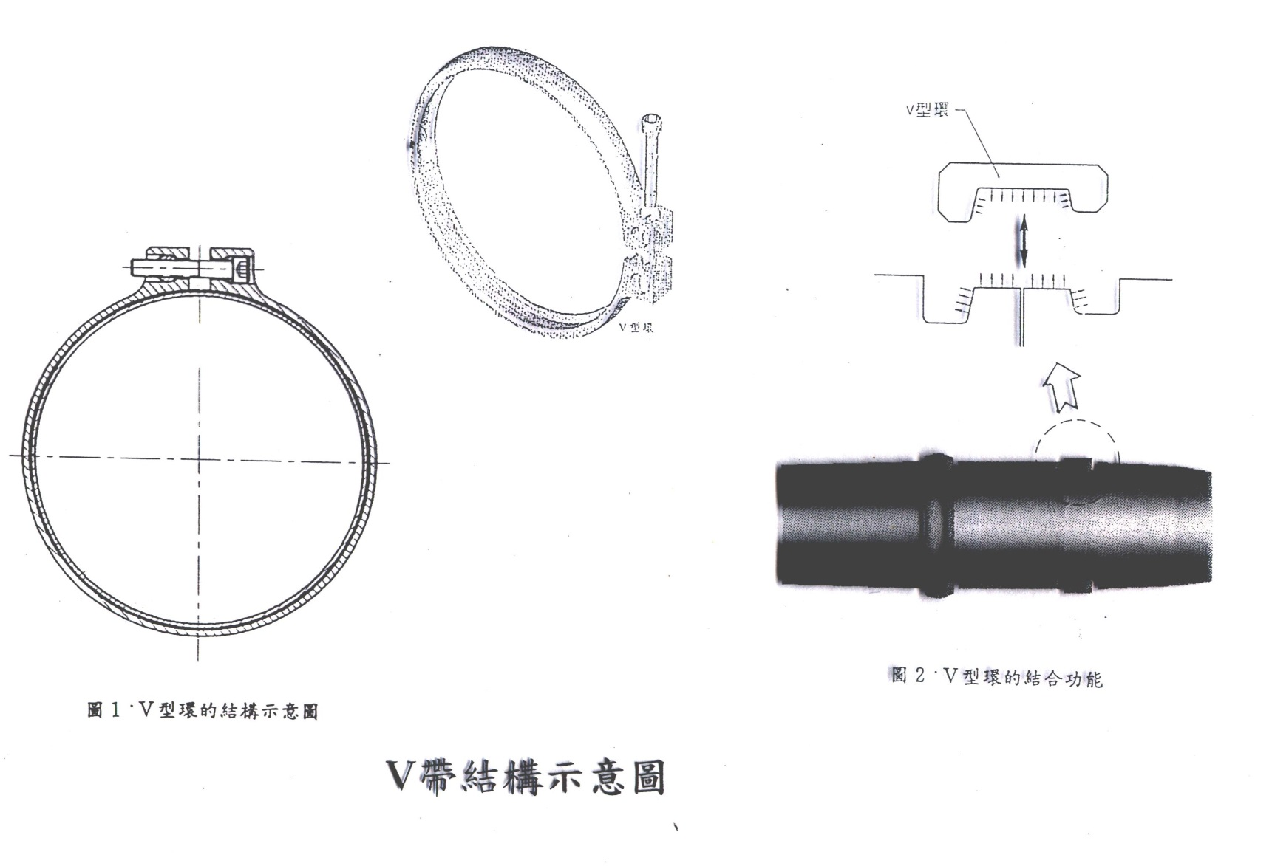
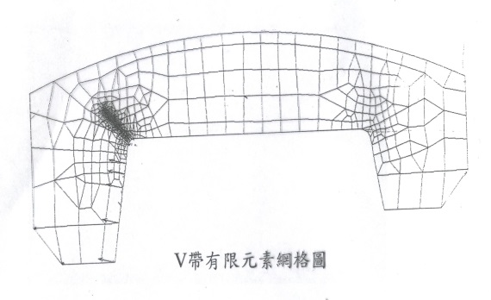
V-band structure (Tien-Gen missile)

Slide 24
Parasite of BEM (2000-2018)
Minimum singular value
t(a,0)
Rank-deficient systems
0/0
Radius
Mechanics Research Communications
Fictitious frequency
Pitfall
Parasite
Degenerate scale
Engineering Analysis with Boundary Elements
Dependency
Spurious eigenvalue
Degenerate boundary
International Journal for Numerical Methods in Engineering
Thermochimita Acta
Parasite of BEM.pptx made by York

Slide 25



(Hangzhou: paradise in the world) (U(x,s):parasite in the BEM)
BEM/BIEM (Disadvantage: Failure)
Match maker (ask for help)
Engineering
problems
Test function
Fundamental sol.
Green function
PDE and IE are
not equivalent
PDE model
IE model(BEM)
Existence
unique solution
Degenerate scale
Degenerate boundary
Spurious eigenvalues
Fictitious frequency
Nonunique solution
Fredholm alternative theorem
Range deficiency
Rank deficiency
Singular matrix
Infinite solution (Not sufficient)
引狼入室
(set a fox to keep geese)
No solution (Not necessary)

Slide 27
Conclusions
1.
Overview of TwSIAM
2.
Overview of Taiwan BEM development
3.
Paradise and parasite of BEM
Rank deficient systems in BIEM/BEM

Slide 28

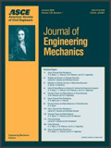
Citing records of dual BEM
(updated June 23, 2018)
Chen and Hong, 1999
ASME-AMR
Hong and Chen, 1988
ASCE-EM
WOS: 203
Google: 307
WOS: 284
Google: 387

Slide 29


New direction 八卦邊界元
Trigram (Bagua) boundary element method
Real variable BEM
Complex variable BEM
八卦
BEM
Clifford algebra valued BEM
Quaternion valued BEM

Slide 30


Thanks Prof. Corfdir to arrange this talk
Thanks for your kind attentions
Welcome to visit the web site of MSVLAB/NTOU
http://msvlab.hre.ntou.edu.tw/ Since 1999

Slide 31

Welcome to visit NTOU/MSV
MSV
窗外

Slide 32





















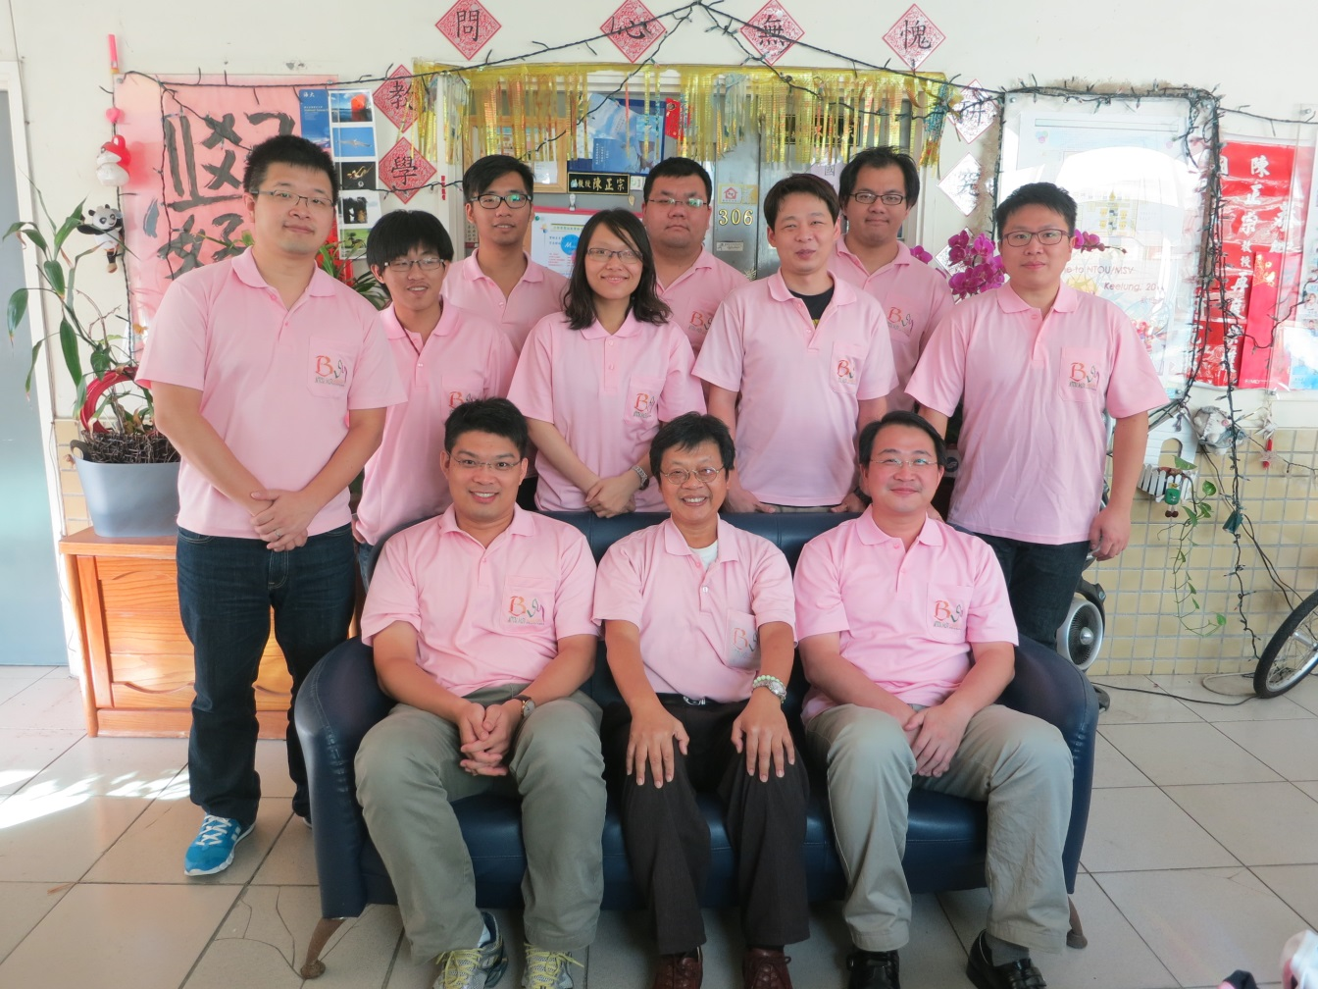

































http://msvlab.hre.ntou.edu.tw/ Since 1999
台灣製造 輸出中國
NTOU/MSV 有您真好
Welcome to visit the web site of MSVLAB/NTOU
台灣天下
捨我其誰
E mail: jtchen@mail.ntou.edu.tw

Slide 33
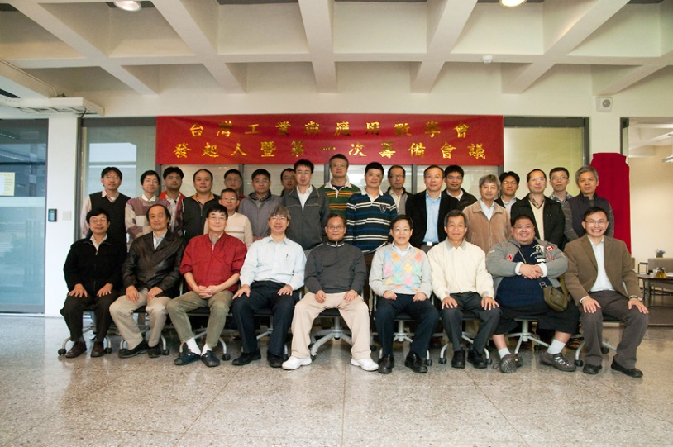
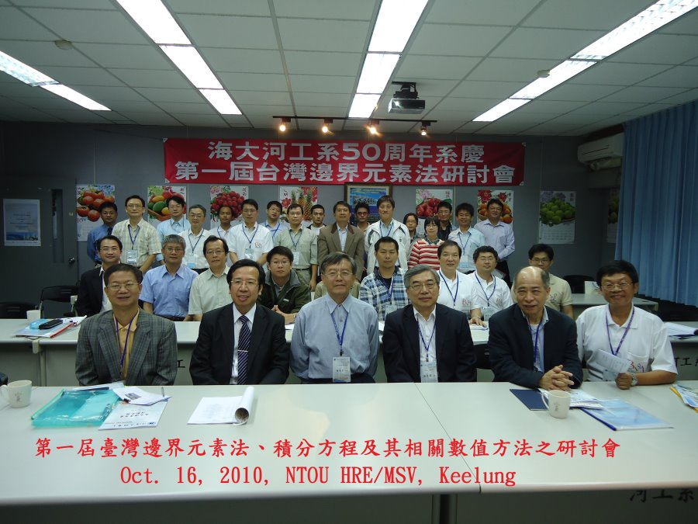
臺灣數學與工程互動(Bridge: computational mechanics)
Taiwan SIAM 扮演的角色
  建立數學與工程的連接橋樑
  Mathematics與Engineering並重
研究強度
數學
工程
(由數學界發起的)
Mathematics & Engineering
(Taiwan SIAM) may bridge the gap
研究強度
Time Evolution
Taiwan BEM
series meeting
(由工程界發起的)
33
數學
工程
Filename: NTOUMSV交叉.ppt

