Slide 1

Analysis of Partial Differential Equations using Novel Physics-Informed Neural Network Techniques
Der-Liang Young, Ph.D., P.E.
Professor Emeritus at Civil Engineering
National Taiwan University, Taipei, Taiwan
July 2,2025 Kobe, Japan

Slide 2
Outlines
Multilayer Perceptron
ResNet and Proposed SQR-ResNet
SQR-ResNet vs. Plain NN for Solving
  Partial Differential Equations Problems (1)
  Inverse Problems (2)
  1. Noorizadegan et al,2024,EABE,168,105933.
  2. Noorizadegan et al,2024,Applied Mathematics and Computation,480.128910.

Slide 3
Machine Learning for Solving PDEs

Slide 4
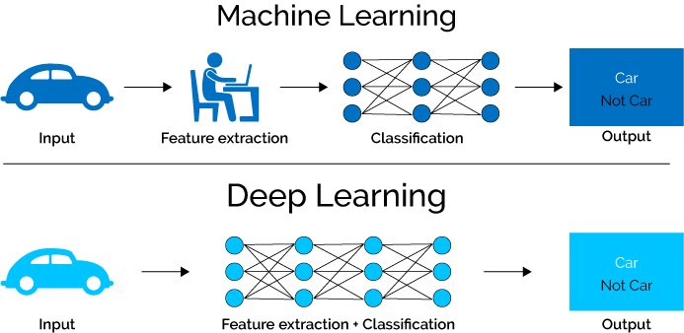
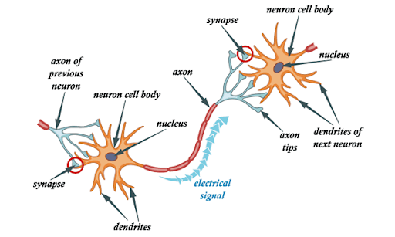
Machine Learning vs. Deep Learning

Slide 5




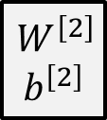






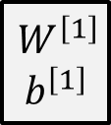






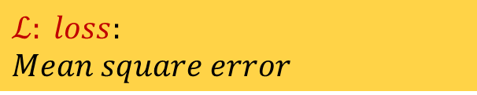






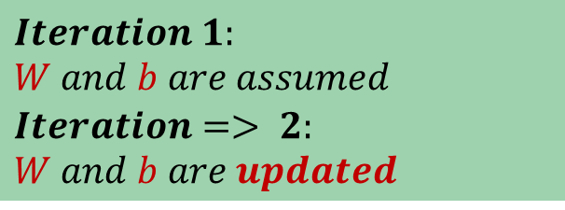




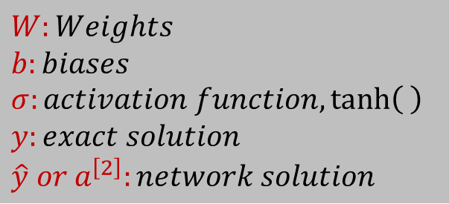
Multilayer Perceptron
(MLP)
$$W:Weights$$
$$b:biases$$
$$σ:activation function,\tanh\left( \right)$$
$$y:exact solution$$
$$\hat{y} or a^{\left[2\right]}:network solution$$
$$x_{1}$$
$2−layer$
$$x_{2}$$
$$\hat{y}=a^{\left[2\right]}$$
$$x_{3}$$
$$x_{1}$$
$$Iteration 1:$$
$$W and b are assumed$$
$$Iteration=> 2:$$
$$W and b are updated$$
$$x_{2}$$
$$\hat{y}=a^{\left[2\right]}$$
$$x_{3}$$
$$input$$
$$W^{\left[1\right]}b^{\left[1\right]}$$
$$\left[1\right]$$
$$W^{\left[2\right]}b^{\left[2\right]}$$
$$\left[2\right]$$
$$output$$
$$ℒ: loss:$$
$$Mean square error$$
$$W^{\left[1\right]}$$
$$b^{\left[1\right]}$$
$$W^{\left[2\right]}$$
$$b^{\left[2\right]}$$
$$z^{\left[1\right]}=W^{\left[1\right]}x+b^{[1]}$$
$$a^{\left[1\right]}=σ⁡(z^{\left[1\right]})$$
$$z^{\left[2\right]}=W^{\left[2\right]}a^{\left[1\right]}+b^{[2]}$$
$$a^{\left[2\right]}=σ⁡(z^{\left[2\right]})$$
$$ℒ⁡(a^{\left[2\right]},y)$$
$$x$$
$$a^{\left[1\right]}$$
$$input$$
$$Hidden layer:\left[1\right]$$
$$Hidden layer:\left[2\right]$$
$$output$$

Slide 6













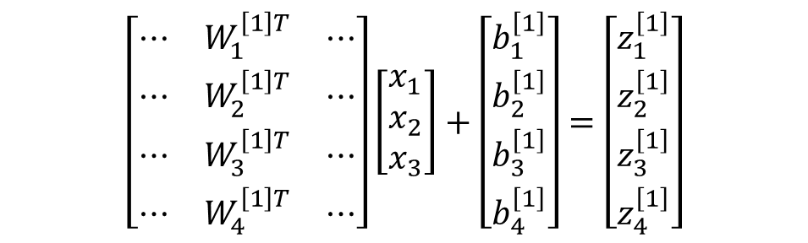










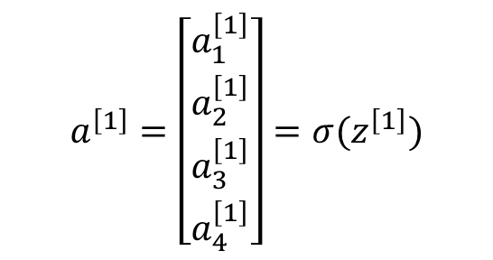






MLP in
Matrix Form
$$x_{1}$$
$$f(x)$$
$$x_{1}$$
$$x_{2}$$
$$\hat{y}=a^{\left[2\right]}$$
$$x_{2}$$
$$a$$
$$W^{T}x+b$$
$$σ(z)$$
$$x_{3}$$
$$z$$
$$a$$
$$x_{3}$$
$$z_{1}^{\left[1\right]}$$
$$a_{1}^{\left[1\right]}$$
$$z_{1}^{\left[1\right]}=W_{1}^{\left[1\right]T}x+b_{1}^{\left[1\right]} ,a_{1}^{\left[1\right]}=σ(z_{1}^{\left[1\right]})$$
$$W^{\left[1\right]}$$
$$\left[\begin{matrix}⋯ & W_{1}^{\left[1\right]T} & ⋯ \\ ⋯ & W_{2}^{\left[1\right]T} & ⋯ \\ ⋯ & W_{3}^{\left[1\right]T} & ⋯ \\ ⋯ & W_{4}^{\left[1\right]T} & ⋯\end{matrix}\right]\left[\begin{matrix}x_{1} \\ x_{2} \\ x_{3}\end{matrix}\right]+\left[\begin{matrix}b_{1}^{\left[1\right]} \\ b_{2}^{\left[1\right]} \\ b_{3}^{\left[1\right]} \\ b_{4}^{\left[1\right]}\end{matrix}\right]=\left[\begin{matrix}z_{1}^{\left[1\right]} \\ z_{2}^{\left[1\right]} \\ z_{3}^{\left[1\right]} \\ z_{4}^{\left[1\right]}\end{matrix}\right]$$
$$z_{2}^{\left[1\right]}$$
$$a_{2}^{\left[1\right]}$$
$$z_{2}^{\left[1\right]}=W_{2}^{\left[1\right]T}x+b_{2}^{\left[1\right]},a_{2}^{\left[1\right]}=σ(z_{2}^{\left[1\right]})$$
$$x_{1}$$
$$x_{2}$$
$$x_{3}$$
$$z_{3}^{\left[1\right]}$$
$$a_{3}^{\left[1\right]}$$
$$z_{3}^{\left[1\right]}=W_{3}^{\left[1\right]T}x+b_{3}^{\left[1\right]},a_{3}^{\left[1\right]}=σ(z_{3}^{\left[1\right]})$$
$$a^{\left[1\right]}=\left[\begin{matrix}a_{1}^{\left[1\right]} \\ a_{2}^{\left[1\right]} \\ a_{3}^{\left[1\right]} \\ a_{4}^{\left[1\right]}\end{matrix}\right]=σ(z^{\left[1\right]})$$
$$z_{4}^{\left[1\right]}$$
$$a_{4}^{\left[1\right]}$$
$$z_{4}^{\left[1\right]}=W_{4}^{\left[1\right]T}x+b_{4}^{\left[1\right]},a_{4}^{\left[1\right]}=σ(z_{4}^{\left[1\right]})$$

Slide 7
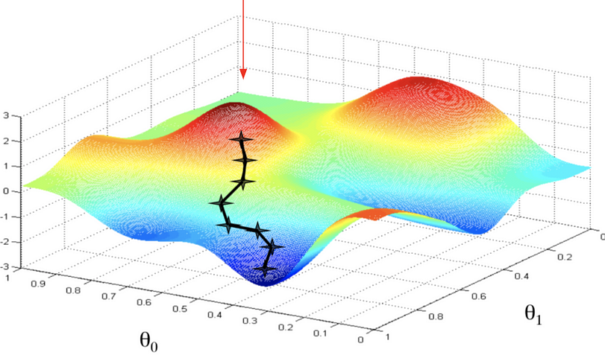

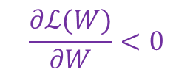

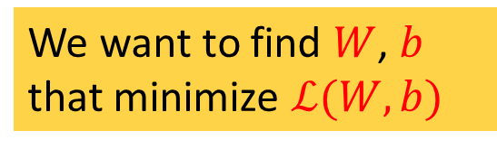


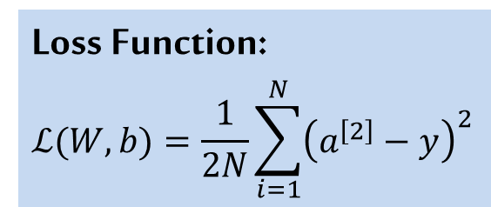
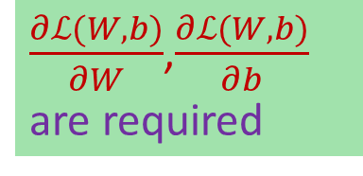



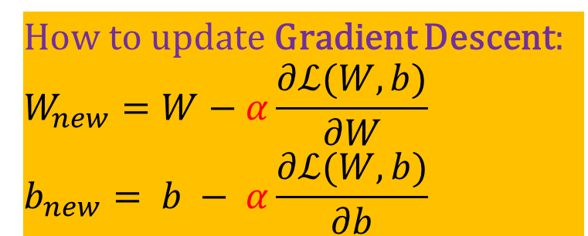


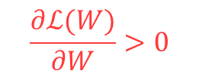
Optimization
We are here with random $W$and $b$
$$ℒ(W,b)$$
Loss Function:
$$ℒ(W,b)=\frac{1}{2N}\sum_{i=1}^{N}{{\left(a^{\left[2\right]}−y\right)}^{2}}$$
$$ℒ$$
We want to find $W$, $b$
that minimize $ℒ(W,b)$
$$b$$
$$W$$
$$\frac{∂ℒ(W)}{∂W}<0$$
$$\frac{∂ℒ(W)}{∂W}>0$$
How to update Gradient Descent:
$$W_{new}=W−α\frac{∂ℒ(W,b)}{∂W}$$
$$b_{new}= b − α\frac{∂ℒ(W,b)}{∂b}$$
$\frac{∂ℒ(W,b)}{∂W}$,$\frac{∂ℒ(W,b)}{∂b}$
are required
$$ℒ(W)$$
$$Backpropagation$$
$$α:learning rate$$
$$W$$

Slide 8

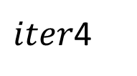


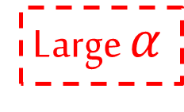






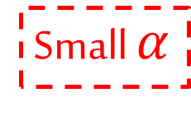
Learning Rate
$$ℒ(W)$$
Small $α$
starting point
$$iter1$$
$$W$$
$$ℒ(W)$$
$$iter2$$
$$iter3$$
$$ℒ(W)$$
$iter$4
Large $α$
$$W$$
minimum
$$W$$

Slide 9

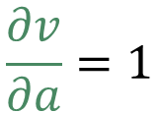


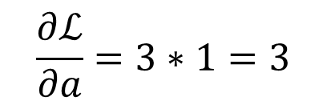

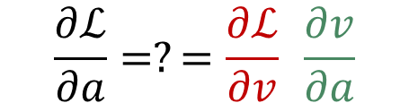
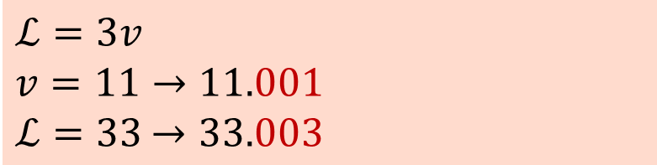
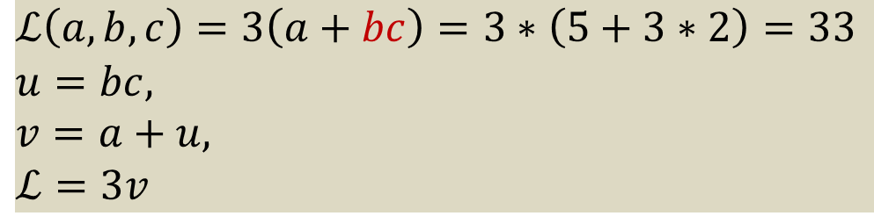

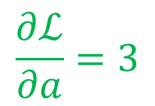

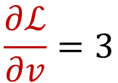



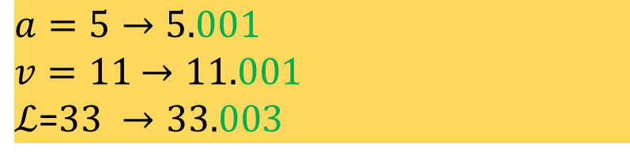



Simple
Backpropagation
$$ℒ\left(a,b,c\right)=3\left(a+bc\right)=3∗\left(5+3∗2\right)=33$$
$$u=bc,$$
$v=a+u,$
$$ℒ=3v$$
$$u$$
$$v$$
$$a=5$$
$$v=a+u$$
$$ℒ =3∗v$$
$$u=bc$$
$$11$$
$$33$$
$$b=3$$
$$\frac{∂ℒ}{∂a}=?=\frac{∂ℒ}{∂v} \frac{∂v}{∂a}$$
$$6$$
$$c=2$$
$$ℒ=3v$$
$$v=11→11.001$$
$ℒ=33$ $→33.003$
$$\frac{∂ℒ}{∂v}=3$$
$$\frac{∂ℒ}{∂v}\text{=3 }$$
$$\frac{∂v}{∂a}=1$$
$$a=5→5.001$$
$v=11$ $→11.001$
$ℒ$=$33 →33.003$
$$\frac{∂ℒ}{∂a}=3$$
$$\frac{∂ℒ}{∂a}=3∗1=3$$

Slide 10

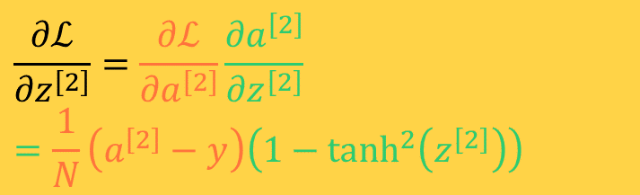
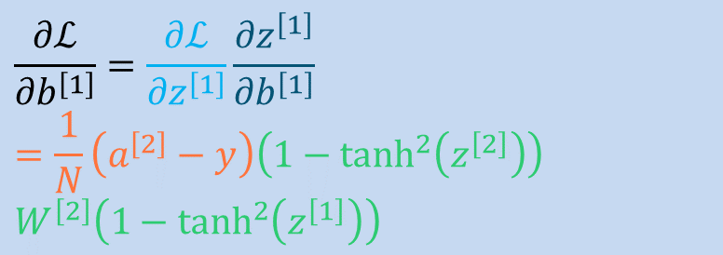


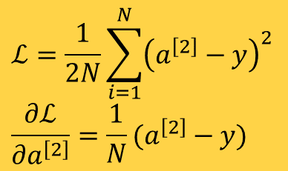
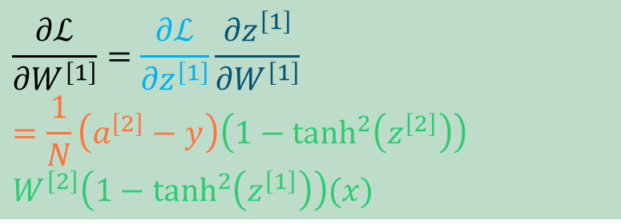

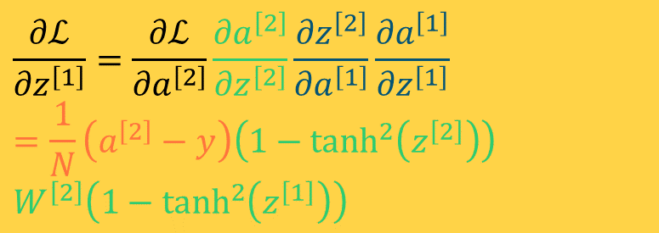



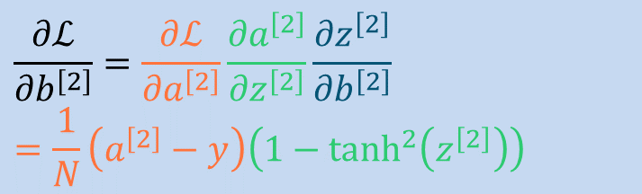

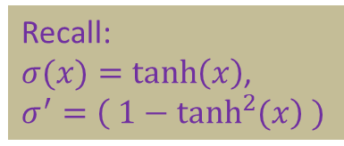


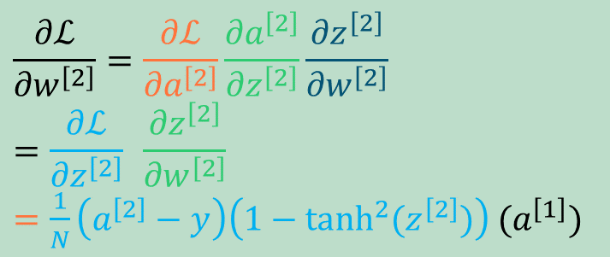
Backpropagation
$$b^{\left[1\right]}$$
$$b^{\left[2\right]}$$
$$W^{\left[2\right]}$$
$$W^{\left[1\right]}$$
$$x$$
$$z^{\left[1\right]}=W^{\left[1\right]}x+b^{[1]}$$
$$a^{\left[1\right]}=σ⁡(z^{\left[1\right]})$$
$$z^{\left[2\right]}=W^{\left[2\right]}a^{\left[1\right]}+b^{[2]}$$
$$a^{\left[2\right]}=σ⁡(z^{\left[2\right]})$$
$$ℒ⁡(a^{\left[2\right]},y)$$
$$\frac{∂ℒ}{{∂z}^{\left[1\right]}}=\frac{∂ℒ}{{∂a}^{\left[2\right]}}\frac{{∂a}^{\left[2\right]}}{{∂z}^{\left[2\right]}}\frac{{∂z}^{\left[2\right]}}{{∂a}^{\left[1\right]}}\frac{{∂a}^{\left[1\right]}}{{∂z}^{\left[1\right]}}$$
$$=\frac{1}{N}\left(a^{\left[2\right]}−y\right)\left(1−\tanh^{2}\left(z^{\left[2\right]}\right)\right)$$
$$W^{\left[2\right]}\left(1−\tanh^{2}\left(z^{\left[1\right]}\right)\right)$$
$$\frac{∂ℒ}{{∂z}^{\left[2\right]}}=\frac{∂ℒ}{{∂a}^{\left[2\right]}}\frac{{∂a}^{\left[2\right]}}{{∂z}^{\left[2\right]}}$$
$$=\frac{1}{N}\left(a^{\left[2\right]}−y\right)\left(1−\tanh^{2}\left(z^{\left[2\right]}\right)\right)$$
$$ℒ=\frac{1}{2N}\sum_{i=1}^{N}{{\left(a^{\left[2\right]}−y\right)}^{2}}$$
$$\frac{∂ℒ}{{∂a}^{\left[2\right]}}=\frac{1}{N}(a^{\left[2\right]}−y)$$
$$\frac{∂ℒ}{{∂w}^{\left[2\right]}}=\frac{∂ℒ}{{∂a}^{\left[2\right]}}\frac{{∂a}^{\left[2\right]}}{{∂z}^{\left[2\right]}}\frac{{∂z}^{\left[2\right]}}{{∂w}^{\left[2\right]}}$$
$$=\frac{∂ℒ}{{∂z}^{\left[2\right]}} \frac{{∂z}^{\left[2\right]}}{{∂w}^{\left[2\right]}}$$
$=\frac{1}{N}\left(a^{\left[2\right]}−y\right)\left(1−\tanh^{2}{(z^{\left[2\right]})}\right)$ ${(a}^{\left[1\right]})$
$$\frac{∂ℒ}{{∂W}^{\left[1\right]}}=\frac{∂ℒ}{{∂z}^{\left[1\right]}}\frac{{∂z}^{\left[1\right]}}{{∂W}^{\left[1\right]}}$$
$$=\frac{1}{N}\left(a^{\left[2\right]}−y\right)\left(1−\tanh^{2}\left(z^{\left[2\right]}\right)\right)$$
$$W^{\left[2\right]}\left(1−\tanh^{2}\left(z^{\left[1\right]}\right)\right)(x)$$
$$\frac{∂ℒ}{{∂b}^{\left[1\right]}}=\frac{∂ℒ}{{∂z}^{\left[1\right]}}\frac{{∂z}^{\left[1\right]}}{{∂b}^{\left[1\right]}}$$
$$=\frac{1}{N}\left(a^{\left[2\right]}−y\right)\left(1−\tanh^{2}\left(z^{\left[2\right]}\right)\right)$$
$$W^{\left[2\right]}\left(1−\tanh^{2}\left(z^{\left[1\right]}\right)\right)$$
$$\frac{∂ℒ}{{∂b}^{\left[2\right]}}=\frac{∂ℒ}{{∂a}^{\left[2\right]}}\frac{{∂a}^{\left[2\right]}}{{∂z}^{\left[2\right]}}\frac{{∂z}^{\left[2\right]}}{{∂b}^{\left[2\right]}}$$
$$=\frac{1}{N}\left(a^{\left[2\right]}−y\right)\left(1−\tanh^{2}\left(z^{\left[2\right]}\right)\right)$$
Recall:
$σ(x)=\tanh\left(x\right)$,
$$σ^{′}=\left( 1−\tanh^{2}{(x}\right) )$$

Slide 11
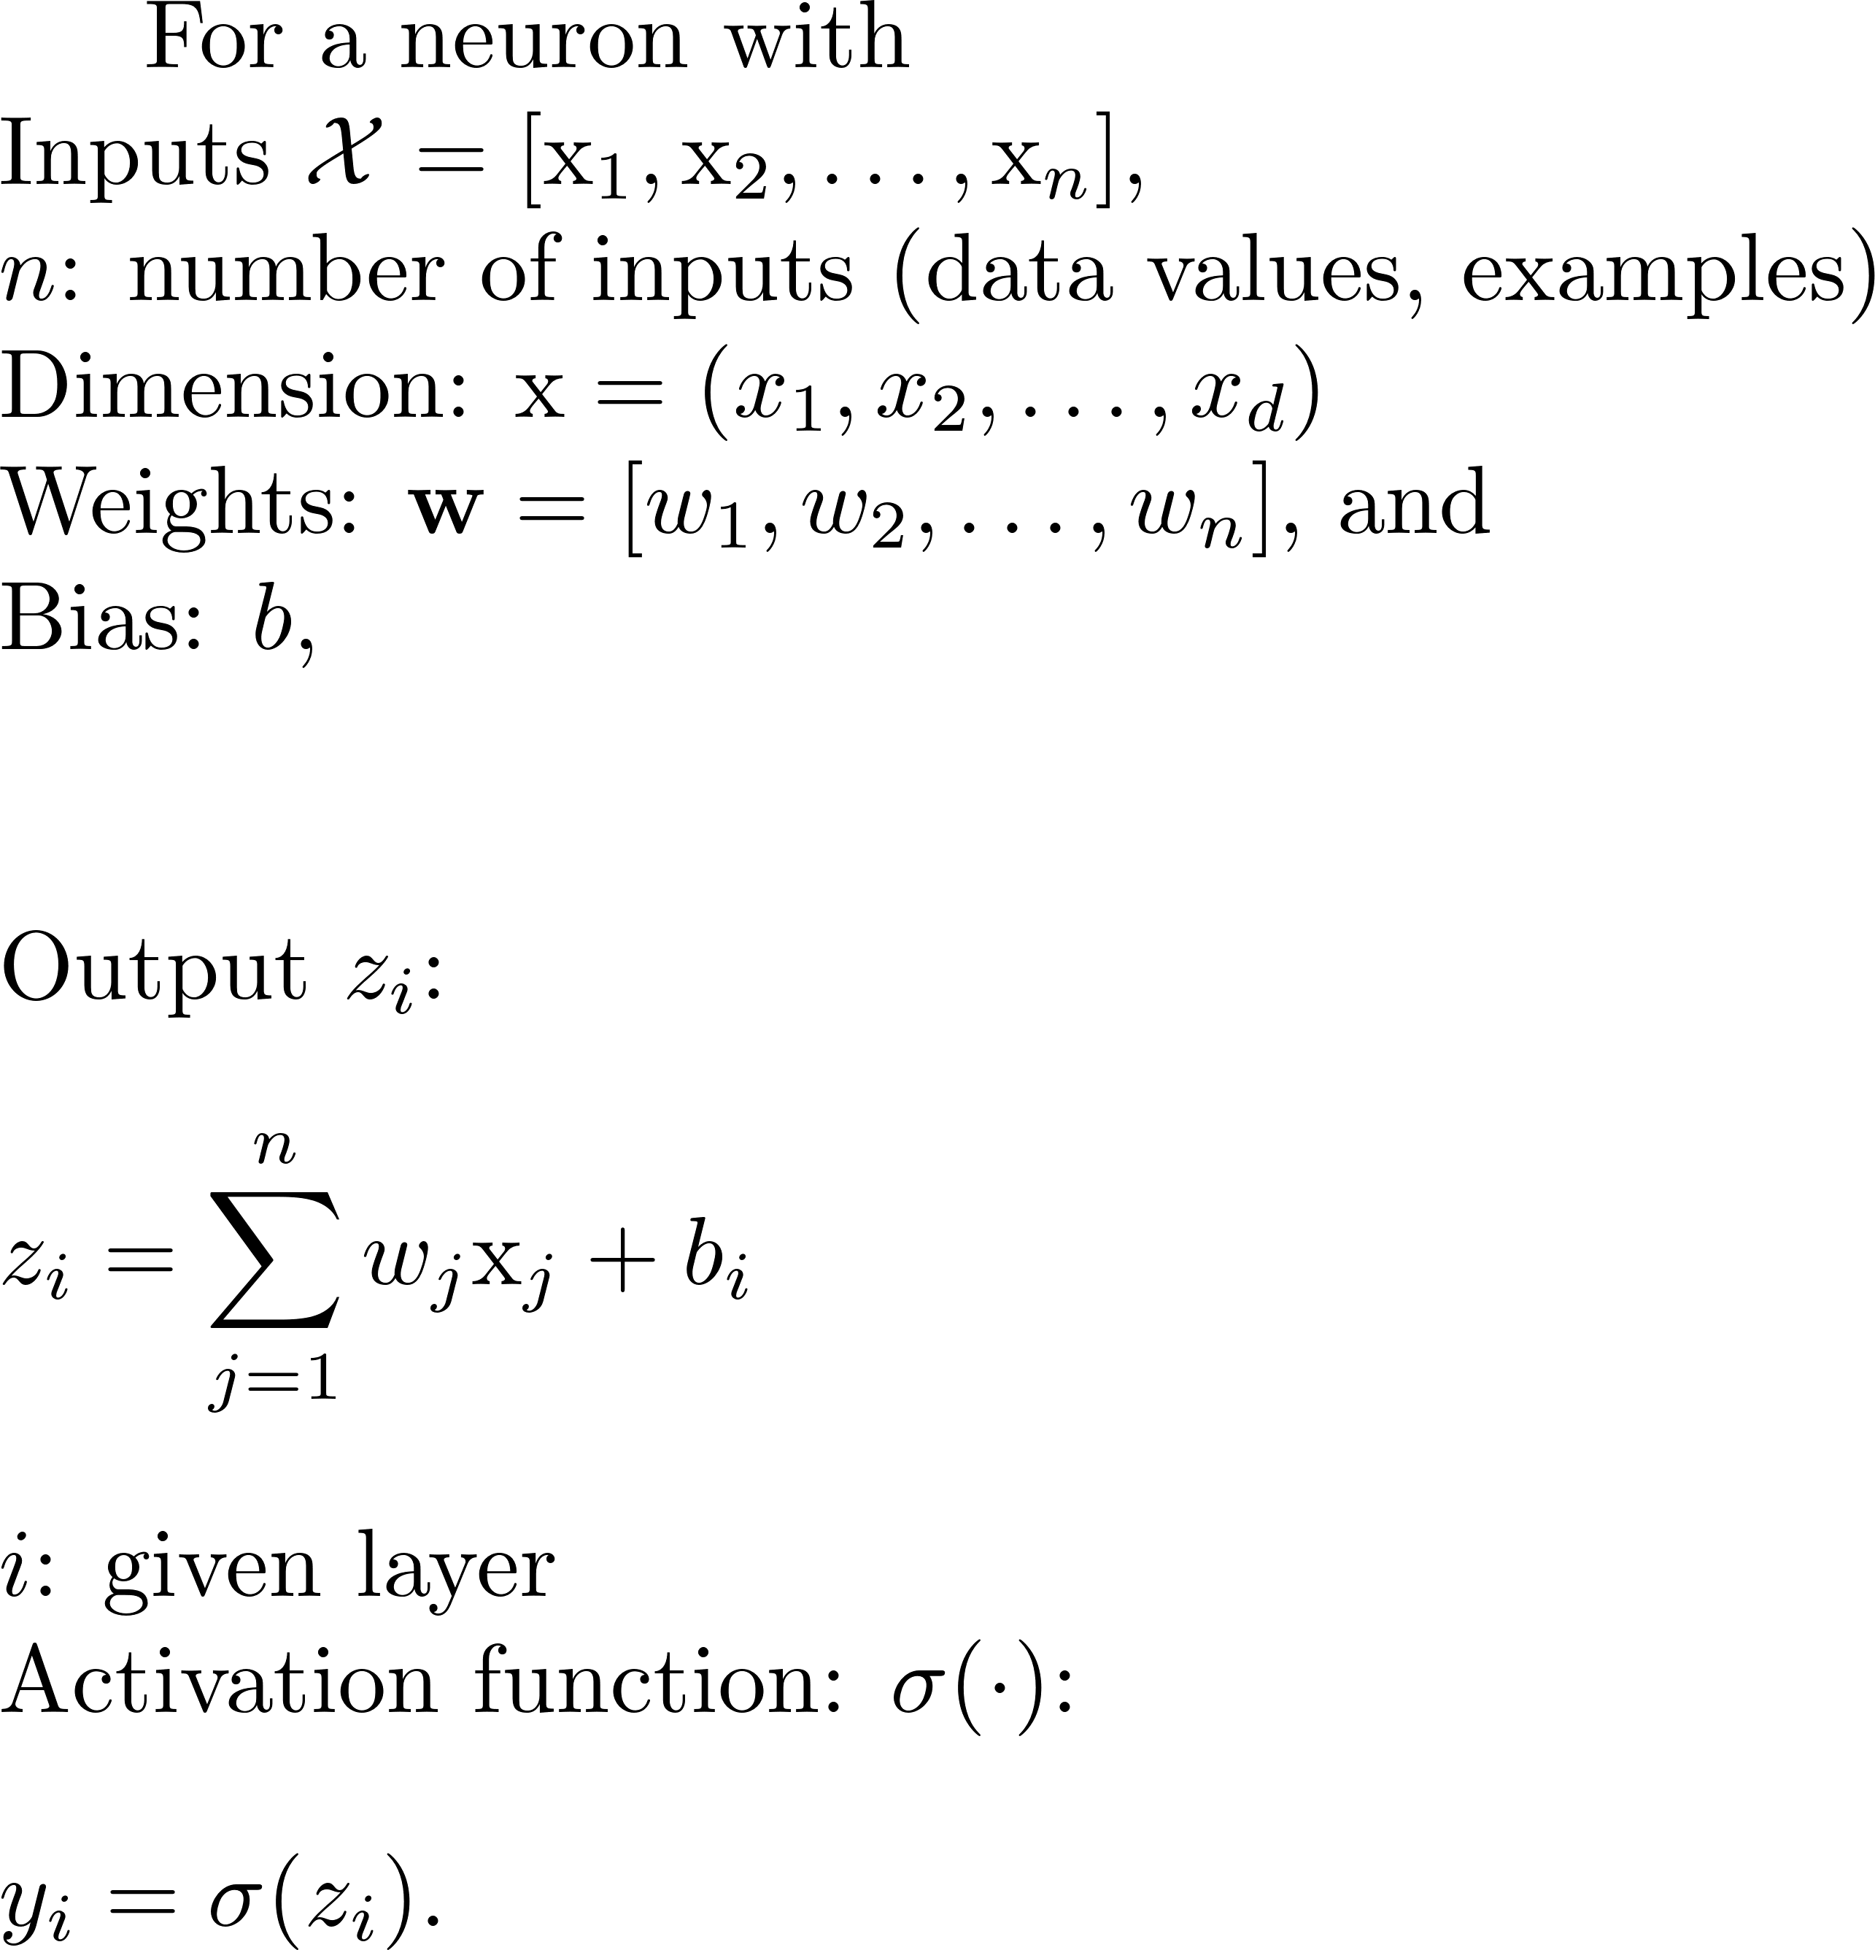






















Neural Network-Feedforward
$$f(x)$$
$$x_{1}$$
$$x_{2}$$
$$W^{T}x+b$$
$$σ(z)$$
$$a$$
$$x_{3}$$
$$z$$
$$a$$
$$z$$
$$a$$
$$z$$
$$z$$
$$a$$
$$z$$
$$N$$
$$⋮$$
$$⋮$$
$$z$$
$$a$$
$$z$$

Slide 12
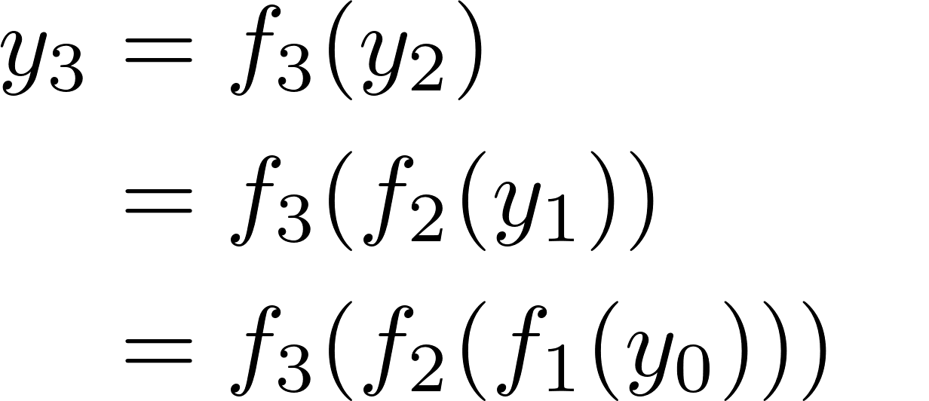
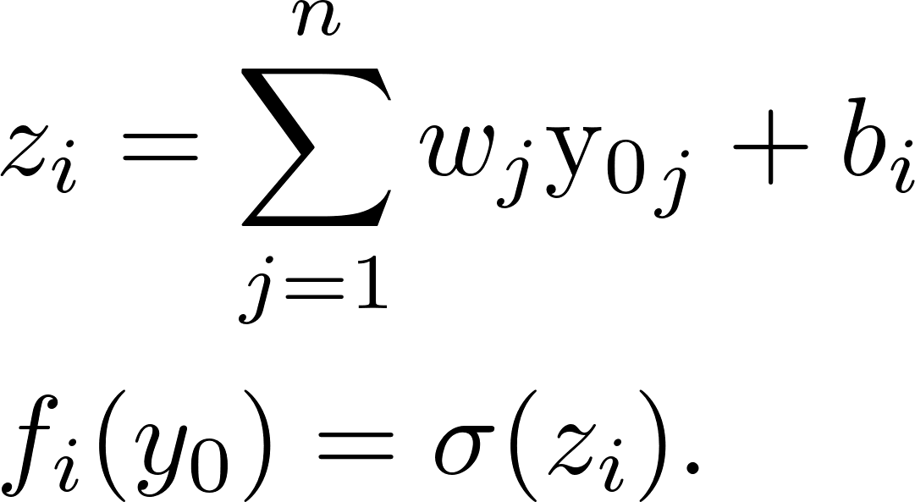
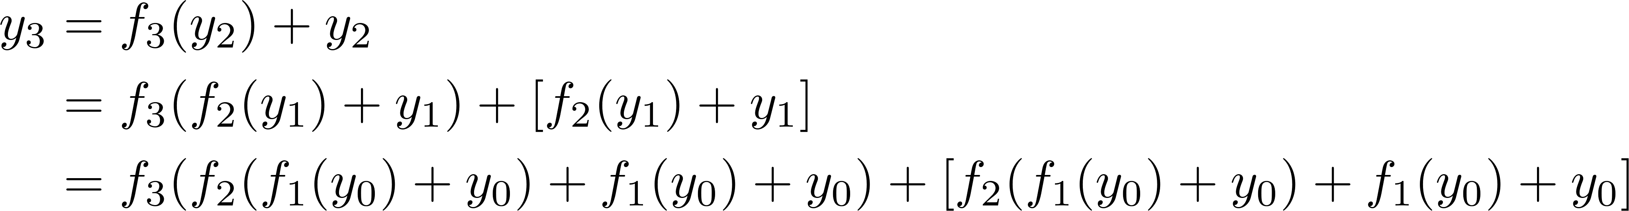
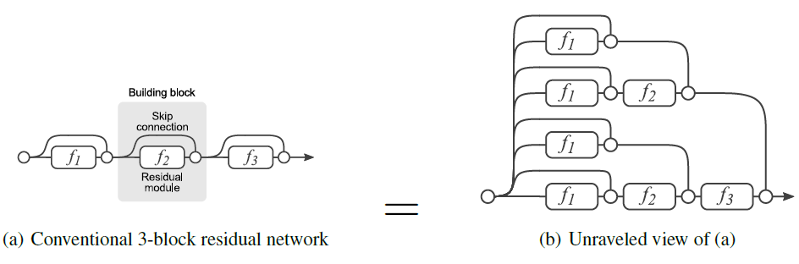
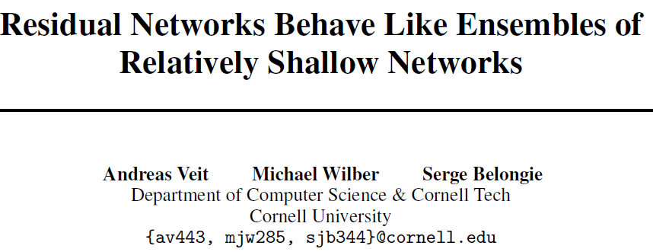





















Networks Architectures
$$(a)$$
Plain NN
$$f_{1}$$
$$f_{2}$$
$$f_{3}$$
$$⋯$$
$$y_{0}$$
$$y_{1}$$
$$y_{2}$$
$$y_{3}$$
$$(b)$$
Residual Network (Highway Network)
$$y_{0}$$
$$y_{1}$$
$$y_{2}$$
$$f_{1}$$
$$f_{2}$$
$$f_{3}$$
$$⋯$$
$$y_{0}$$
$$y_{1}$$
$$y_{2}$$
$$y_{3}$$
2016

Slide 13
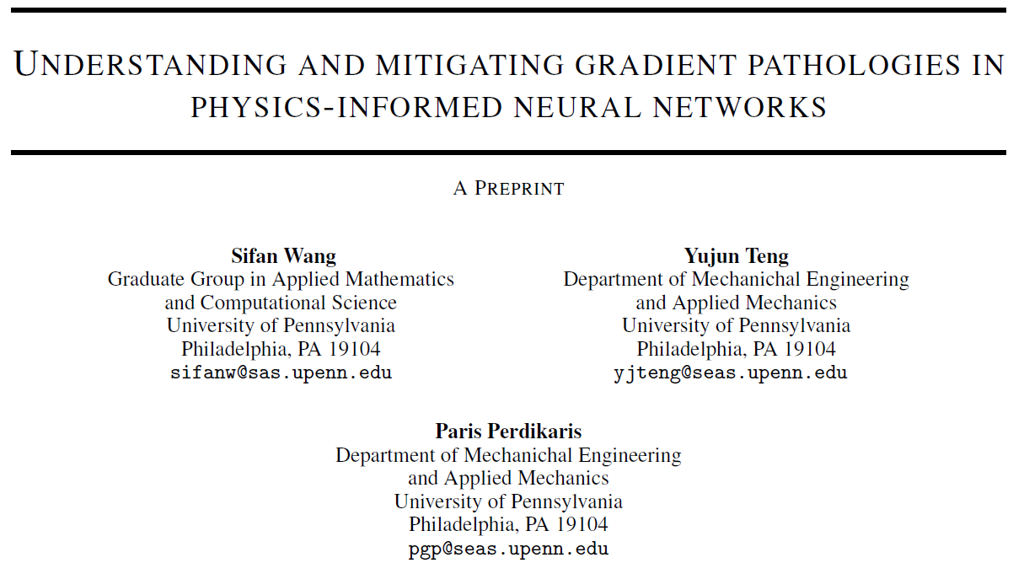
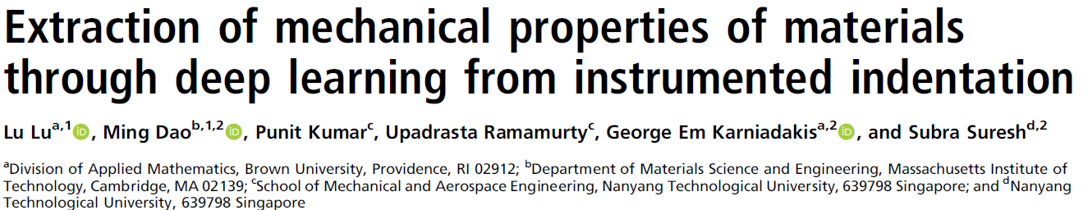
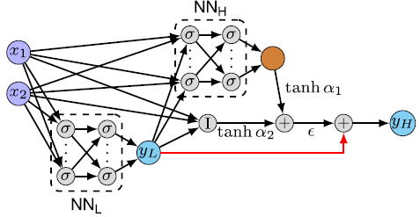
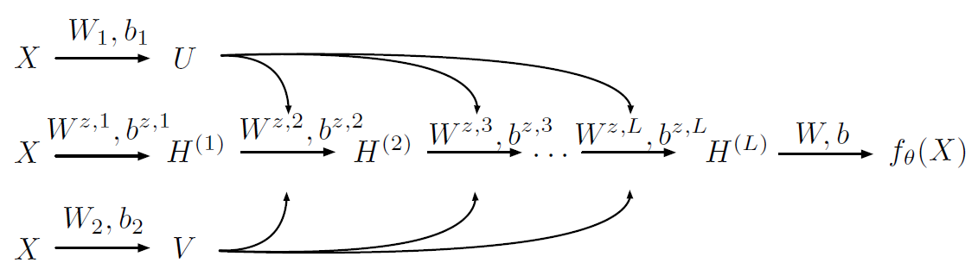
ResNet for Engineering
2020
2021
Residual Data
Residual Data
Residual Data
Element-wise multiplication, not a summation

Slide 14
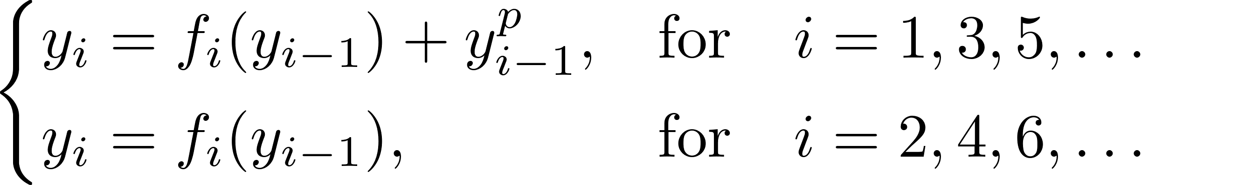
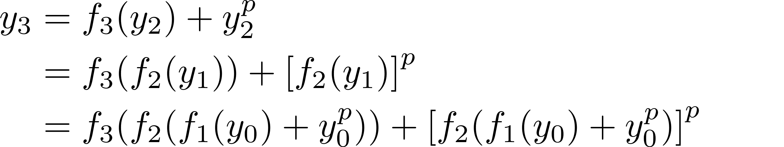



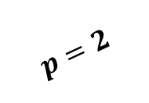
















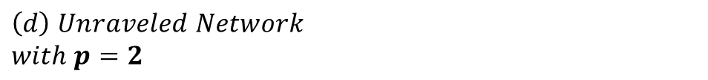















Power-Enhanced ResNet
$$\left(a\right) Power−Enhanced ResNet$$
$$\left(d\right) Unraveled Network$$
$$with p=2$$
$$y_{0}^{p}$$
$$y_{2}^{p}$$
$$f_{1}$$
$$f_{2}$$
$$f_{3}$$
$$⋯$$
$$y_{0}$$
$$y_{1}$$
$$y_{2}$$
$$y_{3}$$
$$y_{0}^{2}$$
$$f_{1}$$
$$f_{2}$$
$$y_{0}$$
$$y_{1}$$
$$y_{2}$$
$$\left(b\right) Equation$$
$$y_{0}^{2}$$
$$y_{2}^{2}$$
$$y_{2}$$
$$f_{1}$$
$$f_{2}$$
$$y_{0}$$
$$y_{1}$$
$$y_{0}^{2}$$
$$\left(c\right) Expression tree$$
$$y_{0}$$
$$f_{1}$$
$$y_{1}$$
$$f_{2}$$
$$y_{2}$$
$$f_{3}$$
$$y_{3}$$
$$p=2$$

Slide 15



What Is $p$?

Slide 16










































Networks Architectures
$$(a)$$
$$(b)$$
ResNet
Plain NN
$$y_{0}$$
$$y_{1}$$
$$y_{2}$$
$$f_{1}$$
$$f_{2}$$
$$f_{3}$$
$$⋯$$
$$f_{1}$$
$$f_{2}$$
$$f_{3}$$
$$⋯$$
$$y_{0}$$
$$y_{1}$$
$$y_{2}$$
$$y_{3}$$
$$y_{0}$$
$$y_{1}$$
$$y_{2}$$
$$y_{3}$$
$$(c)$$
SkipResNet
$$(d)$$
SQR-SkipResNet
$$y_{0}$$
$$y_{2}$$
$$y_{2}^{2}$$
$$y_{0}^{2}$$
$$f_{1}$$
$$f_{2}$$
$$f_{3}$$
$$⋯$$
$$⋯$$
$$y_{0}$$
$$y_{1}$$
$$y_{2}$$
$$y_{3}$$
$$f_{1}$$
$$y_{1}$$
$$f_{2}$$
$$y_{2}$$
$$f_{3}$$
$$y_{0}$$
$$y_{3}$$

Slide 17
Partial Differential Equations

Slide 18

































$$x_{1}$$
$$f(x)$$
Neural Networks + Physics
$$x_{2}$$
$$W^{T}x+b$$
$$σ(z)$$
$$a$$
$$x_{3}$$
$$z$$
$$a$$
$$II:Physics$$
$$I:Neural Networks$$
$$z,h$$
$$z$$
$$\frac{∂}{∂t}$$
${\left\{x_{i}\right\}}_{i=1}^{n}$
$$z,h$$
$$z$$
$$⋮$$
$$⋮$$
$$⋮$$
$$N$$
$$\frac{∂}{∂x}$$
PDEs
$${\left\{t_{i}\right\}}_{i=1}^{n}$$
$$z,h$$
$$z$$
$$\frac{∂^{2}}{∂x^{2}}$$
$$z,h$$
$$z$$
$$Done!$$
$$No$$
$$MSE$$
$$MSE<thereshold$$
$$yes$$

Slide 19
































$$x_{1}$$
$$f(x)$$
$$x_{2}$$
$$a$$
Neural Networks + Physics
$$W^{T}x+b$$
$$σ(z)$$
$$x_{3}$$
$$z$$
$$a$$
$$II:Physics$$
$$I:Neural Networks$$
$$z,h$$
$$z$$
${\left\{x_{i}\right\}}_{i=1}^{n}$
$$z,h$$
$$z$$
$$⋮$$
$$⋮$$
$$⋮$$
$$N$$
$${\left\{t_{i}\right\}}_{i=1}^{n}$$
$$z,h$$
$$z$$
$$z,h$$
$$z$$
$$f_{1}$$
$$f_{2}$$
$$f_{3}$$
$$⋯$$
Improving NN using ResNet!
$$y_{0}$$
$$y_{1}$$
$$y_{2}$$
$$y_{3}$$

Slide 20





















































Three Networks
$\left(a\right)$PINN
$\left(d\right)$Unravaled PI-SqrResNet
$$f_{1}$$
$$f_{2}$$
$$f_{3}$$
$$⋯$$
$$y_{0}^{2}$$
$$y_{0}$$
$$y_{1}$$
$$y_{2}$$
$$y_{3}$$
+ physics
$$f_{1}$$
$$f_{2}$$
$$y_{0}$$
$$y_{1}$$
$$y_{2}$$
$$y_{0}$$
$$y_{2}$$
$\left(b\right)$ PI-ResNet
$$y_{0}^{2}$$
$$y_{2}^{2}$$
$$f_{1}$$
$$f_{2}$$
$$f_{3}$$
$$⋯$$
+ physics
$$y_{2}$$
$$y_{0}$$
$$y_{1}$$
$$y_{2}$$
$$y_{3}$$
$$f_{1}$$
$$f_{2}$$
$$y_{0}$$
$$y_{1}$$
$(c)$ PI-SqrResNet
$$y_{0}^{2}$$
$$y_{2}^{2}$$
$$y_{0}^{2}$$
$$f_{1}$$
$$f_{2}$$
$$f_{3}$$
$$⋯$$
+ physics
$$y_{0}$$
$$y_{1}$$
$$y_{2}$$
$$y_{3}$$
$$f_{1}$$
$$f_{2}$$
$$f_{3}$$
$$y_{0}$$
$$y_{1}$$
$$y_{2}$$
$$y_{3}$$

Slide 21

Study Examples Overview

Slide 22

Setting-Three Methods:

Slide 23



Setting-Assumptions:

Slide 24

Setting-Metrics:

Slide 25

Setting-Status:

Slide 26

Poisson equation in 1D with Dirichlet boundary conditions
CPU/L-BFGS
Large
train loss
from the beginning
Large train loss or “nan”
after some steps
Best results

Slide 27


Poisson equation in 1D with Dirichlet boundary conditions
CPU/L-BFGS, Loss and metric at NL=20:

Slide 28

Poisson equation in 1D with Dirichlet boundary conditions
GPU/Adam:

Slide 29

Heat equation

Slide 30


Results; Heat equation

Slide 31

Diffusion-reaction equation

Slide 32


Results; Diffusion-reaction equation

Slide 33

Nonlinear Schrödinger equation with periodic boundary conditions

Slide 34


Results; Nonlinear Schrödinger equation with periodic boundary conditions

Slide 35








2D linear elasticity problem
4- Body Forces
1- PDEs
2- Constitutive
Relations
8- BCs
6- Exact Solution
3- Strain
7- Parameters

Slide 36
Inverse Problems

Slide 37








Physics-Informed Neural Network (Inverse Burgers’ Equation)
Minimize:
Predict: $\left\{\begin{aligned}λ_{1}=1 \\ λ_{2}=\frac{1}{100π}=0.003183 \\ N\end{aligned}\right\}$
2017

Slide 38




Results (Inverse Burgers’ Equation)

Slide 39
Conclusion
1. PINN vs PI-SQRResNet
  PI-SQRResNet has better convergence
  PI-SQRResNet is more accurate
  PI-SQRResNet is stable
2. PI-SQRResNet works for
  Function interpolation,
  Forward problems, and
  Inverse problems.
3. Interesting observations:
  We could achieve better accuracy in deeper layers.
  An appropriate number of hidden layers is problem dependent.

Slide 40
Thank You
Any Questions?

