Slide 1




Application of boundary integral quadrature method to a circular torsion bar with an edge crack
Minisymposium 0803
Advance and application
of meshfree methods
Jia-Wei Lee, Yu-Sheng Hiesh & Jeng-Tzong Chen
Date: July 24, 2024
Time: 11:25~11:45
Place: Room 205,
Vancouver Convention Centre

Slide 2

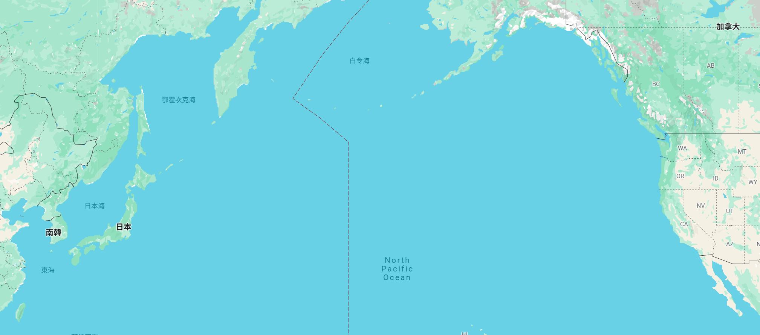
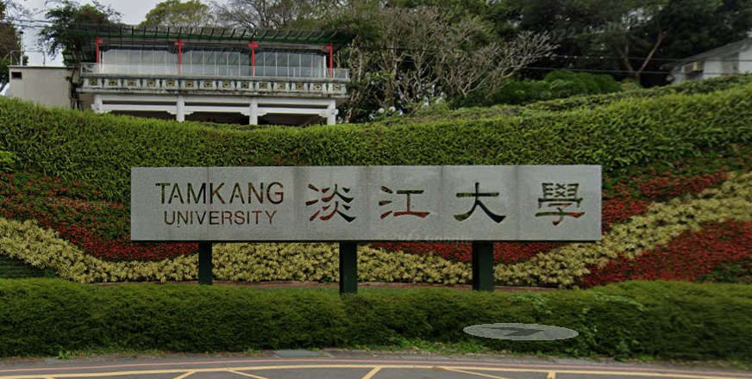
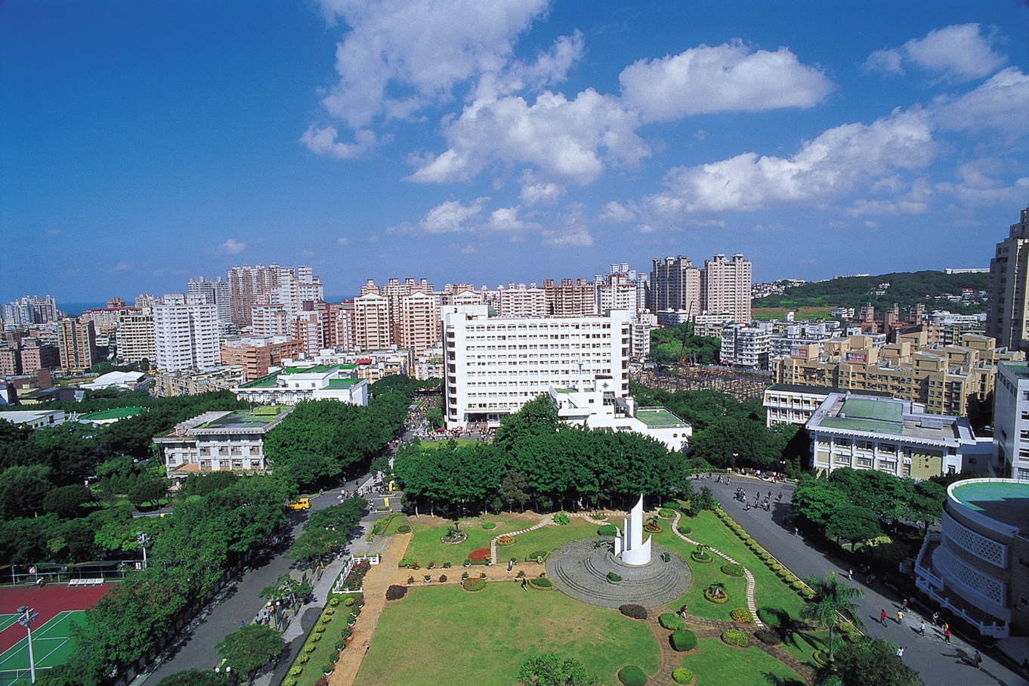
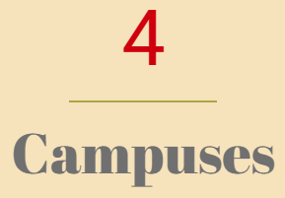


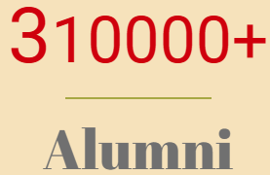
Tamkang University
Private university
Canada
Vancouver Convention Centre
TKU
We spent about 12 hours taking the airplane.
Taiwan

Slide 3
Outline
Introduction
Problem statement
Present approach
Numerical results
Conclusions

Slide 4
Outline
Introduction
Problem statement
Present approach
Numerical results
Conclusions

Slide 5
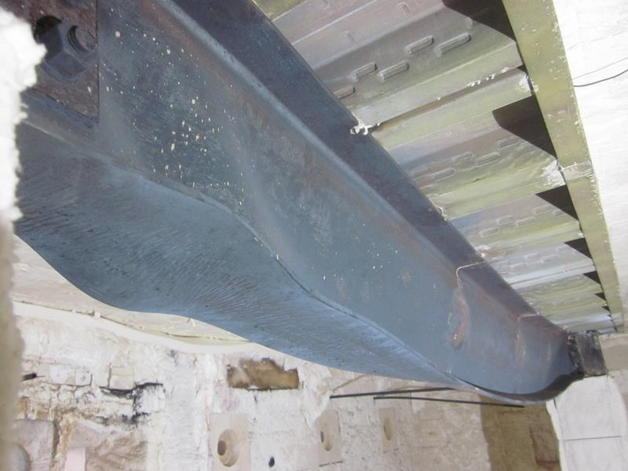
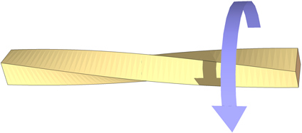
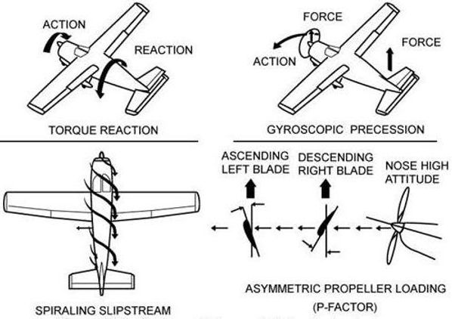
Motivation
Torsion Problem
the twisting of an object due to an applied torque
https://upload.wikimedia.org/wikipedia/
commons/4/4f/Twisted_bar.png
https://www.abri.gov.tw/PeriodicalDetail.aspx?
n=861&s=1786&key=70&isShowAll=false
Civil engineering
Architecture
steel construction
torsion buckling
Reinforced Concrete
Mechanical engineering
machine element
screw
shaft
automobile drive shaft
Aerospace engineering
aircraft
flaps
rotary wing
https://www.apexflightacademy.com/
post/hang-kong-xiao-jiao-shi-left-turning-tendency

Slide 6
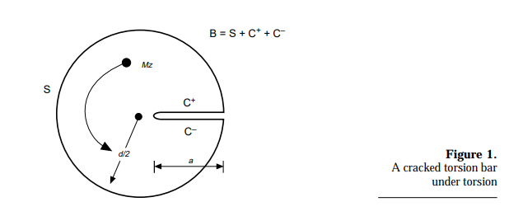
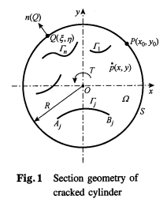
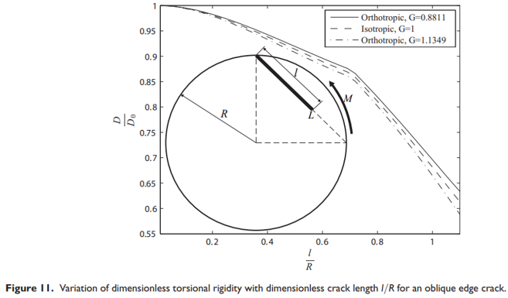
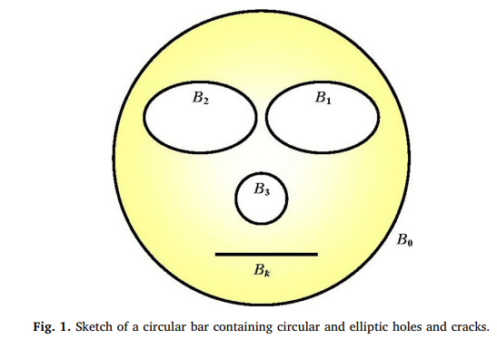
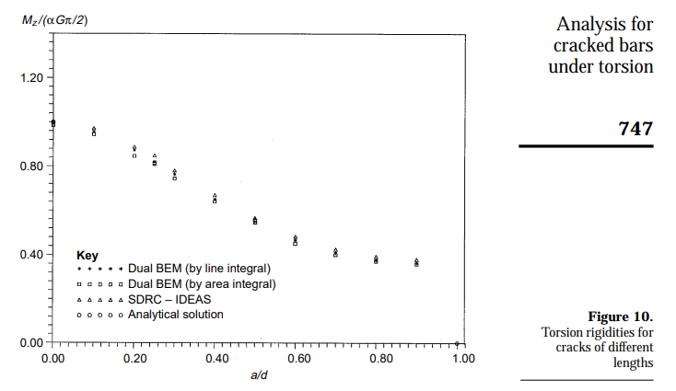
Literature Review
Torsion Problem containing cracks
1998 | 2005 | 2014 | 2019
J.T. Chen et al. | Y. B. Wang and Z. Z. Lu | A. Hassani and R. T. Faal | Y. T. Lee et al.
Used the dual boundary element to solve the cracked torsion bar. | Calculated the torsional rigidity and stress intensity factor for a cylinder with curvilinear cracks | Calculated the torsional rigidity and stress intensity factor with a circular cross-section containing multiple cracks. | Used the dual null-field BIEM to compute the torsional rigidity and stress intensity factor solve a circular bar containing multiple holes and/or cracks.

Slide 7
Motivation
 | Null-field BIEM | Conventional BEM
Pros | Meshless Well-posed Free of boundary layer effect Exponential rate convergence Free of principal values | Arbitrary geometry
Cons | Only special geometry (circle or ellipse) | Need mesh generation in model preparation
Boundary
Nodes
Degenerate kernel
Fourier series
Boundary elements
Closed-form fundamental solution
Interpolation function
We proposed the Meshfree BIEM that have both advantages of these two methods since 2021

Slide 8
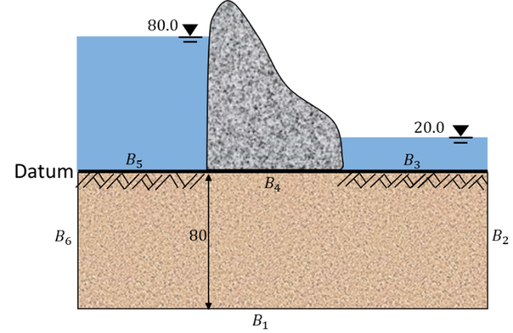
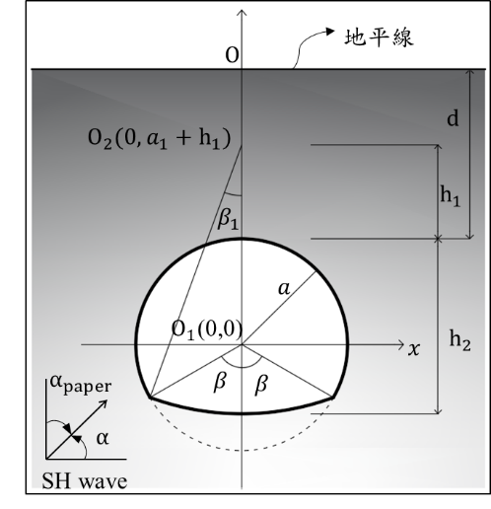

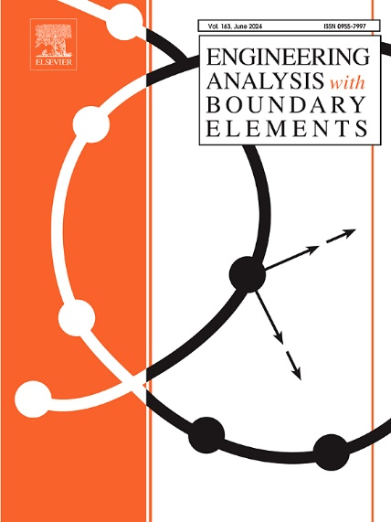
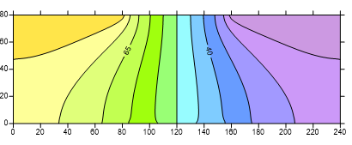
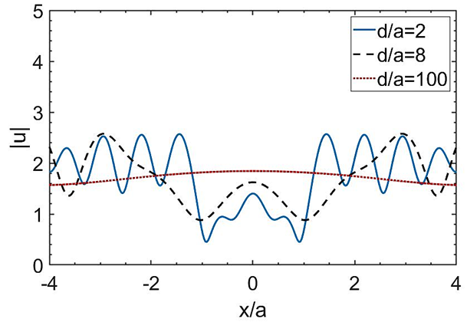
Development of BIQM
Since 2021 |  | 2023 | 2024
Interior potential problem | Membrane free vibration problem | Steady state heat conduction problem
Exterior anti-plane problem | SH-wave scattering problem
Simply-connected domain |  | Multiply-connected domain | Degenerate boundary
Laplace equation | Helmholtz equation | Laplace equation
Singular integral (Adaptive exact solution) Nearly singular integral (Adaptive exact solution) Meshfree (Gaussian quadrature) |  | Singular integral (Adaptive exact solution) Nearly singular integral (Adaptive exact solution) Meshfree (Gaussian quadrature) Degenerate scale (CLEEF) Degenerate boundary (Dual BIEM) Singular integral on slit (Adaptive exact solution for slit)

Slide 9
Outline
Introduction
Problem statement
Present approach
Numerical results
Conclusions

Slide 10
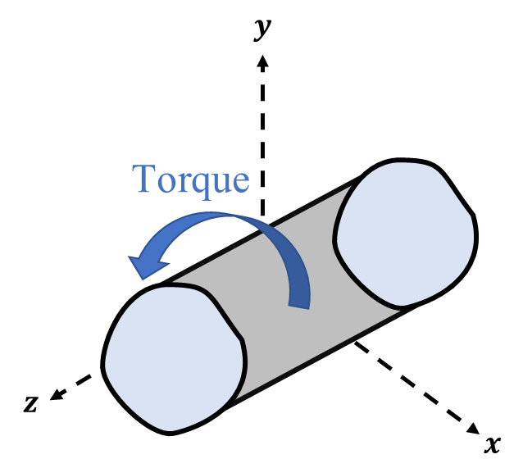
Torsion problem containing an edge crack
Displacement fields
Stress fields
Equilibrium equation
Beltrami–Michell compatibility equation
Governing equation
Boundary condition
is the stress function
is the shear modulus
is the angle of twist per unit length

Slide 11
Outline
Introduction
Problem statement
Present approach
Numerical results
Conclusions

Slide 12

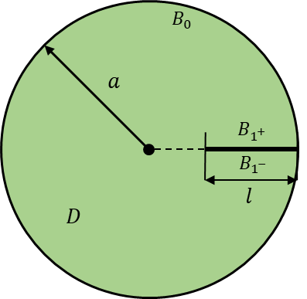
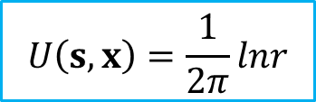
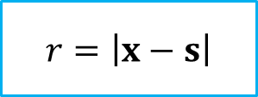
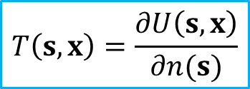
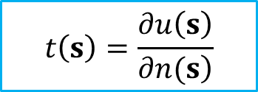
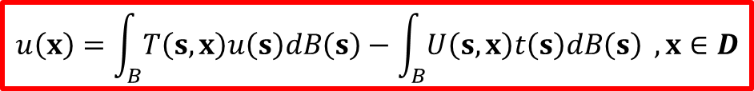
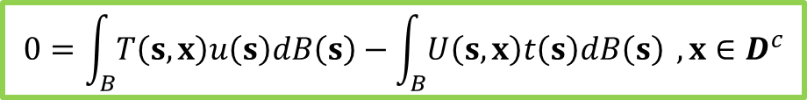
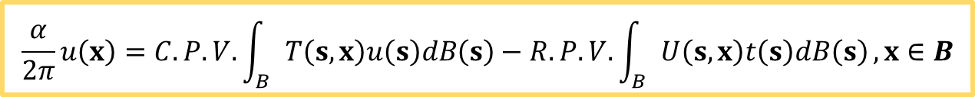
Boundary integral equation
Basic solution of
Laplace equation
in the domain
in the complementary domain
on the boundary

Slide 13
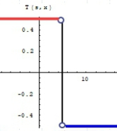
Who is responsible for the discontinuity of the
double-layer potential? (boundary, kernel or density?)
邊界密度函數的解析延拓。
(Taylor expansion)
(Kisu, 1988)
Gauss’ theorem
Residue Theorem
p(x) jump from De to D^{i}.
CPV (Cauchy)
s
x
x
s
Degenerate kernel
discontinuity
山不轉。路轉。
Bump contour
山不轉。路不轉。人轉。

Slide 14
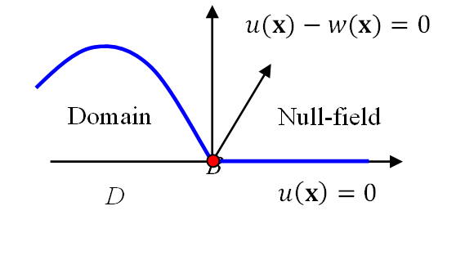
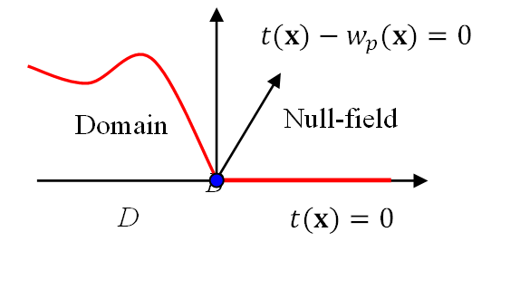



Adaptive exact solution
To enforce the smoothness and continuity of potential and its normal flux across the boundary, we introduce the adaptive exact solution.
$$w\left(s\right)=u\left(x\right)+[\left(s_{x}−x\right)n_{x}\left(x\right)+\left(s_{y}−y\right)n_{y}\left(x\right)]t\left(x\right)$$
w$hen n\left(x\right)$=($n_{x}\left(x\right),n_{y}\left(x\right)$) &$s=(s_{x},s_{y})$
$$\left(u\left(s\right)−w\left(s\right){\left)|\right.}_{s=x}=0\right.$$
Discontinuous
Continuous
$$\left(t\left(s\right)−w_{p}\left(s\right){\left)|\right.}_{s=x}=0\right.$$
$$0=\int_{B}{T\left(s,x\right)\left[u\left(s\right)−w\left(s\right)\right]dB\left(s\right)}−\int_{B}{U\left(s,x\right)\left[t\left(s\right)−w_{p}\left(s\right)\right]dB\left(s\right)},x∈B$$
Skillful calculation of singular integral
computation of solid angle is free

Slide 15
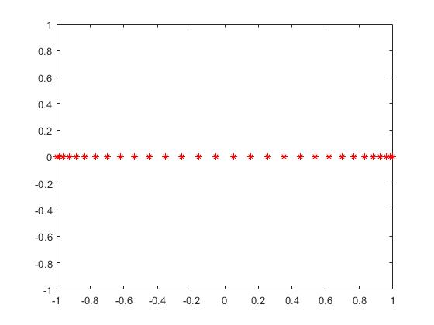
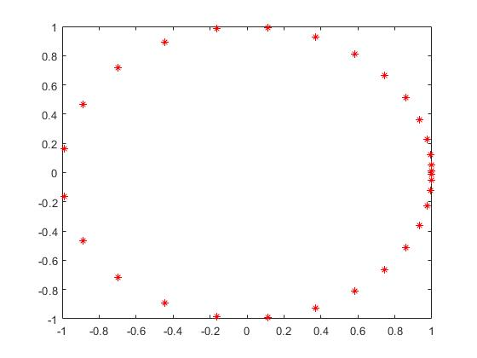
Integral equation to algebraic equation
Parametric representation for each boundary
Gaussian quadrature
IE -> AE
Gaussian points
Boundary node points

Slide 16

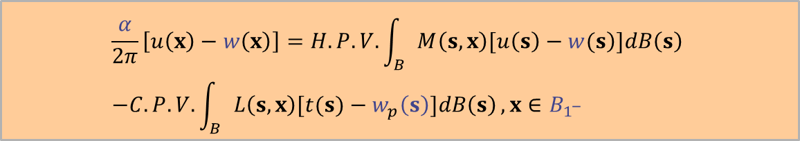

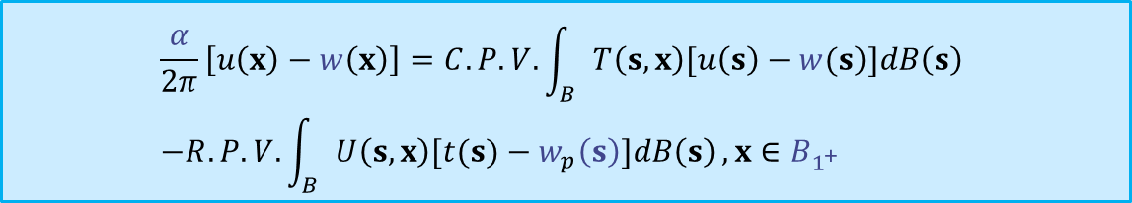


Dual BIE for the degenerate boundary
$$x^{+}$$
$$B_{1^{+}}$$
$$x^{−}$$
$$B_{1^{−}}$$
$$\frac{α}{2π}\left[u\left(x\right)−w\left(x\right)\right]=C.P.V.\int_{B}{\left.T\left(s,x\right)[u\left(s\right)−w(s\right)]dB\left(s\right)} \\ −R.P.V.\int_{B}{U\left(s,x\right)[t(s)−w_{p}\left(s\right)]dB\left(s\right)}, x∈B_{1^{+}}$$
UT
$$\frac{α}{2π}\left[u\left(x\right)−w\left(x\right)\right]=H.P.V.\int_{B}{\left.M\left(s,x\right)[u\left(s\right)−w(s\right)]dB\left(s\right)} \\ −C.P.V.\int_{B}{L\left(s,x\right)[t(s)−w_{p}\left(s\right)]dB\left(s\right)}, x∈B_{1^{−}}$$
LM
In addition, the dual BIE is also required for present problem.

Slide 17
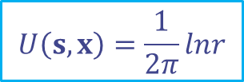

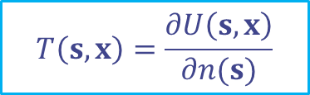





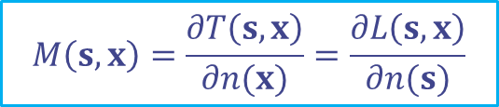

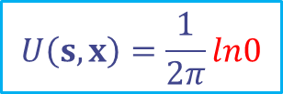
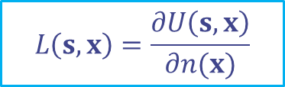

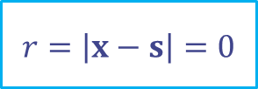

Adaptive exact solution for the degenerate boundary
$$U\left(s,x\right)=\frac{1}{2π}lnr$$
$${x=x}^{+}=x^{−}$$
$$B_{1}$$
$$B_{1^{+}}$$
$$s=x^{+},s=x^{−}$$
$$T\left(s,x\right)=\frac{∂U\left(s,x\right)}{∂n(s)}$$
$$x$$
$$x^{+}$$
$$r=\left|x−s\right|=0$$
$$B_{1^{−}}$$
$$L\left(s,x\right)=\frac{∂U\left(s,x\right)}{∂n(x)}$$
$$x^{−}$$
$$M\left(s,x\right)=\frac{∂T\left(s,x\right)}{∂n(x)}=\frac{∂L\left(s,x\right)}{∂n(s)}$$
$$B_{0}$$
$$U\left(s,x\right)=\frac{1}{2π}ln0$$
When a collocation point is located on the degenerate boundary,
the singularities may occur in both upside and downside of the degenerate boundary at the same time.
Therefore, the above adaptive exact solution is not suitable.

Slide 18
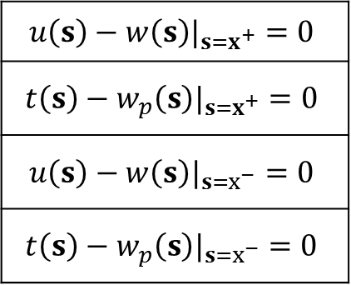
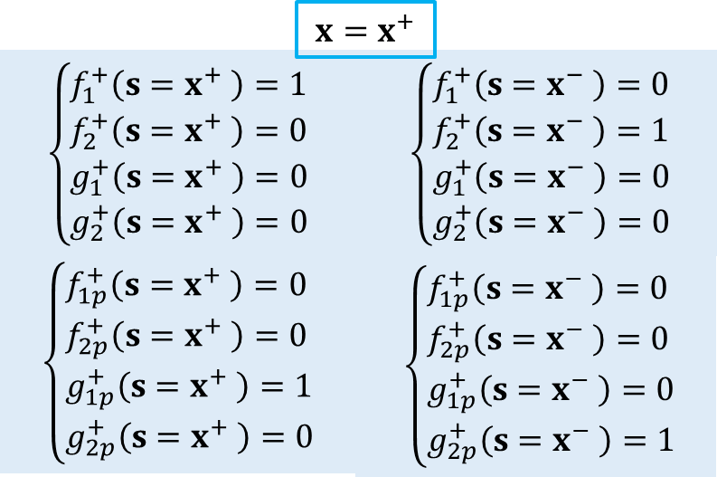
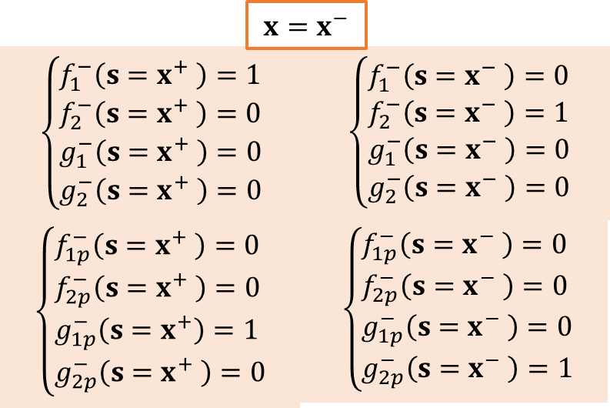

Adaptive exact solution for the degenerate boundary
$$s=x^{+},s=x^{−}$$
According to the continuous conditions across the boundary, we have four continuous equations for a collocation point located on the degenerate boundary.

Slide 19
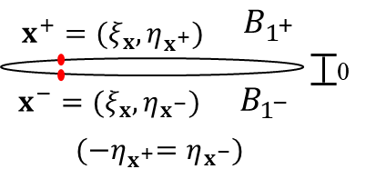
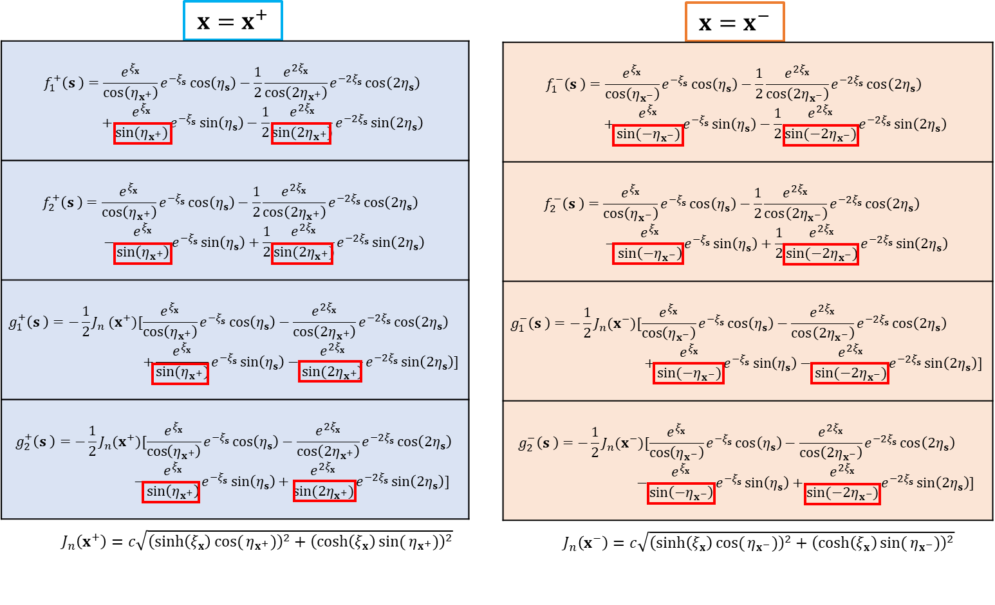

Adaptive exact solution for the degenerate boundary
We employ the exterior harmonic basis of the elliptical coordinates to derive the adaptive exact solution.
E$lliptical coordinates (ξ,η)$

Slide 20


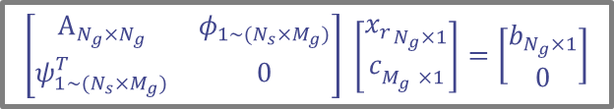


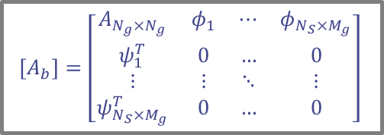
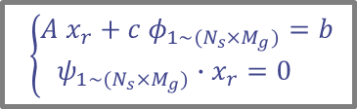



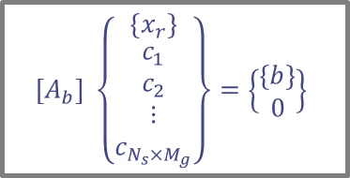






A self-regularized approach
$$\left[A\right] \left\{x_{b}\right\}=\left\{b\right\}$$
singular value decomposition
$$\left[A\right]=Φ_{A} Σ_{A} Ψ_{A}^{T}$$
for an degenerate boundary $B_{1}$
$$Ψ_{A}=\left[\left\{ψ_{1}\right\}\left\{ψ_{2}\right\}⋯\left\{ψ_{N_{S}×M_{g}}\right\}\right]$$
$$x^{+}$$
$$B_{1^{+}}$$
Introduce the self-regularized approach
UT
$$x^{−}$$
$$B_{1^{−}}$$
LM
$$Φ_{A}=\left[\left\{φ_{1}\right\}\left\{φ_{2}\right\}⋯\left\{φ_{N_{S}×M_{g}}\right\}\right]$$
$$\left\{\begin{aligned}A x_{r}+c φ_{1\sim (N_{s}×M_{g})}=b \\ ψ_{1\sim (N_{s}×M_{g})}∙x_{r}=0 \end{aligned}\right.$$
$$[A_{b}]=\left[\begin{matrix}A_{N_{g}×N_{g}} & φ_{1} & ⋯ & φ_{N_{S}×M_{g}} \\ ψ_{1}^{T} & 0 & … & 0 \\ ⋮ & ⋮ & ⋱ & ⋮ \\ ψ_{N_{S}×M_{g}}^{T} & 0 & … & 0\end{matrix}\right]$$
rearrange
UT
$$x^{+}$$
$$B_{1^{+}}$$
UT
$$x^{−}$$
$$B_{1^{−}}$$
$$\left[A_{b}\right] \left\{\begin{matrix}\left\{x_{r}\right\} \\ \begin{aligned}c_{1} \\ c_{2} \\ ⋮ \\ c_{N_{s}×M_{g}}\end{aligned}\end{matrix}\right\}=\left\{\begin{matrix}\left\{b\right\} \\ 0\end{matrix}\right\}$$
$$\left[\begin{matrix}A_{N_{g}×N_{g}} & φ_{1\sim (N_{s}×M_{g})} \\ ψ_{1\sim (N_{s}×M_{g})}^{T} & 0\end{matrix}\right] \left[\begin{matrix}{x_{r}}_{N_{g}×1} \\ c_{M_{g}^{}×1}\end{matrix}\right]=\left[\begin{matrix}b_{N_{g}×1} \\ 0\end{matrix}\right]$$
algebraic equation
promoting the rank of the deficient matrix

Slide 21
Outline
Introduction
Problem statement
Present approach
Numerical results
Conclusions

Slide 22
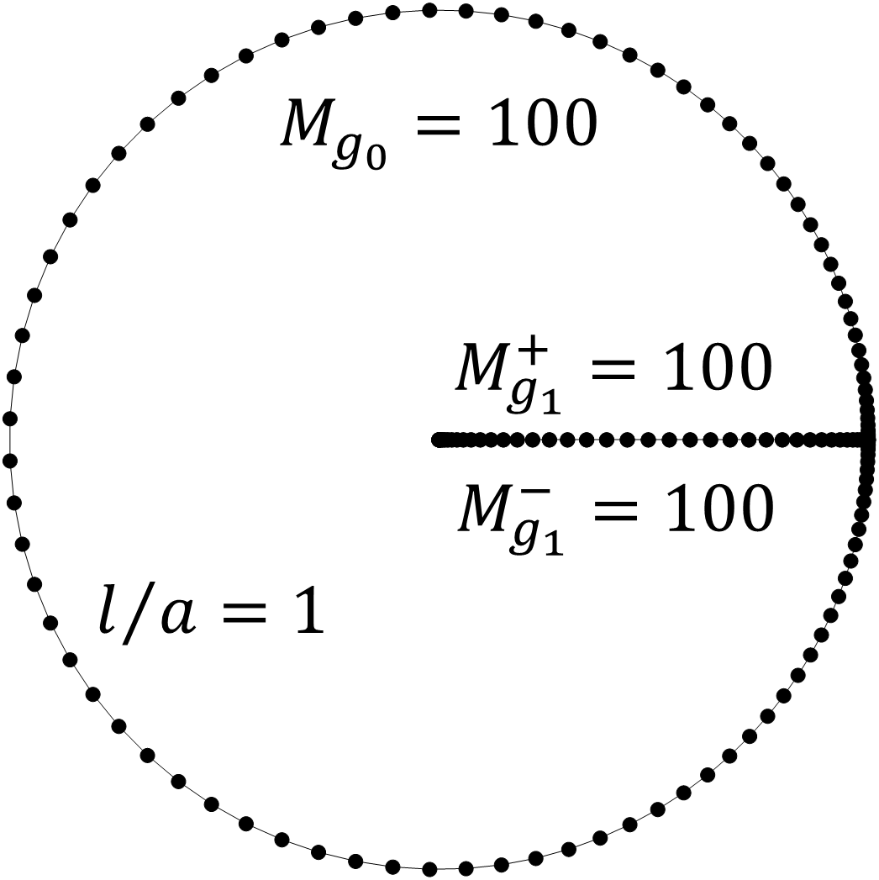

A circular cross-section with a radial edge crack
Torsional rigidity
Ratio of torsional rigidity $D_{r}/D_{0}$, ($D_{0}={Gπa^{4}}/2$)
$$l/a$$ $$(a=2)$$ | BIQM + self-regularized approach | Dual BIQM | Conventional dual BEM (No. of boundary element$=300$) | Analytical solution Lebedev et al.
0.5 | $$0.8285 (0.00 \%)$$ | $$0.8285 (0.00 \%)$$ | $$0.8279 (0.07 \%)$$ | $$0.8285$$
0.6 | $$0.7727 (0.00 \%)$$ | $$0.7727 (0.00 \%)$$ | $$0.7723 (0.04 \%)$$ | $$0.7727$$
0.7 | $$0.7160 (0.00 \%)$$ | $$0.7160 (0.00 \%)$$ | $$0.7157 (0.04 \%)$$ | $$0.7160$$
0.8 | $$0.6603 (0.02 \%)$$ | $$0.6603 (0.02 \%)$$ | $$0.6603 (0.02 \%)$$ | $$0.6604$$
0.9 | $$0.6076 (0.00 \%)$$ | $$0.6076 (0.00 \%)$$ | $$0.6076 (0.00 \%)$$ | $$0.6076$$
1 | $$0.5590 (0.00 \%)$$ | $$0.5590 (0.00 \%)$$ | $$0.5591 (0.02 \%)$$ | $$0.5590$$
References：
N. N. Lebedev, I. P. Skalskaya and Y. S. Uflyand, Worked problems in applied mathematics, Dover, New York, 1965.

Slide 23

A circular cross-section with a radial edge crack
Stress intensity factor
Ratio of stress intensity factor $K_{III}/K_{0}$, ($K_{0}={2 D_{r}β\sqrt{πl}}/{π a^{3}}$)
$$l/a$$ $$(a=2)$$ | BIQM + self-regularized approach | Dual BIQM | Hassani and Faal | Wang
0.1 | $$0.9541$$ | $$0.9541$$ | 0.9566 | 0.9591
0.2 | $$0.9263$$ | $$0.9263$$ | 0.9276 | 0.9280
0.3 | $$0.9082$$ | $$0.9082$$ | 0.9090 | 0.9088
0.4 | $$0.8973$$ | $$0.8973$$ | 0.8979 | 0.8973
0.5 | $$0.8915$$ | $$0.8915$$ | 0.8920 | 0.8913
0.6 | $$0.8888$$ | $$0.8888$$ | 0.8892 | 0.8883
0.7 | $$0.8868$$ | $$0.8868$$ | 0.8872 | 0.8864
0.8 | $$0.8831$$ | $$0.8831$$ | 0.8835 | 0.8830
0.9 | $$0.8748$$ | $$0.8748$$ | 0.8752 | 0.8777
1 | $$0.8587$$ | $$0.8587$$ | NA. | NA.
References：
A. Hassani and R. T. Faal, Saint-Venant torsion of orthotropic bars with a circular cross-section containing multiple cracks, Mathematics and Mechanics of Solids, Vol. 21, pp. 1-17, 2014.
Y. Wang, Torsion of a thick-walled cylinder with an external crack: boundary collocation method, Theoretical and Applied Fracture Mechanics, Vol. 14, pp. 267-273, 1990.

Slide 24


A circular cross-section with a slant edge crack
Torsional rigidity
References：
J. T. Chen, K. H. Chen and W. Yeih, Dual boundary element analysis for cracked bars under torsion, Engineering Computations, Vol. 15 (6), pp. 732-749, 1998.
A. Hassani and R. T. Faal, Saint-Venant torsion of orthotropic bars with a circular cross-section containing multiple cracks, Mathematics and Mechanics of Solids, Vol. 21, pp. 1-17, 2014.

Slide 25

A circular cross-section with a slant edge crack
Torsional rigidity
Ratio of torsional rigidity, $D_{r}/D_{0}$, ($D_{0}={Gπa^{4}}/2$)
$$l/a$$ $$(a=2)$$ | BIQM + self-regularized approach | Dual BIQM | Conventional dual BEM (No. of boundary element$=300$)
0.5 | $$0.9137$$ | $$0.9137$$ | $$0.9127$$
0.6 | $$0.8895$$ | $$0.8895$$ | $$0.8886$$
0.7 | $$0.8669$$ | $$0.8669$$ | $$0.8661$$
0.8 | $$0.8470$$ | $$0.847$$ | $$0.8463$$
0.9 | $$0.8306$$ | $$0.8306$$ | $$0.8298$$
1 | $$0.8179$$ | $$0.8179$$ | $$0.8171$$
References：
A. Hassani and R. T. Faal, Saint-Venant torsion of orthotropic bars with a circular cross-section containing multiple cracks, Mathematics and Mechanics of Solids, Vol. 21, pp. 1-17, 2014.

Slide 26

A circular cross-section with a slant edge crack
Stress intensity factor
Ratio of stress intensity factor $K_{III}/K_{0}$, ($K_{0}={2 D_{r}β\sqrt{πl}}/{π a^{3}}$)
$$l/a$$ $$(a=2)$$ | BIQM + self-regularized approach | Dual BIQM
0.1 | $$0.7108$$ | $$0.7108$$
0.2 | $$0.6670$$ | $$0.6670$$
0.3 | $$0.6258$$ | $$0.6258$$
0.4 | $$0.5850$$ | $$0.5850$$
0.5 | $$0.5430$$ | $$0.5430$$
0.6 | $$0.4985$$ | $$0.4985$$
0.7 | $$0.4507$$ | $$0.4506$$
0.8 | $$0.3989$$ | $$0.3989$$
0.9 | $$0.3432$$ | $$0.3432$$
1 | $$0.2839$$ | $$0.2838$$
References：
A. Hassani and R. T. Faal, Saint-Venant torsion of orthotropic bars with a circular cross-section containing multiple cracks, Mathematics and Mechanics of Solids, Vol. 21, pp. 1-17, 2014.

Slide 27
A circular cross-section with a slant edge crack
Torsional rigidity
Stress intensity factor
References：
A. Hassani and R. T. Faal, Saint-Venant torsion of orthotropic bars with a circular cross-section containing multiple cracks, Mathematics and Mechanics of Solids, Vol. 21, pp. 1-17, 2014.

Slide 28




elliptical cross-section with double radial edge cracks
Ratio of torsional rigidity, $D_{r}/D_{0}$, ($D_{0}=Gπ[{a^{3}b^{3}}/{(a^{2}+b^{2})}]$)
$$b/a$$ $$(a=4)$$ | $$l/a$$ | BIQM + self-regularized approach | Dual BIQM | Conventional dual BEM (No. of boundary element$=400$) | Analytical solution Lebedev et al.
$$1/4$$ | $$0.035$$ | $$0.9986 (0.04 \%)$$ | $$0.9986 (0.04 \%)$$ | $$0.9974 (0.16 \%)$$ | $$0.9990$$
$$1/2$$ | $$0.135$$ | $$0.9724 (0.00 \%)$$ | $$0.9724 (0.00 \%)$$ | $$0.9721 (0.03 \%)$$ | $$0.9724$$
$$3/4$$ | $$0.338$$ | $$0.8242 (0.01 \%)$$ | $$0.8242 (0.01 \%)$$ | 0.8251$(0.10 \%)$ | $$0.8243$$
Ratio of stress intensity factor, $K_{III}/K_{0}$, ($K_{0}={2D_{r}β\sqrt{πl}}/{πab^{2}}$)
$$b/a$$ $$(a=4)$$ | $$l/a$$ | BIQM + self-regularized approach | Dual BIQM
$$1/4$$ | $$0.035$$ | $$0.2413$$ | $$0.2413$$
$$1/2$$ | $$0.135$$ | $$0.4957$$ | $$0.4957$$
$$3/4$$ | $$0.338$$ | $$0.7573$$ | $$0.7573$$
References：
N. N. Lebedev, I. P. Skalskaya and Y. S. Uflyand, Worked problems in applied mathematics, Dover, New York, 1965.

Slide 29
Outline
Introduction
Problem statement
Present approach
Numerical results
Conclusions

Slide 30
Conclusions
1. After introducing the adaptive exact solution and Gaussian quadrature, the BIQM is a meshless method.
2. To solve the rank-deficient problem arising from a degenerate boundary in the BIQM, we used not only the dual BIE but also the self-regularized approach.
Dual BIE
Aelf-regularized approach
(only singular BIE)
$$x^{+}$$
$$B_{1^{+}}$$
$$x^{+}$$
$$B_{1^{+}}$$
UT
UT
$$B_{1^{−}}$$
LM
UT
$$x^{−}$$
$$x^{−}$$
$$B_{1^{−}}$$

Slide 31

Conclusions
3. For the torsional rigidities, the results of BIQM is more accurate than those of conventional dual BEM.
Ratio of torsional rigidity, $D_{r}/D_{0}$, ($D_{0}=Gπ[{a^{3}b^{3}}/{(a^{2}+b^{2})}]$)
$$b/a$$ $$(a=4)$$ | $$l/a$$ | BIQM + self-regularized approach | Dual BIQM | Conventional dual BEM (No. of boundary element$=400$) | Analytical solution Lebedev et al.
$$1/4$$ | $$0.035$$ | $$0.9986 (0.04 \%)$$ | $$0.9986 (0.04 \%)$$ | $$0.9974 (0.16 \%)$$ | $$0.9990$$
$$1/2$$ | $$0.135$$ | $$0.9724 (0.00 \%)$$ | $$0.9724 (0.00 \%)$$ | $$0.9721 (0.03 \%)$$ | $$0.9724$$
$$3/4$$ | $$0.338$$ | $$0.8242 (0.01 \%)$$ | $$0.8242 (0.01 \%)$$ | 0.8251$(0.10 \%)$ | $$0.8243$$
4. For the slant case, it is found some difference between the present results and the results of reference.

Slide 32

Related papers
if anyone has interest on the BIQM, two papers are now available.
The pdf file is upon your request.
J. W. Lee*, H. W. Yang and J. T. Chen, 2023, ASME Journal of Heat and Mass Transfer, Vol. 145 (11), p.110901.
J. W. Lee*, H. W. Yang and J. T. Chen, 2024, Engineering Analysis with Boundary Elements, Vol. 165, 105798.

Slide 33

The end
Thanks for your kind attentions

Slide 34


Conclusions
Double degeneracy
Inner boundary
Slit
Degenerate boundary
Dual BIE
Outer boundary
Ellipse
Degenerate scale
CLEEF & Dual BIE
Degenerate scale is dominated by the outer boundary instead of the inner boundary.
The dual BIE is the well-posed model for dealing with all degenerate problems.

Slide 35


Related papers
If anyone has interesting to our work. There are four related papers can be found.
The pdf file is upon your request.
J. W. Lee*, H. W. Yang and J. T. Chen, 2023, ASME Journal of Heat and Mass Transfer, Vol. 145 (11), p.110901.
J. H. Kao, J. W. Lee*, J. Y. Young and J. T. Chen, 2023, Numerical Heat Transfer, Part B: Fundamentals, accepted.
J. W. Lee*, H. W. Yang and J. T. Chen, 2024, Engineering Analysis with Boundary Elements, Vol. 165, 105798.
J. H. Kao, C. Y. Yang, J. W. Lee*, J. T. Chen, 2024, International Journal of Heat and Mass Transfer, Accepted.

Slide 36










Degenerate scale
The value of degenerate scale in the numerical result can be predicted by using the analytical derivation.
2D Laplace problem
Dirichlet BC
$$a$$
$$a=1$$
BEM/BIEM
$$u\left(x\right)=\int_{B}^{ }{T\left(s,x\right)u\left(s\right)dB\left(s\right)}$$
No solution or non-unique
$$a$$
$$−\int_{B}^{ }{U\left(s,x\right)t\left(s\right)dB\left(s\right)} ,x∈D$$
$$U\left(s,x\right)=\frac{1}{2π}ln\left|x−s\right|$$
$$T\left(s,x\right)=\frac{∂U\left(s,x\right)}{∂n(s)}$$
$a=1.$694

Slide 37











Treatments for degenerate scale
Method 1 | Method 2
Hypersingular boundary integral equation | CLEEF (UT or LM)
$$UT→LM$$
$$UT$$
$$UT or LM \\ equation$$
$$\left[U_{r}\right]\left\{t_{g}\right\}=\left[T_{r}\right]\left\{u_{g}\right\}$$
=CLEEF point
$$r=N_{g}×N_{g}$$
$${\left[U_{b}^{c}\right]}^{T}\left[U_{b}^{c}\right]\left\{t_{g}\right\}={\left[U_{b}^{c}\right]}^{T}\left[T_{b}^{c}\right]\left\{u_{g}\right\}$$
$$g=N_{g}×1$$
$$b=(N_{g}+1)×N_{g}$$
${\left\{t_{g}\right\}=({\left[U_{b}^{c}\right]}^{T}\left[U_{b}^{c}\right])}^{−1}$(${\left[U_{b}^{c}\right]}^{T} \left[T_{b}^{c}\right]\left\{u_{g}\right\})$

Slide 38
Conclusions
The meshfree boundary integral method was successfully applied to solve the two-dimensional steady-state heat conduction problem of heat exchanger tubes containing slits.
The generation of the mesh on the boundary was not required in the model preparation.
The proper local exact solution for a problem containing a degenerate boundary was constructed by using the harmonic basis in elliptical coordinates.
The CLEEF idea can be employed to effectively suppress the numerical instability due to a degenerate scale.

Slide 39



Heat transfer Problem: Conduction shape factor
1913年 | 1961年
Convection and radiation of heat | Steady state temperature distribution and heat flow in prismatic bars with isothermal boundary conditions
Irving Langmuir | M.J.Balcerzak、S.Raynor
Trans. Am. Electrochem Soc. 23,299–332 | International Journal of Heat and Mass Transfer, 3, 113-125
He was the first to propose the concept of conduction shape factor. | Conformal mapping was used to calculate the temperature distribution, and exact solution for the conduction shape factor was derived.
Irving Langmuir
Fellow of the American Academy of Arts and Sciences (1918)
Perkin Medal (1928)
Nobel Prize in Chemistry (1932)
Franklin Medal (1934)
Faraday Medal (1944)

Slide 40
Motivation
 | Null-field BIEM | Conventional BEM
Pros | Meshless Well-posed Free of boundary layer effect Exponential rate convergence Free of principal values | Arbitrary geometry
Cons | Only special any (circle or ellipse) | Need mesh generation in model preparation
Boundary
Nodes
Degenerate kernel
Fourier series
Boundary elements
Closed-form fundamental solution
Interpolation function
To develop a BIEM with Meshfree & for Arbitrary Geometry

Slide 41


Development of meshfree BIEM
Since 2021 |  | 2023
Interior potential problem | Membrane free vibration problem | Steady state heat conduction problem
Exterior anti-plane problem | SH-wave scattering problem
Simply-connected domain |  | Multiply-connected domain
Laplace equation | Helmholtz equation | Laplace equation
Singular integral (Adaptive exact solution) Nearly singular integral (Adaptive exact solution) Meshfree (Gaussian quadrature) |  | Singular integral (Adaptive exact solution) Nearly singular integral (Adaptive exact solution) Meshfree (Gaussian quadrature) Degenerate scale (CHEEF) Degenerate boundary (Dual BIEM) Singular integral on slit (Adaptive exact solution for slit)

Slide 42




An elliptical tube containing a focal slit
Governing equation: Laplace equation
$$\frac{∂^{2}u(x)}{∂x^{2}}+\frac{∂^{2}u(x)}{∂y^{2}}=0 ,x∈D$$
$u\left(x\right)=$ temperature field
$u_{1}=$outer boundary
temperature (unit: K)
$u_{0}=$ inner boundary
temperature (unit: K)
$B_{1}=$ outer boundary
$B_{0}=$ inner boundary
Boundary condition
Constant temperature
$$\left\{\begin{aligned}u\left(x\right)=u_{1}=400K, \\ u\left(x\right)=u_{0}=300K, \end{aligned}\right.$$
$$x∈B_{1} \\ x∈B_{0}$$

Slide 43







Boundary integral equation
Basic solution of
Laplace equation
$$x$$
$$∇^{2}U\left(s,x\right)=δ(x−s)$$
$$D^{c}$$
$$x$$
$$U\left(s,x\right)=\frac{1}{2π}lnr$$
$$r=\left|x−s\right|$$
$$B$$
$$T\left(s,x\right)=\frac{∂U\left(s,x\right)}{∂n(s)}$$
$$D$$
$$x$$
$$t\left(s\right)=\frac{∂u\left(s\right)}{\left.∂n(s\right)}$$
in the domain
$$u\left(x\right)=\int_{B}^{ }{T\left(s,x\right)u\left(s\right)dB\left(s\right)}−\int_{B}^{ }{U\left(s,x\right)t\left(s\right)dB\left(s\right)} ,x∈D$$
in the complementary domain
$$0=\int_{B}^{ }{T\left(s,x\right)u\left(s\right)dB\left(s\right)}−\int_{B}^{ }{U\left(s,x\right)t\left(s\right)dB\left(s\right)} ,x∈D^{c}$$
on the boundary
$$\frac{α}{2π}u\left(x\right)=C.P.V.\int_{B}{T\left(s,x\right)u\left(s\right)dB\left(s\right)}−R.P.V.\int_{B}{U\left(s,x\right)t\left(s\right)dB\left(s\right)},x∈B$$

Slide 44




Adaptive exact solution
$$w\left(s\right)=f\left(s,x\right)u\left(s\right)+g\left(s,x\right)t\left(s\right)$$
$$f{(s,x)|}_{s=x}=1$$ | $$\frac{∂f\left(s,x\right)}{∂n\left(s\right)}|_{s=x}=0$$
$$g(s,x)|_{s=x}=0$$ | $$\frac{∂g\left(s,x\right)}{∂n\left(s\right)}|_{s=x}=1$$
by using the
shape functions
$$w_{p}\left(s\right)=\frac{∂f\left(s,x\right)}{∂n\left(s\right)}u\left(s\right)+\frac{∂g\left(s,x\right)}{∂n\left(s\right)}t\left(s\right)$$
$$w\left(s\right)=u\left(x\right)+[\left(s_{x}−x\right)n_{x}\left(x\right)+\left(s_{y}−y\right)n_{y}\left(x\right)]t\left(x\right)$$
w$hen n\left(x\right)$=($n_{x}\left(x\right),n_{y}\left(x\right)$) &$s=(s_{x},s_{y})$
$$0=\int_{B}{T\left(s,x\right)\left[u\left(s\right)−w\left(s\right)\right]dB\left(s\right)}−\int_{B}{U\left(s,x\right)\left[t\left(s\right)−w_{p}\left(s\right)\right]dB\left(s\right)},x∈B$$
Skillful calculation of singular integral
computation of solid angle is free

Slide 45


Adaptive exact solution
Auxiliary solution
$$\frac{α}{2π}u\left(x\right)=C.P.V.\int_{B}{T\left(s,x\right)u\left(s\right)dB\left(s\right)}−R.P.V.\int_{B}{U\left(s,x\right)t\left(s\right)dB\left(s\right)},x∈B$$
$$\frac{α}{2π}w\left(x\right)=C.P.V.\int_{B}{T\left(s,x\right)w\left(s\right)dB\left(s\right)}−R.P.V.\int_{B}{U\left(s,x\right)\frac{∂w\left(s\right)}{∂n\left(s\right)}dB\left(s\right)},x∈B$$
Subtract
$$\frac{α}{2π}\left[u\left(x\right)−w\left(x\right)\right]=C.P.V.\int_{B}{\left.T\left(s,x\right)[u\left(s\right)−w(s\right)]dB\left(s\right)}−R.P.V.\int_{B}{U\left(s,x\right)[t(s)−w_{p}\left(s\right)]dB\left(s\right)}, x∈B$$

Slide 46








Adaptive exact solution
$$\frac{α}{2π}\left[u\left(x\right)−w\left(x\right)\right]=C.P.V.\int_{B}{\left.T\left(s,x\right)[u\left(s\right)−w(s\right)]dB\left(s\right)}−R.P.V.\int_{B}{U\left(s,x\right)[t(s)−w_{p}\left(s\right)]dB\left(s\right)}, x∈B$$
$$w_{p}\left(s\right)=\frac{∂w\left(s\right)}{\left.∂n(s\right)}$$
satisfies the 2D Laplace equation
$$∇^{2}w\left(s\right)=0$$
When $s=x$
$$\left(u\left(s\right)−w\left(s\right){\left)|\right.}_{s=x}=0\right.$$
$${\left.w\left(s\right)\right|}_{s=x}=u\left(s\right)$$
$$\left(t\left(s\right)−w_{p}\left(s\right){\left)|\right.}_{s=x}=0\right.$$
$${\left.\frac{∂w\left(s\right)}{\left.∂n(s\right)}\right|}_{s=x}=t\left(s\right)$$

Slide 47



Adaptive exact solution for the degenerate boundary
E$lliptical coordinates (ξ,η)$
Harmonic basis for the exterior problem
$$h\left(s \right)=c_{1}e^{{−ξ}_{s}}\cos\left(η_{s}\right)+c_{2}e^{{−2ξ}_{s}}\cos\left(2η_{s}\right) \\ +d_{1}e^{{−ξ}_{s}}\sin\left(η_{s}\right)+d_{2}e^{{−2ξ}_{s}}\sin\left(2η_{s}\right)$$

Slide 48
Adaptive exact solution for the degenerate boundary

Slide 49

Single slit and multiple slits
Elliptical tube containing a focal slit
Elliptical tube containing 3 radial slits
a=5
b=4
a=5
b=4
l=1

Slide 50
Contour plots of the temperature field
Elliptical tube containing a focal slit
Elliptical tube containing 3 radial slits
Meshfree BIEM
Meshfree BIEM
Dual BEM
Dual BEM

Slide 51
CSF and degenerate scale
Elliptical tube containing a focal slit
Elliptical tube containing 3 radial slits

Slide 52
Conclusions
The meshfree boundary integral method was successfully applied to solve the two-dimensional steady-state heat conduction problem of heat exchanger tubes containing slits.
The generation of the mesh on the boundary was not required in the model preparation.
The proper local exact solution for a problem containing a degenerate boundary was constructed by using the harmonic basis in elliptical coordinates.
$$0=\int_{B}{T\left(s,x\right)\left[u\left(s\right)−w\left(s\right)\right]dB\left(s\right)}−\int_{B}{U\left(s,x\right)\left[t\left(s\right)−w_{p}\left(s\right)\right]dB\left(s\right)},x∈B$$

Slide 53
Conclusions
This work also numerically verified that all the cases suffered the problem of degenerate scale due to the logarithmic kernel and corresponding size of the outer boundary.
The CLEEF idea can be employed to effectively suppress the numerical instability due to a degenerate scale.
Double degeneracy of not only the degenerate scale of outer boundary but also the degenerate boundary of inner slit, were solved at the same time by using regularization techniques and dual equations, respectively.

Slide 54









Deal with nearly singular integral by adaptive exact solution
$$x in the domain$$
Boundary layer effect due to the nearly singular
$$U\left(s,x\right)=\frac{1}{2π}lnr$$
$x$ out of domain
$$x$$
$$\left.x_{b}=(x_{b},y_{b}\right)$$
$$r=\left|x−s\right|$$
$$u\left(x\right) =\int_{B}{T\left(s,x\right)u(s)−U\left(s,x\right)t(s)dB\left(s\right)}, x∈D$$
$$w\left(x\right) =\int_{B}{T\left(s,x\right)w(s)−U\left(s,x\right)w_{p}(s)dB\left(s\right)}, x∈D$$
Adaptive exact solution
Subtract
$$w\left(s\right)=u\left(x_{b}\right)+\left[\left(s_{x}−x_{b}\right)n_{x}\left(x_{b}\right)+\left(s_{y}−y_{b}\right)n_{y}\left(x_{b}\right)\right]t\left(x_{b}\right),_x_{b}∈B$$
$$u\left(x\right) =\int_{B}{\left.T\left(s,x\right)[u(s\right)−w(s)]−U\left(s,x\right)[t\left(s\right)−w_{p}(s)]dB\left(s\right)}+w(s),_{}x∈D$$

Slide 55

BIEM/BEM for solving engineering problem
Dual boundary integral equation
2D Laplace and Helmholtz equations
seepage
free vibration
wave scattering
anti-plane shear
Mesh reduction and efficient

Slide 56

Null-field BIEM in NTOU/MSV since 2003
Null-field formulation
Fundamental solution
Degenerate kernel
Boundary density
Fourier series
Five advantages
Meshless
Well-posed
Free of boundary layer effect
Exponential rate convergence
Free of principal values
a

Slide 57


Contour plots of temperature fields
Cross-section | Case 1
 | Without the treatment of boundary layer effect | With the treatment of boundary layer effect
a=1
b=3

Slide 58
Contour plots of temperature fields
Cross-section | Case 2
 | Without the treatment of boundary layer effect | With the treatment of boundary layer effect
a=1
b=3

Slide 59






Convergence of CSF
$$Err=\left|\frac{CSF−{CSF}_{ex}}{{CSF}_{ex}}\right|×100 \%$$
$N_{g}$=4 $M_{g}$
$N_{g}$=5 $M_{g}$
$$(\%)$$
$$(\%)$$
$N_{g}$=6 $M_{g}$
$N_{g}$=6 $M_{g}$

