Slide 1



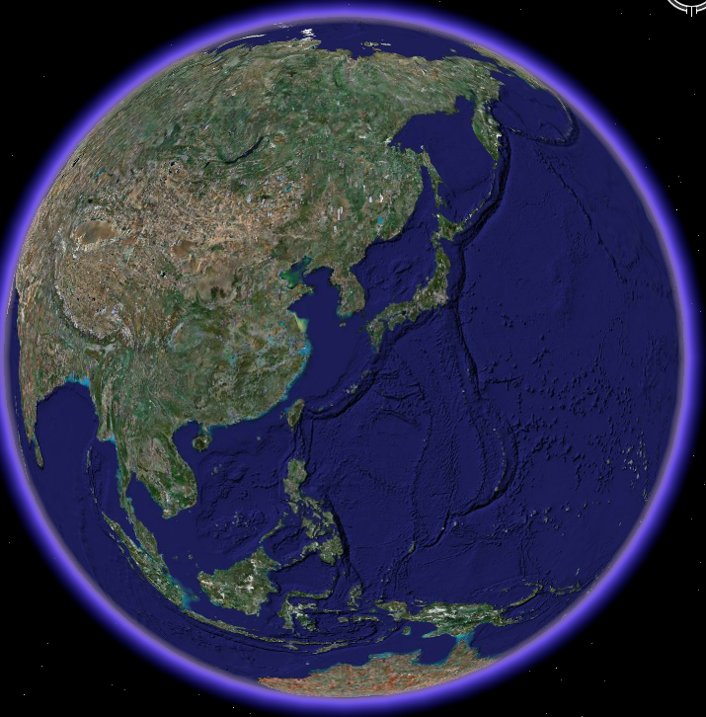
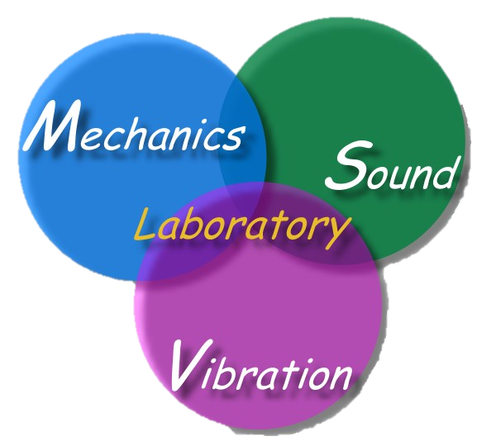
On the role of degenerate kernels for BIEM/BEM
Chen J T
Distinguished Chair Prof.
Taiwan Ocean University
Guest Prof. , Taiwan University
Joint. Prof., Cheng-Kung University
10:10-10:40, Nov. 3, 2023
廈門大學
Location: Concert Hall (科艺中心音乐厅)
Icome2023-xiaman.ppt

Slide 2


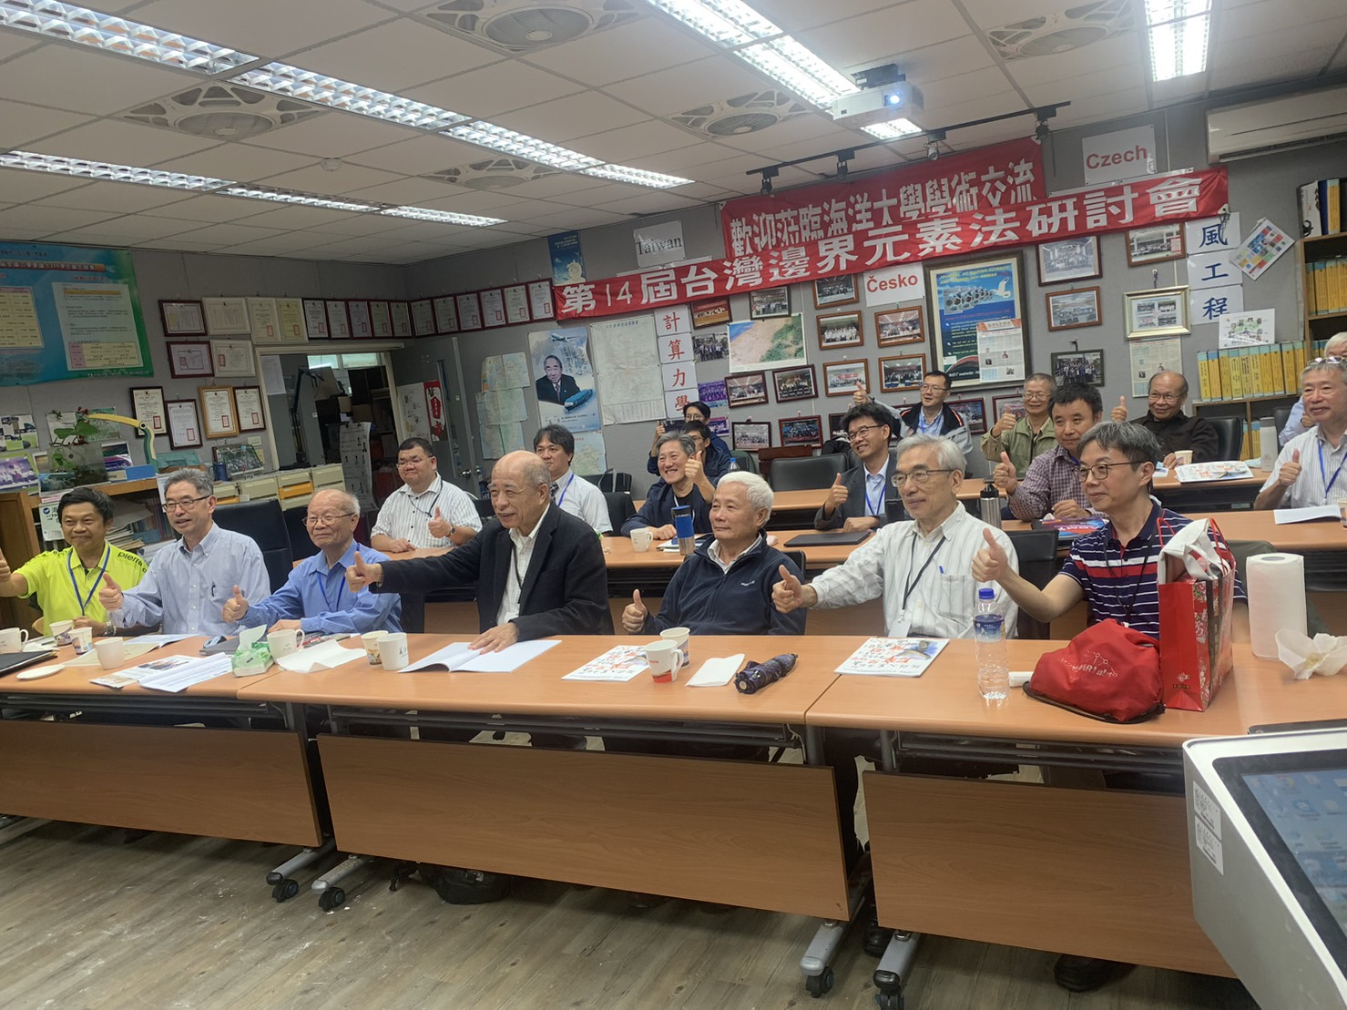
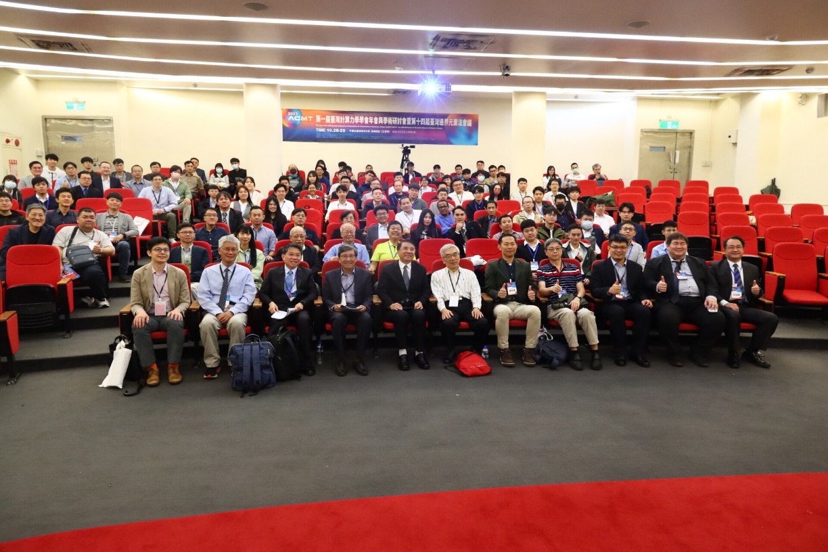
ACMT 1
TwBEM 14

Slide 3
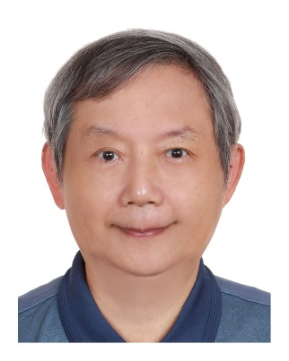
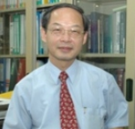


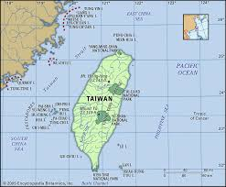









Taiwan team
楊永斌
馬劍清
程宏達
陳正宗
倪蘇娜
Sonal Nirwal
楊子儀
范佳銘
李家瑋
廖亦倫
戴國釗
Four generations together
四代同堂
李柏緯
劉彥辰
李宗翰

Slide 4

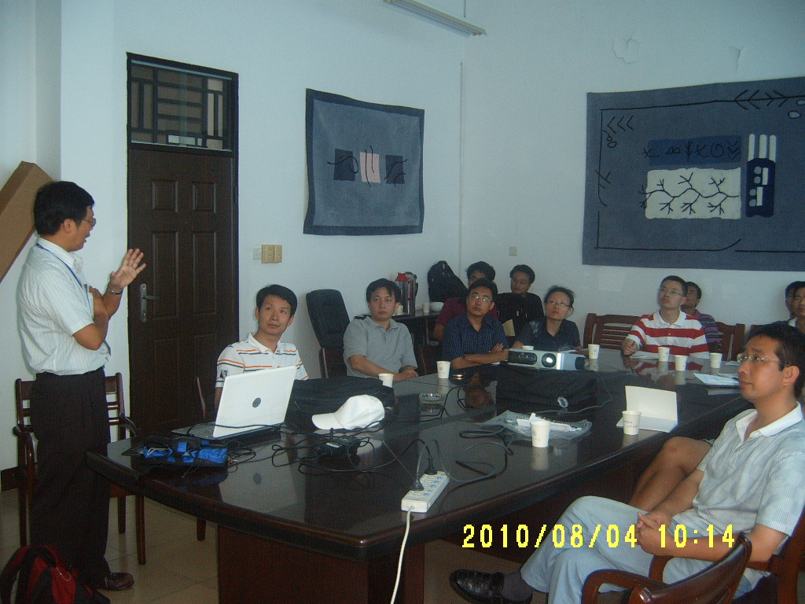
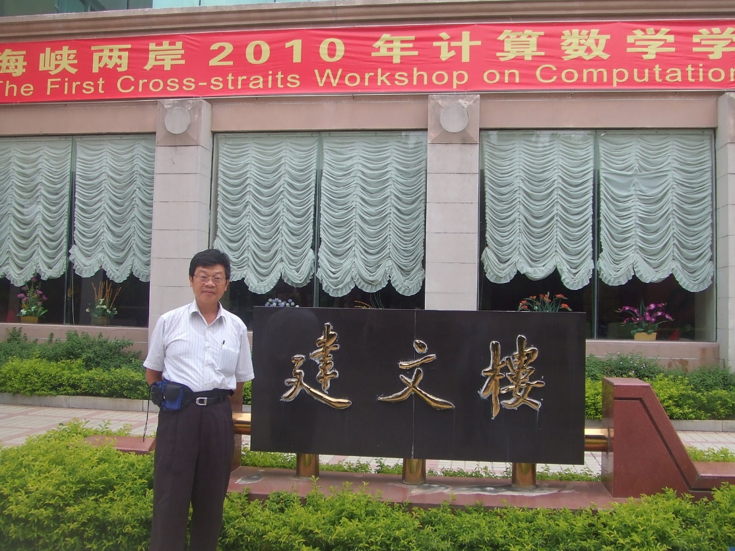
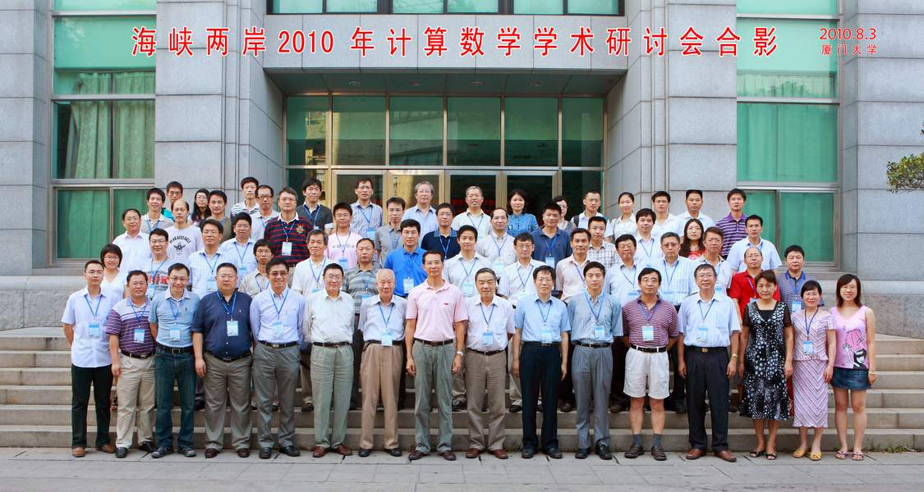
Previous visit (2010) Chen J T
Filename: 與印度結緣.ppt Made by HJ

Slide 5
ICOME Series 2023
edited by Taiwan NTOU/MSV Group
年度 | 地點 | 主辦人
2003 | 北海道札幌 | H. IGARASHI(五十嵐廣之) T. Honma(本間俊久)
2006 | 中國安徽合肥 中國科大與合工大 | 牛忠榮, 陳海波
2009 | 中國南京 河海大學 | 陳文
2012 | 日本京都大學 | 西村直志
2015 | 中國杭州浙大 | 鄭耀
2019 | 中國東北 大連理工大學 | 高效偉
2023 11/2~11/5 | 廈門大學 | 王東東

Slide 6
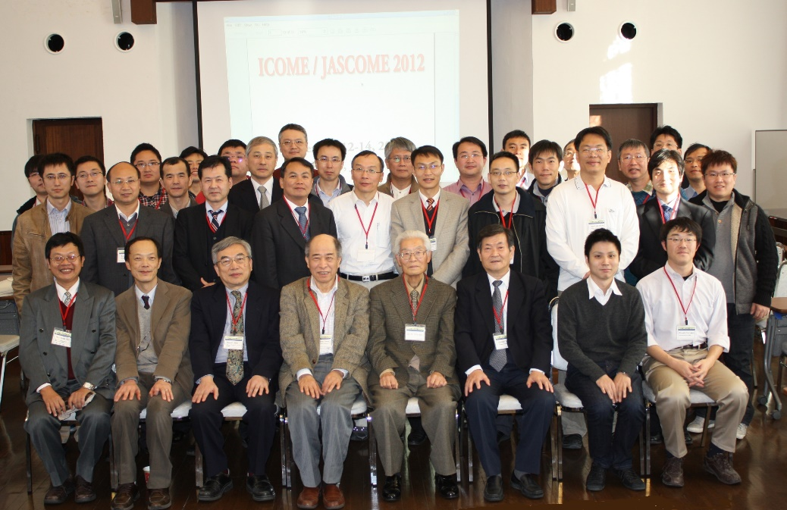
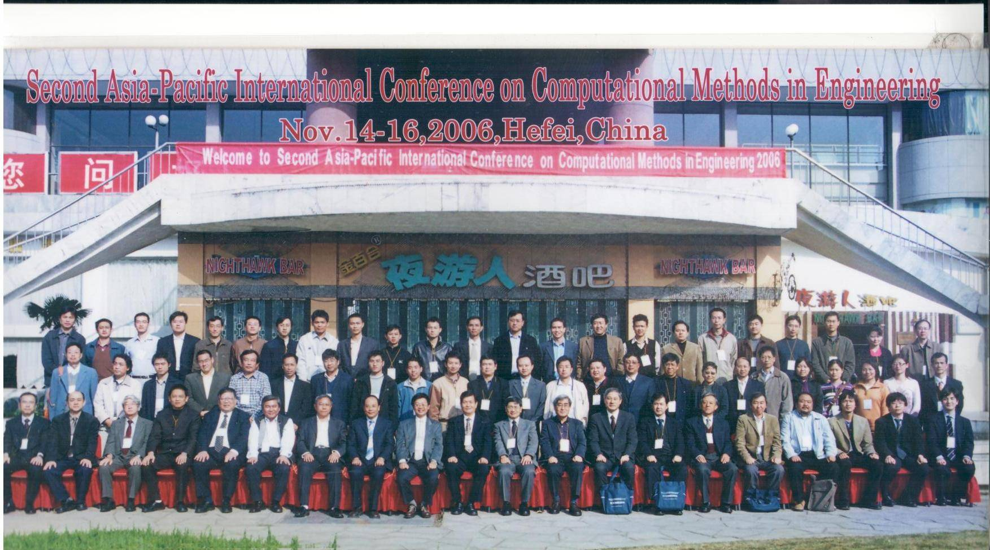
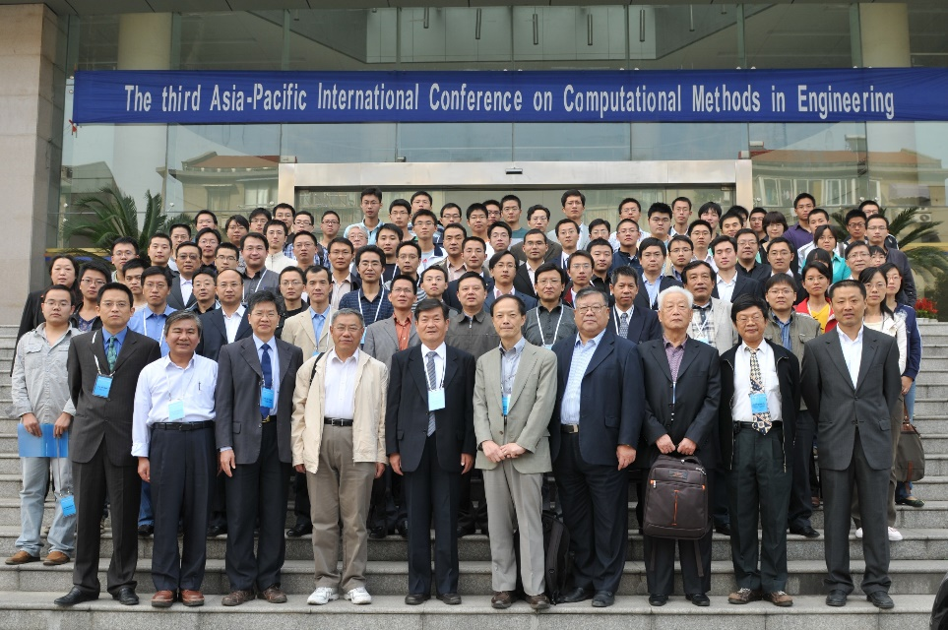
ICOME Series 2006, 2009, 2012

Slide 7

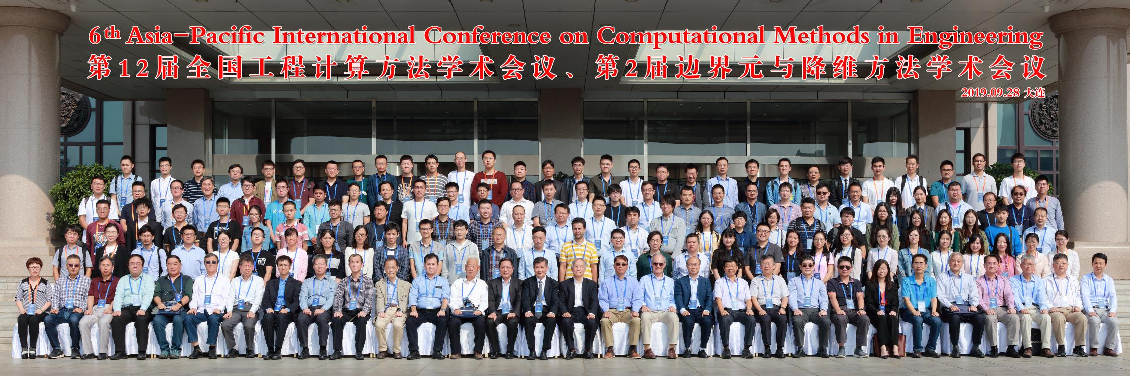
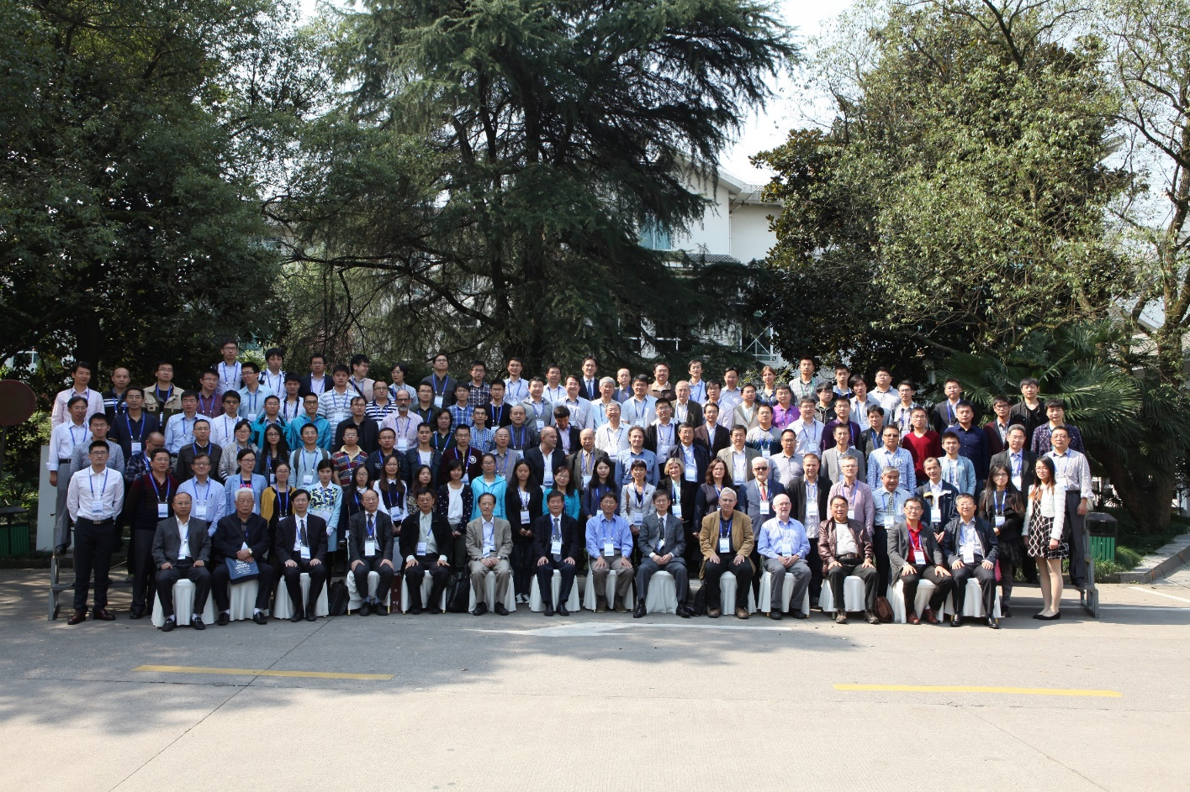
ICOME Series 2015, 2019 … level
ICOME 2027 ?
(Olympic 4 years)

Slide 8

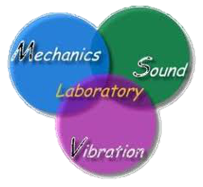




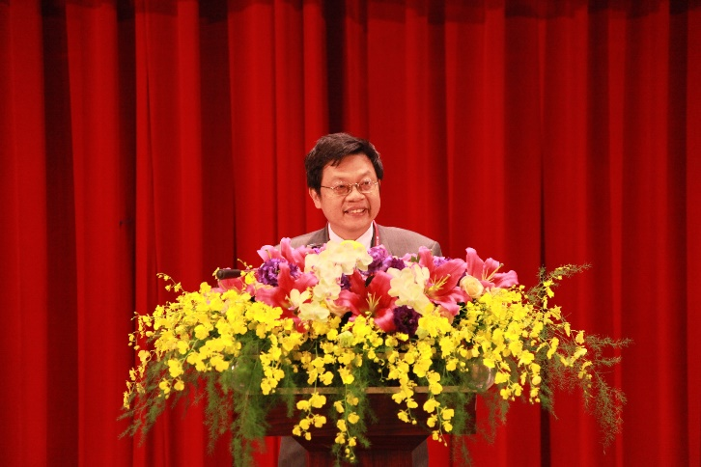




海洋大學
陳正宗
特聘講座教授
NTOU Dist. Chair Prof.
NCKU,
Joint Prof.
NTU Guest Prof.
台灣大學
陳正宗
客座教授
陳正宗
合聘教授
成功大學
File name:三校五系合聘教授 by Mei-Na

Slide 9


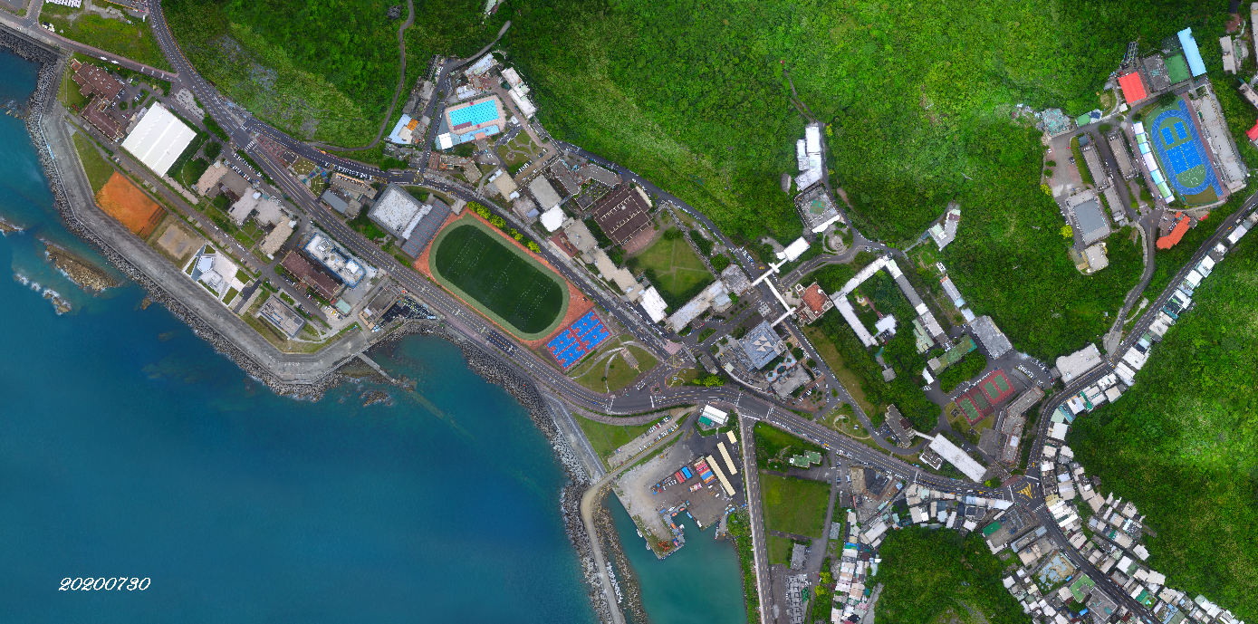


NTOU campus (1994-2023)
National Taiwan Ocean University
Harbor & River Engineering

Slide 10
What is the degenerate kernel
Paradise, parasite and paradox
Rank-deficiency mechanism
Double degeneracy
Green function, BVP
Outline

Slide 11
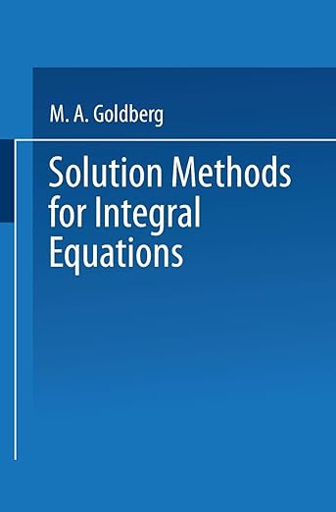
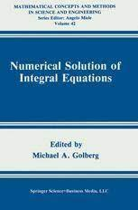
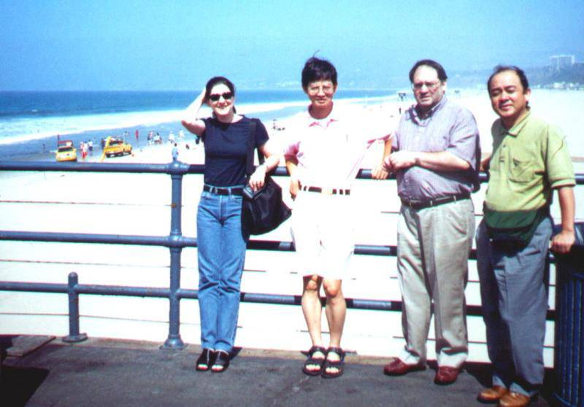
Degenerate kernel (DK)? (爹不疼 娘不愛)
Mathematicians and Engineers no care
1979 1990
DK plays an important role in the theory of Fredholm equations
But taken a back seat (Golberg, 1979)
But little explicit practical use (Golberg, 1990)
The theory of Fredholm equations with
degenerate kernels involves nothing more than
the linear algebra. (Cochran, 1982)
Welcome to visit the NTOU/MSV web site
where more than 250 sci papers can be found.
(Prof. Golberg requested my reprint paper on degenerate kernel in 1995)
(I first met Golberg and CS in Univ. Winscosin, Madison, BEM 17, 1995)
Golberg
CS
藤崎涉

Slide 12
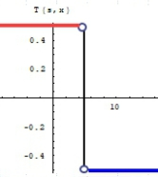
Who is responsible for the discontinuity of the double-layer potential? (boundary, kernel or density?)
邊界密度函數的解析延拓。
(Taylor expansion)
(Kisu, 1988)
Gauss’ theorem
Residue Theorem
p(x) jump from De to D^{i}.
CPV (Cauchy)
s
x
x
s
discontinuity
山不轉。路轉。
山不轉。路不轉。人轉。

Slide 13
Degenerate kernel
Objectivity for any observer
Various coordinates
(polar, bipolar and elliptical coordinates)
Different locations
(origin and focus)

Slide 14
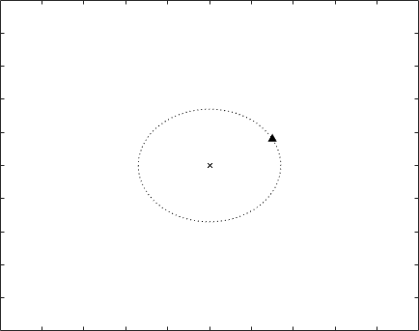
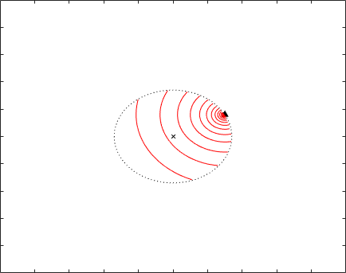
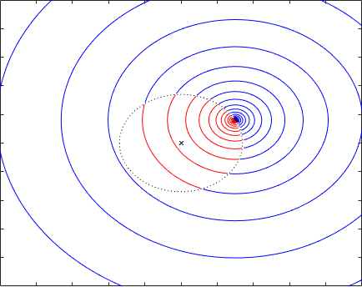
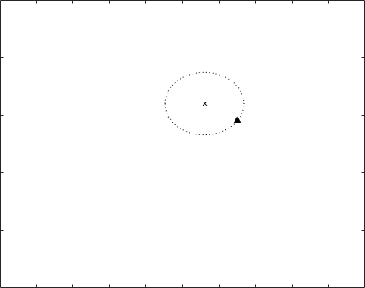
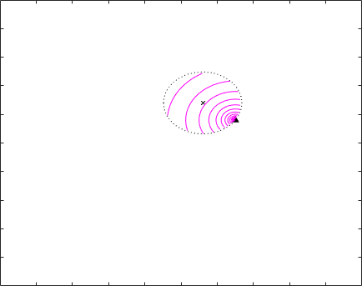

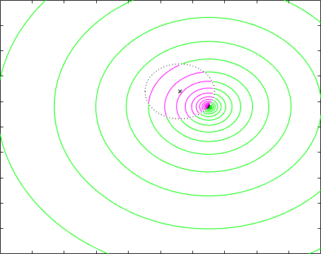
Polar coordinates for ln(r) and theta

Slide 15
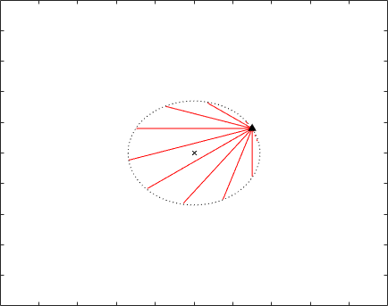
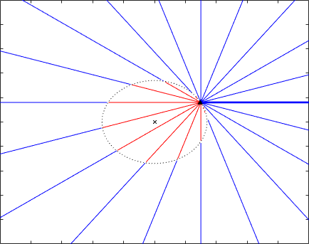
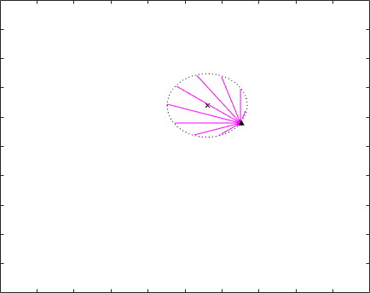
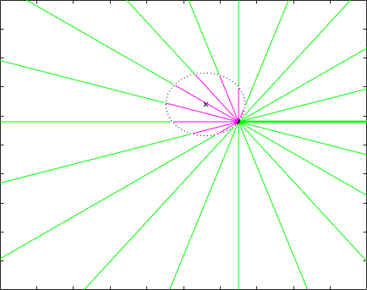

Polar coordinates for ln(r) and theta

Slide 16
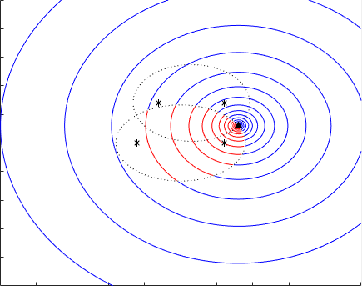
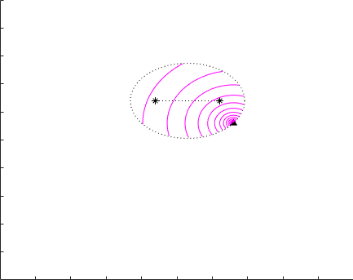
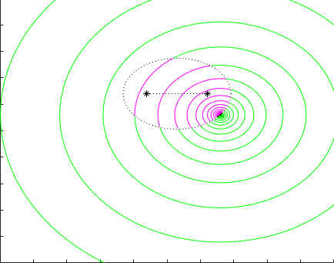
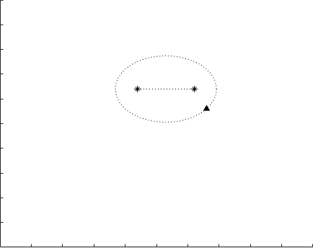
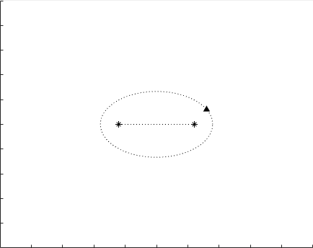
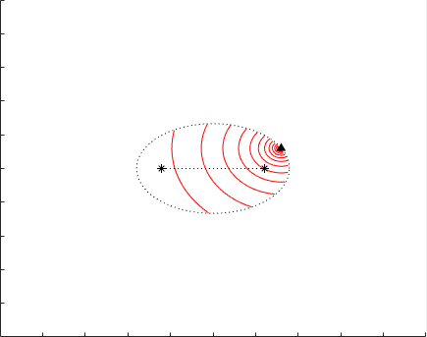

Elliptical coordinates for ln(r) and theta

Slide 17
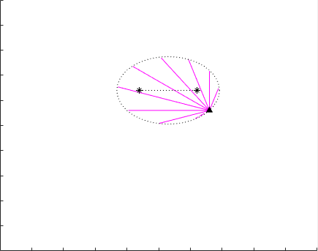
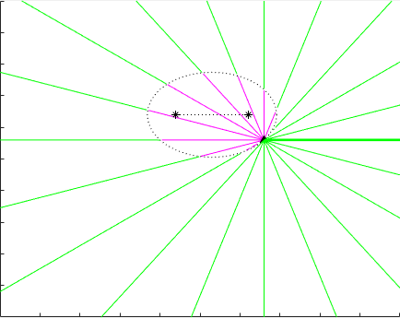
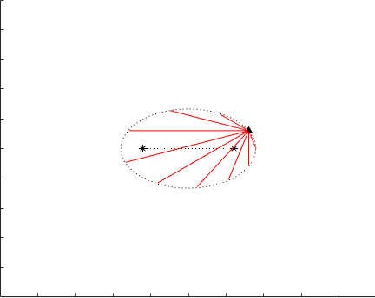
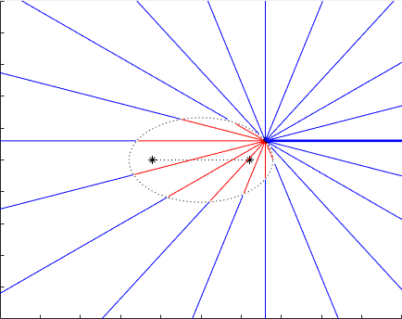
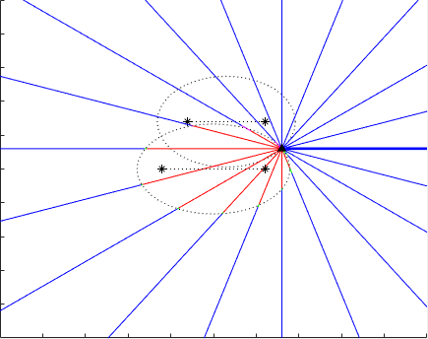
Elliptical coordinates for ln(r) and theta

Slide 18
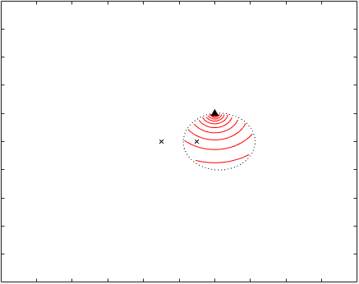
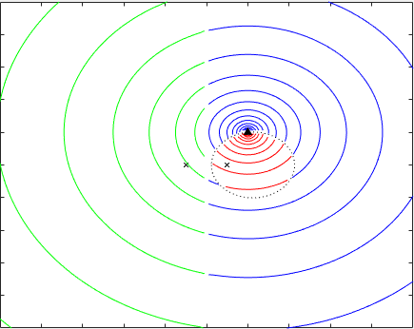
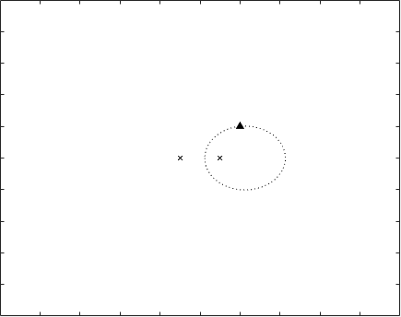
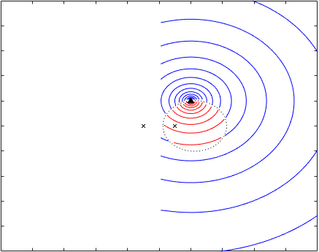
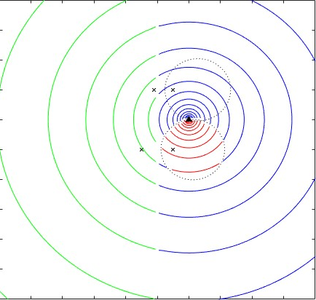
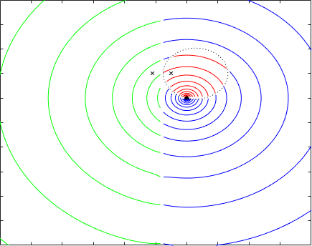
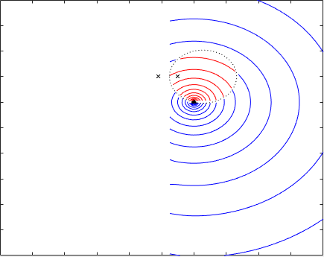


Bipolar coordinates for ln(r) and theta

Slide 19








Bipolar coordinates for ln(r) and theta

Slide 20

Polar, elliptical and bipolar coordinates
for ln(r) and theta

Slide 21
What is the degenerate kernel
Paradise, parasite and paradox
Rank-deficiency mechanism
Double degeneracy
Green function, BVP
Outline

Slide 22











3 Para~ over 39 years (1984-2023)
Fictitious frequency
Spurious eigenvalue
3D→2D
Infinite domain
Stress concentration
Fracture and fatigue
Paradise
(1988-1998)
Parasite
(1998-2008)
Dependency
Degenerate scale
Degenerate boundary
Resonance
Levy’s problem
( From T.C.T. Ting )
Paradox
(2008-2022)
Degenerate scale

Slide 23
Parasite of BEM (1998-2008)
Minimum singular value
t(a,0)
Rank-deficient systems
0/0
Radius
Mechanics Research Communications
Fictitious frequency
Pitfall
Parasite
Degenerate scale
Engineering Analysis with Boundary Elements
Dependency
Spurious eigenvalue
Degenerate boundary
International Journal for Numerical Methods in Engineering
Thermochimita Acta
Parasite of BEM.pptx made by York

Slide 24












Numerical evidence
Statics (rigid line inclusion) 2D Laplace equation (SIF) | Dynamics (time-harmonic) Helmholtz equation (RCS) | Statics (heat conduction) 2D Laplace equation (CSF)
Degenerate scale | Fictitious frequency | Degenerate scale
($l=2.37291$)
[$l=2.37105$]
Exchanger tube
conduction shape factor
radiation and scattering
Stress intensity factor
File name:Numerical instability of BEMBIEM by PH

Slide 25
Parasite
Degenerate boundary
Degenerate scale
Double degeneracy
Outline

Slide 26

If there is no sufficient and necessary
BIE formulation, BEM involves a parasite for solving problems with degenerate boundaries.
Once the dual BEM
(Hong and Chen 1988) is available, the BEM is a paradise for solving problems with degenerate boundaries.

Slide 27




Taiwan-India joint work on breakwater using the dual BEM (2022-2023)
C.S. Nishad, S. Neelamani, J.T. Chen, and K.G. Vijay, 2023, Gravity Wave Interaction with Cage Enveloped Breakwaters using DBEM, Z Angew Math Mech (ZAMM), Revised.
K.G. Vijay, C. S. Nishad, S. Neelamani, and J.T. Chen, 2021, Dual BEM for Wave Scattering by a H-Type Porous Barrier with Nonlinear Pressure Drop, Engineering Analysis with Boundary Elements, Vol.131, pp.280-294.

Slide 28


Citing records of dual BEM
(updated Oct.19, 2023)
Hong and Chen, 1988
ASCE-EM
Chen and Hong, 1999
ASME-AMR
Google: 427
Google: 480

Slide 29
What is the degenerate kernel
Paradise, parasite and paradox
Rank-deficiency mechanism
Double degeneracy
Green function, BVP
Outline

Slide 30



(Hangzhou: paradise in the world) (U(x,s):parasite in the BIEM/BEM)
BEM/BIEM (Disadvantage: Failure)
Match maker (ask for help)
Engineering
problems
Test function
Fundamental sol.
Green function
PDE and IE are
not equivalent
PDE model
IE model(BEM)
Existence
unique solution
Degenerate scale
Degenerate boundary
Spurious eigenvalues
Fictitious frequency
Nonunique solution
Fredholm alternative theorem
Range deficiency
Rank deficiency
Singular matrix
Infinite solution (Not sufficient)
引狼入室
(set a fox to keep geese)
No solution (Not necessary)

Slide 31

Analytical derivation (dimensional analysis)
(Objectivity)
dimensionless argument
Degrees
Rad
radius
arc
Laplace equation
Lin and Wu(2007), Journal of the Mathematical Society of the Philippines

Slide 32

Conventional BIE vs the null-field BIEM
Null-field BIE for the well-posed BVP
Conventional BIE
Free term
Jump term
Present approach
Null-field BIE+ Degenerate kernel
Eigenfunction expansion for unknown boundary densities
Closed-form fundamental solution
Advantage of using degenerate kernel:
s
Avoiding calculating the principal value
Obtaining the analytical solution
x
Degenerate kernel

Slide 33
Parasite
Degenerate boundary
Degenerate scale
Double degeneracy
Outline

Slide 34


邊界元素法 阿基里斯腱 BEM/BIEM Achilles tendon
Failure of BIEM/BEM
for the special geometry
Double degeneracy :
degenerate scale and degenerate boundary

Slide 35
邊界元素法
阿基里斯腱
Failure of
BEM/BIEM
for a critical size
Achilles
tendon

Slide 36
Outline
Paradise Parasite Paradox
Degenerate boundary
Degenerate scale
Degenerate kernel
Double degeneracy

Slide 37
Degenerate kernel can explain the rank deficiency
Degenerate boundary
Degenerate scale
Spurious euigenvalue
Fictitious frequency
Double degeneracy

Slide 38
Double-degeneracy (BIEM/BEM)
 | Degenerate scale (statics) (interior and exterior) | Spurious eigenvalue (dynamics) (interior) | Fictitious frequency (dynamics) (exterior) | Degenerate boundary (statics) or (dynamics)
Degenerate scale (statics) | ­－ | Ｘ | Ｘ | V: same boundary
Spurious eigenvalue (dynamics) (interior) | Ｘ | － | Ｘ | V: different boundary
Fictitious frequency (dynamics) (exterior) | Ｘ | Ｘ | － | V: different boundary
Degenerate boundary (statics) or (dynamics) | V: same boundary | V: different boundary | V: different boundary | －
Double degeneracy :
degenerate scale and degenerate boundary
Ｏ：possible appearance; Ｘ：impossible appearance

Slide 39








Double degeneracy
Rigid line inclusion (SIF) V: same boundary | Steady state heat conduction (CSF) V: different boundary | Circular membrane V: different boundary | Water wave problem V: different boundary
J.T. Chen, J.H. Kao, Y.L. Huang and S.K. Kao, 2021, Study on the stress intensity factor and the double-degeneracy mechanism in the BEM/BIEM for anti-plane shear problems, Theoretical and Applied Fracture Mechanics, 112, 102830. 2. J.T. Chen, J.H. Kao, S.K. Kao, Y.T. Lee and S.R. Kuo, 2022, Study on the double-degeneracy mechanism of BEM/BIEM for a plane elasticity problem with line segments, Engineering Analysis with Boundary Elements, 136, 290-302. 3. J.T. Chen, J.H. Kao, S.K. Kao, and T.A. Wu, 2023, Are the direct and indirect BEM/BIEMs equivalent ?, Engineering Analysis with Boundary Elements, Vol.157, pp.441-461. | J. W. Lee, H. W. Yang and J. T. Chen, 2023, Steady state heat conduction in exchanger tubes by using the meshfree boundary integral equation method: conduction shape factor and degenerate scale, ASME Journal of Heat and Mass Transfer, Vol. 145 / 111901-1.. 2. J.W. Lee, H.W. Yang and J.T. Chen, 2023, Steady state heat conduction in exchanger tubes by using the meshfree boundary integral equation method: conduction shape factor and degenerate scale, ASME Journal of Heat Transfer, Accepted. | J.W. Lee, 2010, Null-field boundary integral equations approach for solving Helmholtz problems of free vibration and water wave containing circular and elliptical boundaries, Master thesis, National Taiwan Ocean University, Taiwan. | J.W. Lee and J.T. Chen, 2019, Null-field boundary integral equation approach for solving the water wave scattering containing a circular, an elliptical cylinders and a thin breakwater, 第26屆全國計算流體力學學術研討會, 基隆. 2. J.W. Lee, 2010, Null-field boundary integral equations approach for solving Helmholtz problems of free vibration and water wave containing circular and elliptical boundaries, Master thesis, National Taiwan Ocean University, Taiwan.
Degenerate boundary + degenerate scale
Degenerate
boundary
2a=4
Degenerate scale

Slide 40









Rank of matrix in the ordinary scale, the degenerate scale, the degenerate boundary and double degeneracy
$1$0
$$6$$
$$7$$
$$8$$
$$9$$
$$5$$
4
$$3$$
$$2$$
$$1$$
2a
 | Number of nonzero singular values | Number of zero singular values
0: Ordinary scale (without any degeneracy) | 2N | 0
1: Degenerate boundary (without a degenerate scale) | N | N
2: Double degeneracy (with a degenerate boundary and a degenerate scale) | N-1 | N+1
Paradise, parasite and paradox in the dual BEM (U, T , L and M matrices)

Slide 41




Null space of influence matrices in the BEM
SVD decomposition
Stupid Chen paid more than 40 years (from 1981 to 2023) to understand the book cover of Master Strang book
Paradise, parasite and paradox in the dual BEM (U, T , L and M matrices)

Slide 42






Mapping diagram of Strang
No. | Year | Author | Book or paper | Title | Status
1 | 2016 | Gilbert Strang | Book | Introduction to Linear Algebra (5th edition) | Appear
2 | 2021 | YL Huang | TAFM | Study on the stress intensity factor and the double-degeneracy mechanism in the BEM/BIEM for anti-plane shear problems (double degeneracy) | Appear
3 | 2021 | WC Tai | CPAA | An indirect BIE free of degenerate scales (degenerate scale) | Appear
4 | 2021 | CH Shao | EABE | On the role of singular and hypersingular BIEs for the BVPs containing a degenerate boundary (degenerate boundary) | Appear
5 | 2022 | JH Kao | JE | Study on the double-degeneracy mechanism of BEM/BIEM for a plane elasticity problem with the line segments (double degeneracy) | Appear
6 | 2023 | JH Kao | EABE | Are the direct and indirect BEM/BIEMs equivalent ? | Appear
1
2
3
4
5
6
File name: Mapping diagram of Strang Made by T.L.

Slide 43
Message from Gilbert Strang
(May 15, 2023 last MIT lecture)
Dear NTOU/MSV people,
Thank you for such a generous message ! I am very happy
that you approve of the final lecture -- I wasn‘t sure what to say . I am so fortunate to have the chance to teach at MIT and also to have the lectures for Math 18.06 and 18.065 on Opencourseware ocw.mit.edu. It is neat that you found applications for the 4 subspaces figure.
Linear algebra is a beautiful subject --- and teaching is a beautiful life.
I hope all your work and your life goes well !
Very best wishes
Gilbert Strang May 17, 2023

Slide 44
Outline
Paradise, parasite and paradox
Objectivity
Analytical tool:
Singular and hypersingular integrals
Rank-deficiency mechanism
Green function, BVP
Double degeneracy

Slide 45


Three steps of NTOU/MSV for two circular boundary problems
Hong
(closed-form kernel)
JT Chen and WC Shen
polar degenerate kernel
J T Chen and W C Dai
bipolar degenerate kernel
BEM
(Numerical)
Null-field BIE+ polar degenerate kernel
using adaptive observer
(Semi analytical)
Null-field BIE+
bipolar degenerate kernel
(Analytical)
Taiwan
MSV group
1982
2006
2023
NTU
NTOU
NTOU+TKU

Slide 46






BVP and Green’s function using degenerate kernels
2023
BVP
Green’s function
Green’s function
2022
2022
Revision
Screw dislocation
2022
Anti-plane remote shear

Slide 47


八卦邊界元
Bagua boundary element method
Real variable BEM
Complex variable BEM
八卦
BEM
Clifford algebra valued BEM
Quaternion valued BEM

Slide 48












太極
Real variable
兩儀
Complex variable
四相Quaternion
八卦Clifford
ASCE, 1988
(324 citings)
2018
2016
2000
2013
NTOU/MSV
J. T. Chen
NCKU/MSV
L.W. Liu
ASME, 1999
(398 citings)
NTU/MSV
H.-K.Hong
TKU/MSV
J.W. Lee
2015

Slide 49







Degenerate Terminology 退化 ?
Degenerate eigenvalue | Degenerate scale | Degenerate boundary | Degenerate kernel
a<1
$${Γ }^{−}$$
$${Γ }^{+}$$
a=1
$$U\left(x,s\right)=\left\{\begin{aligned}P\left(x\right)Q\left(s\right), \left|x\right|>\left|s\right| \\ P\left(s\right)Q\left(x\right), \left|x\right|<\left|s\right|\end{aligned}\right.$$
$${Γ }^{+}$$
a>1
$$\iint{U\left(x,s\right)}db(x)db\left(s\right)=\int{P\left(x\right)}db(x)\int{Q\left(s\right)}db(s)$$
$${Γ }^{−}$$
(2.1) (1.2) modes eigenvalues 相同
eigen mode 不同

Slide 50
Conclusion
Paradise, parasite and paradox of BIEM/BEM
Successful experiences in India-Taiwan on the parasite of dual BEM
Degenerate boundary and degenerate scale may occur together for the same geometry (double degeneracy)
Degenerate kernel is the key to explain what happens for the degeneracy mechanism in the BIEM/BEM
Objectivity of degenerate kernel is demonstrated.

Slide 51

邊界元 來結緣 Line group 學術俱樂部
(我們不是邊緣人)
Academic line group of BEM club

Slide 52


Thank you for your attention

